Slide 1
Lecture 18:
Writing a Scientific Report
SCIF10002 – Introduction to Coding and Data Analysis for Scientists
Tom Maullin-Sapey
19th March 2026
Slide 0/19

Slide 2
Todays Lecture
Lecture 18: Writing a Scientific Report
Report structure
What should be in a report?
General guidance
Practical
Next up:
Easter break
Lecture 19: Reflections
Lecture 20: Drop-in Session
Slide 1/19

Slide 3
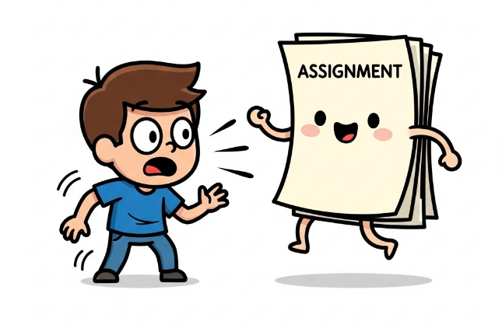
Important Announcement: Project 4
Important: Project 4 has been released!
Released: Wednesday 18th March at 12:00 midday
Due: Wednesday 22nd April at 12:00 midday
This project requires you to:
Analyse a dataset of your choice using the tools you’ve learned throughout the course (two datasets available)
Write a scientific report that explains the background, your methodology, results, and conclusions.
In this workshop, we shall focus on the report writing aspect in the specific context of a computational project.
Slide 2/19

Slide 4
Important Announcement: Project 4
This will be submitted via Blackboard, not noteable!
Look for “Brief for Project 4” for instructions
You must submit:
The code for your analysis as a Jupyter Notebook
A report describing your analysis in Word or LaTeX
Templates are available on blackboard, LaTeX recommended
This is assessed! 40% of your grade
Slide 3/19

Slide 5


Today’s Aims
Today’s class will be a little different to previous classes…
In this workshop, we will:
Provide an overview of the typical structure of a scientific report (applicable to both Word and LaTeX)
Explore how to use LaTeX to write a report that is both rigorous and visually appealing
Slide 4/19

Slide 6
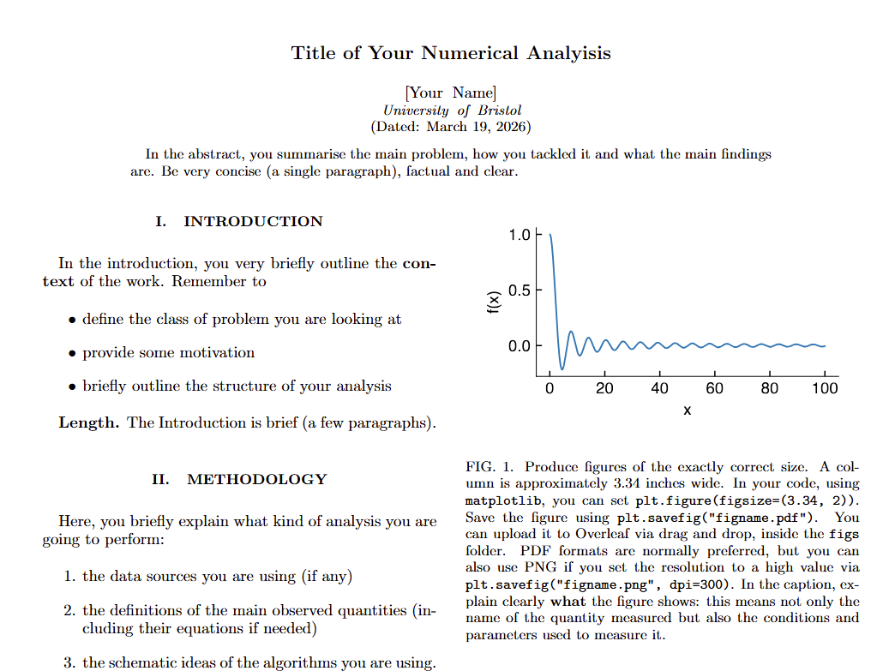
Structuring your Report
A report is a brief, structured document
It should explain the motivation, the methods, the results, and the conclusions of a project.
The focus is on clarity, purpose and rigour.
You can think of this as a draft of a scientific paper…
…but without comprehensive literature review or a detailed discussion of related work.
The emphasis is on the methodology and the results.
Slide 5/19

Slide 7
What should be in a report?
We have provided you with a template which includes the following:
Title
Abstract
Introduction
Methodology
Results
Conclusion
Let’s take a look at these in a little more detail!
Slide 6/19

Slide 8
The Abstract
The abstract is an extremely brief summary of the report
Usually no more than 100-150 words
It should give a brief overview of:
The problem you are investigating
The methods you are using
Your main findings and conclusions
You can think of it as like a blurb for a book
Slide 7/19

Slide 9
The Abstract
Slide 7/19

Slide 10
The Introduction
In this section you must contextualise the problem
i.e. provide background and motivation
You should answer the following questions:
What kind of problem are we looking at?
Why does it matter?
What question do you want to answer?
You should also briefly outline your roadmap to the reader, so they know what to expect in the rest of the report.
Slide 8/19

Slide 11
The Introduction
Slide 8/19

Slide 12
The Methodology
Here you prepare the reader with the necessary information to understand your approach.
Define all quantities of interest that will be tracked in your results section
Explain the rationale behind your choices
You should answer the following questions:
What data are we using?
What hypothesis or research question are we investigating, and how will we do it?
Are we defining any new metrics?
Are we using any specific models to fit/explain the data?
Slide 9/19

Slide 13
The Methodology
Slide 9/19

Slide 14
The Methodology
Slide 9/19

Slide 15
The Results
Slide 9/19

Slide 16
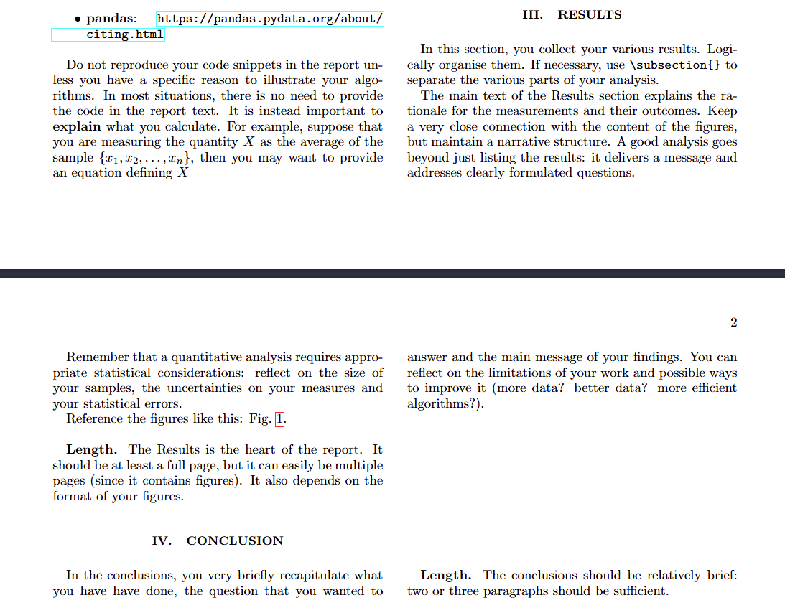
The Results
This is the where you describe your findings.
This is where you can place figures, tables, and description and interpretation of your results.
You should answer the following questions:
What did we find?
How do we interpret these results?
What do they mean in the context of our original problem?
Slide 10/19

Slide 17
The Results
Slide 10/19

Slide 18
The Results: Some Dos and Don’ts
Do:
Tell a coherent story using the text and figures together.
Make the figures clear and informative!
Maximise the ratio of information to ink!
Slide 11/19

Slide 19
The Results: Some Dos and Don’ts
Do:
Tell a coherent story using the text and figures together.
Make the figures clear and informative!
Provide clear and informative captions for figures.
Annotate the figures (with arrows or text) to highlight key findings
Use tables to summarize key results, but be selective in the results you present!
Don’t overwhelm the reader!
Slide 11/19

Slide 20
The Results: Some Dos and Don’ts
Do:
Tell a coherent story using the text and figures together.
Make the figures clear and informative!
Provide clear and informative captions for figures.
Annotate the figures (with arrows or text) to highlight key findings
Use tables to summarize key results, but be selective in the results you present!
Lead the reader step by step, show how the results build to support your conclusions.
Slide 11/19

Slide 21
The Results: Some Dos and Don’ts
Don’t:
Produce many figures with the same information
Combine to avoid repetition!
Slide 12/19

Slide 22
The Results: Some Dos and Don’ts
Don’t:
Produce many figures with the same information
Include figures that are not referenced in the text!
Every figure should be clearly explained
Slide 12/19

Slide 23
The Results: Some Dos and Don’ts
Don’t:
Produce many figures with the same information
Include figures that are not referenced in the text!
Do not speculate on the results.
The results must be factual
Slide 12/19

Slide 24
The Results: Some Dos and Don’ts
Don’t:
Produce many figures with the same information
Include figures that are not referenced in the text!
Do not speculate on the results.
Slide 12/19

Slide 25
The Results: Some Dos and Don’ts
Slide 12/19

Slide 26
The Conclusion
Here you want to briefly summarise your findings and their implications
You should:
Clearly address the scientific questions set our earlier
Explain how your results answer those questions
Slide 13/19

Slide 27
The Conclusion
Slide 13/19

Slide 28
The Conclusion
Slide 13/19

Slide 29
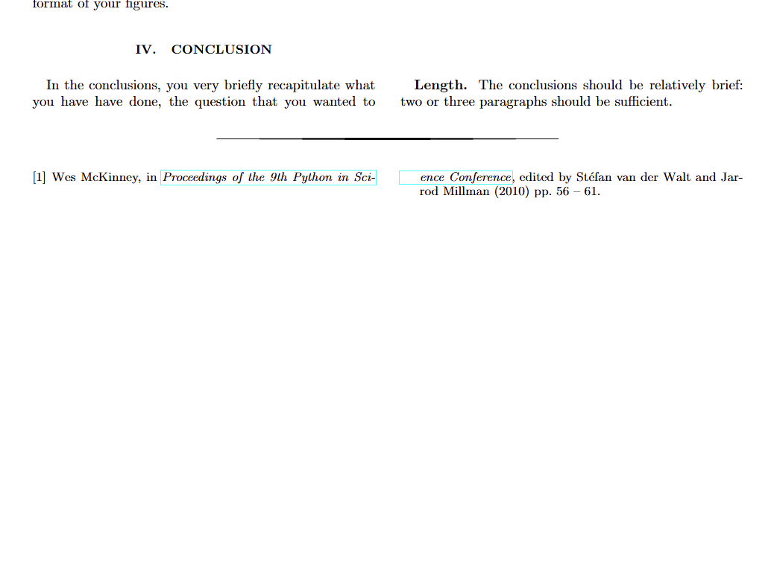
References
A reference is a source of information you cite to support a claim.
References allow us to compare with previous work and give credit to the original authors.
Here, references can be used to:
Link to broader context.
Provide the data source, if it is not your own data.
Cite the specific algorithms or models you are using, especially if they are not standard
Cite specific libraries or tools that you are using, especially if they are not widely known.
Slide 14/19

Slide 30
References
Slide 14/19

Slide 31
Report Quality
When completing your report, ask yourself the following questions:
How accessible is my report to a general reader?
Is the report well organised?
Is my research question clear?
Is my motivation clear? Why should anyone care about this problem?
What are my key findings? Are they clear to identify?
Are my statements actually supported by my findings?
Slide 15/19

Slide 32
Report Quality
Slide 15/19

Slide 33
Writing Style
Scientific writing should focus on clarity, precision and concision.
Keep the language direct and simple
Use first person where appropriate - this is an individual report so you can use “I”
Be precise where possible: specific concepts can be clearly conveyed using well-defined technical terms
Avoid subjective language (“This result easily follows”, “An obvious conclusion”)
Slide 16/19

Slide 34



LaTeX
LaTeX is a typesetting system
It takes a plain text file with some special syntax and produces a beautifully formatted document.
It is standard in many scientific fields, including physics, chemistry, computer science and mathematics.
Advantages of using LaTeX:
It produces high-quality, professional looking documents
It embeds mathematical equations and symbols seamlessly
It has powerful features for bibliography/references
For the rest of today, we shall explore LaTeX in more depth…
Slide 17/19

Slide 35

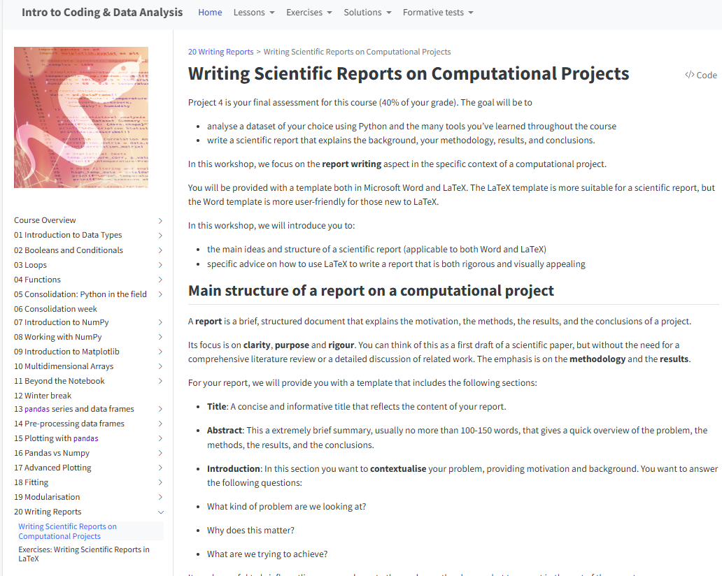
Practical
There is no noteable material today!
For the rest of today, you must:
Open Quarto. That is, on blackboard go to: Topics > Link to the Main Material of the Course
Navigate to the “Writing reports” section and read through: Writing Scientific Reports on Computational Projects
Work through the exercises in: Exercises: Writing Scientific Reports in LaTeX
Then, start on Project 4
Slide 18/19

Slide 36
Next Time
Lecture 18: Writing a Scientific Report
Report structure
What should be in a report?
General Guidance
Practical
Next up:
Easter Break
Lecture 19: Reflections
Lecture 20: Drop-in Session
Slide 19/19

