Slide 1
Lecture 19:
Reflections
SCIF10002 – Introduction to Coding and Data Analysis for Scientists
Tom Maullin-Sapey
16th April 2026
Slide 0/11

Slide 2
Todays Lecture
Lecture 19: Reflections
Overview
Continuing to Learn Anaconda, SciPy, Scikit-learn, Object Oriented Programming
Practical
Lecture 20: Drop-in Session
Slide 1/11

Slide 3
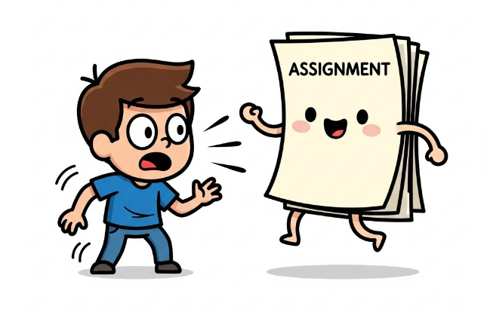
Reminder: Project 4
Important: Project 4 has been released!
Released: Wednesday 18th March at 12:00 midday
Due: Wednesday 22nd April at 12:00 midday
This project requires you to:
Analyse a dataset of your choice using the tools you’ve learned throughout the course (two datasets available)
Write a scientific report that explains the background, your methodology, results, and conclusions.
It is submitted via Blackboard, not noteable!
Look for “Brief for Project 4” for instructions
Slide 2/11

Slide 4


Overview
Over the past two terms, we have covered a range of topics
The basics of Python: Variables, data types, control flow, functions and modules.
Data analysis libraries
Data manipulation and cleaning
Real-world data analysis
Report writing and communication of findings
In doing so, we have gained plenty of practice in programming and problem-solving
Slide 3/11

Slide 5



Where next?
For the rest of today, we are going to look at where you can take your programming journey from here.
Next steps:
Local setup with Anaconda
Scikit-learn
SciPy
Object Oriented Programming
Slide 4/11

Slide 6

Local Python Environments
So far, we’ve been using Python in a remote notebook (Noteable)
In practice, you may find that you want to run Python locally (on your own computer)
Slide 5/11

Slide 7
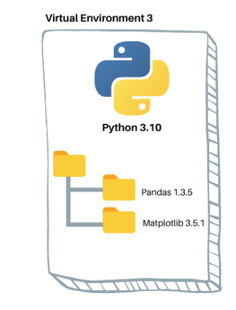
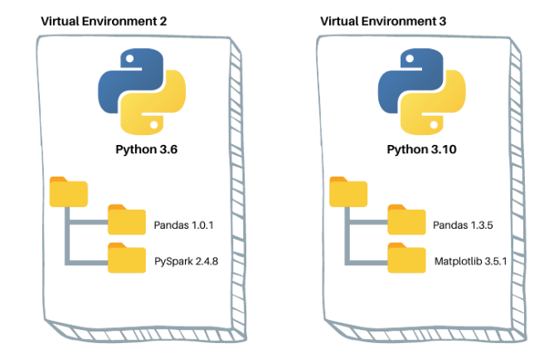
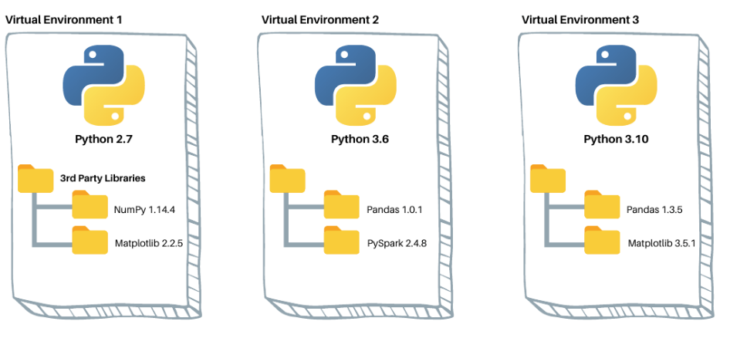
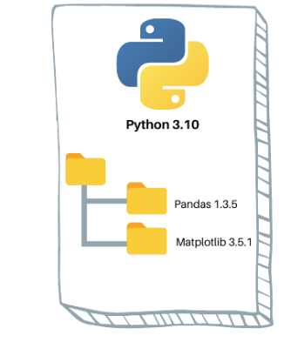
Local Python Environments
So far, we’ve been using Python in a remote notebook (Noteable)
In practice, you may find that you want to run Python locally (on your own computer)
A local setup lets you:
Work offline without relying on an internet portal
Manage your own Python version and packages
Create multiple virtual environments (separate Python setups for different projects)
One of the easiest ways to do this is to install Anaconda
Slide 5/11

Slide 8
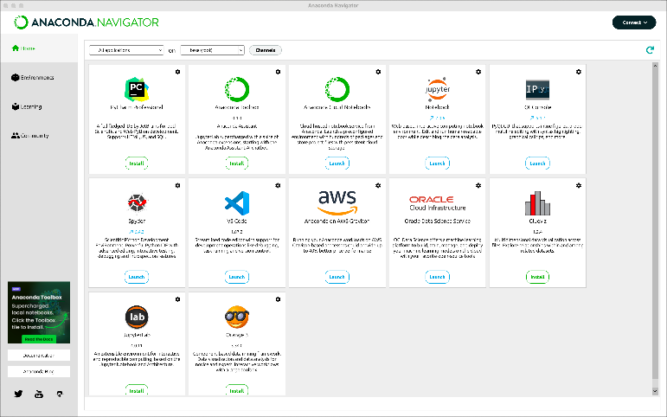
Anaconda
Anaconda is a Python distribution designed for data science and scientific computing
It includes:
Python itself
Many commonly used libraries (e.g. NumPy, pandas, SciPy)
Comes with conda to:
Create and manage separate environments
Install and update packages easily
Provides Anaconda Navigator (a graphical interface):
Launch Jupyter notebooks
Manage environments without using the command line
A simple, all-in-one way to get started with Python locally
Slide 6/11

Slide 9
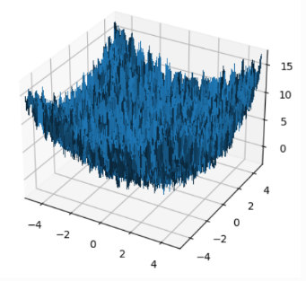
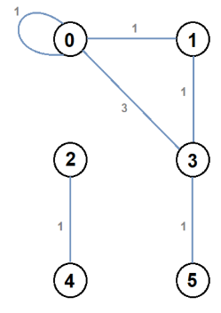
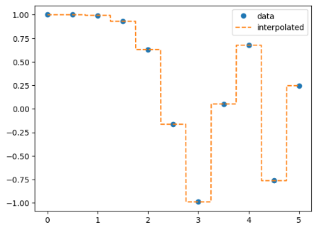
The SciPy Module
We’ve spent a while looking at the Numerical Python (NumPy) package
The Scientific Python (SciPy) package builds directly on top of NumPy providing a range of more advanced tools.
Examples include:
Network Analysis
Numerical Integration
Sparse Matrices
Root finding algorithms
Statistical Methods
Interpolation
You can learn more about this in lecture_reflections.ipynb & exercises_scipy_supplement
Slide 7/11

Slide 10
The SciPy Module
We’ve spent a while looking at the Numerical Python (NumPy) package
The Scientific Python (SciPy) package builds directly on top of NumPy providing a range of more advanced tools.
Examples include:
Network Analysis
Numerical Integration
Sparse Matrices
Root finding algorithms
Statistical Methods
Interpolation
Slide 7/11

Slide 11
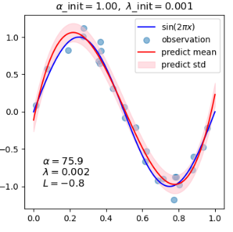
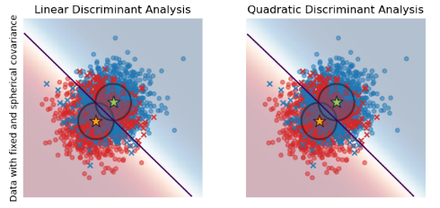
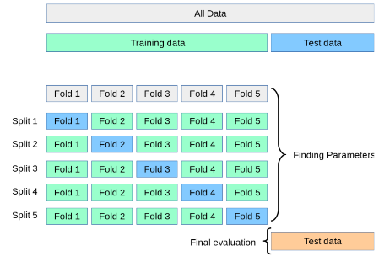
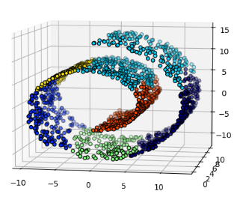
Scikit-Learn
Another package which may be of use is Scikit-learn
This package covers a range of statistical machine learning methods, including:
Regression
Classification
Clustering
Dimension Reduction
Model Selection
If you pursue a career in scientific computing, you may find yourself using many of these methods
You can learn more about this in lecture_reflections.ipynb as well as on the scikitlearn website
Slide 8/11

Slide 12
Scikit-Learn
Another package which may be of use is Scikit-learn
This package covers a range of statistical machine learning methods, including:
Regression
Classification
Clustering
Dimension Reduction
Model Selection
If you pursue a career in scientific computing, you may find yourself using many of these methods
Slide 8/11

Slide 13
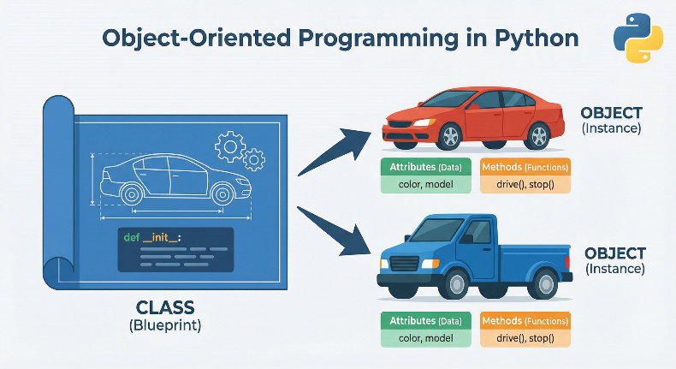
Object Oriented Programming
A natural next step on your Python journey is to learn about Object Oriented Programming
In Python, fundamentally everything is an object.
An object may be thought of as anything which made up of:
data (variables),
methods (functions which, in some sense, belong to the object).
Any time you write something of the form x=y you are creating a new object!
OOP allows you to define your own types of objects.
We shall not cover OOP in detail here, but you can learn more in SCIF20002
Today you can look at lecture_reflections.ipynb & exercises_object_oriented_supplemental.ipynb
Slide 9/11

Slide 14
Object Oriented Programming
A natural next step on your Python journey is to learn about Object Oriented Programming
In Python, fundamentally everything is an object.
An object may be thought of as anything which made up of:
data (variables),
methods (functions which, in some sense, belong to the object).
Any time you write something of the form x=y you are creating a new object!
OOP allows you to define your own types of objects.
We shall not cover OOP in detail here, but you can learn more in SCIF20002
Slide 9/11

Slide 15
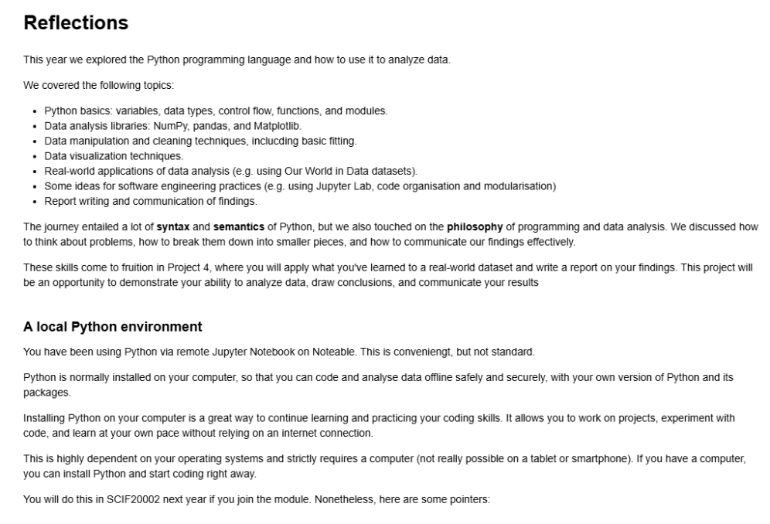
Practical
For the rest of today, you must:
Work through: lecture_reflections.ipynb
Work through the exercises in: exercises_reflections.ipynb
For those who wish to learn more about scipy and OOP, optional extra notebooks are available: exercises_scipy_supplemental.ipynb exercises_object_oriented_supplemental.ipynb
Slide 10/11

Slide 16
Next Time
Lecture 19: Reflections
Overview
Continuing to Learn Anaconda, SciPy, Scikit-learn, Object Oriented Programming
Practical
Lecture 20: Drop-in Session
Slide 11/11

