Slide 1
Lecture 9:
Multi-Dimensional Arrays
SCIF10002 – Introduction to Coding and Data Analysis for Scientists
Tom Maullin-Sapey
27th November 2025
Slide 0/17

Slide 2
Today’s Lecture
Slide 1/17

Slide 3
Today’s Lecture
Lecture 9: Multi-dimensional Arrays
Slide 1/17

Slide 4
Today’s Lecture
Lecture 9: Multi-dimensional Arrays
What are Multi-dimensional Arrays?
Slide 1/17

Slide 5
Today’s Lecture
Lecture 9: Multi-dimensional Arrays
What are Multi-dimensional Arrays?
2D Arrays
Slide 1/17

Slide 6
Today’s Lecture
Lecture 9: Multi-dimensional Arrays
What are Multi-dimensional Arrays?
2D Arrays
Arrays as Images
Slide 1/17

Slide 7
Today’s Lecture
Lecture 9: Multi-dimensional Arrays
What are Multi-dimensional Arrays?
2D Arrays
Arrays as Images
Practical
Slide 1/17

Slide 8
Today’s Lecture
Lecture 9: Multi-dimensional Arrays
What are Multi-dimensional Arrays?
2D Arrays
Arrays as Images
Practical
Lecture 10: Beyond the Notebook
Outside Jupyter
File Management
The Terminal
Running Scripts
Practical
Slide 1/17

Slide 9
Reminder: Project 2
Slide 2/17

Slide 10

Reminder: Project 2
Slide 2/17

Slide 11
Reminder: Project 2
Important
Slide 2/17

Slide 12
Reminder: Project 2
Important: Project 2 has been released!
Slide 2/17

Slide 13
Reminder: Project 2
Important: Project 2 has been released!
Released: Wednesday 19th November at 12:00 midday
Slide 2/17

Slide 14
Reminder: Project 2
Important: Project 2 has been released!
Released: Wednesday 19th November at 12:00 midday
Due: Wednesday 3rd December at 12:00 midday
Slide 2/17

Slide 15
Reminder: Project 2
Important: Project 2 has been released!
Released: Wednesday 19th November at 12:00 midday
Due: Wednesday 3rd December at 12:00 midday
The tasks require you to solve a scientific problem and complete a template Notebook.
Slide 2/17

Slide 16
Reminder: Project 2
Important: Project 2 has been released!
Released: Wednesday 19th November at 12:00 midday
Due: Wednesday 3rd December at 12:00 midday
The tasks require you to solve a scientific problem and complete a template Notebook.
You will have to write code, alongside reflective text about your code
Slide 2/17

Slide 17
Reminder: Project 2
Important: Project 2 has been released!
Released: Wednesday 19th November at 12:00 midday
Due: Wednesday 3rd December at 12:00 midday
The tasks require you to solve a scientific problem and complete a template Notebook.
You will have to write code, alongside reflective text about your code
This will be submitted via Blackboard, not noteable!
Slide 2/17

Slide 18
Reminder: Project 2
Important: Project 2 has been released!
Released: Wednesday 19th November at 12:00 midday
Due: Wednesday 3rd December at 12:00 midday
The tasks require you to solve a scientific problem and complete a template Notebook.
You will have to write code, alongside reflective text about your code
This will be submitted via Blackboard, not noteable!
Look for “Brief for Project 2” for instructions
Slide 2/17

Slide 19
Reminder: Project 2
Important: Project 2 has been released!
Released: Wednesday 19th November at 12:00 midday
Due: Wednesday 3rd December at 12:00 midday
The tasks require you to solve a scientific problem and complete a template Notebook.
You will have to write code, alongside reflective text about your code
This will be submitted via Blackboard, not noteable!
Look for “Brief for Project 2” for instructions
This is assessed! 30% of your grade
Slide 2/17

Slide 20
What are Multi-dimensional Arrays?
Slide 3/17

Slide 21
What are Multi-dimensional Arrays?
In lectures 6 and 7, we’ve been looking at NumPy arrays.
Slide 3/17

Slide 22
What are Multi-dimensional Arrays?
In lectures 6 and 7, we’ve been looking at NumPy arrays.
Specifically, we looked at one-dimensional arrays!
Slide 3/17

Slide 23
What are Multi-dimensional Arrays?
In lectures 6 and 7, we’ve been looking at NumPy arrays.
Specifically, we looked at one-dimensional arrays!
NumPy arrays can also have more than one dimension.
Slide 3/17

Slide 24
What are Multi-dimensional Arrays?
In lectures 6 and 7, we’ve been looking at NumPy arrays.
Specifically, we looked at one-dimensional arrays!
NumPy arrays can also have more than one dimension.
1D array: a finite sequence of numbers (vector)
Slide 3/17

Slide 25
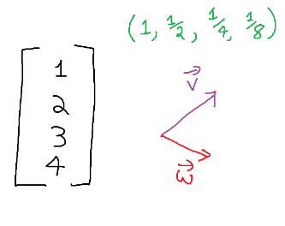
What are Multi-dimensional Arrays?
In lectures 6 and 7, we’ve been looking at NumPy arrays.
Specifically, we looked at one-dimensional arrays!
NumPy arrays can also have more than one dimension.
1D array: a finite sequence of numbers (vector)
Slide 3/17

Slide 26
What are Multi-dimensional Arrays?
In lectures 6 and 7, we’ve been looking at NumPy arrays.
Specifically, we looked at one-dimensional arrays!
NumPy arrays can also have more than one dimension.
1D array: a finite sequence of numbers (vector)
Slide 3/17

Slide 27
What are Multi-dimensional Arrays?
In lectures 6 and 7, we’ve been looking at NumPy arrays.
Specifically, we looked at one-dimensional arrays!
NumPy arrays can also have more than one dimension.
1D array: a finite sequence of numbers (vector)
Slide 3/17

Slide 28
What are Multi-dimensional Arrays?
In lectures 6 and 7, we’ve been looking at NumPy arrays.
Specifically, we looked at one-dimensional arrays!
NumPy arrays can also have more than one dimension.
1D array: a finite sequence of numbers (vector)
Slide 3/17

Slide 29
What are Multi-dimensional Arrays?
In lectures 6 and 7, we’ve been looking at NumPy arrays.
Specifically, we looked at one-dimensional arrays!
NumPy arrays can also have more than one dimension.
1D array: a finite sequence of numbers (vector)
2D array: a grid of numbers with rows and columns (matrix)
Slide 3/17

Slide 30
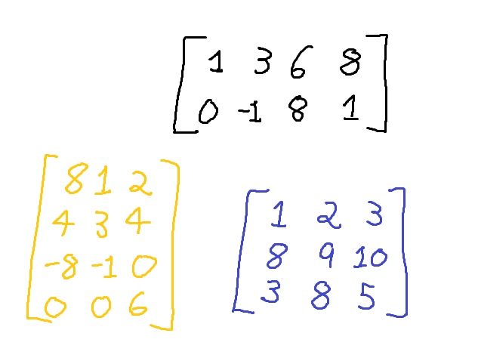
What are Multi-dimensional Arrays?
In lectures 6 and 7, we’ve been looking at NumPy arrays.
Specifically, we looked at one-dimensional arrays!
NumPy arrays can also have more than one dimension.
1D array: a finite sequence of numbers (vector)
2D array: a grid of numbers with rows and columns (matrix)
Slide 3/17

Slide 31
What are Multi-dimensional Arrays?
In lectures 6 and 7, we’ve been looking at NumPy arrays.
Specifically, we looked at one-dimensional arrays!
NumPy arrays can also have more than one dimension.
1D array: a finite sequence of numbers (vector)
2D array: a grid of numbers with rows and columns (matrix)
Slide 3/17

Slide 32
What are Multi-dimensional Arrays?
In lectures 6 and 7, we’ve been looking at NumPy arrays.
Specifically, we looked at one-dimensional arrays!
NumPy arrays can also have more than one dimension.
1D array: a finite sequence of numbers (vector)
2D array: a grid of numbers with rows and columns (matrix)
Slide 3/17

Slide 33
What are Multi-dimensional Arrays?
In lectures 6 and 7, we’ve been looking at NumPy arrays.
Specifically, we looked at one-dimensional arrays!
NumPy arrays can also have more than one dimension.
1D array: a finite sequence of numbers (vector)
2D array: a grid of numbers with rows and columns (matrix)
3D array: a cuboid of numbers (tensor)
Slide 3/17

Slide 34
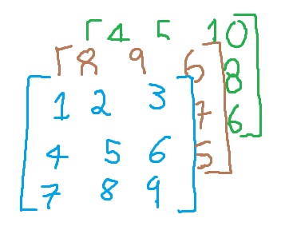
What are Multi-dimensional Arrays?
In lectures 6 and 7, we’ve been looking at NumPy arrays.
Specifically, we looked at one-dimensional arrays!
NumPy arrays can also have more than one dimension.
1D array: a finite sequence of numbers (vector)
2D array: a grid of numbers with rows and columns (matrix)
3D array: a cuboid of numbers (tensor)
Slide 3/17

Slide 35
What are Multi-dimensional Arrays?
In lectures 6 and 7, we’ve been looking at NumPy arrays.
Specifically, we looked at one-dimensional arrays!
NumPy arrays can also have more than one dimension.
1D array: a finite sequence of numbers (vector)
2D array: a grid of numbers with rows and columns (matrix)
3D array: a cuboid of numbers (tensor)
And so on...
Slide 3/17

Slide 36
What are Multi-dimensional Arrays?
In lectures 6 and 7, we’ve been looking at NumPy arrays.
Specifically, we looked at one-dimensional arrays!
NumPy arrays can also have more than one dimension.
1D array: a finite sequence of numbers (vector)
2D array: a grid of numbers with rows and columns (matrix)
3D array: a cuboid of numbers (tensor)
And so on...
Each NumPy array possesses its own shape.
Slide 3/17

Slide 37
What are Multi-dimensional Arrays?
In lectures 6 and 7, we’ve been looking at NumPy arrays.
Specifically, we looked at one-dimensional arrays!
NumPy arrays can also have more than one dimension.
1D array: a finite sequence of numbers (vector)
2D array: a grid of numbers with rows and columns (matrix)
3D array: a cuboid of numbers (tensor)
And so on...
Each NumPy array possesses its own shape.
(4,)
Slide 3/17

Slide 38
What are Multi-dimensional Arrays?
In lectures 6 and 7, we’ve been looking at NumPy arrays.
Specifically, we looked at one-dimensional arrays!
NumPy arrays can also have more than one dimension.
1D array: a finite sequence of numbers (vector)
2D array: a grid of numbers with rows and columns (matrix)
3D array: a cuboid of numbers (tensor)
And so on...
Each NumPy array possesses its own shape.
(4,)
(4,)
Slide 3/17

Slide 39
What are Multi-dimensional Arrays?
In lectures 6 and 7, we’ve been looking at NumPy arrays.
Specifically, we looked at one-dimensional arrays!
NumPy arrays can also have more than one dimension.
1D array: a finite sequence of numbers (vector)
2D array: a grid of numbers with rows and columns (matrix)
3D array: a cuboid of numbers (tensor)
And so on...
Each NumPy array possesses its own shape.
(4,)
(4,)
(2,)
Slide 3/17

Slide 40
What are Multi-dimensional Arrays?
In lectures 6 and 7, we’ve been looking at NumPy arrays.
Specifically, we looked at one-dimensional arrays!
NumPy arrays can also have more than one dimension.
1D array: a finite sequence of numbers (vector)
2D array: a grid of numbers with rows and columns (matrix)
3D array: a cuboid of numbers (tensor)
And so on...
Each NumPy array possesses its own shape.
(4,)
(4,)
(2,)
(2,4)
Slide 3/17

Slide 41
What are Multi-dimensional Arrays?
In lectures 6 and 7, we’ve been looking at NumPy arrays.
Specifically, we looked at one-dimensional arrays!
NumPy arrays can also have more than one dimension.
1D array: a finite sequence of numbers (vector)
2D array: a grid of numbers with rows and columns (matrix)
3D array: a cuboid of numbers (tensor)
And so on...
Each NumPy array possesses its own shape.
(4,)
(4,)
(2,)
(2,4)
(4,3)
Slide 3/17

Slide 42
What are Multi-dimensional Arrays?
In lectures 6 and 7, we’ve been looking at NumPy arrays.
Specifically, we looked at one-dimensional arrays!
NumPy arrays can also have more than one dimension.
1D array: a finite sequence of numbers (vector)
2D array: a grid of numbers with rows and columns (matrix)
3D array: a cuboid of numbers (tensor)
And so on...
Each NumPy array possesses its own shape.
(4,)
(4,)
(2,)
(2,4)
(4,3)
(3,3)
Slide 3/17

Slide 43
What are Multi-dimensional Arrays?
In lectures 6 and 7, we’ve been looking at NumPy arrays.
Specifically, we looked at one-dimensional arrays!
NumPy arrays can also have more than one dimension.
1D array: a finite sequence of numbers (vector)
2D array: a grid of numbers with rows and columns (matrix)
3D array: a cuboid of numbers (tensor)
And so on...
Each NumPy array possesses its own shape.
(4,)
(4,)
(2,)
(2,4)
(4,3)
(3,3)
(3,3,3)
Slide 3/17

Slide 44
Creating a 2D Array
Slide 4/17

Slide 45
Creating a 2D Array
Let’s look at a simple example
Slide 4/17

Slide 46
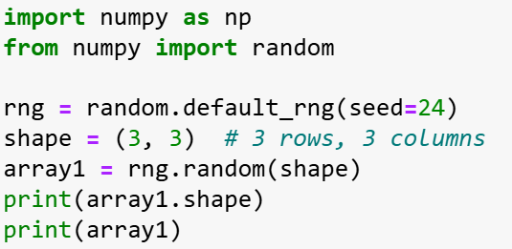

Creating a 2D Array
Let’s look at a simple example
Slide 4/17

Slide 47
Creating a 2D Array
Let’s look at a simple example
Slide 4/17

Slide 48
Creating a 2D Array
Let’s look at a simple example
Slide 4/17

Slide 49
Creating a 2D Array
Let’s look at a simple example
Slide 4/17

Slide 50
Creating a 2D Array
Let’s look at a simple example
We can create a 2D array of random numbers by first specifying the shape of the array we want
Slide 4/17

Slide 51
Creating a 2D Array
Let’s look at a simple example
We can create a 2D array of random numbers by first specifying the shape of the array we want
Slide 4/17

Slide 52
Creating a 2D Array
Let’s look at a simple example
We can create a 2D array of random numbers by first specifying the shape of the array we want
Slide 4/17

Slide 53
Creating a 2D Array
Let’s look at a simple example
We can create a 2D array of random numbers by first specifying the shape of the array we want
We can then use rng.random to generate the array exactly like before
Slide 4/17

Slide 54
Creating a 2D Array
Let’s look at a simple example
We can create a 2D array of random numbers by first specifying the shape of the array we want
We can then use rng.random to generate the array exactly like before
Slide 4/17

Slide 55
Creating a 2D Array
Let’s look at a simple example
We can create a 2D array of random numbers by first specifying the shape of the array we want
We can then use rng.random to generate the array exactly like before
Slide 4/17

Slide 56
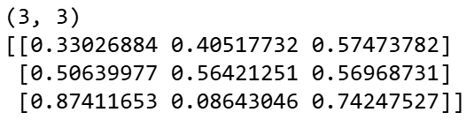
Creating a 2D Array
Let’s look at a simple example
We can create a 2D array of random numbers by first specifying the shape of the array we want
We can then use rng.random to generate the array exactly like before
Slide 4/17

Slide 57
Creating a 2D Array
Let’s look at a simple example
We can create a 2D array of random numbers by first specifying the shape of the array we want
We can then use rng.random to generate the array exactly like before
Slide 4/17

Slide 58
Creating a 2D Array
Let’s look at a simple example
We can create a 2D array of random numbers by first specifying the shape of the array we want
We can then use rng.random to generate the array exactly like before
Slide 4/17

Slide 59
Creating a 2D Array
Let’s look at a simple example
We can create a 2D array of random numbers by first specifying the shape of the array we want
We can then use rng.random to generate the array exactly like before
Slide 4/17

Slide 60
Creating a 2D Array
Let’s look at a simple example
We can create a 2D array of random numbers by first specifying the shape of the array we want
We can then use rng.random to generate the array exactly like before
The number of nested brackets tells us the dimension of the array
Slide 4/17

Slide 61
Creating a 2D Array
Let’s look at a simple example
We can create a 2D array of random numbers by first specifying the shape of the array we want
We can then use rng.random to generate the array exactly like before
The number of nested brackets tells us the dimension of the array
Slide 4/17

Slide 62
Creating a 2D Array
Let’s look at a simple example
We can create a 2D array of random numbers by first specifying the shape of the array we want
We can then use rng.random to generate the array exactly like before
The number of nested brackets tells us the dimension of the array
Slide 4/17

Slide 63
Creating a 2D Array
Let’s look at a simple example
We can create a 2D array of random numbers by first specifying the shape of the array we want
We can then use rng.random to generate the array exactly like before
The number of nested brackets tells us the dimension of the array
Two nested sets of brackets → 2D Array
Slide 4/17

Slide 64
Creating a 2D Array
Let’s look at a simple example
We can create a 2D array of random numbers by first specifying the shape of the array we want
We can then use rng.random to generate the array exactly like before
The number of nested brackets tells us the dimension of the array
Two nested sets of brackets → 2D Array
Slide 4/17

Slide 65
Creating a 2D Array
Let’s look at a simple example
We can create a 2D array of random numbers by first specifying the shape of the array we want
We can then use rng.random to generate the array exactly like before
The number of nested brackets tells us the dimension of the array
Slide 4/17

Slide 66
Array Shape and Initialization
Slide 5/17

Slide 67
Array Shape and Initialization
We can create multi-dimensional arrays using many of the familiar functions we’ve already seen.
Slide 5/17

Slide 68
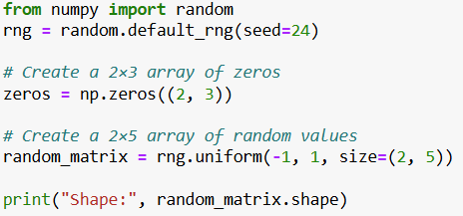
Array Shape and Initialization
We can create multi-dimensional arrays using many of the familiar functions we’ve already seen.
Slide 5/17

Slide 69
Array Shape and Initialization
We can create multi-dimensional arrays using many of the familiar functions we’ve already seen.
Slide 5/17

Slide 70
Array Shape and Initialization
We can create multi-dimensional arrays using many of the familiar functions we’ve already seen.
Slide 5/17

Slide 71
Array Shape and Initialization
We can create multi-dimensional arrays using many of the familiar functions we’ve already seen.
We only need to provide the shape, as a tuple.
Slide 5/17

Slide 72
Array Shape and Initialization
We can create multi-dimensional arrays using many of the familiar functions we’ve already seen.
We only need to provide the shape, as a tuple. E.g. (rows, columns) for 2D
Slide 5/17

Slide 73


Array Shape and Initialization
We can create multi-dimensional arrays using many of the familiar functions we’ve already seen.
We only need to provide the shape, as a tuple. E.g. (rows, columns) for 2D
See week 1 intermediate notebook for more information on tuples!
Slide 5/17

Slide 74
Array Shape and Initialization
We can create multi-dimensional arrays using many of the familiar functions we’ve already seen.
We only need to provide the shape, as a tuple. E.g. (rows, columns) for 2D
Slide 5/17

Slide 75
Array Shape and Initialization
We can create multi-dimensional arrays using many of the familiar functions we’ve already seen.
We only need to provide the shape, as a tuple. E.g. (rows, columns) for 2D
Slide 5/17

Slide 76
Array Shape and Initialization
We can create multi-dimensional arrays using many of the familiar functions we’ve already seen.
We only need to provide the shape, as a tuple. E.g. (rows, columns) for 2D
Slide 5/17

Slide 77
Array Shape and Initialization
We can create multi-dimensional arrays using many of the familiar functions we’ve already seen.
We only need to provide the shape, as a tuple. E.g. (rows, columns) for 2D
Slide 5/17

Slide 78
Array Shape and Initialization
We can create multi-dimensional arrays using many of the familiar functions we’ve already seen.
We only need to provide the shape, as a tuple. E.g. (rows, columns) for 2D
Slide 5/17

Slide 79
Array Shape and Initialization
We can create multi-dimensional arrays using many of the familiar functions we’ve already seen.
We only need to provide the shape, as a tuple. E.g. (rows, columns) for 2D
Slide 5/17

Slide 80
Array Shape and Initialization
We can create multi-dimensional arrays using many of the familiar functions we’ve already seen.
We only need to provide the shape, as a tuple. E.g. (rows, columns) for 2D
The number of dimensions of an array is sometimes referred to as it’s rank
Slide 5/17

Slide 81
Array Shape and Initialization
We can create multi-dimensional arrays using many of the familiar functions we’ve already seen.
We only need to provide the shape, as a tuple. E.g. (rows, columns) for 2D
The number of dimensions of an array is sometimes referred to as it’s rank
For instance, a 2D array has rank 2, an n-dimensional array has rank n
Slide 5/17

Slide 82
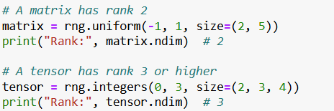
Array Shape and Initialization
We can create multi-dimensional arrays using many of the familiar functions we’ve already seen.
We only need to provide the shape, as a tuple. E.g. (rows, columns) for 2D
The number of dimensions of an array is sometimes referred to as it’s rank
For instance, a 2D array has rank 2, an n-dimensional array has rank n
Slide 5/17

Slide 83
Array Shape and Initialization
We can create multi-dimensional arrays using many of the familiar functions we’ve already seen.
We only need to provide the shape, as a tuple. E.g. (rows, columns) for 2D
The number of dimensions of an array is sometimes referred to as it’s rank
For instance, a 2D array has rank 2, an n-dimensional array has rank n
Slide 5/17

Slide 84
Array Shape and Initialization
We can create multi-dimensional arrays using many of the familiar functions we’ve already seen.
We only need to provide the shape, as a tuple. E.g. (rows, columns) for 2D
The number of dimensions of an array is sometimes referred to as it’s rank
For instance, a 2D array has rank 2, an n-dimensional array has rank n
Slide 5/17

Slide 85
Array Shape and Initialization
We can create multi-dimensional arrays using many of the familiar functions we’ve already seen.
We only need to provide the shape, as a tuple. E.g. (rows, columns) for 2D
The number of dimensions of an array is sometimes referred to as it’s rank
For instance, a 2D array has rank 2, an n-dimensional array has rank n
Slide 5/17

Slide 86

Array Shape and Initialization
We can create multi-dimensional arrays using many of the familiar functions we’ve already seen.
We only need to provide the shape, as a tuple. E.g. (rows, columns) for 2D
The number of dimensions of an array is sometimes referred to as it’s rank
For instance, a 2D array has rank 2, an n-dimensional array has rank n
Slide 5/17

Slide 87
Array Shape and Initialization
We can create multi-dimensional arrays using many of the familiar functions we’ve already seen.
We only need to provide the shape, as a tuple. E.g. (rows, columns) for 2D
The number of dimensions of an array is sometimes referred to as it’s rank
For instance, a 2D array has rank 2, an n-dimensional array has rank n
Slide 5/17

Slide 88
Array Shape and Initialization
We can create multi-dimensional arrays using many of the familiar functions we’ve already seen.
We only need to provide the shape, as a tuple. E.g. (rows, columns) for 2D
The number of dimensions of an array is sometimes referred to as it’s rank
For instance, a 2D array has rank 2, an n-dimensional array has rank n
Slide 5/17

Slide 89
Array Shape and Initialization
We can create multi-dimensional arrays using many of the familiar functions we’ve already seen.
We only need to provide the shape, as a tuple. E.g. (rows, columns) for 2D
The number of dimensions of an array is sometimes referred to as it’s rank
For instance, a 2D array has rank 2, an n-dimensional array has rank n
Slide 5/17

Slide 90
Array Shape and Initialization
We can create multi-dimensional arrays using many of the familiar functions we’ve already seen.
We only need to provide the shape, as a tuple. E.g. (rows, columns) for 2D
The number of dimensions of an array is sometimes referred to as it’s rank
For instance, a 2D array has rank 2, an n-dimensional array has rank n
Slide 5/17

Slide 91
Array Shape and Initialization
We can create multi-dimensional arrays using many of the familiar functions we’ve already seen.
We only need to provide the shape, as a tuple. E.g. (rows, columns) for 2D
The number of dimensions of an array is sometimes referred to as it’s rank
For instance, a 2D array has rank 2, an n-dimensional array has rank n
Slide 5/17

Slide 92
Array Shape and Initialization
We can create multi-dimensional arrays using many of the familiar functions we’ve already seen.
We only need to provide the shape, as a tuple. E.g. (rows, columns) for 2D
The number of dimensions of an array is sometimes referred to as it’s rank
For instance, a 2D array has rank 2, an n-dimensional array has rank n
Important: This is not the same as the notion of rank you will see in linear algebra!! Do not confuse these terms!
Slide 5/17

Slide 93
Array Shape and Initialization
We can create multi-dimensional arrays using many of the familiar functions we’ve already seen.
We only need to provide the shape, as a tuple. E.g. (rows, columns) for 2D
The number of dimensions of an array is sometimes referred to as it’s rank
For instance, a 2D array has rank 2, an n-dimensional array has rank n
Important: This is not the same as the notion of rank you will see in linear algebra!! Do not confuse these terms!
Slide 5/17

Slide 94
Array Shape and Initialization
We can create multi-dimensional arrays using many of the familiar functions we’ve already seen.
We only need to provide the shape, as a tuple. E.g. (rows, columns) for 2D
The number of dimensions of an array is sometimes referred to as it’s rank
For instance, a 2D array has rank 2, an n-dimensional array has rank n
Slide 5/17

Slide 95
Indexing in 2D
Slide 6/17

Slide 96
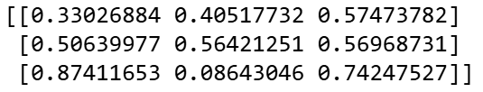
Indexing in 2D
Slide 6/17

Slide 97
Indexing in 2D
Just like we did for one dimension, we can use indexing to get elements of our array
Slide 6/17

Slide 98
Indexing in 2D
Just like we did for one dimension, we can use indexing to get elements of our array
For example, in 2D, you can access elements using [row, column] notation
Slide 6/17

Slide 99
Indexing in 2D
Just like we did for one dimension, we can use indexing to get elements of our array
For example, in 2D, you can access elements using [row, column] notation
Slide 6/17

Slide 100

Indexing in 2D
Just like we did for one dimension, we can use indexing to get elements of our array
For example, in 2D, you can access elements using [row, column] notation
Slide 6/17

Slide 101
Indexing in 2D
Just like we did for one dimension, we can use indexing to get elements of our array
For example, in 2D, you can access elements using [row, column] notation
Remember: indices start at 0, and the order is [row, column] (like [y, x]).
Slide 6/17

Slide 102
Indexing in 2D
Just like we did for one dimension, we can use indexing to get elements of our array
For example, in 2D, you can access elements using [row, column] notation
Remember: indices start at 0, and the order is [row, column] (like [y, x]).
We can also use the : operator to select entire dimensions
Slide 6/17

Slide 103
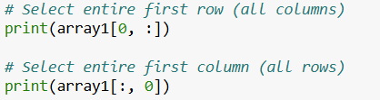
Indexing in 2D
Just like we did for one dimension, we can use indexing to get elements of our array
For example, in 2D, you can access elements using [row, column] notation
Remember: indices start at 0, and the order is [row, column] (like [y, x]).
We can also use the : operator to select entire dimensions
Slide 6/17

Slide 104
Indexing in 2D
Just like we did for one dimension, we can use indexing to get elements of our array
For example, in 2D, you can access elements using [row, column] notation
Remember: indices start at 0, and the order is [row, column] (like [y, x]).
We can also use the : operator to select entire dimensions
Slide 6/17

Slide 105
Indexing in 2D
Just like we did for one dimension, we can use indexing to get elements of our array
For example, in 2D, you can access elements using [row, column] notation
Remember: indices start at 0, and the order is [row, column] (like [y, x]).
We can also use the : operator to select entire dimensions
Slide 6/17

Slide 106

Indexing in 2D
Just like we did for one dimension, we can use indexing to get elements of our array
For example, in 2D, you can access elements using [row, column] notation
Remember: indices start at 0, and the order is [row, column] (like [y, x]).
We can also use the : operator to select entire dimensions
Slide 6/17

Slide 107
Indexing in 2D
Just like we did for one dimension, we can use indexing to get elements of our array
For example, in 2D, you can access elements using [row, column] notation
Remember: indices start at 0, and the order is [row, column] (like [y, x]).
We can also use the : operator to select entire dimensions
Slide 6/17

Slide 108
Indexing in 2D
Just like we did for one dimension, we can use indexing to get elements of our array
For example, in 2D, you can access elements using [row, column] notation
Remember: indices start at 0, and the order is [row, column] (like [y, x]).
We can also use the : operator to select entire dimensions
Slide 6/17

Slide 109
Indexing in 2D
Just like we did for one dimension, we can use indexing to get elements of our array
For example, in 2D, you can access elements using [row, column] notation
Remember: indices start at 0, and the order is [row, column] (like [y, x]).
We can also use the : operator to select entire dimensions
Slide 6/17

Slide 110
Indexing in 2D
Just like we did for one dimension, we can use indexing to get elements of our array
For example, in 2D, you can access elements using [row, column] notation
Remember: indices start at 0, and the order is [row, column] (like [y, x]).
We can also use the : operator to select entire dimensions
Slide 6/17

Slide 111
Indexing in 2D
Just like we did for one dimension, we can use indexing to get elements of our array
For example, in 2D, you can access elements using [row, column] notation
Remember: indices start at 0, and the order is [row, column] (like [y, x]).
We can also use the : operator to select entire dimensions
The : means "all elements" in that dimension.
Slide 6/17

Slide 112
Indexing in 2D
Slide 6/17

Slide 113
Slicing in 2D
Slide 7/17

Slide 114
Slicing in 2D
Similarly, we can use slicing to get subsets of our array
Slide 7/17

Slide 115
Slicing in 2D
Similarly, we can use slicing to get subsets of our array
With multi-dimensional arrays, you can slice along multiple axes at once by using the syntax we saw for 1D arrays
Slide 7/17

Slide 116
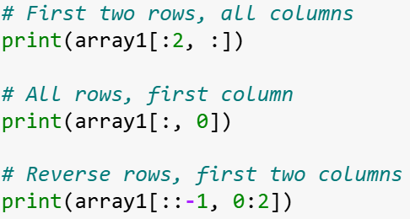
Slicing in 2D
Similarly, we can use slicing to get subsets of our array
With multi-dimensional arrays, you can slice along multiple axes at once by using the syntax we saw for 1D arrays
Slide 7/17

Slide 117
Slicing in 2D
Similarly, we can use slicing to get subsets of our array
With multi-dimensional arrays, you can slice along multiple axes at once by using the syntax we saw for 1D arrays
Slide 7/17

Slide 118
Slicing in 2D
Similarly, we can use slicing to get subsets of our array
With multi-dimensional arrays, you can slice along multiple axes at once by using the syntax we saw for 1D arrays
Slide 7/17

Slide 119

Slicing in 2D
Similarly, we can use slicing to get subsets of our array
With multi-dimensional arrays, you can slice along multiple axes at once by using the syntax we saw for 1D arrays
Slide 7/17

Slide 120
Slicing in 2D
Similarly, we can use slicing to get subsets of our array
With multi-dimensional arrays, you can slice along multiple axes at once by using the syntax we saw for 1D arrays
Slide 7/17

Slide 121
Slicing in 2D
Similarly, we can use slicing to get subsets of our array
With multi-dimensional arrays, you can slice along multiple axes at once by using the syntax we saw for 1D arrays
Slide 7/17

Slide 122
Slicing in 2D
Similarly, we can use slicing to get subsets of our array
With multi-dimensional arrays, you can slice along multiple axes at once by using the syntax we saw for 1D arrays
Slide 7/17

Slide 123
Slicing in 2D
Similarly, we can use slicing to get subsets of our array
With multi-dimensional arrays, you can slice along multiple axes at once by using the syntax we saw for 1D arrays
Slide 7/17

Slide 124
Slicing in 2D
Similarly, we can use slicing to get subsets of our array
With multi-dimensional arrays, you can slice along multiple axes at once by using the syntax we saw for 1D arrays
Slide 7/17

Slide 125

Slicing in 2D
Similarly, we can use slicing to get subsets of our array
With multi-dimensional arrays, you can slice along multiple axes at once by using the syntax we saw for 1D arrays
Slide 7/17

Slide 126
Slicing in 2D
Similarly, we can use slicing to get subsets of our array
With multi-dimensional arrays, you can slice along multiple axes at once by using the syntax we saw for 1D arrays
Slice indices for each dimension must be separated with commas.
Slide 7/17

Slide 127
Slicing in 2D
Similarly, we can use slicing to get subsets of our array
With multi-dimensional arrays, you can slice along multiple axes at once by using the syntax we saw for 1D arrays
Slice indices for each dimension must be separated with commas.
Reminder: The syntax a:b is zero indexed and does not include b!
Slide 7/17

Slide 128
Operations Along Axes
Slide 8/17

Slide 129
Operations Along Axes
It is very useful to be able to perform operations only along specific dimensions (axes) of an array
Slide 8/17

Slide 130
Operations Along Axes
It is very useful to be able to perform operations only along specific dimensions (axes) of an array
This is easiest to see with an example…
Slide 8/17

Slide 131
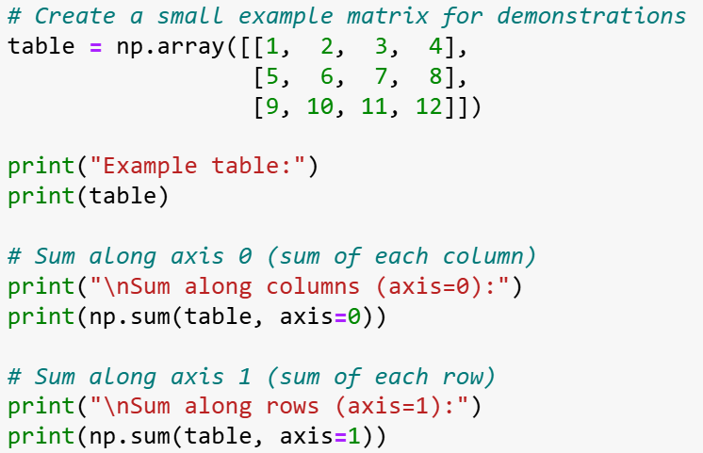
Operations Along Axes
It is very useful to be able to perform operations only along specific dimensions (axes) of an array
This is easiest to see with an example…
Slide 8/17

Slide 132
Operations Along Axes
It is very useful to be able to perform operations only along specific dimensions (axes) of an array
This is easiest to see with an example…
Slide 8/17

Slide 133
Operations Along Axes
It is very useful to be able to perform operations only along specific dimensions (axes) of an array
This is easiest to see with an example…
Slide 8/17

Slide 134
Operations Along Axes
It is very useful to be able to perform operations only along specific dimensions (axes) of an array
This is easiest to see with an example…
Slide 8/17

Slide 135
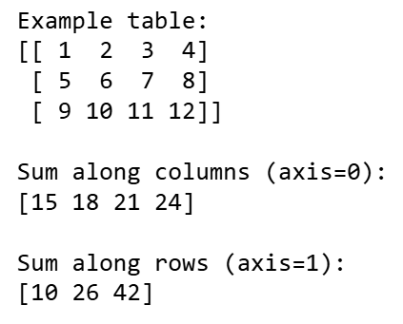
Operations Along Axes
It is very useful to be able to perform operations only along specific dimensions (axes) of an array
This is easiest to see with an example…
Slide 8/17

Slide 136
Operations Along Axes
It is very useful to be able to perform operations only along specific dimensions (axes) of an array
This is easiest to see with an example…
Slide 8/17

Slide 137
Operations Along Axes
It is very useful to be able to perform operations only along specific dimensions (axes) of an array
This is easiest to see with an example…
We can compute the sum of each column of an array using np.sum and axis=0
Slide 8/17

Slide 138
Operations Along Axes
It is very useful to be able to perform operations only along specific dimensions (axes) of an array
This is easiest to see with an example…
We can compute the sum of each column of an array using np.sum and axis=0
Slide 8/17

Slide 139
Operations Along Axes
It is very useful to be able to perform operations only along specific dimensions (axes) of an array
This is easiest to see with an example…
We can compute the sum of each column of an array using np.sum and axis=0
Slide 8/17

Slide 140
Operations Along Axes
It is very useful to be able to perform operations only along specific dimensions (axes) of an array
This is easiest to see with an example…
We can compute the sum of each column of an array using np.sum and axis=0
Slide 8/17

Slide 141
Operations Along Axes
It is very useful to be able to perform operations only along specific dimensions (axes) of an array
This is easiest to see with an example…
We can compute the sum of each column of an array using np.sum and axis=0
Slide 8/17

Slide 142
Operations Along Axes
It is very useful to be able to perform operations only along specific dimensions (axes) of an array
This is easiest to see with an example…
We can compute the sum of each column of an array using np.sum and axis=0
Similarly, we can compute the sum of each row using axis=1
Slide 8/17

Slide 143
Operations Along Axes
It is very useful to be able to perform operations only along specific dimensions (axes) of an array
This is easiest to see with an example…
We can compute the sum of each column of an array using np.sum and axis=0
Similarly, we can compute the sum of each row using axis=1
Slide 8/17

Slide 144
Operations Along Axes
It is very useful to be able to perform operations only along specific dimensions (axes) of an array
This is easiest to see with an example…
We can compute the sum of each column of an array using np.sum and axis=0
Similarly, we can compute the sum of each row using axis=1
Slide 8/17

Slide 145
Operations Along Axes
It is very useful to be able to perform operations only along specific dimensions (axes) of an array
This is easiest to see with an example…
We can compute the sum of each column of an array using np.sum and axis=0
Similarly, we can compute the sum of each row using axis=1
Slide 8/17

Slide 146
Operations Along Axes
It is very useful to be able to perform operations only along specific dimensions (axes) of an array
This is easiest to see with an example…
We can compute the sum of each column of an array using np.sum and axis=0
Similarly, we can compute the sum of each row using axis=1
Slide 8/17

Slide 147
Operations Along Axes
It is very useful to be able to perform operations only along specific dimensions (axes) of an array
This is easiest to see with an example…
We can compute the sum of each column of an array using np.sum and axis=0
Similarly, we can compute the sum of each row using axis=1
axis=0 “squashes data” into a single row, axis=1 “squashes data” into a single column.
Slide 8/17

Slide 148
Operations Along Axes
It is very useful to be able to perform operations only along specific dimensions (axes) of an array
This is easiest to see with an example…
We can compute the sum of each column of an array using np.sum and axis=0
Similarly, we can compute the sum of each row using axis=1
axis=0 “squashes data” into a single row, axis=1 “squashes data” into a single column.
By summing over columns, we are left with a vector which looks like a single row
Slide 8/17

Slide 149
Operations Along Axes
It is very useful to be able to perform operations only along specific dimensions (axes) of an array
This is easiest to see with an example…
We can compute the sum of each column of an array using np.sum and axis=0
Similarly, we can compute the sum of each row using axis=1
axis=0 “squashes data” into a single row, axis=1 “squashes data” into a single column.
Slide 8/17

Slide 150
Operations Along Axes
It is very useful to be able to perform operations only along specific dimensions (axes) of an array
This is easiest to see with an example…
We can compute the sum of each column of an array using np.sum and axis=0
Similarly, we can compute the sum of each row using axis=1
axis=0 “squashes data” into a single row, axis=1 “squashes data” into a single column.
By summing over rows, we are left with a vector which looks like a single column
Slide 8/17

Slide 151
Operations Along Axes
It is very useful to be able to perform operations only along specific dimensions (axes) of an array
This is easiest to see with an example…
We can compute the sum of each column of an array using np.sum and axis=0
Similarly, we can compute the sum of each row using axis=1
axis=0 “squashes data” into a single row, axis=1 “squashes data” into a single column.
Slide 8/17

Slide 152
Operations Along Axes
Slide 8/17

Slide 153
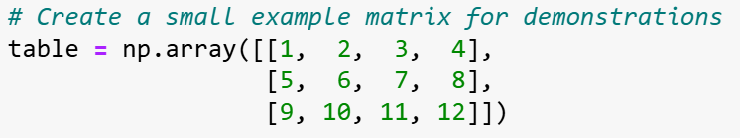
Operations Along Axes
Slide 8/17

Slide 154
Operations Along Axes
We can do this with functions other than np.sum…
Slide 9/17

Slide 155
Operations Along Axes
We can do this with functions other than np.sum… For instance, we can compute statistics along each axis.
Slide 9/17

Slide 156
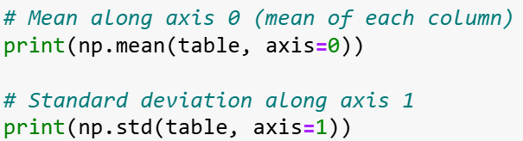
Operations Along Axes
We can do this with functions other than np.sum… For instance, we can compute statistics along each axis.
Slide 9/17

Slide 157
Operations Along Axes
We can do this with functions other than np.sum… For instance, we can compute statistics along each axis.
This works with np.mean,
Slide 9/17

Slide 158
Operations Along Axes
We can do this with functions other than np.sum… For instance, we can compute statistics along each axis.
This works with np.mean, np.std,
Slide 9/17

Slide 159
Operations Along Axes
We can do this with functions other than np.sum… For instance, we can compute statistics along each axis.
This works with np.mean, np.std, np.min,
Slide 9/17

Slide 160
Operations Along Axes
We can do this with functions other than np.sum… For instance, we can compute statistics along each axis.
This works with np.mean, np.std, np.min, np.max,
Slide 9/17

Slide 161
Operations Along Axes
We can do this with functions other than np.sum… For instance, we can compute statistics along each axis.
This works with np.mean, np.std, np.min, np.max, and so on…
Slide 9/17

Slide 162
Operations Along Axes
We can do this with functions other than np.sum… For instance, we can compute statistics along each axis.
This works with np.mean, np.std, np.min, np.max, and so on…
Slide 9/17

Slide 163
Operations Along Axes
We can do this with functions other than np.sum… For instance, we can compute statistics along each axis.
This works with np.mean, np.std, np.min, np.max, and so on…
Slide 9/17

Slide 164

Operations Along Axes
We can do this with functions other than np.sum… For instance, we can compute statistics along each axis.
This works with np.mean, np.std, np.min, np.max, and so on…
Slide 9/17

Slide 165
Operations Along Axes
We can do this with functions other than np.sum… For instance, we can compute statistics along each axis.
This works with np.mean, np.std, np.min, np.max, and so on…
Slide 9/17

Slide 166
Operations Along Axes
We can do this with functions other than np.sum… For instance, we can compute statistics along each axis.
This works with np.mean, np.std, np.min, np.max, and so on…
Slide 9/17

Slide 167
Operations Along Axes
We can do this with functions other than np.sum… For instance, we can compute statistics along each axis.
This works with np.mean, np.std, np.min, np.max, and so on…
Slide 9/17

Slide 168
Operations Along Axes
We can do this with functions other than np.sum… For instance, we can compute statistics along each axis.
This works with np.mean, np.std, np.min, np.max, and so on…
Slide 9/17

Slide 169
Operations Along Axes
We can do this with functions other than np.sum… For instance, we can compute statistics along each axis.
This works with np.mean, np.std, np.min, np.max, and so on…
Pretty much all mathematical numpy functions support this…
Slide 9/17

Slide 170
Operations Along Axes
We can do this with functions other than np.sum… For instance, we can compute statistics along each axis.
This works with np.mean, np.std, np.min, np.max, and so on…
Pretty much all mathematical numpy functions support this…
…but you should always check the documentation to verify!
Slide 9/17

Slide 171
Operations Along Axes
We can do this with functions other than np.sum… For instance, we can compute statistics along each axis.
This works with np.mean, np.std, np.min, np.max, and so on…
Pretty much all mathematical numpy functions support this…
…but you should always check the documentation to verify!
We can also add a vector to each row of a matrix
Slide 9/17

Slide 172
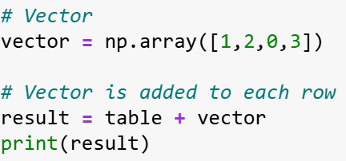
Operations Along Axes
We can do this with functions other than np.sum… For instance, we can compute statistics along each axis.
This works with np.mean, np.std, np.min, np.max, and so on…
Pretty much all mathematical numpy functions support this…
…but you should always check the documentation to verify!
We can also add a vector to each row of a matrix
Slide 9/17

Slide 173
Operations Along Axes
We can do this with functions other than np.sum… For instance, we can compute statistics along each axis.
This works with np.mean, np.std, np.min, np.max, and so on…
Pretty much all mathematical numpy functions support this…
…but you should always check the documentation to verify!
We can also add a vector to each row of a matrix
Slide 9/17

Slide 174
Operations Along Axes
We can do this with functions other than np.sum… For instance, we can compute statistics along each axis.
This works with np.mean, np.std, np.min, np.max, and so on…
Pretty much all mathematical numpy functions support this…
…but you should always check the documentation to verify!
We can also add a vector to each row of a matrix
Slide 9/17

Slide 175
Operations Along Axes
We can do this with functions other than np.sum… For instance, we can compute statistics along each axis.
This works with np.mean, np.std, np.min, np.max, and so on…
Pretty much all mathematical numpy functions support this…
…but you should always check the documentation to verify!
We can also add a vector to each row of a matrix
Slide 9/17

Slide 176
Operations Along Axes
We can do this with functions other than np.sum… For instance, we can compute statistics along each axis.
This works with np.mean, np.std, np.min, np.max, and so on…
Pretty much all mathematical numpy functions support this…
…but you should always check the documentation to verify!
We can also add a vector to each row of a matrix
Slide 9/17

Slide 177
Operations Along Axes
We can do this with functions other than np.sum… For instance, we can compute statistics along each axis.
This works with np.mean, np.std, np.min, np.max, and so on…
Pretty much all mathematical numpy functions support this…
…but you should always check the documentation to verify!
We can also add a vector to each row of a matrix
Slide 9/17

Slide 178
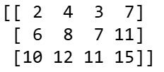
Operations Along Axes
We can do this with functions other than np.sum… For instance, we can compute statistics along each axis.
This works with np.mean, np.std, np.min, np.max, and so on…
Pretty much all mathematical numpy functions support this…
…but you should always check the documentation to verify!
We can also add a vector to each row of a matrix
Slide 9/17

Slide 179
Operations Along Axes
We can do this with functions other than np.sum… For instance, we can compute statistics along each axis.
This works with np.mean, np.std, np.min, np.max, and so on…
Pretty much all mathematical numpy functions support this…
…but you should always check the documentation to verify!
We can also add a vector to each row of a matrix
Slide 9/17

Slide 180
Operations Along Axes
We can do this with functions other than np.sum… For instance, we can compute statistics along each axis.
This works with np.mean, np.std, np.min, np.max, and so on…
Pretty much all mathematical numpy functions support this…
…but you should always check the documentation to verify!
We can also add a vector to each row of a matrix
This is a special instance of something known as broadcasting
Slide 9/17

Slide 181
Operations Along Axes
We can do this with functions other than np.sum… For instance, we can compute statistics along each axis.
This works with np.mean, np.std, np.min, np.max, and so on…
Pretty much all mathematical numpy functions support this…
…but you should always check the documentation to verify!
We can also add a vector to each row of a matrix
This is a special instance of something known as broadcasting
(Not covered in detail today)
Slide 9/17

Slide 182
Operations Along Axes
We can do this with functions other than np.sum… For instance, we can compute statistics along each axis.
This works with np.mean, np.std, np.min, np.max, and so on…
Pretty much all mathematical numpy functions support this…
…but you should always check the documentation to verify!
We can also add a vector to each row of a matrix
This is a special instance of something known as broadcasting
Slide 9/17

Slide 183
Operations Along Axes
We can do this with functions other than np.sum… For instance, we can compute statistics along each axis.
This works with np.mean, np.std, np.min, np.max, and so on…
Pretty much all mathematical numpy functions support this…
…but you should always check the documentation to verify!
We can also add a vector to each row of a matrix
This is a special instance of something known as broadcasting
Broadcasting is worth knowing about – produces faster and simpler code!
Slide 9/17

Slide 184
Operations Along Axes
We can do this with functions other than np.sum… For instance, we can compute statistics along each axis.
This works with np.mean, np.std, np.min, np.max, and so on…
Pretty much all mathematical numpy functions support this…
…but you should always check the documentation to verify!
We can also add a vector to each row of a matrix
This is a special instance of something known as broadcasting
Slide 9/17

Slide 185
Operations Along Axes
We can do this with functions other than np.sum… For instance, we can compute statistics along each axis.
This works with np.mean, np.std, np.min, np.max, and so on…
Pretty much all mathematical numpy functions support this…
…but you should always check the documentation to verify!
We can also add a vector to each row of a matrix
This is a special instance of something known as broadcasting
NumPy’s own rules for applying matrix operations to higher dimensional tensors
Slide 9/17

Slide 186
Flatten and Ravel
Slide 10/17

Slide 187
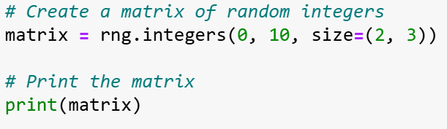
Flatten and Ravel
Slide 10/17

Slide 188
Flatten and Ravel
Slide 10/17

Slide 189
Flatten and Ravel
Slide 10/17

Slide 190
Flatten and Ravel
Slide 10/17

Slide 191

Flatten and Ravel
Slide 10/17

Slide 192
Flatten and Ravel
Slide 10/17

Slide 193
Flatten and Ravel
Sometimes, it is useful to convert higher dimensional arrays to one-dimensional “flattened arrays”
Slide 10/17

Slide 194
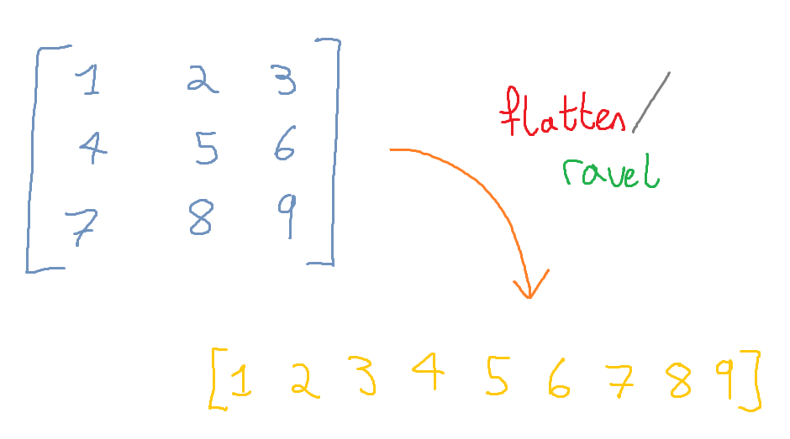
Flatten and Ravel
Sometimes, it is useful to convert higher dimensional arrays to one-dimensional “flattened arrays”
Slide 10/17

Slide 195
Flatten and Ravel
Sometimes, it is useful to convert higher dimensional arrays to one-dimensional “flattened arrays”
Slide 10/17

Slide 196
Flatten and Ravel
Sometimes, it is useful to convert higher dimensional arrays to one-dimensional “flattened arrays”
Slide 10/17

Slide 197
Flatten and Ravel
Sometimes, it is useful to convert higher dimensional arrays to one-dimensional “flattened arrays”
This is done a lot in machine learning, where sometimes we want to “forget the shape” of an array
Slide 10/17

Slide 198
Flatten and Ravel
Sometimes, it is useful to convert higher dimensional arrays to one-dimensional “flattened arrays”
This is done a lot in machine learning, where sometimes we want to “forget the shape” of an array
We can do this using ravel or flatten.
Slide 10/17

Slide 199
Flatten and Ravel
Sometimes, it is useful to convert higher dimensional arrays to one-dimensional “flattened arrays”
This is done a lot in machine learning, where sometimes we want to “forget the shape” of an array
We can do this using ravel or flatten.
Ravel creates a view, whereas flatten creates a copy!
Slide 10/17

Slide 200
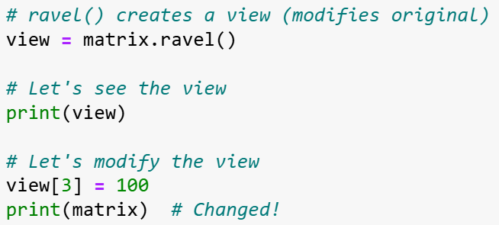
Flatten and Ravel
Sometimes, it is useful to convert higher dimensional arrays to one-dimensional “flattened arrays”
This is done a lot in machine learning, where sometimes we want to “forget the shape” of an array
We can do this using ravel or flatten.
Ravel creates a view, whereas flatten creates a copy!
Slide 10/17

Slide 201
Flatten and Ravel
Sometimes, it is useful to convert higher dimensional arrays to one-dimensional “flattened arrays”
This is done a lot in machine learning, where sometimes we want to “forget the shape” of an array
We can do this using ravel or flatten.
Ravel creates a view, whereas flatten creates a copy!
Slide 10/17

Slide 202
Flatten and Ravel
Sometimes, it is useful to convert higher dimensional arrays to one-dimensional “flattened arrays”
This is done a lot in machine learning, where sometimes we want to “forget the shape” of an array
We can do this using ravel or flatten.
Ravel creates a view, whereas flatten creates a copy!
Slide 10/17

Slide 203
Flatten and Ravel
Sometimes, it is useful to convert higher dimensional arrays to one-dimensional “flattened arrays”
This is done a lot in machine learning, where sometimes we want to “forget the shape” of an array
We can do this using ravel or flatten.
Ravel creates a view, whereas flatten creates a copy!
Slide 10/17

Slide 204

Flatten and Ravel
Sometimes, it is useful to convert higher dimensional arrays to one-dimensional “flattened arrays”
This is done a lot in machine learning, where sometimes we want to “forget the shape” of an array
We can do this using ravel or flatten.
Ravel creates a view, whereas flatten creates a copy!
Slide 10/17

Slide 205
Flatten and Ravel
Sometimes, it is useful to convert higher dimensional arrays to one-dimensional “flattened arrays”
This is done a lot in machine learning, where sometimes we want to “forget the shape” of an array
We can do this using ravel or flatten.
Ravel creates a view, whereas flatten creates a copy!
Slide 10/17

Slide 206
Flatten and Ravel
Sometimes, it is useful to convert higher dimensional arrays to one-dimensional “flattened arrays”
This is done a lot in machine learning, where sometimes we want to “forget the shape” of an array
We can do this using ravel or flatten.
Ravel creates a view, whereas flatten creates a copy!
Slide 10/17

Slide 207
Flatten and Ravel
Sometimes, it is useful to convert higher dimensional arrays to one-dimensional “flattened arrays”
This is done a lot in machine learning, where sometimes we want to “forget the shape” of an array
We can do this using ravel or flatten.
Ravel creates a view, whereas flatten creates a copy!
Slide 10/17

Slide 208

Flatten and Ravel
Sometimes, it is useful to convert higher dimensional arrays to one-dimensional “flattened arrays”
This is done a lot in machine learning, where sometimes we want to “forget the shape” of an array
We can do this using ravel or flatten.
Ravel creates a view, whereas flatten creates a copy!
Slide 10/17

Slide 209
Flatten and Ravel
Sometimes, it is useful to convert higher dimensional arrays to one-dimensional “flattened arrays”
This is done a lot in machine learning, where sometimes we want to “forget the shape” of an array
We can do this using ravel or flatten.
Ravel creates a view, whereas flatten creates a copy!
Slide 10/17

Slide 210
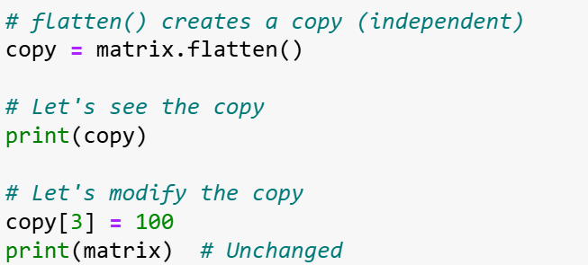
Flatten and Ravel
Sometimes, it is useful to convert higher dimensional arrays to one-dimensional “flattened arrays”
This is done a lot in machine learning, where sometimes we want to “forget the shape” of an array
We can do this using ravel or flatten.
Ravel creates a view, whereas flatten creates a copy!
Slide 10/17

Slide 211
Flatten and Ravel
Sometimes, it is useful to convert higher dimensional arrays to one-dimensional “flattened arrays”
This is done a lot in machine learning, where sometimes we want to “forget the shape” of an array
We can do this using ravel or flatten.
Ravel creates a view, whereas flatten creates a copy!
Slide 10/17

Slide 212
Flatten and Ravel
Sometimes, it is useful to convert higher dimensional arrays to one-dimensional “flattened arrays”
This is done a lot in machine learning, where sometimes we want to “forget the shape” of an array
We can do this using ravel or flatten.
Ravel creates a view, whereas flatten creates a copy!
Slide 10/17

Slide 213
Flatten and Ravel
Sometimes, it is useful to convert higher dimensional arrays to one-dimensional “flattened arrays”
This is done a lot in machine learning, where sometimes we want to “forget the shape” of an array
We can do this using ravel or flatten.
Ravel creates a view, whereas flatten creates a copy!
Slide 10/17

Slide 214

Flatten and Ravel
Sometimes, it is useful to convert higher dimensional arrays to one-dimensional “flattened arrays”
This is done a lot in machine learning, where sometimes we want to “forget the shape” of an array
We can do this using ravel or flatten.
Ravel creates a view, whereas flatten creates a copy!
Slide 10/17

Slide 215
Flatten and Ravel
Sometimes, it is useful to convert higher dimensional arrays to one-dimensional “flattened arrays”
This is done a lot in machine learning, where sometimes we want to “forget the shape” of an array
We can do this using ravel or flatten.
Ravel creates a view, whereas flatten creates a copy!
Slide 10/17

Slide 216
Flatten and Ravel
Sometimes, it is useful to convert higher dimensional arrays to one-dimensional “flattened arrays”
This is done a lot in machine learning, where sometimes we want to “forget the shape” of an array
We can do this using ravel or flatten.
Ravel creates a view, whereas flatten creates a copy!
Slide 10/17

Slide 217
Flatten and Ravel
Sometimes, it is useful to convert higher dimensional arrays to one-dimensional “flattened arrays”
This is done a lot in machine learning, where sometimes we want to “forget the shape” of an array
We can do this using ravel or flatten.
Ravel creates a view, whereas flatten creates a copy!
Slide 10/17

Slide 218

Flatten and Ravel
Sometimes, it is useful to convert higher dimensional arrays to one-dimensional “flattened arrays”
This is done a lot in machine learning, where sometimes we want to “forget the shape” of an array
We can do this using ravel or flatten.
Ravel creates a view, whereas flatten creates a copy!
Slide 10/17

Slide 219
Matrices as Images
Slide 11/17

Slide 220
Matrices as Images
Sometimes it is useful to think of 2D arrays (matrices) as images…
Slide 11/17

Slide 221
Matrices as Images
Sometimes it is useful to think of 2D arrays (matrices) as images…
… and vice versa
Slide 11/17

Slide 222
Matrices as Images
Sometimes it is useful to think of 2D arrays (matrices) as images…
… and vice versa
An image is a grid of intensity values
Slide 11/17

Slide 223
Matrices as Images
Sometimes it is useful to think of 2D arrays (matrices) as images…
… and vice versa
An image is a grid of intensity values
Every gridpoint is a “pixel” and the number is its intensity level.
Slide 11/17

Slide 224
Matrices as Images
Sometimes it is useful to think of 2D arrays (matrices) as images…
… and vice versa
An image is a grid of intensity values
Every gridpoint is a “pixel” and the number is its intensity level.
2D arrays can represent grayscale images
Slide 11/17

Slide 225
Matrices as Images
Sometimes it is useful to think of 2D arrays (matrices) as images…
… and vice versa
An image is a grid of intensity values
Every gridpoint is a “pixel” and the number is its intensity level.
2D arrays can represent grayscale images
We can make an image from an array using plt.imshow
Slide 11/17

Slide 226
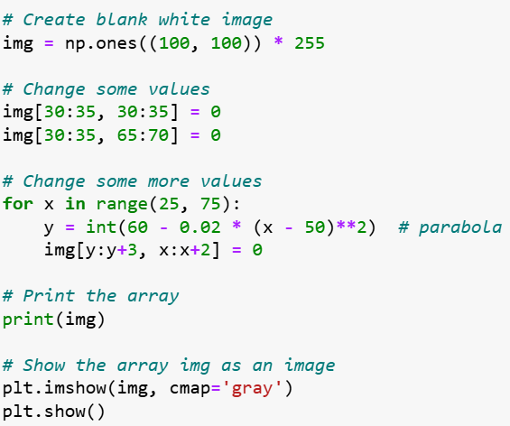
Matrices as Images
Sometimes it is useful to think of 2D arrays (matrices) as images…
… and vice versa
An image is a grid of intensity values
Every gridpoint is a “pixel” and the number is its intensity level.
2D arrays can represent grayscale images
We can make an image from an array using plt.imshow
Slide 11/17

Slide 227
Matrices as Images
Sometimes it is useful to think of 2D arrays (matrices) as images…
… and vice versa
An image is a grid of intensity values
Every gridpoint is a “pixel” and the number is its intensity level.
2D arrays can represent grayscale images
We can make an image from an array using plt.imshow
Slide 11/17

Slide 228
Matrices as Images
Sometimes it is useful to think of 2D arrays (matrices) as images…
… and vice versa
An image is a grid of intensity values
Every gridpoint is a “pixel” and the number is its intensity level.
2D arrays can represent grayscale images
We can make an image from an array using plt.imshow
Slide 11/17

Slide 229
Matrices as Images
Sometimes it is useful to think of 2D arrays (matrices) as images…
… and vice versa
An image is a grid of intensity values
Every gridpoint is a “pixel” and the number is its intensity level.
2D arrays can represent grayscale images
We can make an image from an array using plt.imshow
Slide 11/17

Slide 230
Matrices as Images
Sometimes it is useful to think of 2D arrays (matrices) as images…
… and vice versa
An image is a grid of intensity values
Every gridpoint is a “pixel” and the number is its intensity level.
2D arrays can represent grayscale images
We can make an image from an array using plt.imshow
Slide 11/17

Slide 231
Matrices as Images
Sometimes it is useful to think of 2D arrays (matrices) as images…
… and vice versa
An image is a grid of intensity values
Every gridpoint is a “pixel” and the number is its intensity level.
2D arrays can represent grayscale images
We can make an image from an array using plt.imshow
Slide 11/17

Slide 232
Matrices as Images
Sometimes it is useful to think of 2D arrays (matrices) as images…
… and vice versa
An image is a grid of intensity values
Every gridpoint is a “pixel” and the number is its intensity level.
2D arrays can represent grayscale images
We can make an image from an array using plt.imshow
Slide 11/17

Slide 233
Matrices as Images
Sometimes it is useful to think of 2D arrays (matrices) as images…
… and vice versa
An image is a grid of intensity values
Every gridpoint is a “pixel” and the number is its intensity level.
2D arrays can represent grayscale images
We can make an image from an array using plt.imshow
Slide 11/17

Slide 234
Matrices as Images
Sometimes it is useful to think of 2D arrays (matrices) as images…
… and vice versa
An image is a grid of intensity values
Every gridpoint is a “pixel” and the number is its intensity level.
2D arrays can represent grayscale images
We can make an image from an array using plt.imshow
Slide 11/17

Slide 235
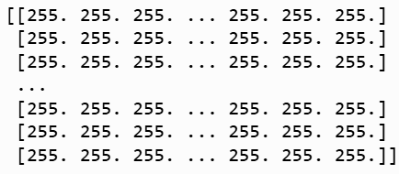
Matrices as Images
Sometimes it is useful to think of 2D arrays (matrices) as images…
… and vice versa
An image is a grid of intensity values
Every gridpoint is a “pixel” and the number is its intensity level.
2D arrays can represent grayscale images
We can make an image from an array using plt.imshow
Slide 11/17

Slide 236
Matrices as Images
Sometimes it is useful to think of 2D arrays (matrices) as images…
… and vice versa
An image is a grid of intensity values
Every gridpoint is a “pixel” and the number is its intensity level.
2D arrays can represent grayscale images
We can make an image from an array using plt.imshow
Slide 11/17

Slide 237
Matrices as Images
Sometimes it is useful to think of 2D arrays (matrices) as images…
… and vice versa
An image is a grid of intensity values
Every gridpoint is a “pixel” and the number is its intensity level.
2D arrays can represent grayscale images
We can make an image from an array using plt.imshow
Slide 11/17

Slide 238
Matrices as Images
Sometimes it is useful to think of 2D arrays (matrices) as images…
… and vice versa
An image is a grid of intensity values
Every gridpoint is a “pixel” and the number is its intensity level.
2D arrays can represent grayscale images
We can make an image from an array using plt.imshow
Slide 11/17

Slide 239
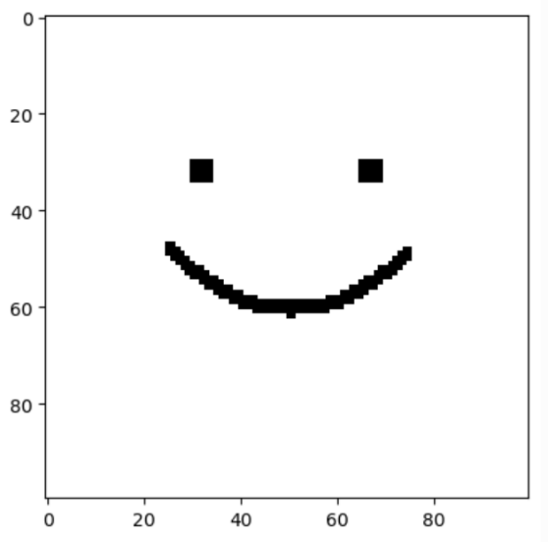
Matrices as Images
Sometimes it is useful to think of 2D arrays (matrices) as images…
… and vice versa
An image is a grid of intensity values
Every gridpoint is a “pixel” and the number is its intensity level.
2D arrays can represent grayscale images
We can make an image from an array using plt.imshow
Slide 11/17

Slide 240
Matrices as Images
Sometimes it is useful to think of 2D arrays (matrices) as images…
… and vice versa
An image is a grid of intensity values
Every gridpoint is a “pixel” and the number is its intensity level.
2D arrays can represent grayscale images
We can make an image from an array using plt.imshow
Viewing arrays as images can help us spot hidden structure in the data
Slide 11/17

Slide 241
Matrices as Images
Slide 12/17

Slide 242
Matrices as Images
2D arrays represent grayscale images
Slide 12/17

Slide 243
Matrices as Images
2D arrays represent grayscale images
What about colour?
Slide 12/17

Slide 244
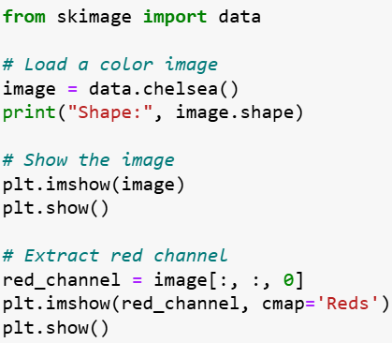
Matrices as Images
2D arrays represent grayscale images
What about colour?
Slide 12/17

Slide 245
Matrices as Images
2D arrays represent grayscale images
What about colour?
Slide 12/17

Slide 246
Matrices as Images
2D arrays represent grayscale images
What about colour?
Slide 12/17

Slide 247
Matrices as Images
2D arrays represent grayscale images
What about colour?
Slide 12/17

Slide 248
Matrices as Images
2D arrays represent grayscale images
What about colour?
A colour image has 3 intensity values at every pixel, not just one
Slide 12/17

Slide 249
Matrices as Images
2D arrays represent grayscale images
What about colour?
A colour image has 3 intensity values at every pixel, not just one
These are the red, green, blue (R, G, B) values
Slide 12/17

Slide 250
Matrices as Images
2D arrays represent grayscale images
What about colour?
A colour image has 3 intensity values at every pixel, not just one
These are the red, green, blue (R, G, B) values
They mix together to make the colour of the pixel
Slide 12/17

Slide 251
Matrices as Images
2D arrays represent grayscale images
What about colour?
A colour image has 3 intensity values at every pixel, not just one
These are the red, green, blue (R, G, B) values
They mix together to make the colour of the pixel
Therefore, we can represent a 2D colour image of size (n x m) as a 3D array of size (n x m x 3)
Slide 12/17

Slide 252
Matrices as Images
2D arrays represent grayscale images
What about colour?
A colour image has 3 intensity values at every pixel, not just one
These are the red, green, blue (R, G, B) values
They mix together to make the colour of the pixel
Therefore, we can represent a 2D colour image of size (n x m) as a 3D array of size (n x m x 3)
Slide 12/17

Slide 253

Matrices as Images
2D arrays represent grayscale images
What about colour?
A colour image has 3 intensity values at every pixel, not just one
These are the red, green, blue (R, G, B) values
They mix together to make the colour of the pixel
Therefore, we can represent a 2D colour image of size (n x m) as a 3D array of size (n x m x 3)
Slide 12/17

Slide 254
Matrices as Images
2D arrays represent grayscale images
What about colour?
A colour image has 3 intensity values at every pixel, not just one
These are the red, green, blue (R, G, B) values
They mix together to make the colour of the pixel
Therefore, we can represent a 2D colour image of size (n x m) as a 3D array of size (n x m x 3)
The “channels” are (R, G, B).
Slide 12/17

Slide 255
Matrices as Images
2D arrays represent grayscale images
What about colour?
A colour image has 3 intensity values at every pixel, not just one
These are the red, green, blue (R, G, B) values
They mix together to make the colour of the pixel
Therefore, we can represent a 2D colour image of size (n x m) as a 3D array of size (n x m x 3)
The “channels” are (R, G, B).
Slide 12/17

Slide 256
Matrices as Images
2D arrays represent grayscale images
What about colour?
A colour image has 3 intensity values at every pixel, not just one
These are the red, green, blue (R, G, B) values
They mix together to make the colour of the pixel
Therefore, we can represent a 2D colour image of size (n x m) as a 3D array of size (n x m x 3)
The “channels” are (R, G, B).
Slide 12/17

Slide 257
Matrices as Images
2D arrays represent grayscale images
What about colour?
A colour image has 3 intensity values at every pixel, not just one
These are the red, green, blue (R, G, B) values
They mix together to make the colour of the pixel
Therefore, we can represent a 2D colour image of size (n x m) as a 3D array of size (n x m x 3)
The “channels” are (R, G, B).
Slide 12/17

Slide 258
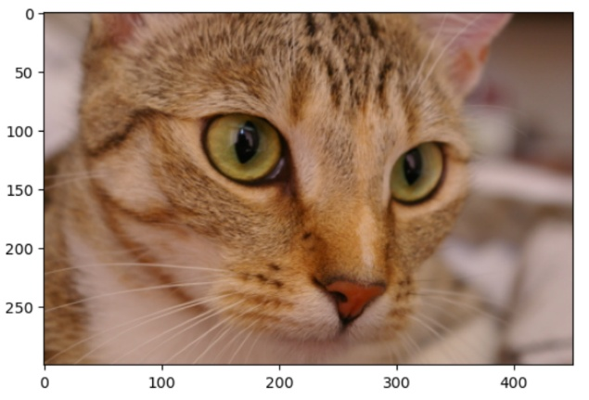
Matrices as Images
2D arrays represent grayscale images
What about colour?
A colour image has 3 intensity values at every pixel, not just one
These are the red, green, blue (R, G, B) values
They mix together to make the colour of the pixel
Therefore, we can represent a 2D colour image of size (n x m) as a 3D array of size (n x m x 3)
The “channels” are (R, G, B).
Slide 12/17

Slide 259
Matrices as Images
2D arrays represent grayscale images
What about colour?
A colour image has 3 intensity values at every pixel, not just one
These are the red, green, blue (R, G, B) values
They mix together to make the colour of the pixel
Therefore, we can represent a 2D colour image of size (n x m) as a 3D array of size (n x m x 3)
The “channels” are (R, G, B).
Slide 12/17

Slide 260
Matrices as Images
2D arrays represent grayscale images
What about colour?
A colour image has 3 intensity values at every pixel, not just one
These are the red, green, blue (R, G, B) values
They mix together to make the colour of the pixel
Therefore, we can represent a 2D colour image of size (n x m) as a 3D array of size (n x m x 3)
The “channels” are (R, G, B).
Slide 12/17

Slide 261
Matrices as Images
2D arrays represent grayscale images
What about colour?
A colour image has 3 intensity values at every pixel, not just one
These are the red, green, blue (R, G, B) values
They mix together to make the colour of the pixel
Therefore, we can represent a 2D colour image of size (n x m) as a 3D array of size (n x m x 3)
The “channels” are (R, G, B).
Slide 12/17

Slide 262
Matrices as Images
2D arrays represent grayscale images
What about colour?
A colour image has 3 intensity values at every pixel, not just one
These are the red, green, blue (R, G, B) values
They mix together to make the colour of the pixel
Therefore, we can represent a 2D colour image of size (n x m) as a 3D array of size (n x m x 3)
The “channels” are (R, G, B).
Slide 12/17

Slide 263
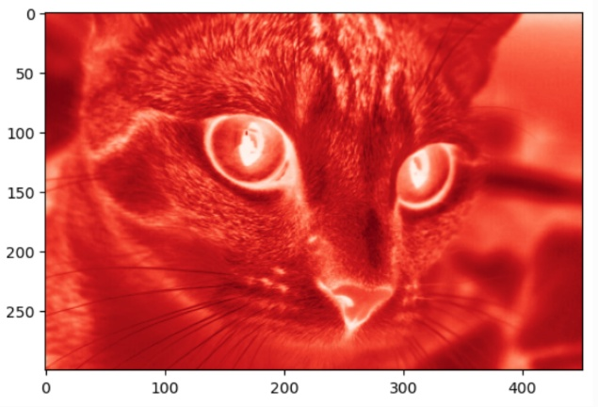
Matrices as Images
2D arrays represent grayscale images
What about colour?
A colour image has 3 intensity values at every pixel, not just one
These are the red, green, blue (R, G, B) values
They mix together to make the colour of the pixel
Therefore, we can represent a 2D colour image of size (n x m) as a 3D array of size (n x m x 3)
The “channels” are (R, G, B).
Slide 12/17

Slide 264
Matrices as Images
Slide 12/17

Slide 265
Boolean Indexing on Images
Slide 13/17

Slide 266
Boolean Indexing on Images
We saw Boolean indexing with 1D arrays.
Slide 13/17

Slide 267
Boolean Indexing on Images
We saw Boolean indexing with 1D arrays.
The same principle applies to multi-dimensional arrays!
Slide 13/17

Slide 268
Boolean Indexing on Images
We saw Boolean indexing with 1D arrays.
The same principle applies to multi-dimensional arrays!
We apply Boolean conditions to elements of an array
Slide 13/17

Slide 269
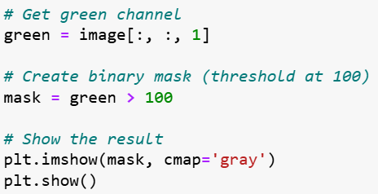
Boolean Indexing on Images
We saw Boolean indexing with 1D arrays.
The same principle applies to multi-dimensional arrays!
We apply Boolean conditions to elements of an array
Slide 13/17

Slide 270
Boolean Indexing on Images
We saw Boolean indexing with 1D arrays.
The same principle applies to multi-dimensional arrays!
We apply Boolean conditions to elements of an array
Slide 13/17

Slide 271
Boolean Indexing on Images
We saw Boolean indexing with 1D arrays.
The same principle applies to multi-dimensional arrays!
We apply Boolean conditions to elements of an array
Slide 13/17

Slide 272
Boolean Indexing on Images
We saw Boolean indexing with 1D arrays.
The same principle applies to multi-dimensional arrays!
We apply Boolean conditions to elements of an array
Slide 13/17

Slide 273
Boolean Indexing on Images
We saw Boolean indexing with 1D arrays.
The same principle applies to multi-dimensional arrays!
We apply Boolean conditions to elements of an array
Slide 13/17

Slide 274
Boolean Indexing on Images
We saw Boolean indexing with 1D arrays.
The same principle applies to multi-dimensional arrays!
We apply Boolean conditions to elements of an array
This gives a new array with the same shape but with True/False entries
Slide 13/17

Slide 275
Boolean Indexing on Images
We saw Boolean indexing with 1D arrays.
The same principle applies to multi-dimensional arrays!
We apply Boolean conditions to elements of an array
This gives a new array with the same shape but with True/False entries
A Boolean array we use to manipulate/access elements of an image is often called a “mask”
Slide 13/17

Slide 276
Boolean Indexing on Images
We saw Boolean indexing with 1D arrays.
The same principle applies to multi-dimensional arrays!
We apply Boolean conditions to elements of an array
This gives a new array with the same shape but with True/False entries
A Boolean array we use to manipulate/access elements of an image is often called a “mask”
Slide 13/17

Slide 277
Boolean Indexing on Images
We saw Boolean indexing with 1D arrays.
The same principle applies to multi-dimensional arrays!
We apply Boolean conditions to elements of an array
This gives a new array with the same shape but with True/False entries
A Boolean array we use to manipulate/access elements of an image is often called a “mask”
Slide 13/17

Slide 278
Boolean Indexing on Images
We saw Boolean indexing with 1D arrays.
The same principle applies to multi-dimensional arrays!
We apply Boolean conditions to elements of an array
This gives a new array with the same shape but with True/False entries
A Boolean array we use to manipulate/access elements of an image is often called a “mask”
Slide 13/17

Slide 279
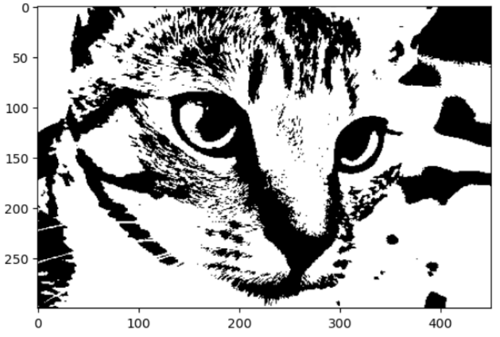
Boolean Indexing on Images
We saw Boolean indexing with 1D arrays.
The same principle applies to multi-dimensional arrays!
We apply Boolean conditions to elements of an array
This gives a new array with the same shape but with True/False entries
A Boolean array we use to manipulate/access elements of an image is often called a “mask”
Slide 13/17

Slide 280
Boolean Indexing on Images
We saw Boolean indexing with 1D arrays.
The same principle applies to multi-dimensional arrays!
We apply Boolean conditions to elements of an array
This gives a new array with the same shape but with True/False entries
A Boolean array we use to manipulate/access elements of an image is often called a “mask”
1/0 mask showing where the image is “very green”
Slide 13/17

Slide 281
Boolean Indexing on Images
We saw Boolean indexing with 1D arrays.
The same principle applies to multi-dimensional arrays!
We apply Boolean conditions to elements of an array
This gives a new array with the same shape but with True/False entries
A Boolean array we use to manipulate/access elements of an image is often called a “mask”
Slide 13/17

Slide 282
Boolean Indexing on Images
We saw Boolean indexing with 1D arrays.
The same principle applies to multi-dimensional arrays!
We apply Boolean conditions to elements of an array
This gives a new array with the same shape but with True/False entries
A Boolean array we use to manipulate/access elements of an image is often called a “mask”
White = 1/True, Black = 0/False
Slide 13/17

Slide 283
Boolean Indexing on Images
We saw Boolean indexing with 1D arrays.
The same principle applies to multi-dimensional arrays!
We apply Boolean conditions to elements of an array
This gives a new array with the same shape but with True/False entries
A Boolean array we use to manipulate/access elements of an image is often called a “mask”
Slide 13/17

Slide 284
Boolean Indexing on Images
Slide 13/17

Slide 285
Boolean Indexing on Images
We can apply logical operators elementwise to combine masks
Slide 14/17

Slide 286
Boolean Indexing on Images
We can apply logical operators elementwise to combine masks
mask1 & mask2 (and) gives an image whose pixels contain True if and only if the corresponding pixel is True in both masks
Slide 14/17

Slide 287
Boolean Indexing on Images
We can apply logical operators elementwise to combine masks
mask1 & mask2 (and) gives an image whose pixels contain True if and only if the corresponding pixel is True in both masks
mask1 | mask2 (or) gives an image whose pixels contain True if and only if the corresponding pixel is True in one mask or the other (or both)
Slide 14/17

Slide 288
Boolean Indexing on Images
We can apply logical operators elementwise to combine masks
mask1 & mask2 (and) gives an image whose pixels contain True if and only if the corresponding pixel is True in both masks
mask1 | mask2 (or) gives an image whose pixels contain True if and only if the corresponding pixel is True in one mask or the other (or both)
~ mask1 (not) gives an image whose pixels contain True if and only if the corresponding pixel is False in mask1
Slide 14/17

Slide 289
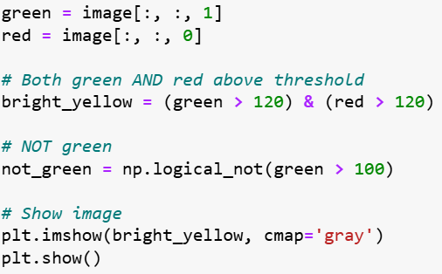
Boolean Indexing on Images
We can apply logical operators elementwise to combine masks
mask1 & mask2 (and) gives an image whose pixels contain True if and only if the corresponding pixel is True in both masks
mask1 | mask2 (or) gives an image whose pixels contain True if and only if the corresponding pixel is True in one mask or the other (or both)
~ mask1 (not) gives an image whose pixels contain True if and only if the corresponding pixel is False in mask1
Slide 14/17

Slide 290
Boolean Indexing on Images
We can apply logical operators elementwise to combine masks
mask1 & mask2 (and) gives an image whose pixels contain True if and only if the corresponding pixel is True in both masks
mask1 | mask2 (or) gives an image whose pixels contain True if and only if the corresponding pixel is True in one mask or the other (or both)
~ mask1 (not) gives an image whose pixels contain True if and only if the corresponding pixel is False in mask1
Slide 14/17

Slide 291
Boolean Indexing on Images
We can apply logical operators elementwise to combine masks
mask1 & mask2 (and) gives an image whose pixels contain True if and only if the corresponding pixel is True in both masks
mask1 | mask2 (or) gives an image whose pixels contain True if and only if the corresponding pixel is True in one mask or the other (or both)
~ mask1 (not) gives an image whose pixels contain True if and only if the corresponding pixel is False in mask1
Slide 14/17

Slide 292
Boolean Indexing on Images
We can apply logical operators elementwise to combine masks
mask1 & mask2 (and) gives an image whose pixels contain True if and only if the corresponding pixel is True in both masks
mask1 | mask2 (or) gives an image whose pixels contain True if and only if the corresponding pixel is True in one mask or the other (or both)
~ mask1 (not) gives an image whose pixels contain True if and only if the corresponding pixel is False in mask1
Slide 14/17

Slide 293
Boolean Indexing on Images
We can apply logical operators elementwise to combine masks
mask1 & mask2 (and) gives an image whose pixels contain True if and only if the corresponding pixel is True in both masks
mask1 | mask2 (or) gives an image whose pixels contain True if and only if the corresponding pixel is True in one mask or the other (or both)
~ mask1 (not) gives an image whose pixels contain True if and only if the corresponding pixel is False in mask1
Slide 14/17

Slide 294
Boolean Indexing on Images
We can apply logical operators elementwise to combine masks
mask1 & mask2 (and) gives an image whose pixels contain True if and only if the corresponding pixel is True in both masks
mask1 | mask2 (or) gives an image whose pixels contain True if and only if the corresponding pixel is True in one mask or the other (or both)
~ mask1 (not) gives an image whose pixels contain True if and only if the corresponding pixel is False in mask1
Slide 14/17

Slide 295
Boolean Indexing on Images
We can apply logical operators elementwise to combine masks
mask1 & mask2 (and) gives an image whose pixels contain True if and only if the corresponding pixel is True in both masks
mask1 | mask2 (or) gives an image whose pixels contain True if and only if the corresponding pixel is True in one mask or the other (or both)
~ mask1 (not) gives an image whose pixels contain True if and only if the corresponding pixel is False in mask1
Slide 14/17

Slide 296
Boolean Indexing on Images
We can apply logical operators elementwise to combine masks
mask1 & mask2 (and) gives an image whose pixels contain True if and only if the corresponding pixel is True in both masks
mask1 | mask2 (or) gives an image whose pixels contain True if and only if the corresponding pixel is True in one mask or the other (or both)
~ mask1 (not) gives an image whose pixels contain True if and only if the corresponding pixel is False in mask1
Slide 14/17

Slide 297
Boolean Indexing on Images
We can apply logical operators elementwise to combine masks
mask1 & mask2 (and) gives an image whose pixels contain True if and only if the corresponding pixel is True in both masks
mask1 | mask2 (or) gives an image whose pixels contain True if and only if the corresponding pixel is True in one mask or the other (or both)
~ mask1 (not) gives an image whose pixels contain True if and only if the corresponding pixel is False in mask1
Slide 14/17

Slide 298
Boolean Indexing on Images
We can apply logical operators elementwise to combine masks
mask1 & mask2 (and) gives an image whose pixels contain True if and only if the corresponding pixel is True in both masks
mask1 | mask2 (or) gives an image whose pixels contain True if and only if the corresponding pixel is True in one mask or the other (or both)
~ mask1 (not) gives an image whose pixels contain True if and only if the corresponding pixel is False in mask1
Slide 14/17

Slide 299
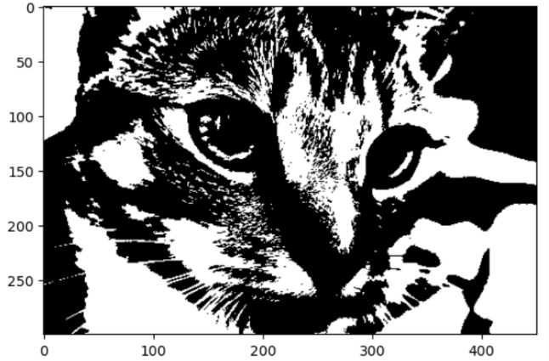
Boolean Indexing on Images
We can apply logical operators elementwise to combine masks
mask1 & mask2 (and) gives an image whose pixels contain True if and only if the corresponding pixel is True in both masks
mask1 | mask2 (or) gives an image whose pixels contain True if and only if the corresponding pixel is True in one mask or the other (or both)
~ mask1 (not) gives an image whose pixels contain True if and only if the corresponding pixel is False in mask1
Slide 14/17

Slide 300
Boolean Indexing on Images
We can apply logical operators elementwise to combine masks
mask1 & mask2 (and) gives an image whose pixels contain True if and only if the corresponding pixel is True in both masks
mask1 | mask2 (or) gives an image whose pixels contain True if and only if the corresponding pixel is True in one mask or the other (or both)
~ mask1 (not) gives an image whose pixels contain True if and only if the corresponding pixel is False in mask1
1/0 mask showing where the image is “bright yellow”
Slide 14/17

Slide 301
Boolean Indexing on Images
We can apply logical operators elementwise to combine masks
mask1 & mask2 (and) gives an image whose pixels contain True if and only if the corresponding pixel is True in both masks
mask1 | mask2 (or) gives an image whose pixels contain True if and only if the corresponding pixel is True in one mask or the other (or both)
~ mask1 (not) gives an image whose pixels contain True if and only if the corresponding pixel is False in mask1
Slide 14/17

Slide 302
Boolean Indexing on Images
We can apply logical operators elementwise to combine masks
mask1 & mask2 (and) gives an image whose pixels contain True if and only if the corresponding pixel is True in both masks
mask1 | mask2 (or) gives an image whose pixels contain True if and only if the corresponding pixel is True in one mask or the other (or both)
~ mask1 (not) gives an image whose pixels contain True if and only if the corresponding pixel is False in mask1
White = 1/True, Black = 0/False
Slide 14/17

Slide 303
Boolean Indexing on Images
We can apply logical operators elementwise to combine masks
mask1 & mask2 (and) gives an image whose pixels contain True if and only if the corresponding pixel is True in both masks
mask1 | mask2 (or) gives an image whose pixels contain True if and only if the corresponding pixel is True in one mask or the other (or both)
~ mask1 (not) gives an image whose pixels contain True if and only if the corresponding pixel is False in mask1
Slide 14/17

Slide 304
Boolean Indexing on Images
We can apply logical operators elementwise to combine masks
mask1 & mask2 (and) gives an image whose pixels contain True if and only if the corresponding pixel is True in both masks
mask1 | mask2 (or) gives an image whose pixels contain True if and only if the corresponding pixel is True in one mask or the other (or both)
~ mask1 (not) gives an image whose pixels contain True if and only if the corresponding pixel is False in mask1
In NumPy, you can use either:
Slide 14/17

Slide 305
Boolean Indexing on Images
We can apply logical operators elementwise to combine masks
mask1 & mask2 (and) gives an image whose pixels contain True if and only if the corresponding pixel is True in both masks
mask1 | mask2 (or) gives an image whose pixels contain True if and only if the corresponding pixel is True in one mask or the other (or both)
~ mask1 (not) gives an image whose pixels contain True if and only if the corresponding pixel is False in mask1
In NumPy, you can use either: & (and),
Slide 14/17

Slide 306
Boolean Indexing on Images
We can apply logical operators elementwise to combine masks
mask1 & mask2 (and) gives an image whose pixels contain True if and only if the corresponding pixel is True in both masks
mask1 | mask2 (or) gives an image whose pixels contain True if and only if the corresponding pixel is True in one mask or the other (or both)
~ mask1 (not) gives an image whose pixels contain True if and only if the corresponding pixel is False in mask1
In NumPy, you can use either: & (and), | (or),
Slide 14/17

Slide 307
Boolean Indexing on Images
We can apply logical operators elementwise to combine masks
mask1 & mask2 (and) gives an image whose pixels contain True if and only if the corresponding pixel is True in both masks
mask1 | mask2 (or) gives an image whose pixels contain True if and only if the corresponding pixel is True in one mask or the other (or both)
~ mask1 (not) gives an image whose pixels contain True if and only if the corresponding pixel is False in mask1
In NumPy, you can use either: & (and), | (or), ~ (not)
Slide 14/17

Slide 308
Boolean Indexing on Images
We can apply logical operators elementwise to combine masks
mask1 & mask2 (and) gives an image whose pixels contain True if and only if the corresponding pixel is True in both masks
mask1 | mask2 (or) gives an image whose pixels contain True if and only if the corresponding pixel is True in one mask or the other (or both)
~ mask1 (not) gives an image whose pixels contain True if and only if the corresponding pixel is False in mask1
In NumPy, you can use either: & (and), | (or), ~ (not) or
Slide 14/17

Slide 309
Boolean Indexing on Images
We can apply logical operators elementwise to combine masks
mask1 & mask2 (and) gives an image whose pixels contain True if and only if the corresponding pixel is True in both masks
mask1 | mask2 (or) gives an image whose pixels contain True if and only if the corresponding pixel is True in one mask or the other (or both)
~ mask1 (not) gives an image whose pixels contain True if and only if the corresponding pixel is False in mask1
In NumPy, you can use either: & (and), | (or), ~ (not) or np.logical_and,
Slide 14/17

Slide 310
Boolean Indexing on Images
We can apply logical operators elementwise to combine masks
mask1 & mask2 (and) gives an image whose pixels contain True if and only if the corresponding pixel is True in both masks
mask1 | mask2 (or) gives an image whose pixels contain True if and only if the corresponding pixel is True in one mask or the other (or both)
~ mask1 (not) gives an image whose pixels contain True if and only if the corresponding pixel is False in mask1
In NumPy, you can use either: & (and), | (or), ~ (not) or np.logical_and, np.logical_or,
Slide 14/17

Slide 311
Boolean Indexing on Images
We can apply logical operators elementwise to combine masks
mask1 & mask2 (and) gives an image whose pixels contain True if and only if the corresponding pixel is True in both masks
mask1 | mask2 (or) gives an image whose pixels contain True if and only if the corresponding pixel is True in one mask or the other (or both)
~ mask1 (not) gives an image whose pixels contain True if and only if the corresponding pixel is False in mask1
In NumPy, you can use either: & (and), | (or), ~ (not) or np.logical_and, np.logical_or, np.logical_not
Slide 14/17

Slide 312
Key Takeaways
Slide 15/17

Slide 313
Key Takeaways
Multi-dimensional arrays have shape and rank
Slide 15/17

Slide 314
Key Takeaways
Multi-dimensional arrays have shape and rank
Slide 15/17

Slide 315
Key Takeaways
Multi-dimensional arrays have shape and rank
Slide 15/17

Slide 316
Key Takeaways
Multi-dimensional arrays have shape and rank
Slide 15/17

Slide 317
Key Takeaways
Multi-dimensional arrays have shape and rank
Index 2D arrays with [row, column] notation
Slide 15/17

Slide 318
Key Takeaways
Multi-dimensional arrays have shape and rank
Index 2D arrays with [row, column] notation
Operations can work along specific axes
Slide 15/17

Slide 319
Key Takeaways
Multi-dimensional arrays have shape and rank
Index 2D arrays with [row, column] notation
Operations can work along specific axes
Reshape and flatten change array structure
Slide 15/17

Slide 320
Key Takeaways
Multi-dimensional arrays have shape and rank
Index 2D arrays with [row, column] notation
Operations can work along specific axes
Reshape and flatten change array structure
2D/3D arrays represent images naturally
Slide 15/17

Slide 321

Key Takeaways
Multi-dimensional arrays have shape and rank
Index 2D arrays with [row, column] notation
Operations can work along specific axes
Reshape and flatten change array structure
2D/3D arrays represent images naturally
Slide 15/17

Slide 322
Key Takeaways
Multi-dimensional arrays have shape and rank
Index 2D arrays with [row, column] notation
Operations can work along specific axes
Reshape and flatten change array structure
2D/3D arrays represent images naturally
Boolean indexing creates powerful masks
Slide 15/17

Slide 323

Key Takeaways
Multi-dimensional arrays have shape and rank
Index 2D arrays with [row, column] notation
Operations can work along specific axes
Reshape and flatten change array structure
2D/3D arrays represent images naturally
Boolean indexing creates powerful masks
Slide 15/17

Slide 324
Practical
Slide 16/17

Slide 325
Practical
For the rest of today, you must:
Slide 16/17

Slide 326
Practical
For the rest of today, you must:
First, read through:
Slide 16/17

Slide 327
Practical
For the rest of today, you must:
First, read through: lecture_multidimensionalArrays.ipynb
Slide 16/17

Slide 328
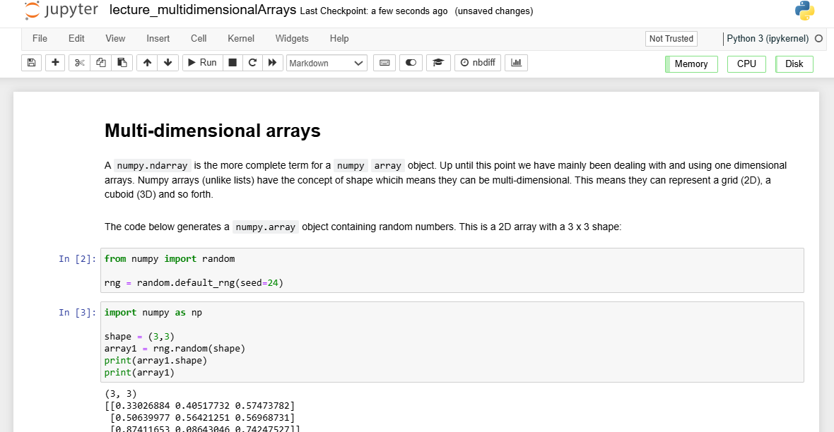
Practical
For the rest of today, you must:
First, read through: lecture_multidimensionalArrays.ipynb
Slide 16/17

Slide 329
Practical
For the rest of today, you must:
First, read through: lecture_multidimensionalArrays.ipynb
Then, in pairs, work through:
Slide 16/17

Slide 330
Practical
For the rest of today, you must:
First, read through: lecture_multidimensionalArrays.ipynb
Then, in pairs, work through: exercises_part1.ipynb
Slide 16/17

Slide 331
Practical
For the rest of today, you must:
First, read through: lecture_multidimensionalArrays.ipynb
Then, in pairs, work through: exercises_part1.ipynb exercises_part2.ipynb
Slide 16/17

Slide 332
Practical
For the rest of today, you must:
First, read through: lecture_multidimensionalArrays.ipynb
Then, in pairs, work through: exercises_part1.ipynb exercises_part2.ipynb
Pair Programming
Slide 16/17

Slide 333
Practical
For the rest of today, you must:
First, read through: lecture_multidimensionalArrays.ipynb
Then, in pairs, work through: exercises_part1.ipynb exercises_part2.ipynb
Pair Programming
One person is the "driver" (writes the code)
Slide 16/17

Slide 334
Practical
For the rest of today, you must:
First, read through: lecture_multidimensionalArrays.ipynb
Then, in pairs, work through: exercises_part1.ipynb exercises_part2.ipynb
Pair Programming
One person is the "driver" (writes the code)
The other is the "navigator" (reviews, suggests, finds docs)
Slide 16/17

Slide 335
Practical
For the rest of today, you must:
First, read through: lecture_multidimensionalArrays.ipynb
Then, in pairs, work through: exercises_part1.ipynb exercises_part2.ipynb
Pair Programming
One person is the "driver" (writes the code)
The other is the "navigator" (reviews, suggests, finds docs)
Switch roles for parts 1 and 2.
Slide 16/17

Slide 336
Practical
For the rest of today, you must:
First, read through: lecture_multidimensionalArrays.ipynb
Then, in pairs, work through: exercises_part1.ipynb exercises_part2.ipynb
Pair Programming
One person is the "driver" (writes the code)
The other is the "navigator" (reviews, suggests, finds docs)
Switch roles for parts 1 and 2.
You can work alone if preferred.
Slide 16/17

Slide 337
Practical
For the rest of today, you must:
First, read through: lecture_multidimensionalArrays.ipynb
Then, in pairs, work through: exercises_part1.ipynb exercises_part2.ipynb
Hints are given in:
Pair Programming
One person is the "driver" (writes the code)
The other is the "navigator" (reviews, suggests, finds docs)
Switch roles for parts 1 and 2.
You can work alone if preferred.
Slide 16/17

Slide 338
Practical
For the rest of today, you must:
First, read through: lecture_multidimensionalArrays.ipynb
Then, in pairs, work through: exercises_part1.ipynb exercises_part2.ipynb
Hints are given in: hint1_mask.ipynb
Pair Programming
One person is the "driver" (writes the code)
The other is the "navigator" (reviews, suggests, finds docs)
Switch roles for parts 1 and 2.
You can work alone if preferred.
Slide 16/17

Slide 339
Practical
For the rest of today, you must:
First, read through: lecture_multidimensionalArrays.ipynb
Then, in pairs, work through: exercises_part1.ipynb exercises_part2.ipynb
Hints are given in: hint1_mask.ipynb hint2_apply_mask.ipynb
Pair Programming
One person is the "driver" (writes the code)
The other is the "navigator" (reviews, suggests, finds docs)
Switch roles for parts 1 and 2.
You can work alone if preferred.
Slide 16/17

Slide 340
Next Time
Lecture 9: Multi-dimensional Arrays
What are Multi-dimensional Arrays
2D Arrays
Arrays as Images
Practical
Lecture 10: Beyond the Notebook
Outside Jupyter
File Management
The Terminal
Running Scripts
Practical
Slide 17/17

