Slide 1
Lecture 12:
Pandas Data Preprocessing
SCIF10002 – Introduction to Coding and Data Analysis for Scientists
Tom Maullin-Sapey
29th January 2026
Slide 0/5

Slide 2
Todays Lecture
Lecture 12: Pandas Data Preprocessing
Loading Data
Exploratory Investigation
Data Type Conversion
Practical
Lecture 13: Plotting with Pandas
Plotting with Pandas Series
Plotting with Pandas DataFrames
Moving Averages in Pandas
Practical
Slide 1/5

Slide 3
Data Preprocessing
Slide 2/5

Slide 4

Data Preprocessing
Slide 2/5

Slide 5

Data Preprocessing
Slide 2/5

Slide 6
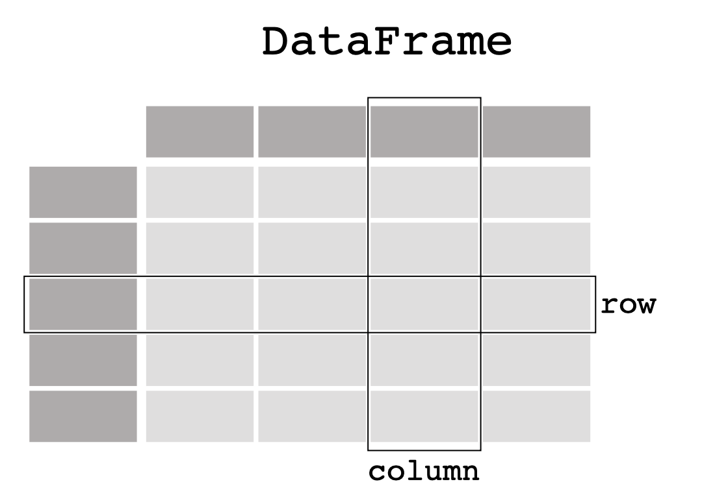
Data Preprocessing
Slide 2/5

Slide 7
Data Preprocessing
When working with real world applications, you will often need to clean the data first.
Slide 2/5

Slide 8
Data Preprocessing
When working with real world applications, you will often need to clean the data first.
Today, we’re going to look at a typical data processing pipeline in Pandas
Slide 2/5

Slide 9
Data Preprocessing
When working with real world applications, you will often need to clean the data first.
Today, we’re going to look at a typical data processing pipeline in Pandas
Loading Data
Slide 2/5

Slide 10
Data Preprocessing
When working with real world applications, you will often need to clean the data first.
Today, we’re going to look at a typical data processing pipeline in Pandas
Loading Data
Exploratory Investigation
Slide 2/5

Slide 11
Data Preprocessing
When working with real world applications, you will often need to clean the data first.
Today, we’re going to look at a typical data processing pipeline in Pandas
Loading Data
Exploratory Investigation
Handling Missing Data
Slide 2/5

Slide 12
Data Preprocessing
When working with real world applications, you will often need to clean the data first.
Today, we’re going to look at a typical data processing pipeline in Pandas
Loading Data
Exploratory Investigation
Handling Missing Data
Adding Derived Features
Slide 2/5

Slide 13
Data Preprocessing
When working with real world applications, you will often need to clean the data first.
Today, we’re going to look at a typical data processing pipeline in Pandas
Loading Data
Exploratory Investigation
Handling Missing Data
Adding Derived Features
Saving Outputs
Slide 2/5

Slide 14
Demonstration
Slide 3/5

Slide 15
Demonstration
To show these steps, we are going to work through an example
Slide 3/5

Slide 16
Demonstration
To show these steps, we are going to work through an example
Material to follow along:
Slide 3/5

Slide 17
Demonstration
To show these steps, we are going to work through an example
Material to follow along: slides_pandas_preprocessing.ipynb
Slide 3/5

Slide 18
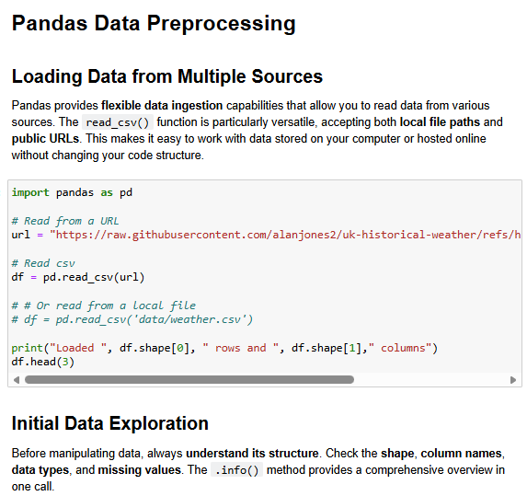
Demonstration
To show these steps, we are going to work through an example
Material to follow along: slides_pandas_preprocessing.ipynb
Slide 3/5

Slide 19
Practical
Slide 4/5

Slide 20
Practical
For the rest of today, you must:
Slide 4/5

Slide 21
Practical
For the rest of today, you must:
Read through the material in:
Slide 4/5

Slide 22
Practical
For the rest of today, you must:
Read through the material in: lecture_pandas_preprocessing.ipynb
Slide 4/5

Slide 23
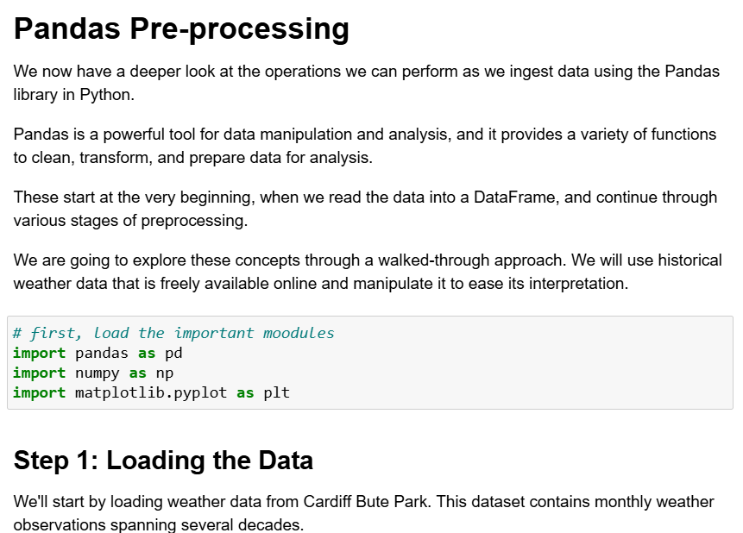
Practical
For the rest of today, you must:
Read through the material in: lecture_pandas_preprocessing.ipynb
Slide 4/5

Slide 24
Practical
For the rest of today, you must:
Read through the material in: lecture_pandas_preprocessing.ipynb
Work through the Pandas exercises in:
Slide 4/5

Slide 25
Practical
For the rest of today, you must:
Read through the material in: lecture_pandas_preprocessing.ipynb
Work through the Pandas exercises in: exercises_pandas_preprocessing.ipynb
Slide 4/5

Slide 26
Next Time
Lecture 12: Pandas Data Preprocessing
Loading Data
Exploratory Investigation
Data Type Conversion
Practical
Lecture 13: Plotting with Pandas
Plotting with Pandas Series
Plotting with Pandas DataFrames
Moving Averages in Pandas
Practical
Slide 5/5

