Slide 1
Lecture 13:
Pandas Plotting
SCIF10002 – Introduction to Coding and Data Analysis for Scientists
Tom Maullin-Sapey
5th February 2026
Slide 0/5

Slide 2
Todays Lecture
Lecture 13: Pandas Plotting
Plotting with Pandas Series
Plotting with Pandas DataFrames
Moving Averages in Pandas
Practical
Lecture 14: Pandas vs NumPy
Indexing and Slicing
Views and Copies
Interoperability
Practical
Slide 1/5

Slide 3
Plotting in Pandas
Slide 2/5

Slide 4

Plotting in Pandas
Slide 2/5

Slide 5

Plotting in Pandas
Slide 2/5

Slide 6
Plotting in Pandas
We’ve now seen the powerful capabilities of Pandas for loading and cleaning various types of data
Slide 2/5

Slide 7
Plotting in Pandas
We’ve now seen the powerful capabilities of Pandas for loading and cleaning various types of data
Back in Lecture 8, we saw that matplotlib can be used to create a range of different plots in python.
Slide 2/5

Slide 8

Plotting in Pandas
We’ve now seen the powerful capabilities of Pandas for loading and cleaning various types of data
Back in Lecture 8, we saw that matplotlib can be used to create a range of different plots in python.
Slide 2/5

Slide 9
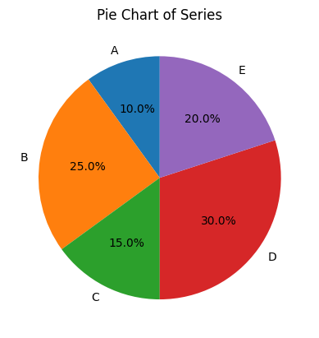
Plotting in Pandas
We’ve now seen the powerful capabilities of Pandas for loading and cleaning various types of data
Back in Lecture 8, we saw that matplotlib can be used to create a range of different plots in python.
Slide 2/5

Slide 10
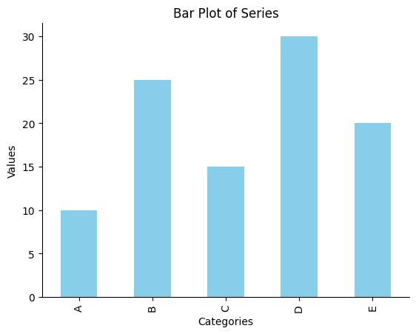
Plotting in Pandas
We’ve now seen the powerful capabilities of Pandas for loading and cleaning various types of data
Back in Lecture 8, we saw that matplotlib can be used to create a range of different plots in python.
Slide 2/5

Slide 11
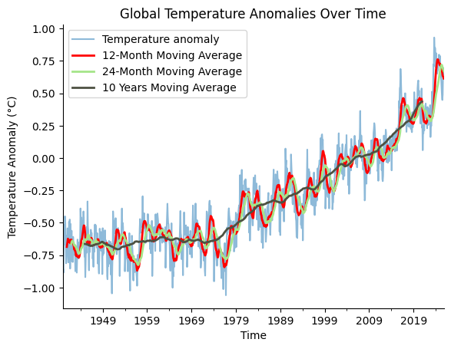
Plotting in Pandas
We’ve now seen the powerful capabilities of Pandas for loading and cleaning various types of data
Back in Lecture 8, we saw that matplotlib can be used to create a range of different plots in python.
Slide 2/5

Slide 12
Plotting in Pandas
We’ve now seen the powerful capabilities of Pandas for loading and cleaning various types of data
Back in Lecture 8, we saw that matplotlib can be used to create a range of different plots in python.
It turns out that many of the functions from matplotlib are built in in Pandas.
Slide 2/5

Slide 13
Plotting in Pandas
We’ve now seen the powerful capabilities of Pandas for loading and cleaning various types of data
Back in Lecture 8, we saw that matplotlib can be used to create a range of different plots in python.
It turns out that many of the functions from matplotlib are built in in Pandas.
This is what we will explore today.
Slide 2/5

Slide 14
Demonstration
Slide 3/5

Slide 15
Demonstration
To show the capabilities of Pandas for plotting, we are going to do a demonstration
Slide 3/5

Slide 16
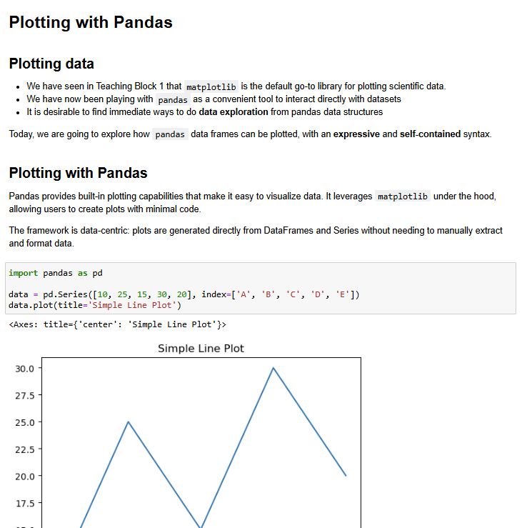
Demonstration
To show the capabilities of Pandas for plotting, we are going to do a demonstration
Slide 3/5

Slide 17
Demonstration
To show the capabilities of Pandas for plotting, we are going to do a demonstration
Material to follow along:
Slide 3/5

Slide 18
Demonstration
To show the capabilities of Pandas for plotting, we are going to do a demonstration
Material to follow along: slides_pandas_plotting.ipynb
Slide 3/5

Slide 19
Practical
Slide 4/5

Slide 20
Practical
For the rest of today, you must:
Slide 4/5

Slide 21
Practical
For the rest of today, you must:
Read through the material in:
Slide 4/5

Slide 22
Practical
For the rest of today, you must:
Read through the material in: lecture_pandas_plotting.ipynb
Slide 4/5

Slide 23
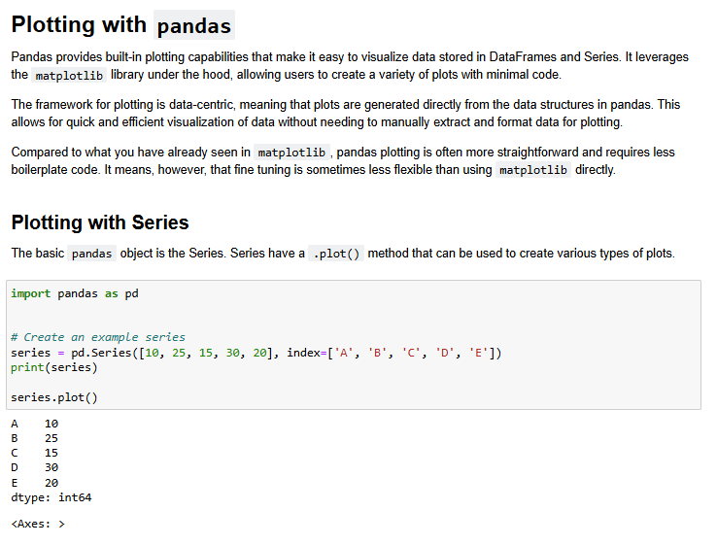
Practical
For the rest of today, you must:
Read through the material in: lecture_pandas_plotting.ipynb
Slide 4/5

Slide 24
Practical
For the rest of today, you must:
Read through the material in: lecture_pandas_plotting.ipynb
Work through the Pandas exercises in:
Slide 4/5

Slide 25
Practical
For the rest of today, you must:
Read through the material in: lecture_pandas_plotting.ipynb
Work through the Pandas exercises in: exercises_pandas_plotting.ipynb
Slide 4/5

Slide 26
Next Time
Lecture 13: Pandas Plotting
Plotting with Pandas Series
Plotting with Pandas DataFrames
Moving Averages in Pandas
Practical
Lecture 14: Pandas vs NumPy
Indexing and Slicing
Views and Copies
Interoperability
Practical
Slide 5/5

