Slide 1

Oil Price and Geopolitical Event API
Thomas Onions (sc23to2)

Slide 2
Project Overview
API created in Python, using FastAPI, and backend SQL Database
Focus on Security By Design Uses HMAC Signing and API Key authentication
Provides all CRUD operations, as well as filtering, sorting and analytics

Slide 3
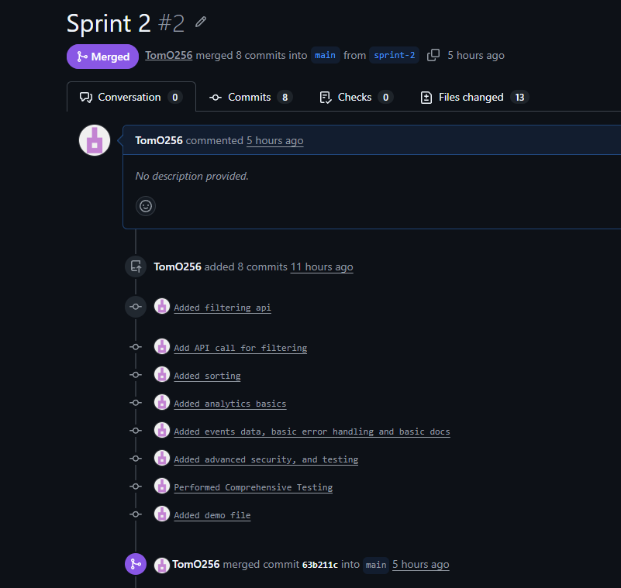
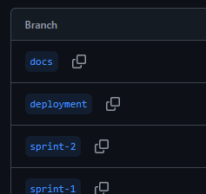
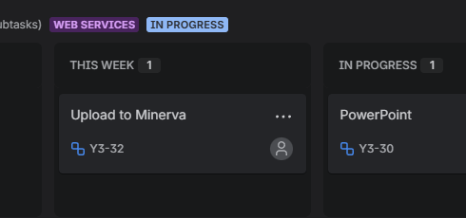
Version Control and Agile Methodology
Use of GitHub for version control, including use of pull requests and meaningful commit names
Use of Agile Methodology, including KanBan and sprint cycles to organise and govern workflow

Slide 4
API Documentation
Automatically documenting code through the use of FastAPI, generating OpenAPI documentation
Covers all endpoints, events, analytics and CRUD options
Includes example requests, and authentication method (also available in the README.md)
Interactive testing and simulation provided through the SwaggerUI interface at: https://81.109.22.44:7578/docs

Slide 5
Technical Report Highlights
Technical Report Highlights
Self created server, hosted on a Raspberry Pi, giving high privacy and ownership of the server
Secure by Design approach – HMAC request signing for secure requests, IP-based rate limiting
CRUD Operations fully functional, with additional options for filtering, sorting and analysis
Call out to multiple different Kaggle datasets, and accumulated in multiple database tables

Slide 6
Demonstration
Demonstration of the run_tests.py and demo.py files, calling out to live endpoint.
Opportunity to see API Docs on live server

Slide 7

Q&A

Slide 8
All Deliverables
GitHub: https://github.com/TomO256/webservcw
API Docs: https://github.com/TomO256/webservcw/blob/main/docs/API%20Docs.pdf
Report: https://github.com/TomO256/webservcw/blob/main/docs/report.pdf

