Slide 1
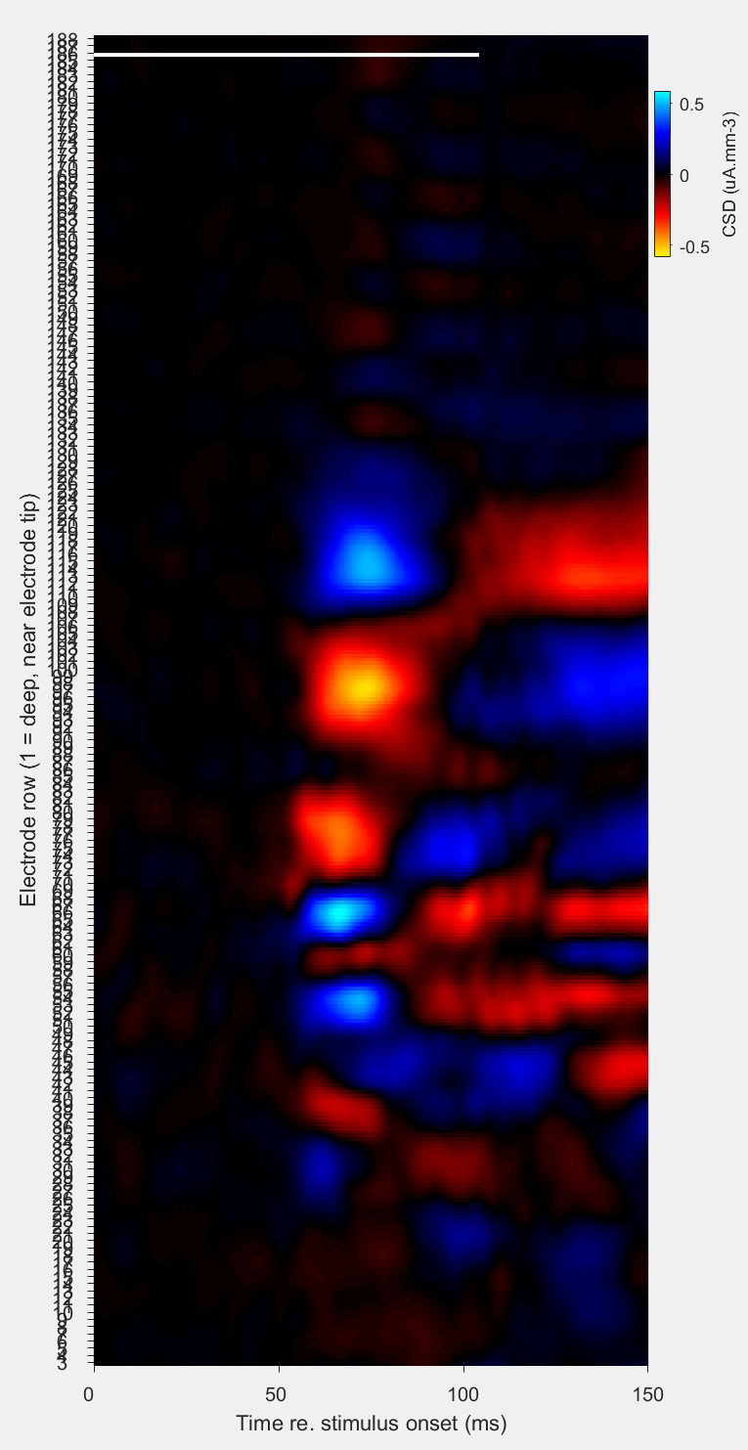
superficial layers
current sink with shortest latency = estimate of granular layers (=input layer, = cortical layer 4)
deep layers

