Slide 1
Housing Price Index (HPI) Analysis, 2000 to 2019
Thomas McGuire, Jake Kaczynski, Anousha Zafaripour, Ryan Geary
IST 687 Final Project; Fall 2020
Notes:
Remember to submit on LMS

Slide 2
Housing Price Index (HPI) Analysis, 2000 to 2019
Defining and Visualizing Housing Price Index
Analyzing Input Variables: Population Density, Median Income & Crime
Modeling HPI using Linear Regression and Machine Learning (KSVM)

Slide 3
Housing Price Index (HPI) Analysis, 2000 to 2019
Defining and Visualizing Housing Price Index
Analyzing Input Variables: Population Density, Median Income & Crime
Modeling HPI using Linear Regression and Machine Learning (KSVM)

Slide 4
Housing Price Indices
What is it? What does it measure?
Housing Price Index measures average price changes in repeat sales or refinancings on the same single-family house prices over time. The way to read the HPI number is as a percent change extending from when tracking began in the mid-1970s¹.
Define other input variables and descriptive stats on those variables
State Population, Total Area (Pop Density), Median Income, Violent Crimes,
Visualizations of these by state, over time?
Build linear regression model to see if the above variables influence HPI with statistical significance
Build a ML model to predict HPI given the above variables.
Notes:
1: Federal Housing Financing Agency (FHFA): https://www.fhfa.gov/DataTools/Downloads/Pages/House-Price-Index.aspx#:~:text=The%20FHFA%20HPI%20is%20a,refinancings%20on%20the%20same%20properties

Slide 5
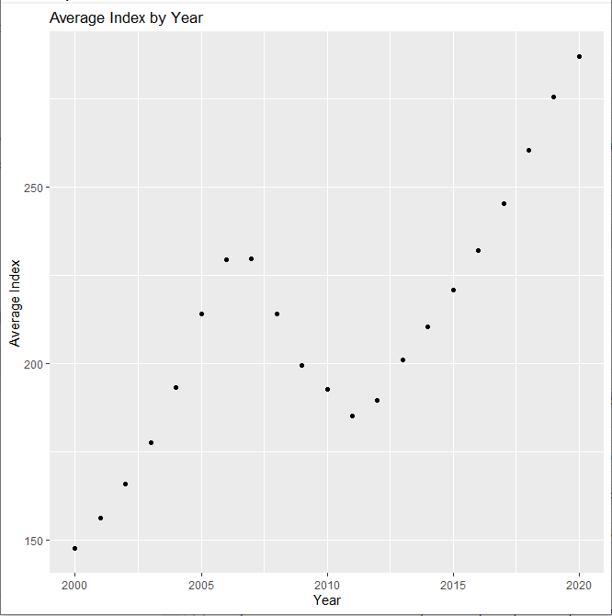
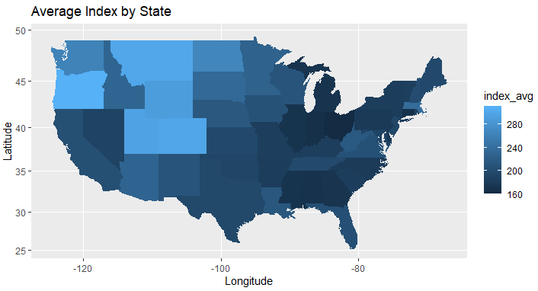
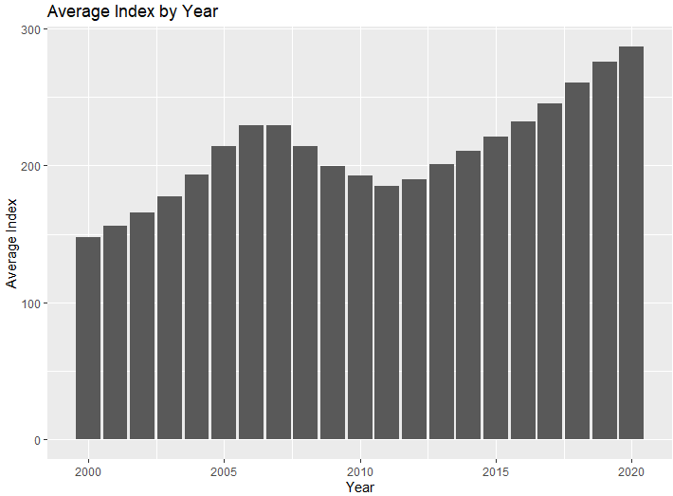
Average HPI by State & by Year

Slide 6
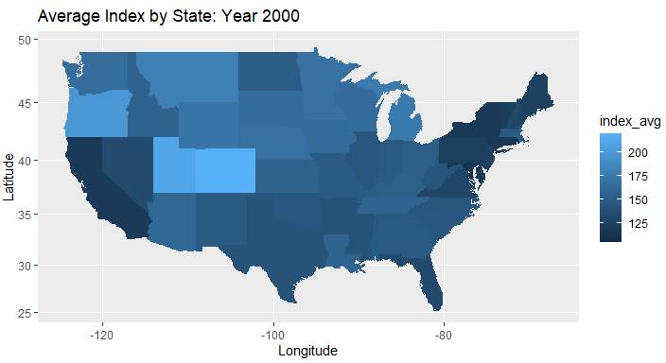
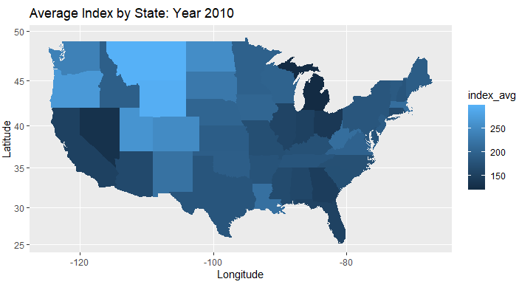
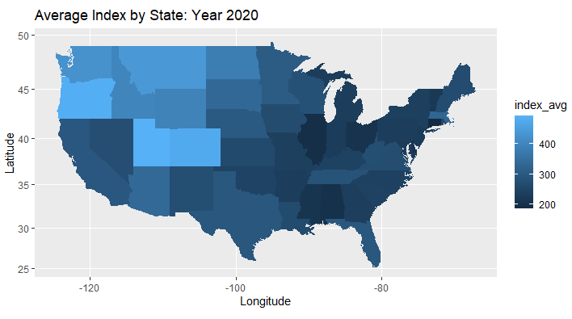

Slide 7
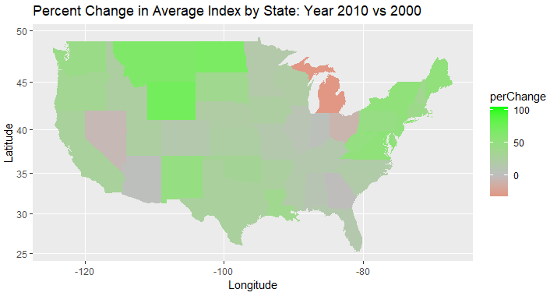
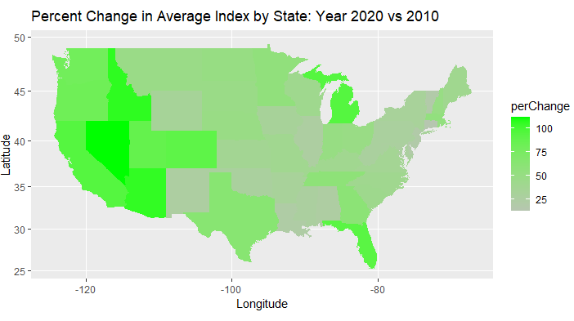
Percent Change in Avg. by State

Slide 8
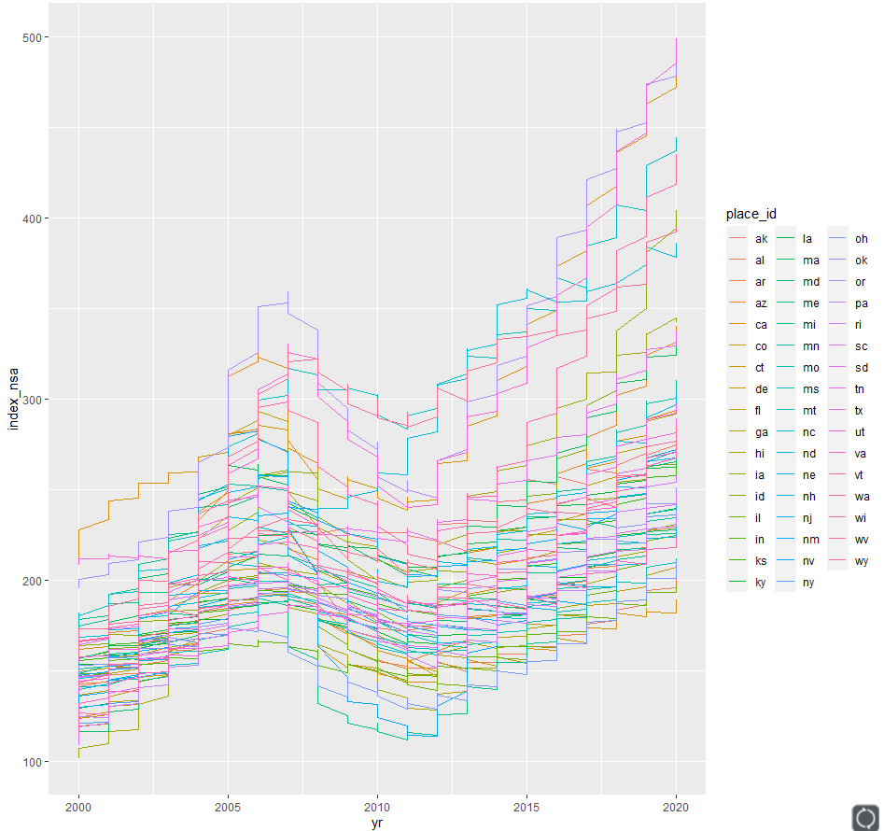
Average HPI by State

Slide 9
Housing Price Index (HPI) Analysis, 2000 to 2019
Defining and Visualizing Housing Price Index
Analyzing Input Variables: Population, Density, Median Income & Crime
Modeling HPI using Linear Regression and Machine Learning (KSVM)

Slide 10
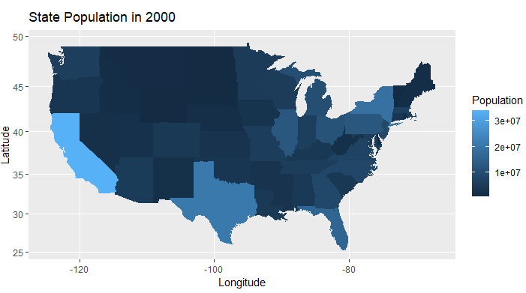
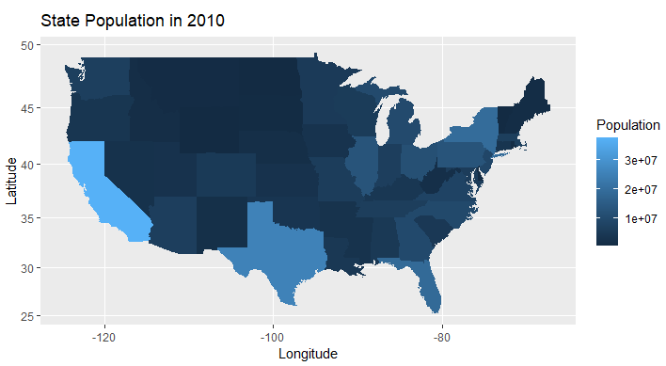

Notes:
State Population 2000, 2010 and 2020

Slide 11
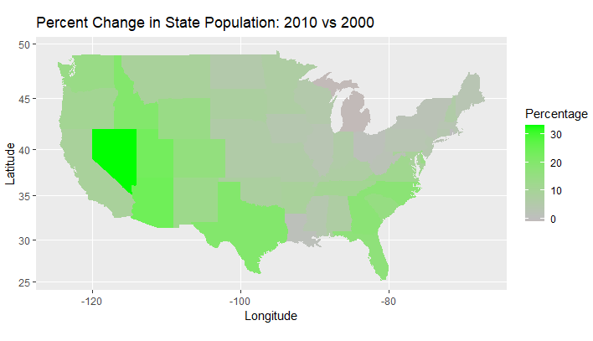
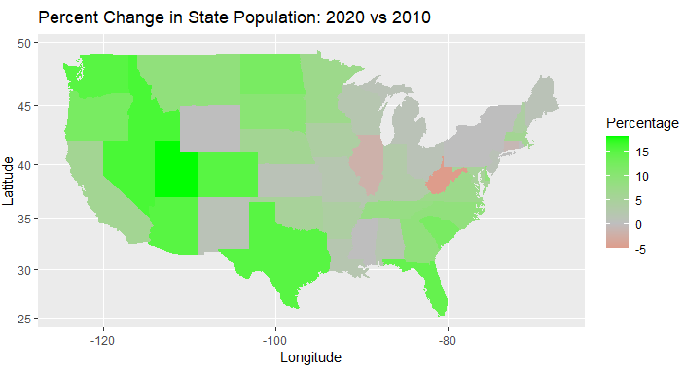
Population Percent Change
Notes:
Percent Change in State Population, 2000-2010, 2010-2020

Slide 12
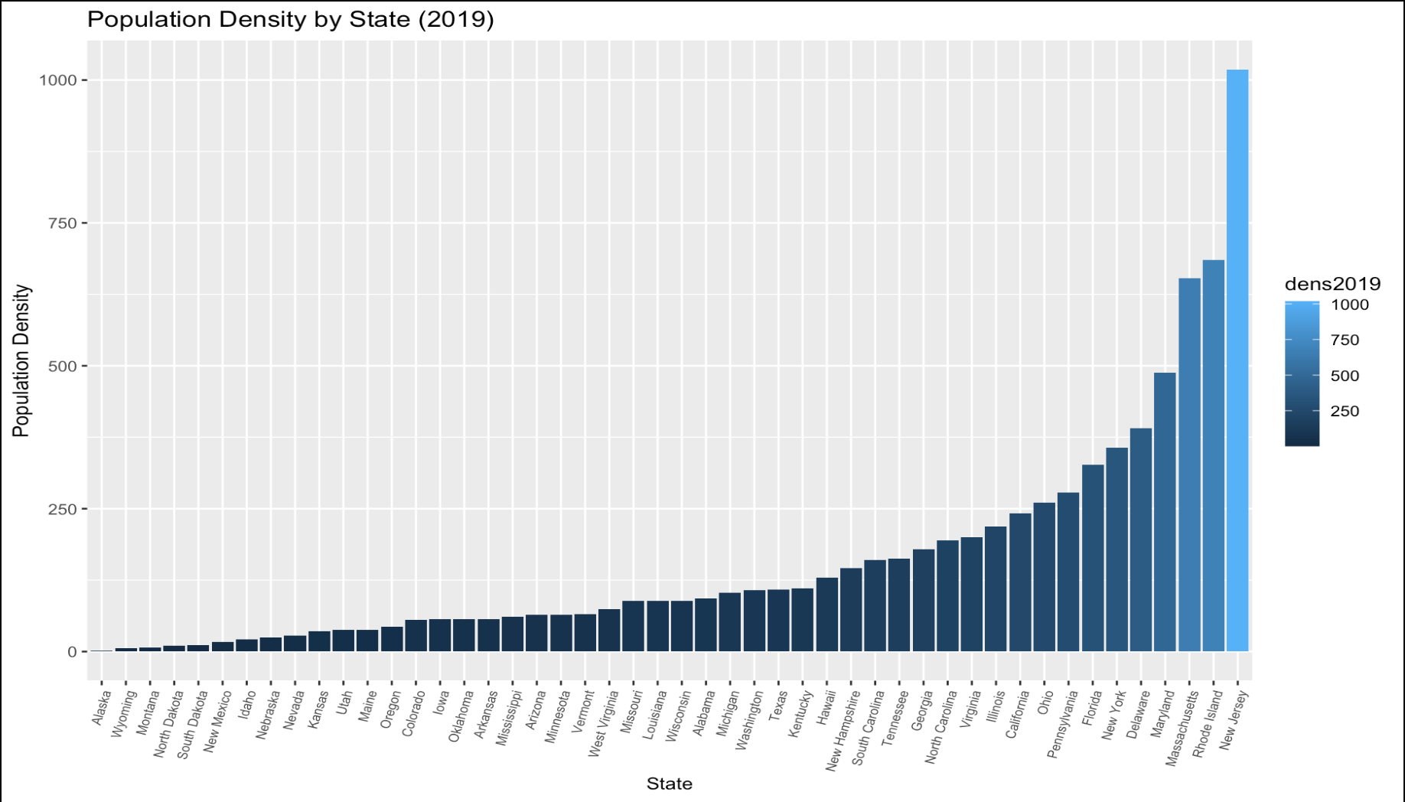
Population Density by State (2019)
Min. : 1.099
1st Qu. : 41.653
Median: 88.826
Mean: 160.671
3rd Qu. : 196.044
Max.: 1018.250
Notes:
Bar Chart of Population Density by state, 2019. Used in linear model and machine learning model

Slide 13
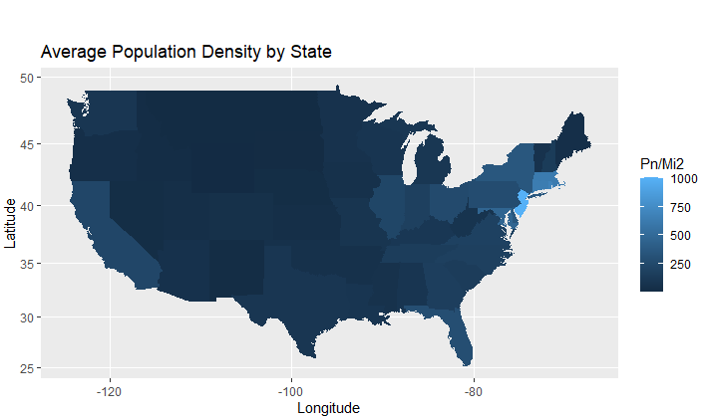
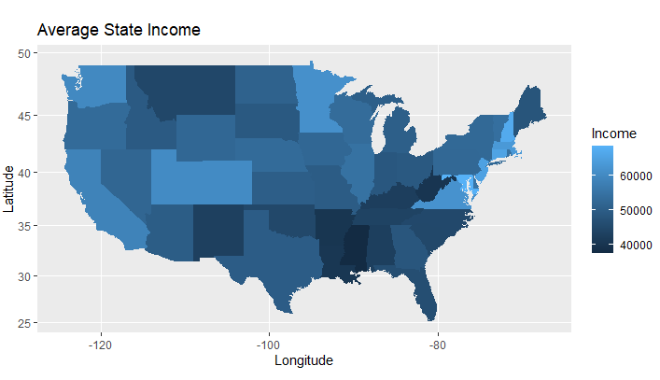
Average Population Density & Average Income by State
Notes:
Average Population Density and Median State Income, 2019

Slide 14
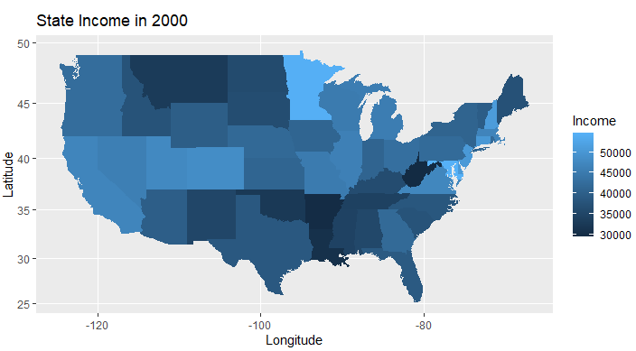
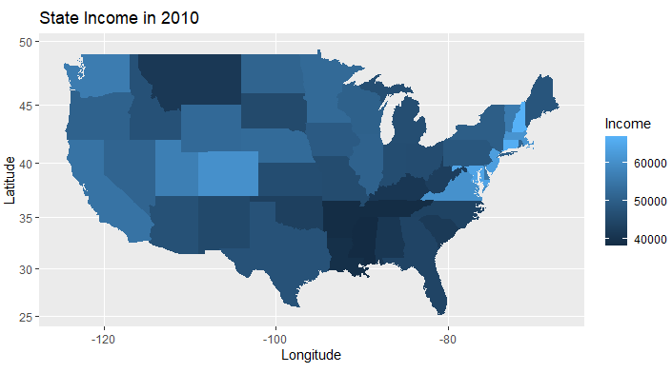
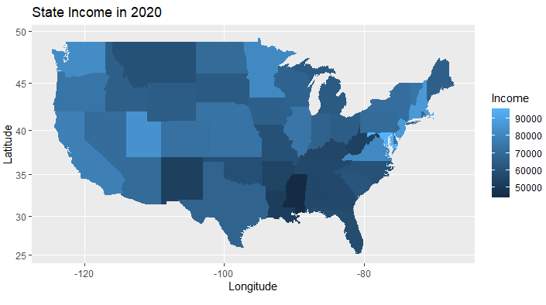
Notes:
State Median Income, 2000, 2010, 2020

Slide 15
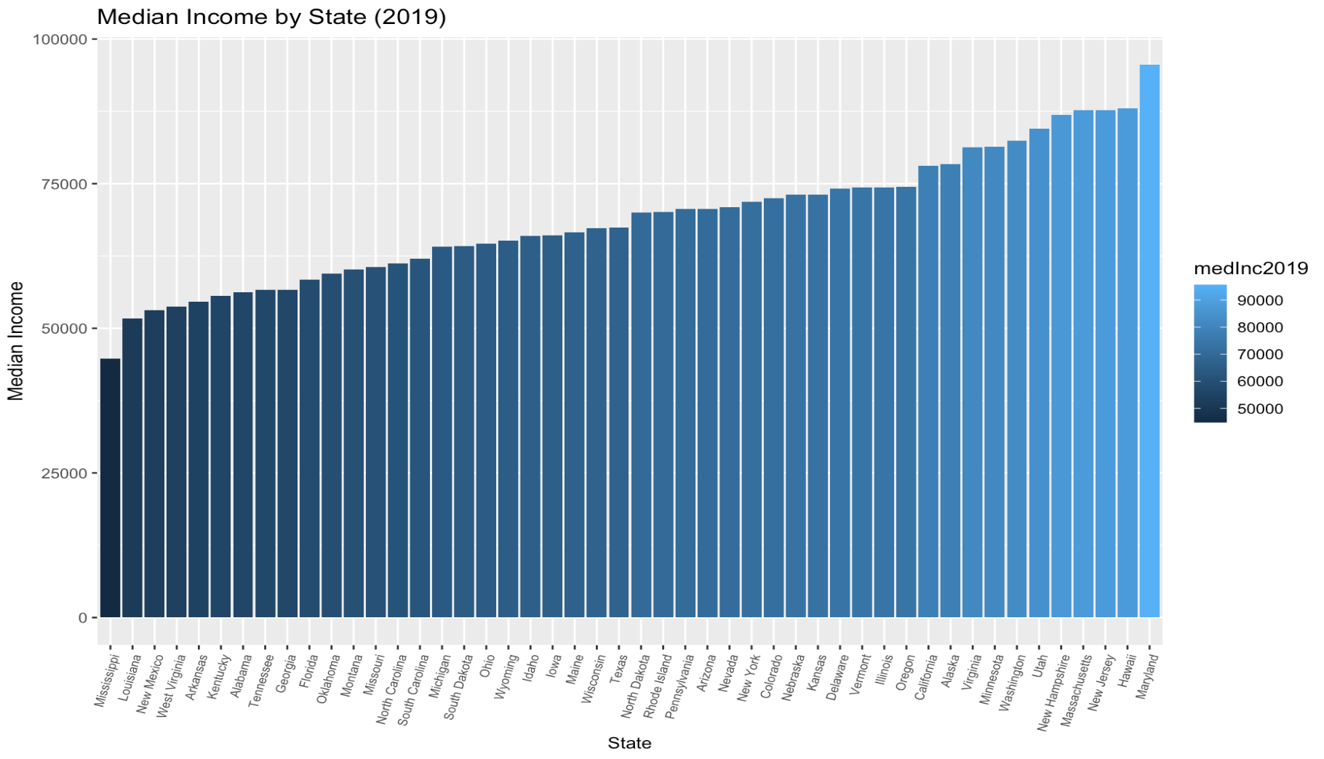
Median Income by State (2019)
Min: $44,787 (Mississippi)
1st Qu: $60,496
Median: $68,738
Mean: $68,930
3rd Qu.: $74,402
Max: $95,572(Maryland)
Notes:
Bar Chart of Median Income by state, 2019. Used in linear model and machine learning model

Slide 16
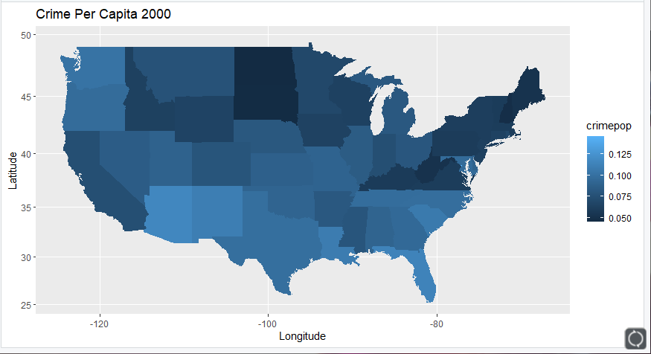
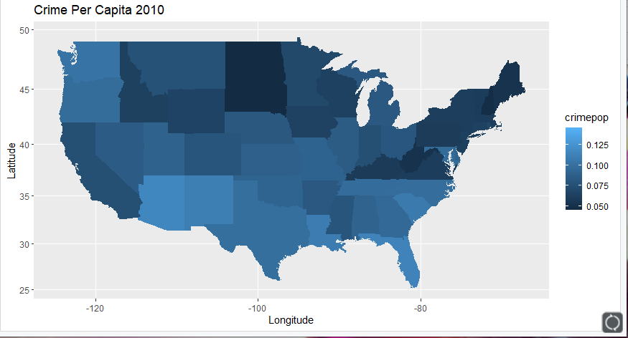
Crime Map 2000 vs Crime 2010
Notes:
State Total Crime per Capita, 2000, 2010

Slide 17
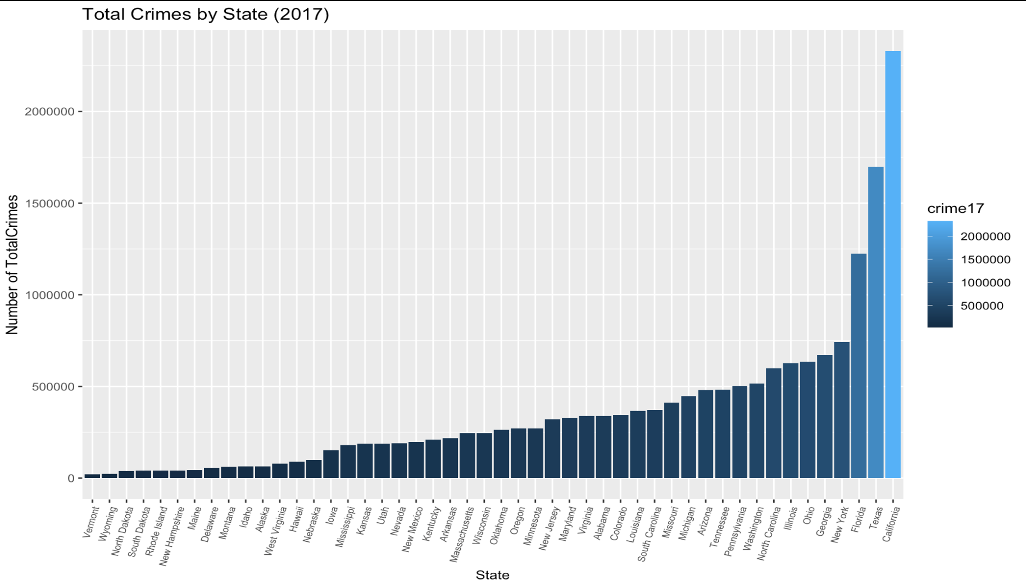
Total Crimes by State (2017)
Min: 19,988 (Vermont)
1st Qu: 85,952
Median: 254,341
Mean: 361,716
3rd Qu.: 456,296
Max: 2,329,482 (California)
Notes:
Bar Chart of Total Crime by state, 2017. Used in linear model and machine learning model

Slide 18
Housing Price Index (HPI) Analysis, 2000 to 2019
Defining and Visualizing Housing Price Index
Analyzing Input Variables: Population Density, Median Income & Crime
Modeling HPI using Linear Regression and Machine Learning (KSVM)

Slide 19
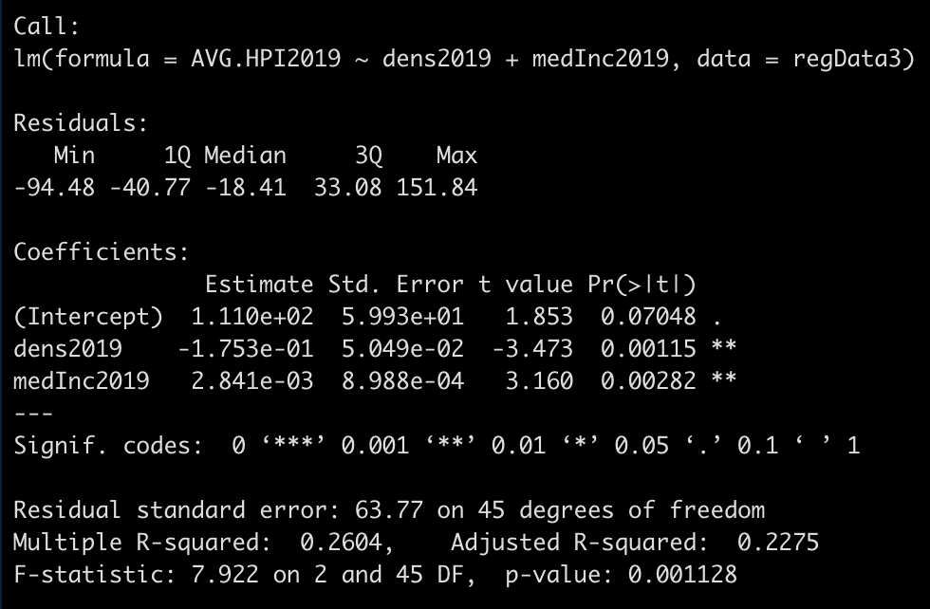
Linear Model
AverageHPI = - 0.175*den2019 + 2841*medInc2019 + 111
F-stat p-value: 0.001
Both variables significant
R-Squared is bad (26%)
Took Crime out because the coefficient was insignificant and it made the model worse.
Notes:
Linear regression model: Using Population Density (2019) and Median Income (2019) to predict average HPI for 2019. Crime was taken out of the model because it wasnt significant and made the model even worse than it already is, which is pretty bad.

Slide 20
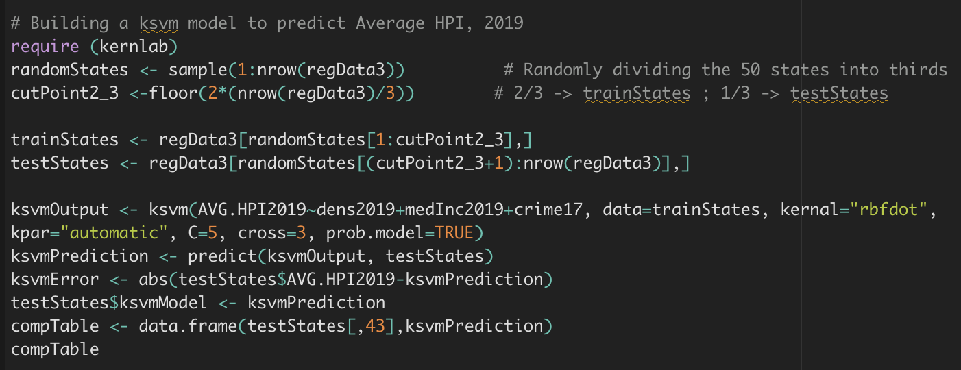
Machine Learning (using KSVM to predict HPI)

Slide 21
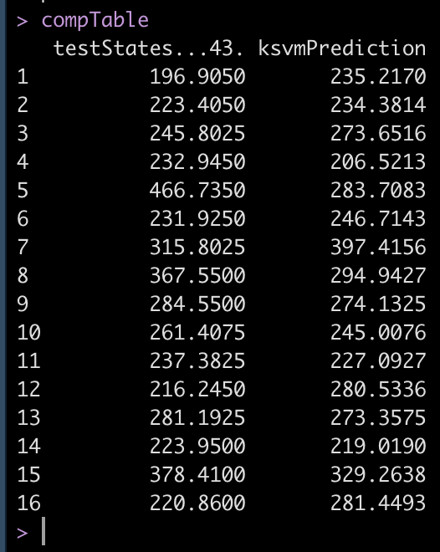
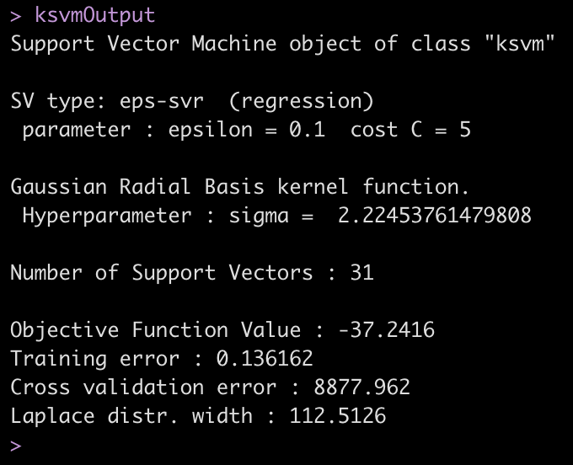
Machine Learning (using KSVM to predict HPI)
Notes:
KSVM prediction versus actual average hpi in states for 2019, where each case is a unique state.

Slide 22
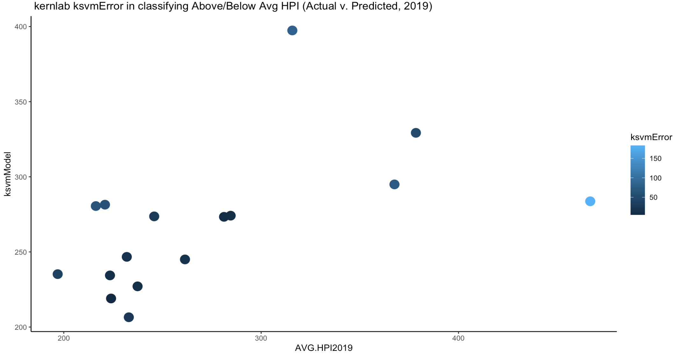
GGplot of Avg. HPI Vs. Predicted HPI
Notes:
Ggplot of actual average hpi v. predicted average hpi from test states (sample of 16 random states). Model uses crime, medInc, and density. Darker dots have smaller error. Model does a much poorer job predicting at higher values of Average HPI than it does for lower values. -Jake

Slide 23
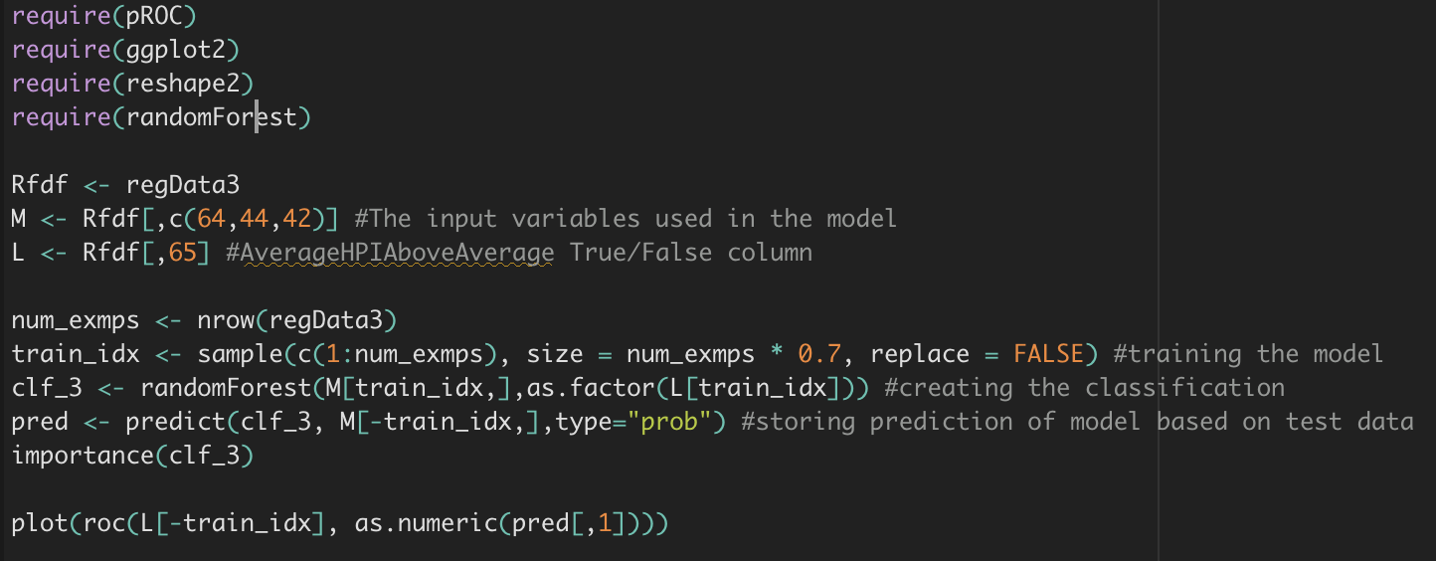
Machine Learning (Second Try using Random Forest)
Notes:
Accidently used the training data set for the prediction instead of the test data set.

Slide 24
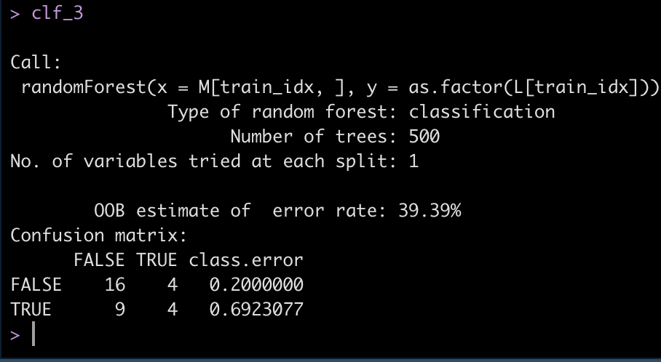
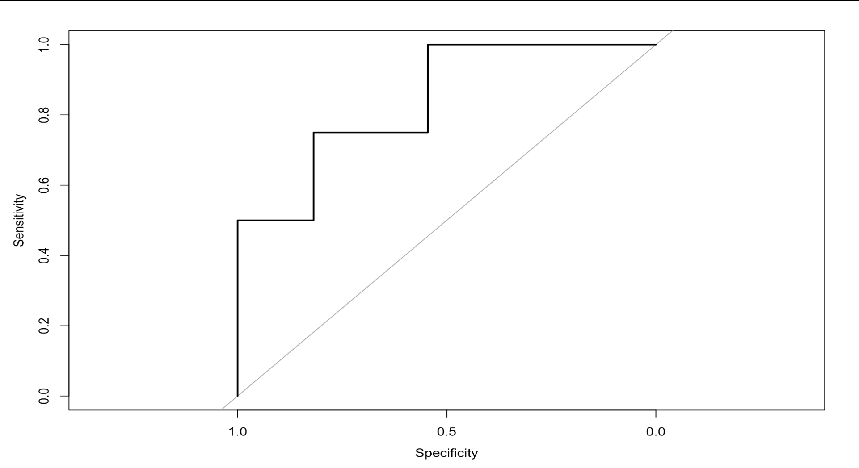
Notes:
The model correctly predicted 16 out of 20 states that were below average HPI, but only 4 of 13 states that were above HPI. Each case is a state, so we’re limited by the amount of states. 50 states is a small sample set and the model is sensative outliers because the training data set is only 16 states.

Slide 25
Housing Price Index (HPI) Analysis, 2000 to 2019
Thomas McGuire, Jake Kaczynski, Anousha Zafaripour, Ryan Geary
IST 687 Final Project; Fall 2020

