Slide 1
Diagrams

Slide 2
Spectrogram Flow Diagram
STFT
Waveform
Frame sampling
Padding
Window function
DFT
Spectrogram

Slide 3
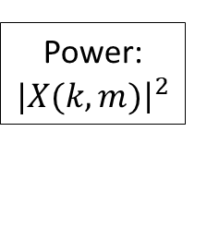
Log-Mel Spectrogram Flow Diagram
STFT
Waveform
Frame sampling
Padding
Window function
DFT
Power: $|X(k,m){\left.​\right|}^{2}$
Power Spectrogram
Mel Filterbank
log/dB scale
Log-Mel Spectrogram

