Slide 1
Labeled data
Data preprocessing
Model training
Modify parameters
Validate model
Output: Model
Training and validating
fail
pass
Testing
Unseen dataset
Trained model
Predicted result

Slide 2
Preprocessed data
Convolution
Pooling
96 filters, size 11x11, stride 4, padding 2
Fully connected layer
size 3x3 filter, stride 2
192 filters, size 5x5, stride 1, padding 2
size 3x3 filter, stride 2
288 filters, size 3x3, stride 1, padding 1
CNN Model
288 filters, size 3x3, stride 1, padding 1
192 filters, size 3x3, stride 1, padding 1
size 3x3, stride 2
4096 neurons
5 neurons
Output

Slide 3
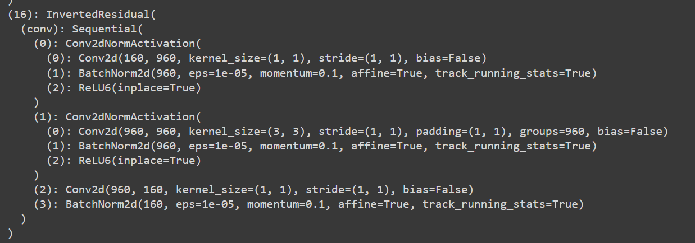

Slide 4
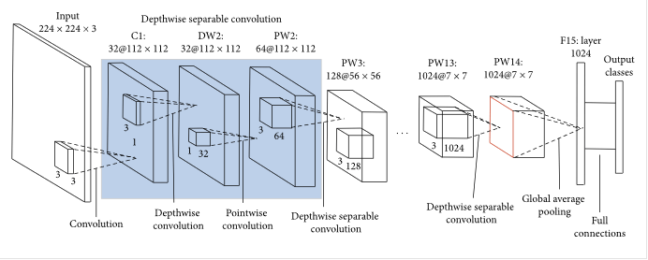

Base MobileNet V2 model
Freeze the first 15 layers
Linear with Dropout
Our model with custom classifier and fine-tuning

Slide 5
Labeled data
Augmented data
(6 classes * 900 images per class)
Data augmentation
Pretrained
MobileNet V2
Fine-tuning
Customization
My model
Train on the augmented dataset
Trained weight
Save the weight and feed it to the local model
End
User start
Choose a demo image using UI
Pass the image through the model
My model
Output: predicted category of waste.
Perform classification

Slide 6
conv2d
batchnorm2d
ReLU6
Inverted residual
Inverted residual
.
.
17 inverted residual blocks
.
Inverted residual
conv2d
batchnorm2d
ReLU6
dropout
linear(1280, 6)

