Slide 1
MARS ROVER
Project by: Nodari Francesco, Tommaso Agosti, Davide Wu and Alessio Wu

Slide 2
System basic workflow
The hole robot was produced using a 3D printer.
Using the MSP432 boosterpack potentiometer we are able to control the robot movement, as a master; the informations are passed to the computer, via cable, and then to the hc05 via bluetooth.
The Arduino Uno, the slave, which will move accordingly to the commands.
An ultrasonic sensor, is mounted to detect the object near the rover and sends an interrupt if it is too close.

Slide 3
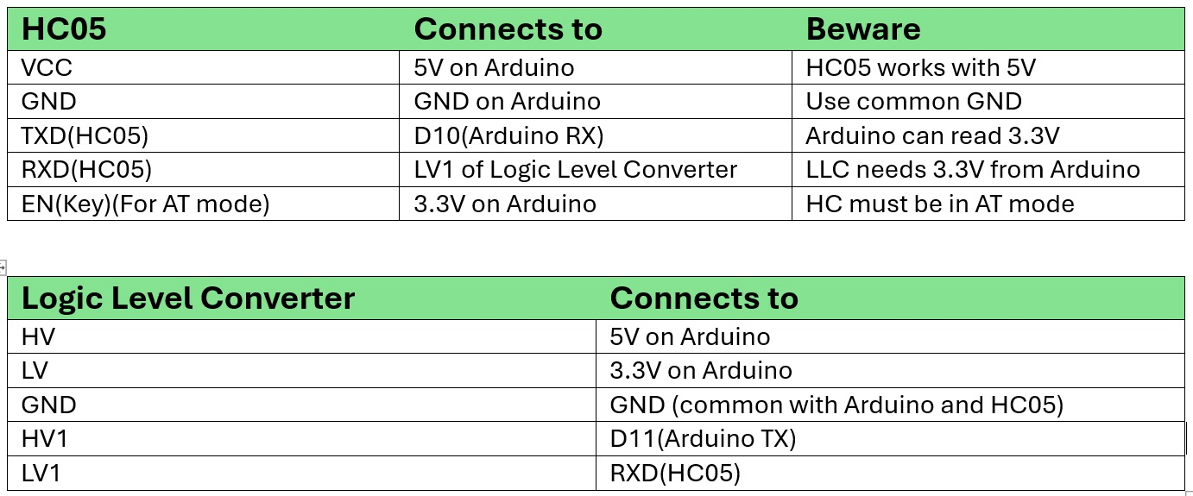
Project circuit pins scheme

Slide 4
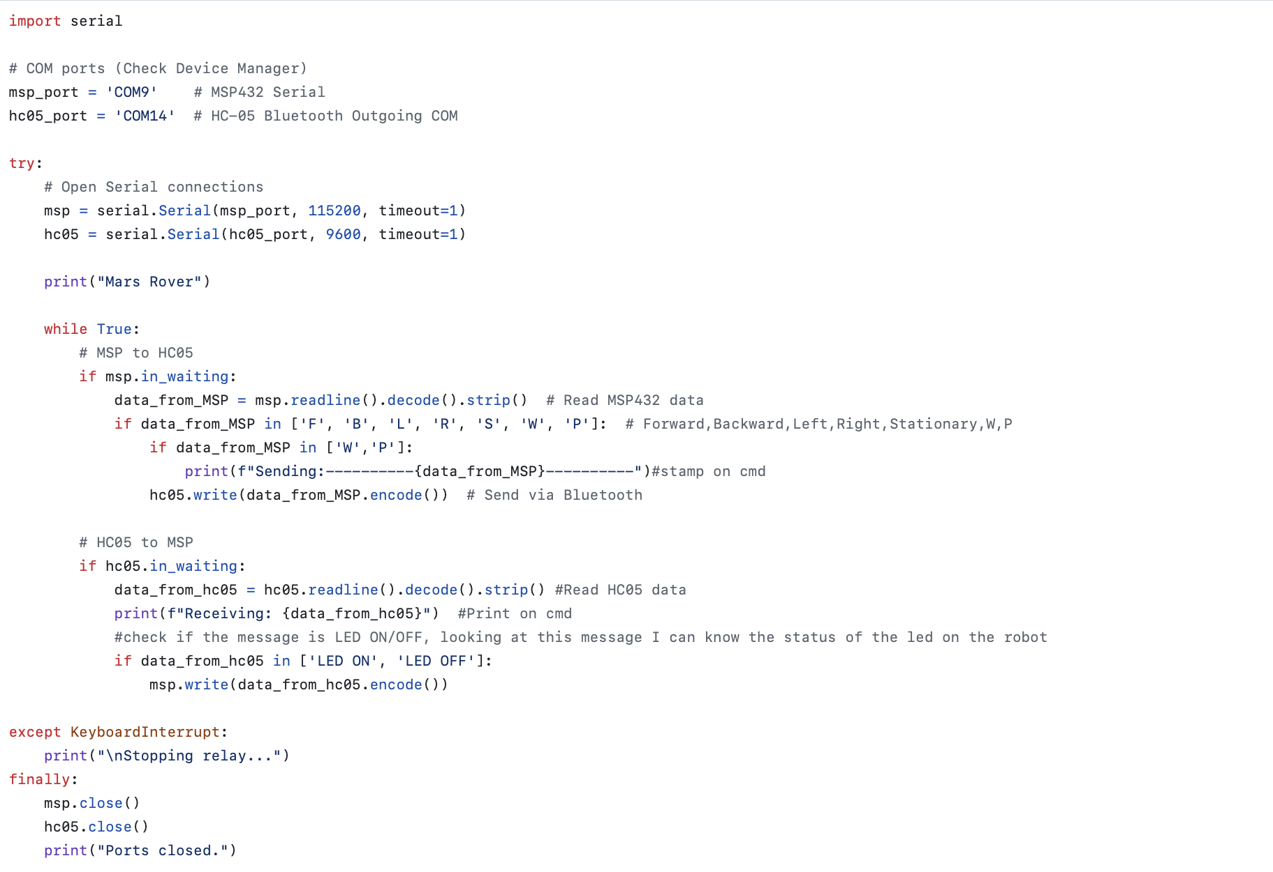
Bluetooth connection summary

Slide 5
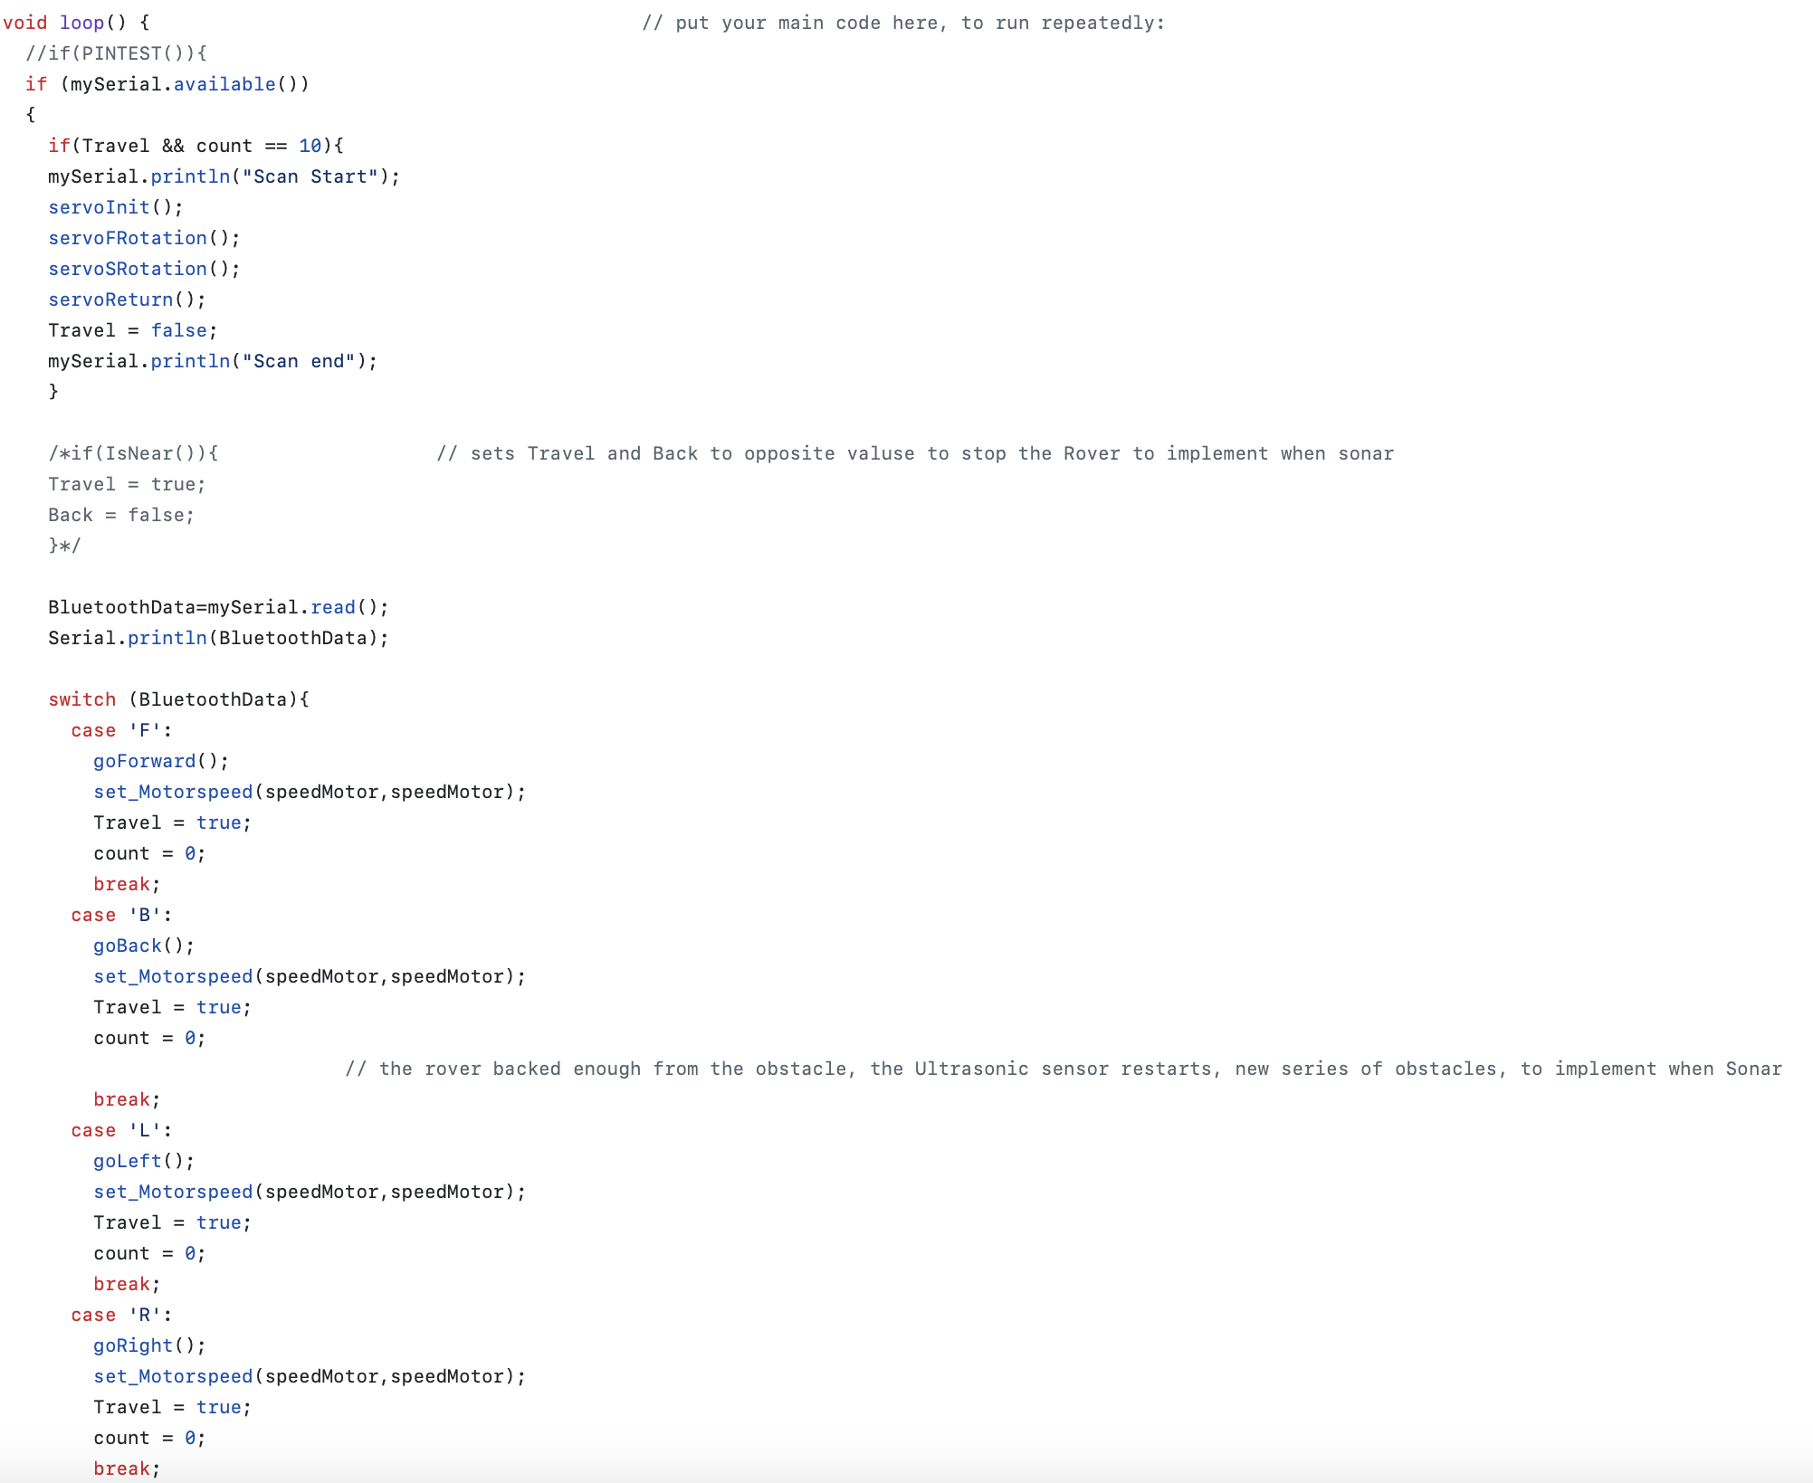
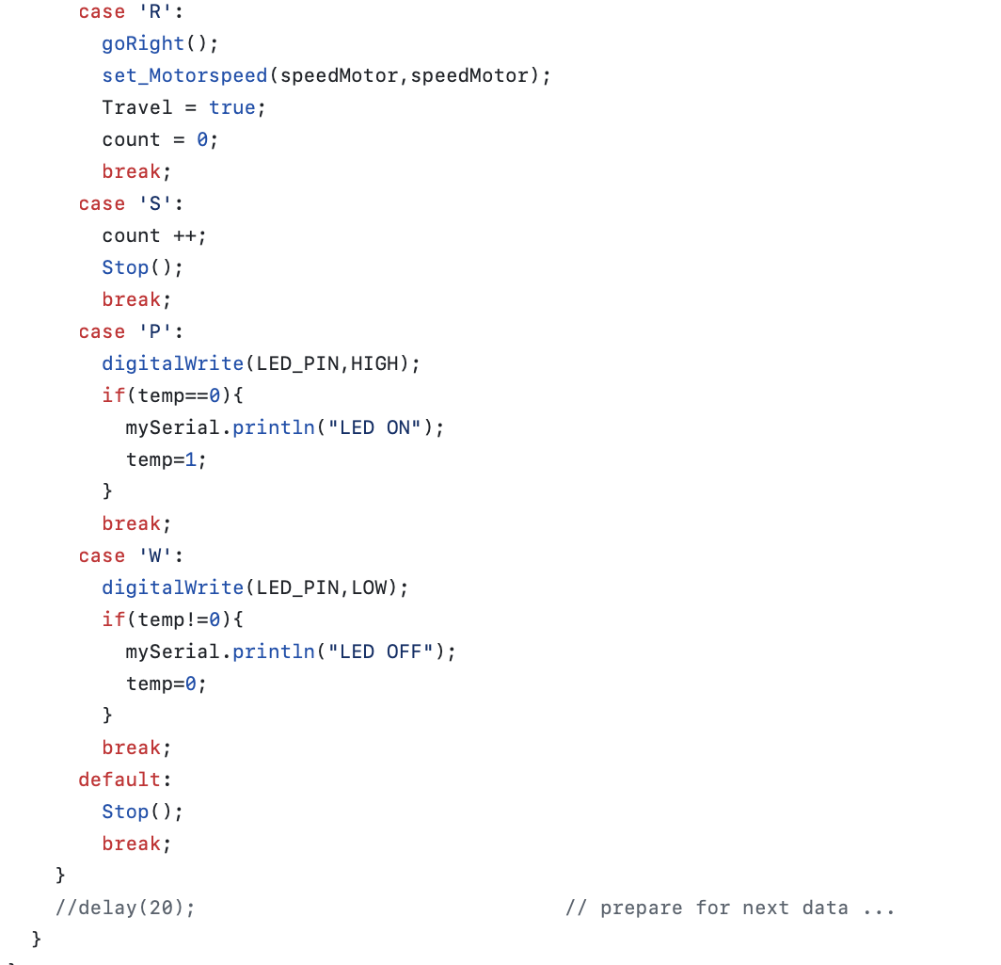
Part of Rover’s movement

Slide 6
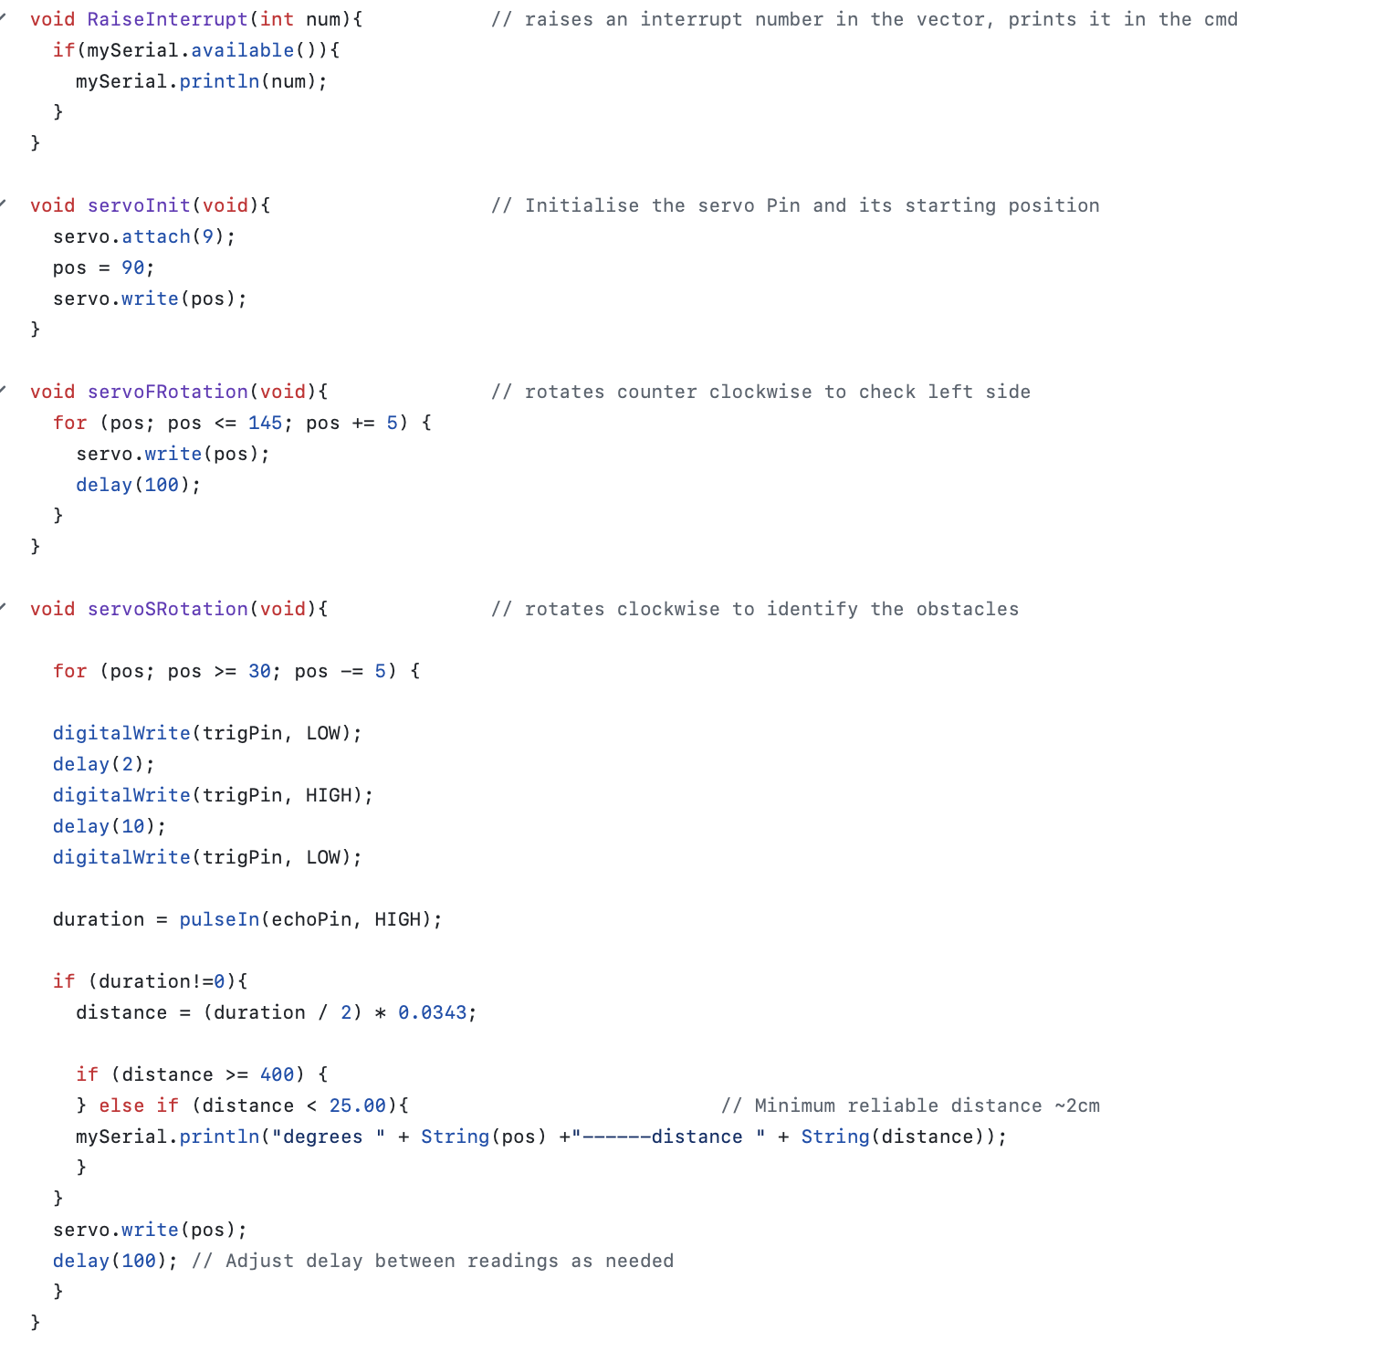
Part of Ultrasonic Sensor

Slide 7
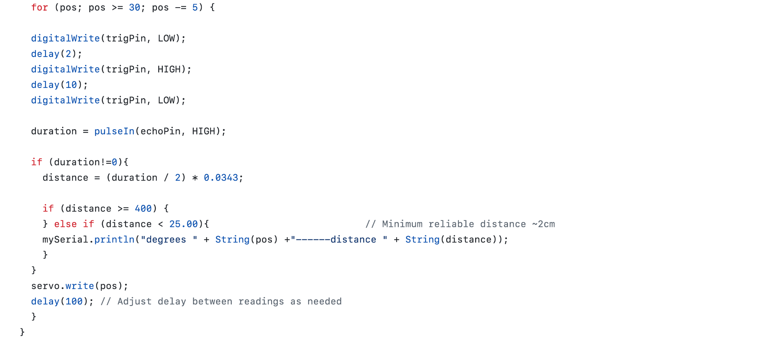
Message Passing

