Slide 1
Course work on the topic: Floyd’s algorithm
Veselskiy Olexiy

Slide 2
Aims
The main aims of these work are:
to improve skills in programming
to learn to write documentation for software products
to practice in using knowledge, gotten while taking a course
to learn to look for solutions of problems and to choose the best ones among them

Slide 3
Task
My task was to create a program, which can visualize the using of Floyd’s algorithm. To complete this task, I need to take the next steps:
Look for ways to complete different parts of program in information sources.
Choose the best solutions among found.
Design the program, build the block-schemes for its parts.
Write program’s code.
Create user interface.
Test the program.
Make a conclusions.

Slide 4
Chosen solutions
For outputting the matrixes I chose HTML-document. My program will write HTML-code into it, and then it will be opened with browser.
For inputting data I chose two ways: from table built on form, and from text file.

Slide 5
How Floyd’s algorithm works
for k = 1 to n
for i = 1 to n
for j = 1 to n
W[i][j] = min(W[i][j], W[i][k] + W[k][j])

Slide 6
Main part of program
Start
Output initial state of matrix
…
…
…
New is shorter
Change value and mark it
Output current state of matrix
Open result file
End

Slide 7
Additional functions
Plus
CountSymbols
FindMax
CreateTable

Slide 8
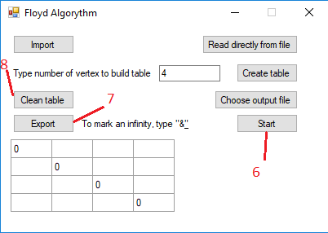
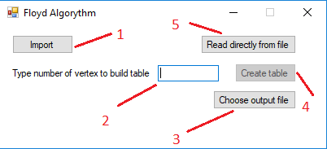
User interface

Slide 9
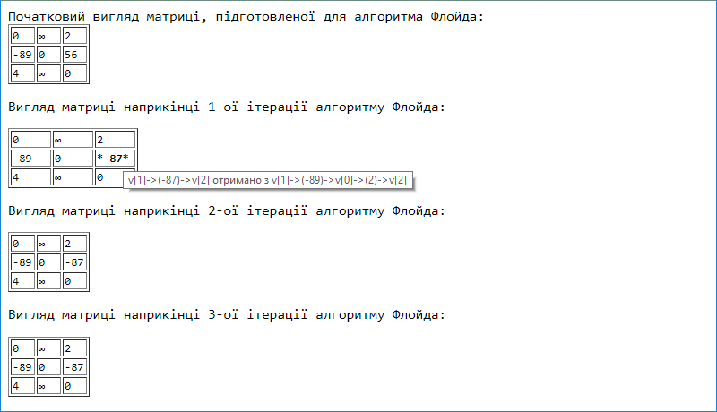
Program’s output

Slide 10
Conclusions
So, I created a software product and wrote documentation for it. I got a invaluable experience, improved my skills in solving problems, choosing the best solutions, and programing. My program can be useful for educational purpose and for solving any tasks that need finding shortest paths in graph.

Slide 11
Thank you for attention!

