Slide 1




ROCKBUSTER STEALTH LLC
z
2020 COMPANY STRATEGY
Tom Radio 6/15/2023

Slide 2

z
INTRODUCTION
Rockbuster Stealth LLC is a renowned movie rental company that once dominated the global market with its brick-and-mortar stores. However, in the face of relentless competition posed by streaming giants like Netflix and Amazon Prime, the visionary management team at Rockbuster Stealth has embarked on a strategic endeavor. Leveraging their extensive collection of movie licenses, they have devised a plan to launch an innovative online video rental service, poised to revolutionize the industry and secure their position amidst fierce rivalry. In this presentation, we will explore the data-driven insights that guided Rockbuster Stealth's decision-making process and unravel the potential impact of this bold transition.
Get ready to embark on an exciting analysis of Rockbuster Stealth's journey towards sustainable competitiveness in the ever-evolving landscape of movie rentals.

Slide 3
SOME BACKGROUND INFORMATION
z
Minimum Rental Duration: 3-Days
Maximum Rental Duration: 7-Days
Average Rental Duration: 5-Days
Minimum Rental Rate: $0.99
Maximum Rental Rate: $4.99
Average Rental Rate: $2.98
Minimum Movie Length: 46-minutes
Maximum Movie Length: 185-minutes
Average Movie Length: 115-minutes
Minimum Replacement Cost: $9.99
Maximum Replacement Cost: $29.99
Average Replacement Cost: $19.98
Total Movie Count: 1000-Movies
Most Common Movie Release Year: “2006”
Most Common Movie MPAA Rating: “PG-13”
Notes: All movies are in English.
All movies were released in 2006.
Movie Genres: Thriller, Sci-Fi, Comedy, War, Family, Games, Crime, Animation, Romance, Documentary, Classics, Sports, New, Children, Music, Travel, Foreign, Horror, Drama, Action.

Slide 4
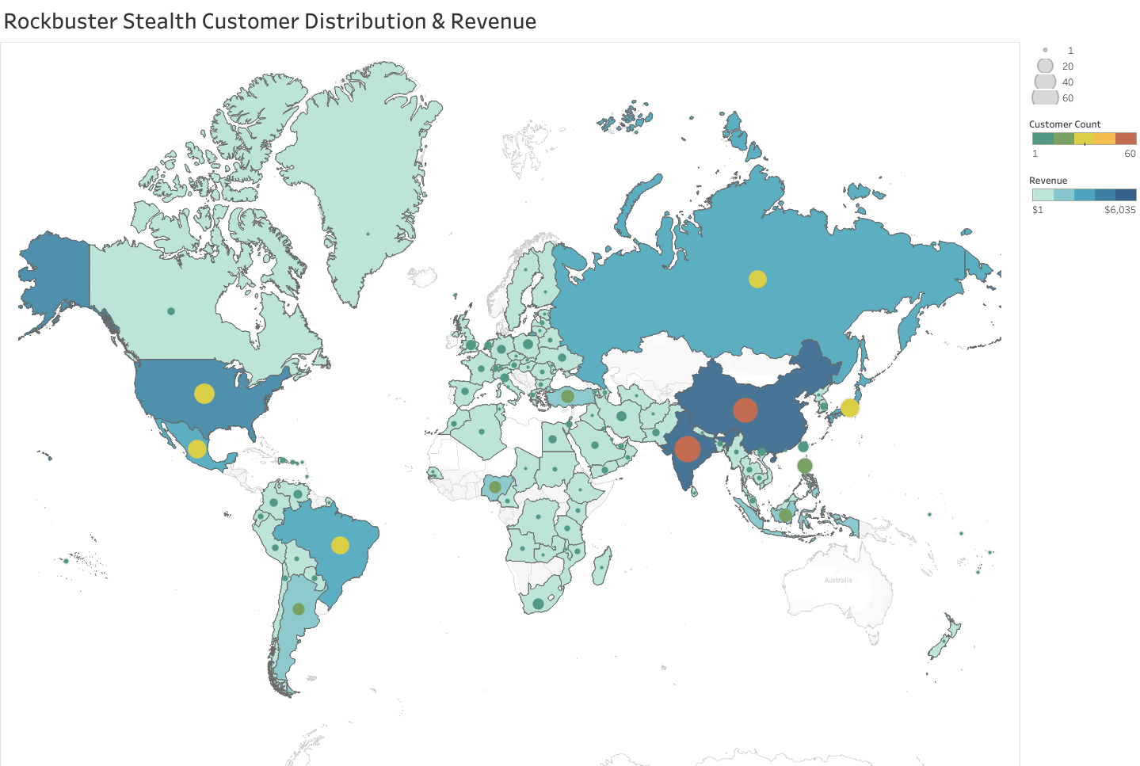
ROCKBUSTER STEALTH CUSTOMER DISTRIBUTION & REVENUE
z

Slide 5
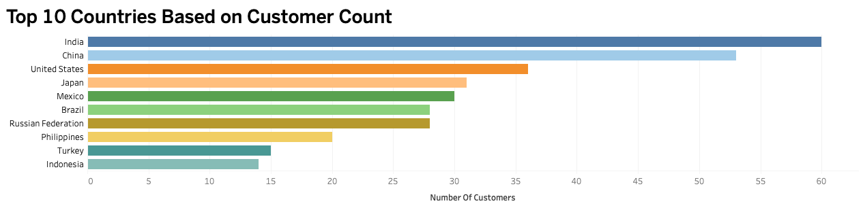
TOP 10 COUNTRIES BY CUSTOMER COUNT
The customer count data allows us to identify the countries where we have the highest concentration of customers, highlighting key markets for our business. Analyzing the customer count in these top 10 countries allows us to allocate resources effectively, tailor marketing strategies, and prioritize our efforts for maximum impact.

Slide 6

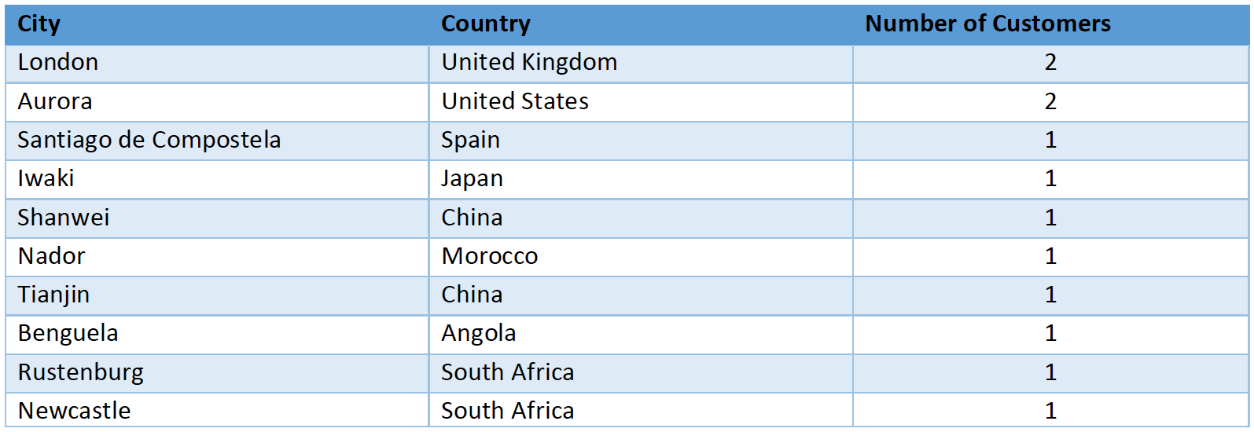
TOP 10 CITIES WITHIN TOP 10 COUNTRIES
Among the top 10 cities, London and Aurora emerge as the leading cities, with both having only 2 customers each.

Slide 7

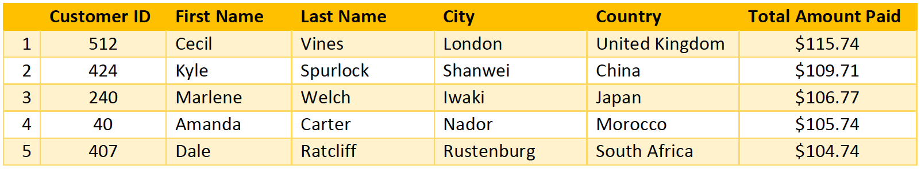
TOP 5 CUSTOMERS WITHIN TOP 10 CITIES
Recognizing the loyalty of our top 5 customers within the top 10 cities allows us to strengthen our customer relationships, inspire others, and foster a culture of loyalty within our customer base. By expressing our gratitude and providing tailored rewards, we create a win-win scenario where both our customers and our business thrive.

Slide 8
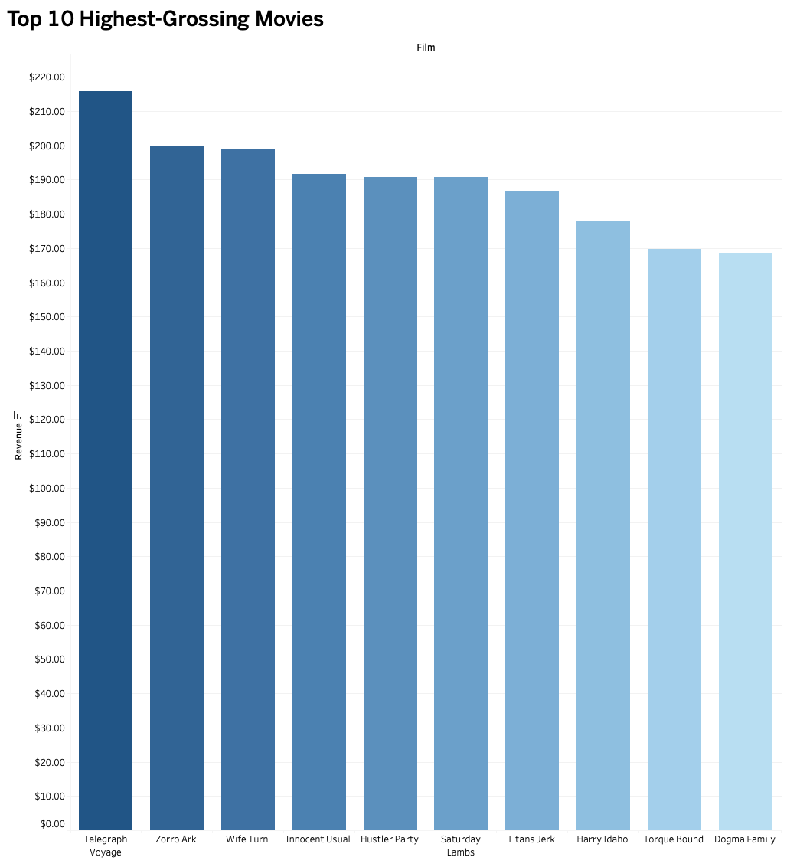

TOP 10 FILMS BY REVENUE
Presented here we have the top 10 highest grossing movies in the Rockbuster Stealth library, showcasing their remarkable financial success and popularity among audiences. These movies have not only captured the hearts of viewers but have also generated substantial revenue for our organization.

Slide 9
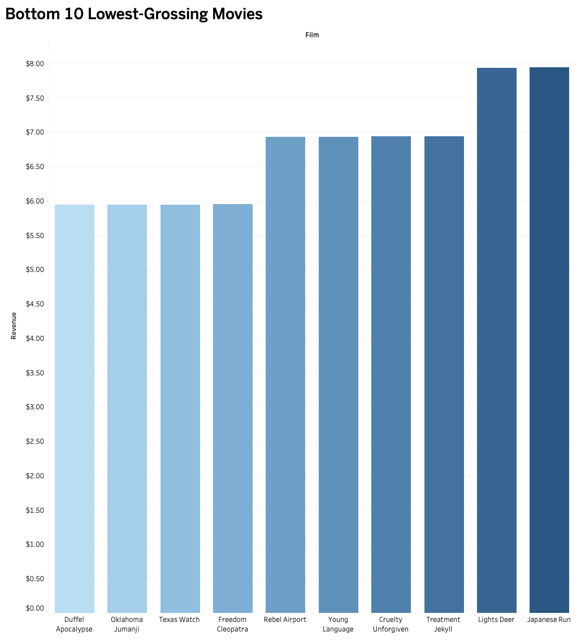

BOTTOM 10 FILMS BY REVENUE
Here we can see the bottom 10 lowest grossing movies in the Rockbuster Stealth library, providing insight into their financial performance within our collection. It is important to note that while these movies may not have generated substantial revenue, they still play a vital role in our library. They cater to diverse tastes, offer alternative viewing experiences, and contribute to the artistic integrity of our collection.

Slide 10
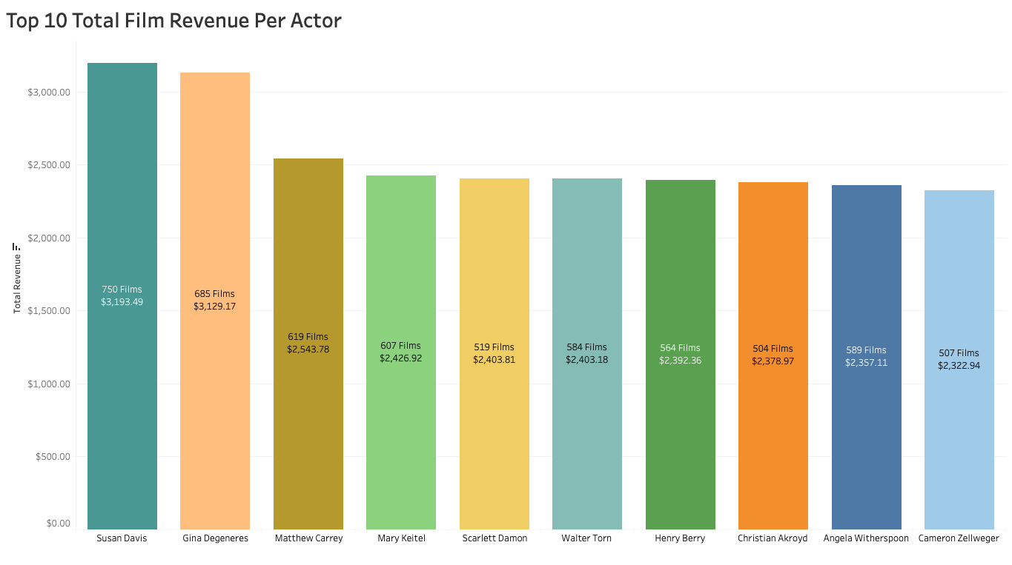
TOP 10 ACTORS BY TOTAL FILM REVENUE
Analyzing the total film revenue of these top 10 actors provides valuable insights into the financial viability of their projects and allows us to identify patterns and preferences among our audience. By understanding the revenue-generating potential of these actors, we can make informed decisions on future film acquisitions, talent collaborations, and strategic partnerships.

Slide 11
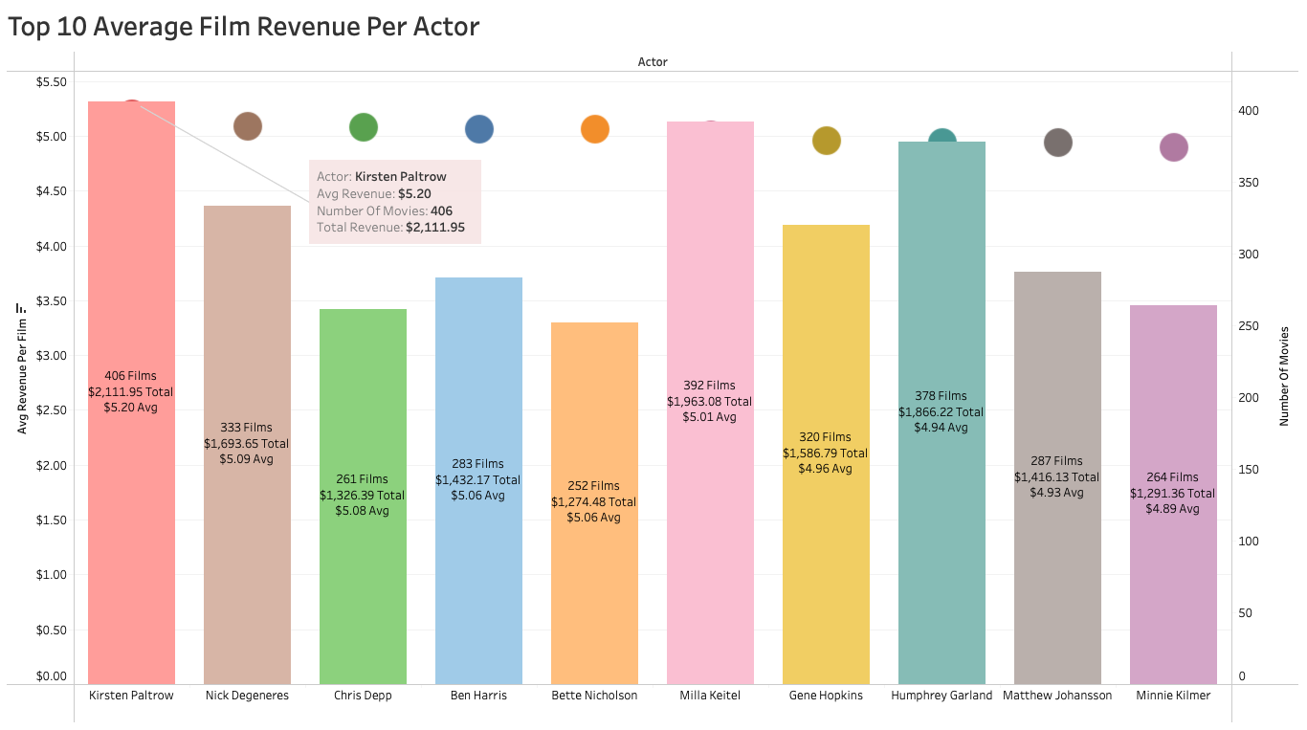
TOP 10 AVERAGE FILM REVENUE PER ACTOR
This slide highlights the top 10 actors in the Rockbuster Stealth film library based on their average film revenue. The graph in the slide visually represents the number of movies associated with each actor through the use of bars, while the dots on the graph represent the average revenue per film.

Slide 12
CONCLUSIONS
z
Geographically, the analysis reveals that the top 3 countries by customer count are India, China, and the U.S.A., indicating significant market potential and opportunities for strategic expansion and targeted marketing efforts.
The analysis identifies the top three movies, "Telegraph Voyage," "Zorro Ark," and "Wife Turn," as significant contributors to revenue gain, showcasing their popularity and financial success within the Rockbuster Stealth film library.
Conversely, the analysis highlights the bottom three movies, "Duffel Apocalypse," "Oklahoma Jumanji," and "Texas Watch," as having contributed the least to revenue gain, indicating potential areas for improvement in terms of audience appeal and market performance.
It is crucial to recognize the significance of films featuring the top film actors by total film revenue, as their star power and wide audience appeal contribute significantly to overall revenue generation and the financial success of our film library.
Also important are films featuring actors with the highest average revenue per film, as they demonstrate consistent financial success and the ability to deliver high-earning projects. These actors have the potential to attract both loyal audiences and lucrative partnerships, driving sustained revenue growth and establishing our organization as a destination for quality and profitable films.

Slide 13
NEXT STEPS
z
Implement data-driven marketing campaigns to target specific regions or demographics that have shown high potential for revenue growth, such as India, China, and the U.S.A.
Evaluate the performance of underperforming movies and analyze the reasons behind their lower revenue. This can guide us in making informed decisions on potential adjustments to distribution strategies, marketing efforts, or content improvements.
Leverage customer feedback and ratings to identify trends and preferences, allowing us to curate a more tailored film collection that resonates with our audience.
Recognize the opportunity to expand our audience base by adding movies in languages other than English. Diversifying the film library with international titles will attract a wider range of viewers, catering to different cultural backgrounds and language preferences. This strategic move will enable us to tap into new markets, increase customer engagement, and ultimately drive revenue growth.
Invest in technology and digital platforms to expand our reach and distribution channels, making our film library easily accessible to a global audience.
Foster relationships with film festivals, industry events, and influential film critics to increase exposure and build credibility for our films.
As the analysis reveals that all movies in the library are from 2006, updating the film library will ensure we offer a diverse and current selection of films that align with the evolving preferences and expectations of our audience, ultimately driving higher engagement and revenue.

Slide 14
THANK YOU! Questions: tomradioemail@myemail.com
z
Links to Tableau Visualizations:
https://public.tableau.com/app/profile/tom.radio/viz/Task3_10Map_16871073723890/Combo?publish=yes
https://public.tableau.com/app/profile/tom.radio/viz/Task3_10Top10CountriesBasedonCustomerCount/Top10CountriesBasedonCustomerCount?publish=yes
https://public.tableau.com/app/profile/tom.radio/viz/Task3_10_1_16868493526070/Top10HighestGrossing?publish=yes
https://public.tableau.com/app/profile/tom.radio/viz/Task3_10_1_16868493526070/Bottom10LowestGrossing?publish=yes
https://public.tableau.com/app/profile/tom.radio/viz/3_10ActorRev_1/TotalRevActor?publish=yes
https://public.tableau.com/app/profile/tom.radio/viz/3_10ActorRev_1/AVGREVACTOR?publish=yes

