Slide 1
HDIIA
Critical Infrastructure
Security Assessment
Executive / client-style security assessment deck
From business-critical services to risks, controls, target architecture, roadmap and measurable maturity outcomes.
Cybersecurity Architecture & Risk Improvement Plan
Risk-driven methodology
Zero Trust target state
Measurable roadmap
Final Portfolio Polish
Prepared as a cybersecurity portfolio artifact

Slide 2
Assessment Methodology
A traceable path from mission context to security improvement priorities.
01
Business Context
02
Critical Services
03
Assets
04
Dependencies
05
Threats
06
Risks
07
Controls
08
Architecture
09
Roadmap
Project intent
Build a portfolio-grade assessment lifecycle, not isolated cybersecurity notes.
Show executive traceability: risk → control → architecture → measurable improvement.
HDIIA Critical Infrastructure Security Assessment | 02
Portfolio-ready client presentation

Slide 3
Business Context & Critical Services
The assessment protects services that support sensitive information infrastructure operations.
Critical services in scope
Secure Data Storage
Confidentiality, integrity and availability of sensitive repositories.
Secure Information Exchange
Controlled exchange of information between authorized entities.
Identity & Access Management
Authentication, authorization and privileged access control.
Critical Application Hosting
Hosting platforms for critical mission applications.
Security Monitoring
Log collection, alerting and incident detection capability.
Data Center Infrastructure
Physical and technical infrastructure for critical systems.
Business impact drives security prioritization
HDIIA Critical Infrastructure Security Assessment | 03
Portfolio-ready client presentation

Slide 4
Current Security Posture
Current state shows defined foundations, with gaps in identity, monitoring and response maturity.
Security Domain
Current Level
Target Level
Governance
Level 3 — Defined
Level 4 — Managed
Asset Management
Level 3 — Defined
Level 4 — Managed
Identity Security
Level 2 — Developing
Level 4 — Managed
Network Security
Level 3 — Defined
Level 4 — Managed
Security Monitoring
Level 2 — Developing
Level 4 — Managed
Incident Response
Level 2 — Developing
Level 4 — Managed
Resilience
Level 3 — Defined
Level 4 — Managed
Interpretation: the program is not starting from zero; it needs managed, measured and repeatable security capabilities.
HDIIA Critical Infrastructure Security Assessment | 04
Portfolio-ready client presentation

Slide 5
Critical Assets & Dependencies
Asset visibility is the foundation for threat modeling, risk scoring and control selection.
Asset ID
Asset
Criticality
Security requirement
HDIIA-IT-001
Identity Management Infrastructure
Critical
MFA, PAM, logging
HDIIA-NET-001
Core Network Infrastructure
Critical
Segmentation, monitoring
HDIIA-DC-001
Data Center Computing Platform
Critical
Hardening, backup, VM
HDIIA-DATA-001
Critical Information Repositories
High
Encryption, access control
HDIIA-SEC-001
Security Monitoring Platform
High
SIEM protection, alert integrity
Assessment principle
Protect assets because they support critical business services — not because they are merely technical components.
HDIIA Critical Infrastructure Security Assessment | 05
Portfolio-ready client presentation

Slide 6
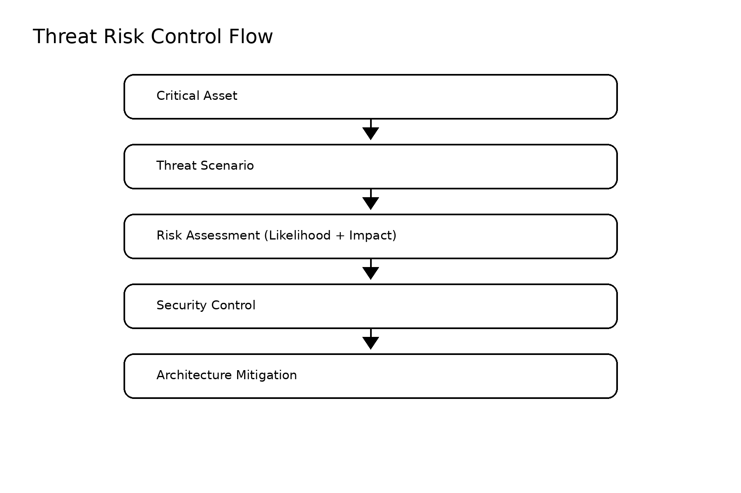
Threat Landscape & Assessment Flow
Threat scenarios are converted into business risks through likelihood, impact and control treatment analysis.
Threat scenarios
TS-001
Ransomware Attack
availability and recovery risk
TS-002
Credential Compromise
identity and access risk
TS-003
Privileged Account Misuse
insider and abuse risk
TS-004
Supply Chain Compromise
external dependency risk
TS-005
Network Disruption
resilience and continuity risk
Outcome: risk treatment priorities feed control mapping and architecture decisions.
HDIIA Critical Infrastructure Security Assessment | 06
Portfolio-ready client presentation

Slide 7
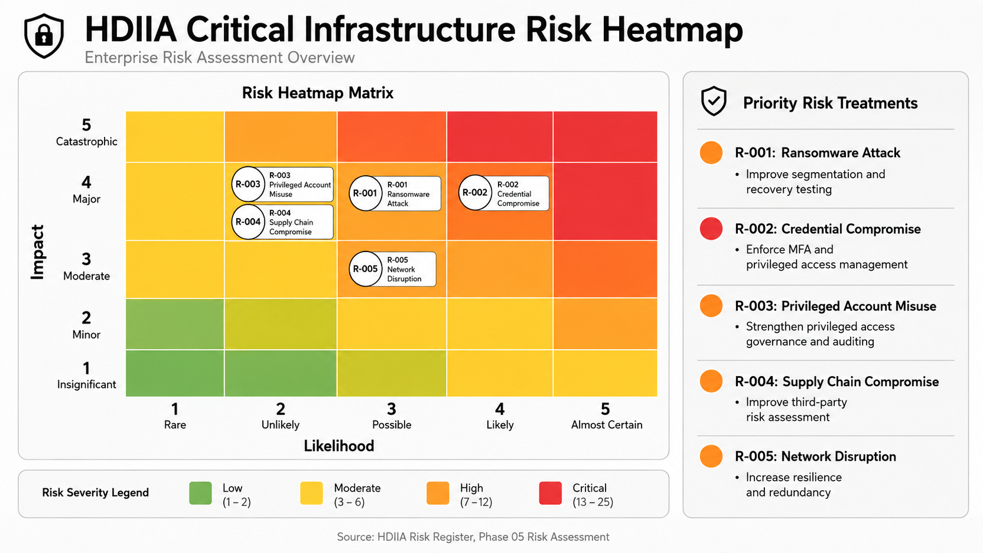
HDIIA Critical Infrastructure Security Assessment | 07
Portfolio-ready client presentation

Slide 8
Priority Risk Treatments
Treatment strategy translates risk findings into practical security actions and accountable ownership.
Risk
Scenario
Level
Owner
Treatment
R-001
Ransomware Attack
High
Application Owner
Segmentation, recovery testing, ransomware protection
R-002
Credential Compromise
Critical
Identity Owner
MFA enforcement and privileged access management
R-003
Privileged Account Misuse
High
Security Manager
Privileged access governance and audit logging
R-004
Supply Chain Compromise
High
Vendor Owner
Third-party risk assessment and supplier controls
R-005
Network Disruption
High
Infrastructure Owner
Resilience, redundancy and network monitoring
Priority logic: address identity and privileged access first, while improving resilience for ransomware and network disruption scenarios.
HDIIA Critical Infrastructure Security Assessment | 08
Portfolio-ready client presentation

Slide 9
Security Control Framework Mapping
Controls are selected for traceability across risk, objective, framework and architecture component.
Identity Controls
Network Controls
Monitoring Controls
MFA, IAM, PAM, access reviews
Segmentation, firewalls, IDS/IPS
Central logging, SIEM, alerting
NIST Protect / ISO Access Control
NIST Protect + Detect / ISO Network Security
NIST Detect + Respond / ISO Monitoring
Resilience Controls
Supplier Controls
Backup, DR, recovery testing
Third-party risk management
NIST Recover / ISO Business Continuity
NIST Identify + Protect / ISO Supplier Security
Risk → Security Objective → Security Control → Framework Reference → Architecture Component
HDIIA Critical Infrastructure Security Assessment | 09
Portfolio-ready client presentation

Slide 10
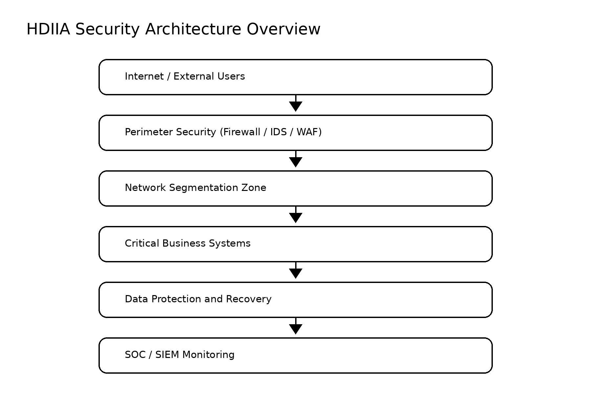
Target Security Architecture
Target design applies defense-in-depth, segmentation, protection, recovery and SOC/SIEM monitoring.
Architecture intent: reduce blast radius, improve visibility and protect critical business systems through layered controls.
HDIIA Critical Infrastructure Security Assessment | 10
Portfolio-ready client presentation

Slide 11
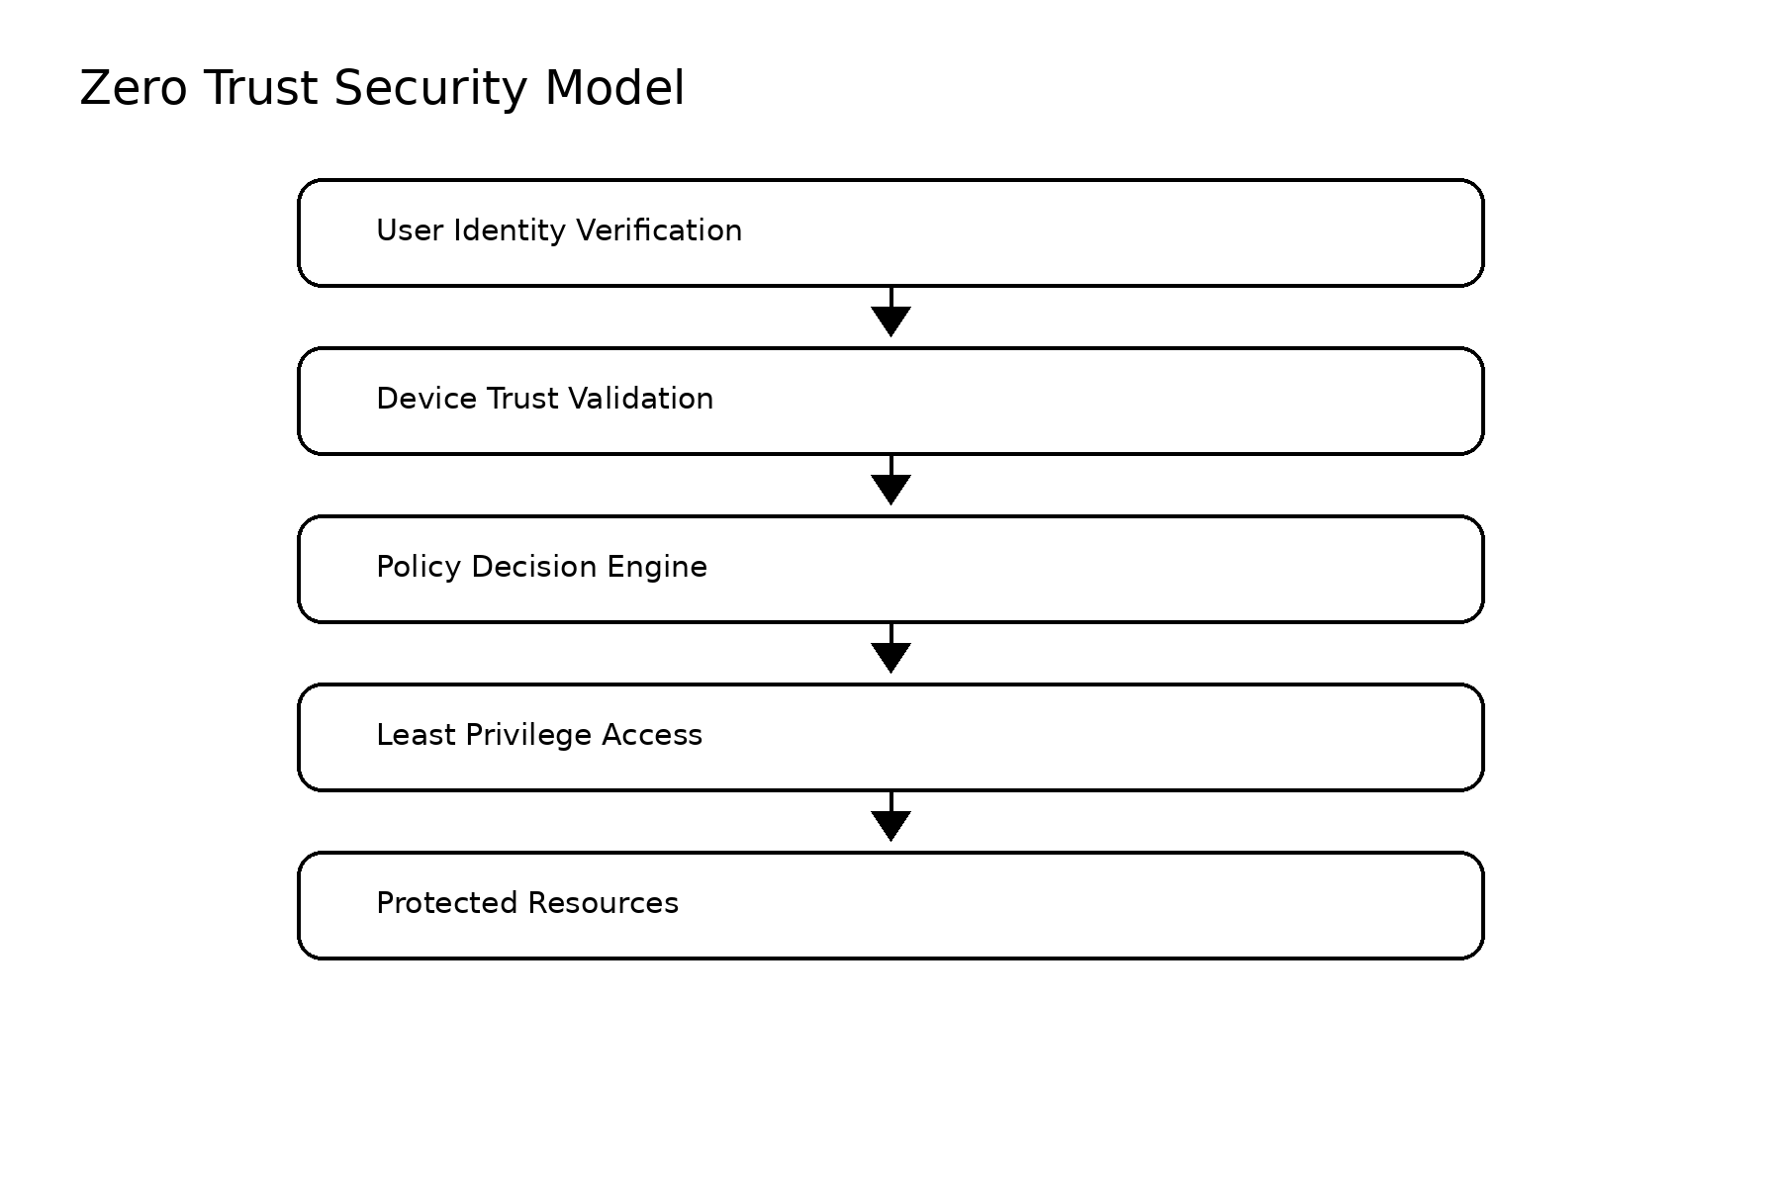
Zero Trust Target Model
The target state validates identity, device, policy and privilege before access to protected resources.
Verify explicitly
Use least privilege
Assume breach
HDIIA Critical Infrastructure Security Assessment | 11
Portfolio-ready client presentation

Slide 12
Security Improvement Roadmap
Priorities are sequenced by risk reduction value, implementation dependency and maturity impact.
0–3 months
3–12 months
12+ months
Stabilize foundations
Build managed capability
Optimize continuously
MFA implementation
Network segmentation
Advanced detection
Security logging improvement
SIEM enhancement
Zero Trust maturity
Critical asset visibility
PAM implementation
Continuous improvement program
Backup validation
Security process maturity
Target outcome: transition from defined capabilities to Level 4 — Managed security architecture and operations.
HDIIA Critical Infrastructure Security Assessment | 12
Portfolio-ready client presentation

Slide 13
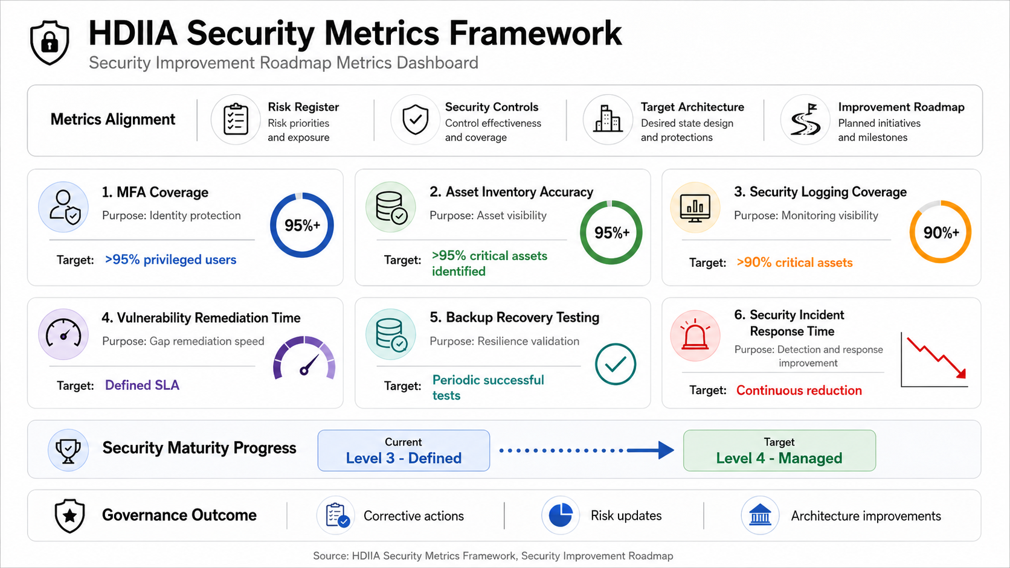
Security Metrics & Final Recommendations
Measure execution, prove maturity growth, and keep risk treatment aligned with architecture decisions.
Executive close
1
Prioritize IAM/PAM hardening
Credential compromise is the only Critical risk.
2
Validate resilience
Ransomware and network disruption require tested recovery.
3
Operationalize metrics
Use KPIs to move from Defined to Managed maturity.
Final position: portfolio-ready consulting artifact for risk, architecture and security improvement planning.
HDIIA Critical Infrastructure Security Assessment | 13
Portfolio-ready client presentation

