Slide 1
Results – stock market predictor
GA DS capstone – tom Pichard

Slide 2
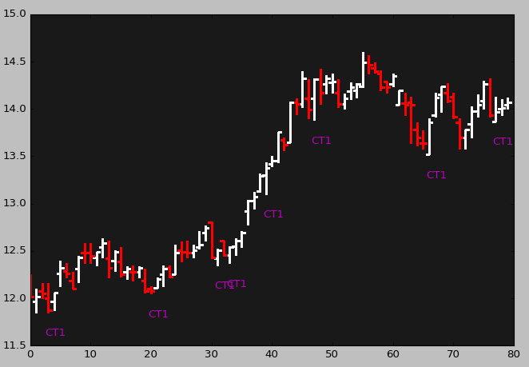
Refresher
Three consecutively rising lows to predict further gains?

Slide 3
results
Model raised doubt about ability to predict 10 to 15 days out due to poor win rate and overall PL performance
50% Win rate
1% > performance < 4% annual return
Second model in design
Early results dubious
Back-testing hampered by seeming lockout from Yahoo.finance API

Slide 4
Achievements
Compiled entire code into one .py file.
Contains entire process from ad-hoc data capture to results of model performance.
Created two models.
Created SP500 ticker inventory file with history availability.
Exposed to Pandas, Python intricate loops (nested while-if-while-if-ifs).
Took project end-to-end from idea to modeling to POC to compiling.

Slide 5
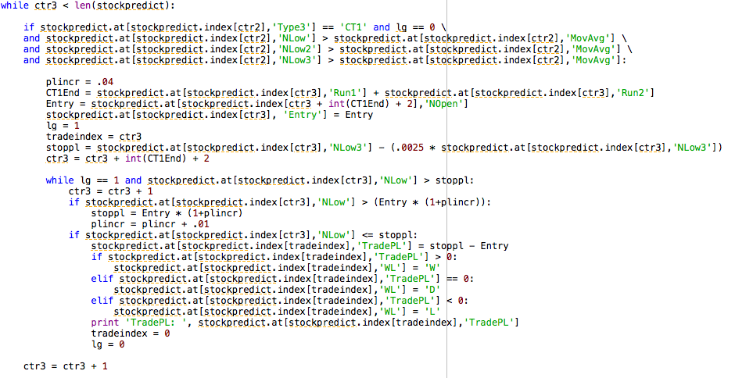
Coding

Slide 6
observations
Raised more questions than answers
Historical reconstruction with respect to stock splits and dividends
Sampling across market trends and individual stocks
One slight misstep (a one day difference) can change entire model’s performance
Challenge in operationalizing
Minutiae of details
Actual orders and automation
Challenge with optimizing the model parameters and balancing out over series of markets and stocks.
Never-ending iterations on model then cross-validation

