Slide 1
Validating an intuition
GA DS capstone – tom Pichard

Slide 2
Background
I have observed what I consider to be a non-traditional stock-commodity chart pattern which I call the parabolic acceleration curve. I witnessed it when working in the markets as an investment professional and associate it with accelerated gains after its completion. I have not validated this pattern from an objective data pattern analysis.
The goal of this capstone then is to code a solution that identifies this pattern, records it and presents it for examination as to predicted future gains or not across an expanded sample of data.
The pattern is made up of successive lows in a stock-commodity progressing over time in a non linear channel.

Slide 3
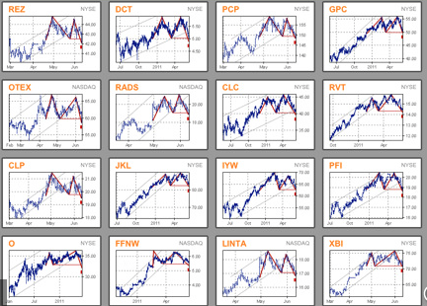
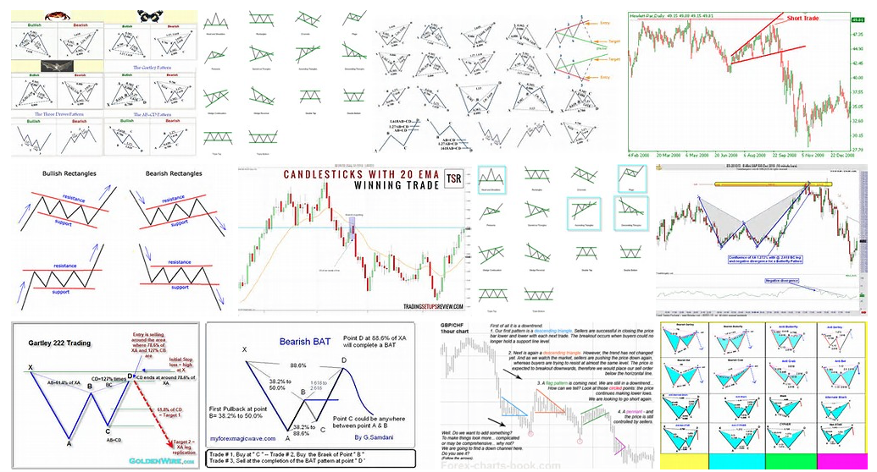
patterns

Slide 4
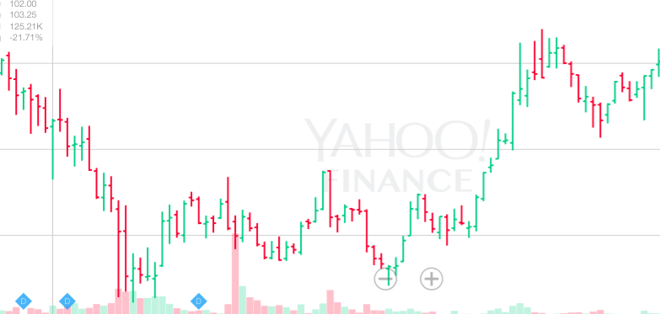
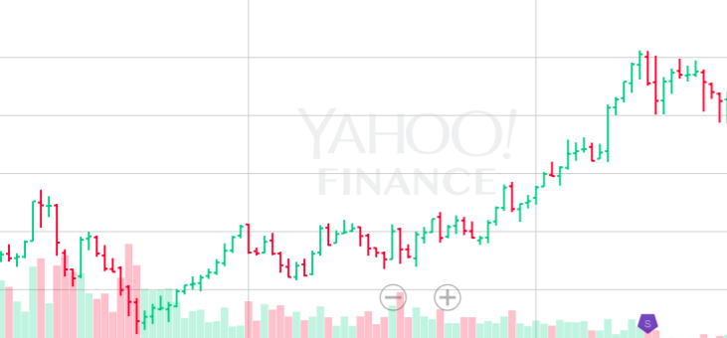
The pattern
3
1
2
3
1
2

Slide 5
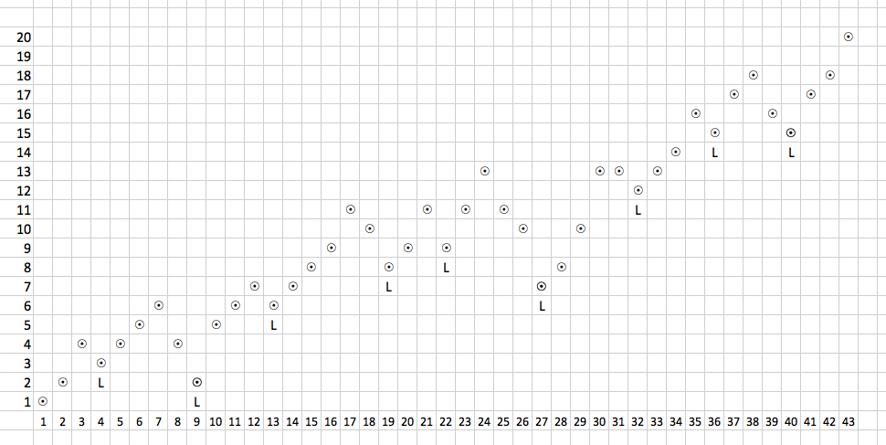
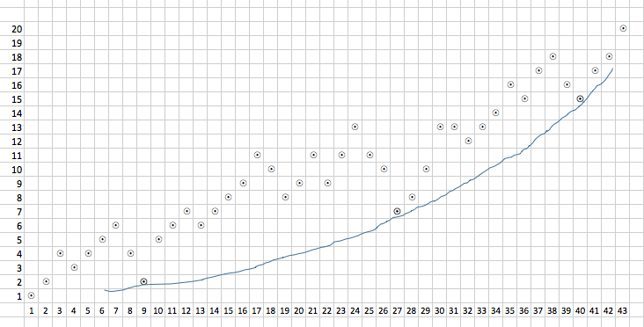
THE pattern (2)

Slide 6
THE pattern (3)

Slide 7
Details
Import OHLC stock time series into Pandas dataframe from Yahoo Finance.
Prepare data for processing and visualization:
Re-sort and Re-index.
Normalize OHLC for historical adjustments in the stock’s price.
Plot as HLC charts.
Prepare data for algorithmic analysis:
Identify and track local lows.
Determine critical lows (3).
Design/Refine search model:
Basic (2 slopes increasing in gradient with time factored in).
Normalize time-price grid across stock prices.
Mapping to non-linear function (power curve, exponential logarithmic, quadratic).
Design/Code/Refine entry-exit criteria.
Scale/Operationalize the model:
Review n+ stock charts.
Track results.

Slide 8
Discussion - questions
Time series nature of the data
Training - testing
Learnings to date
Documentation quality
ETL
Hacking nature of learning today
Approach / Suggestions
Scaling

