Slide 1
Results

Slide 2
Method
ROOT collate data into txt
Buffers
TPC – prompt
TPC – delayed
Calculate production & decays (/yr)
Filter by realistic half life → max 1 yr
Only removes ~ 5 isotopes
Filter by decay energy
Beta: 0-100 keV
Gamma: 0-400keV

Slide 3
Results
Total counts w. physics models → What is original?
Total isotope yields w. physics models
Ratio of detector volumes
Ratio of prompt to delayed
Important unstable in buffer
Important unstable prompt in TPC
Important unstable delayed in TPC
Total important beta & gamma isotopes w. physics models

Slide 4

Geometry
Are labels correct?
Is tank on bottom of hall?
TPC
IB
Hall
OB
Faraday
PB
Membrane + Insulator + Tank
World

Slide 5
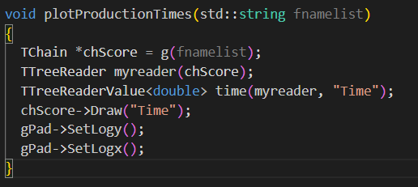
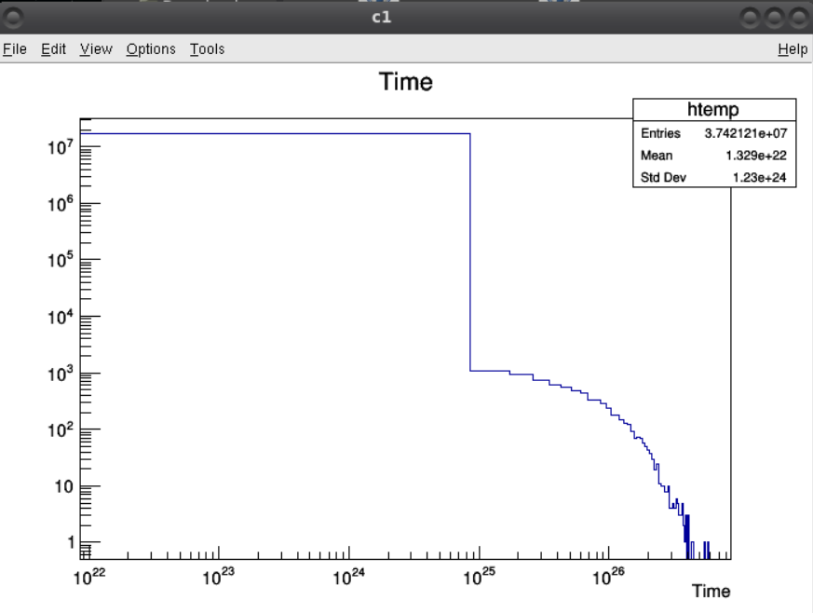
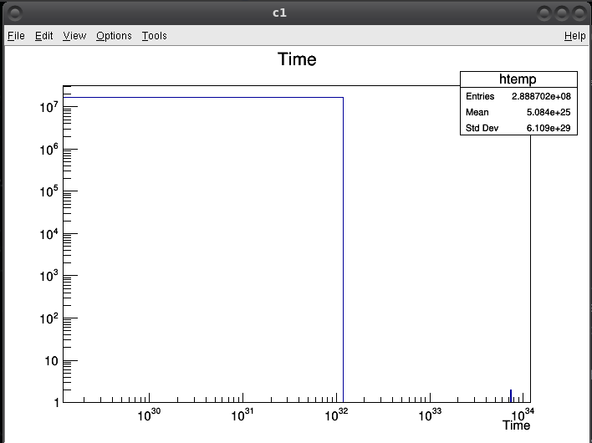
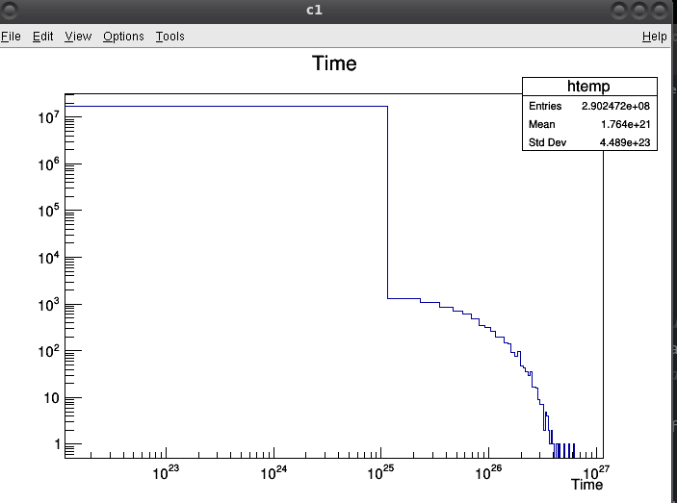
Plotted time in ROOT
Original, NC, FTFP

Slide 6
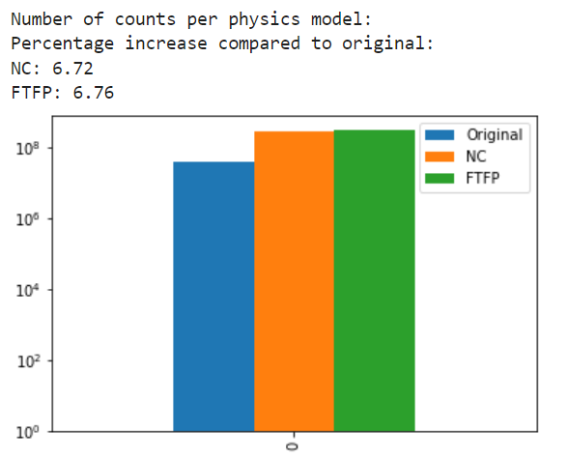
Total counts w. physics models
All 3 physics models → Original, NC, FTFP

Slide 7
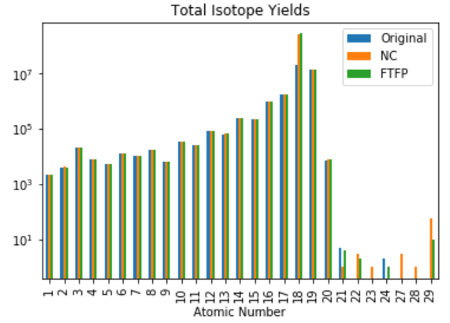

Slide 8
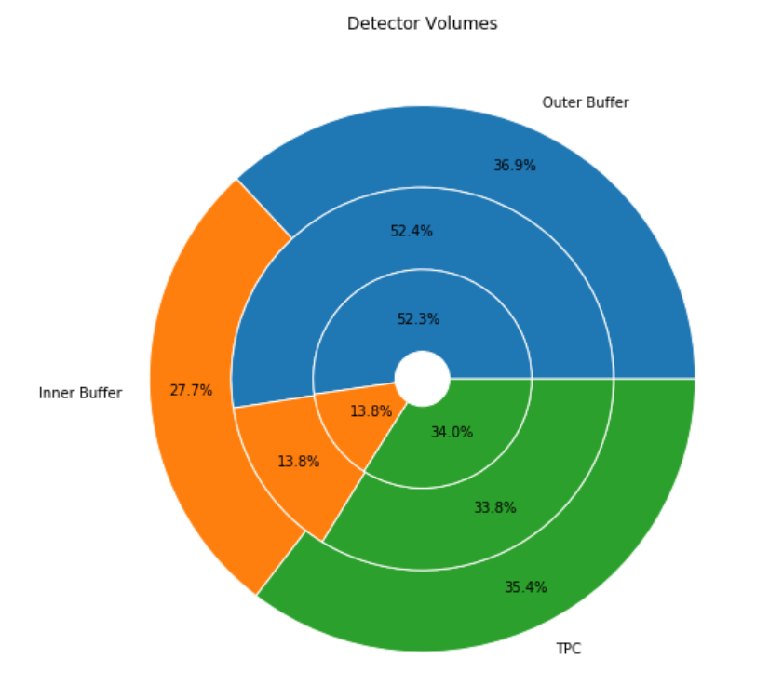
Ratio of Detector Volumes
All 3 physics models → Original, NC, FTFP

Slide 9
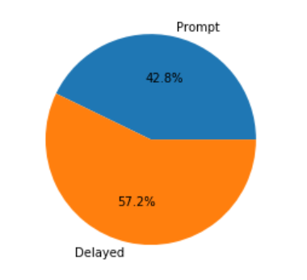
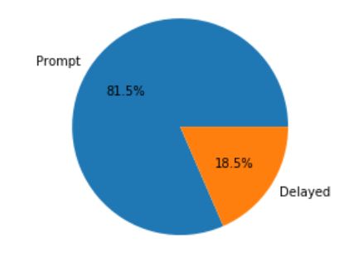
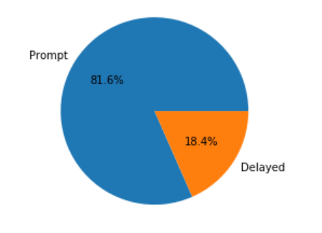
Ratio of Prompt to delayed
All 3 physics models → Original, NC, FTFP

Slide 10
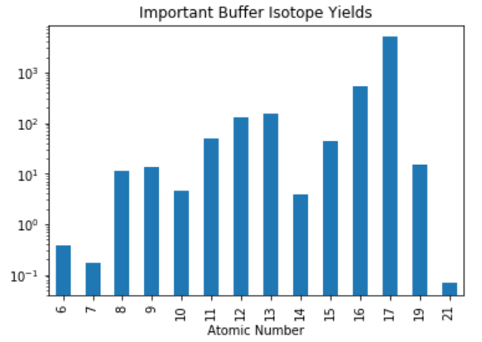
Important unstable in buffer
Looking for gamma in energy range 0-400keV

Slide 11
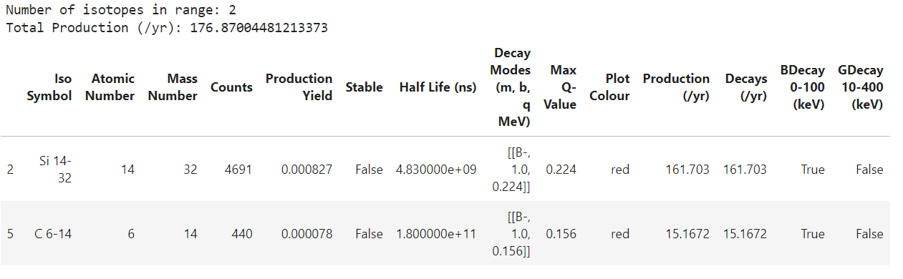
Important unstable prompt TPC
Only prompt isotopes
Filter with half life greater than deadtime (to survive)
Filter with beta & gamma energy ranges

Slide 12
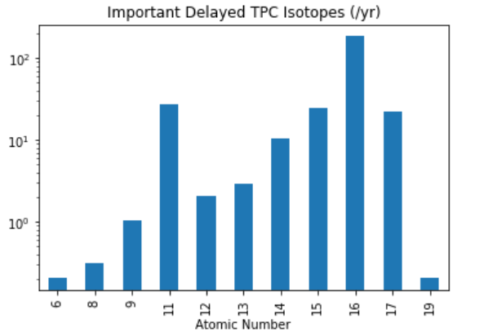
Important unstable delayed TPC
Only delayed isotopes
Filter with beta & gamma energy ranges

Slide 13
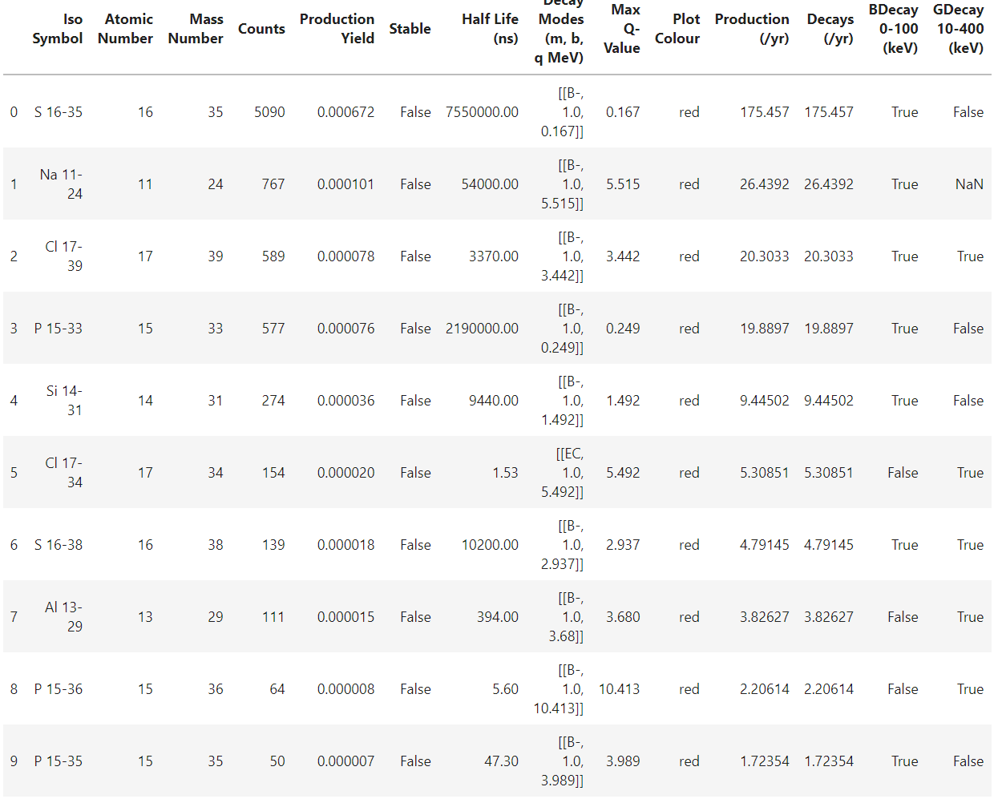
…continued
Table = prev bar plot

Slide 14
