Slide 1
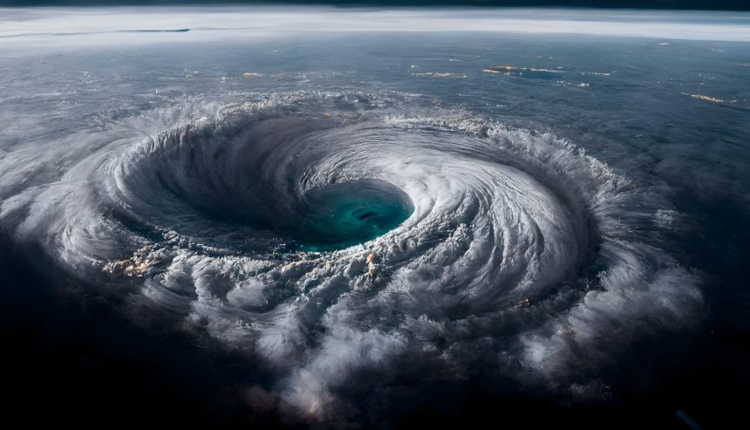
Hurricanes

Slide 2
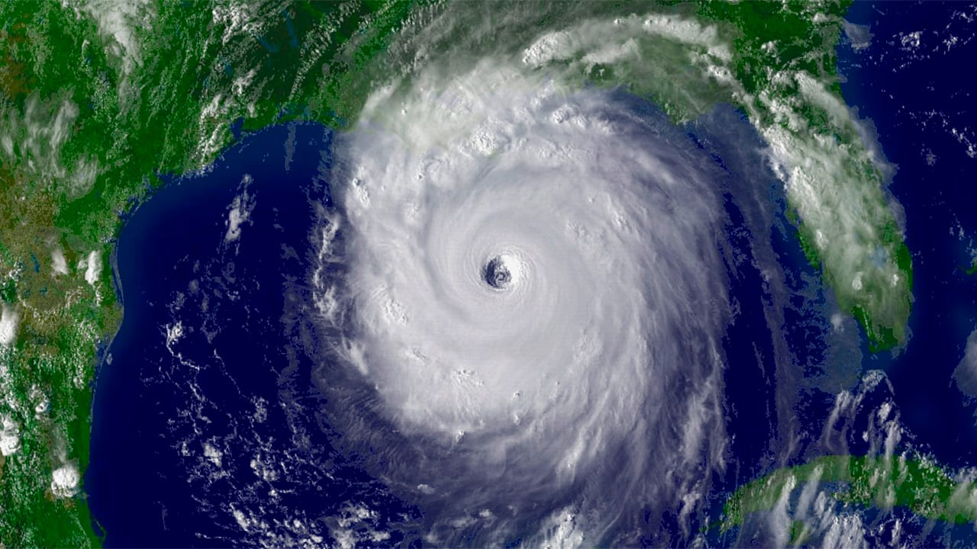
What are huricanes
A huricane is a rotating
low-pressure weather system
that has organized thunderstorms
but no fronts (a boundary
separating two air masses of different densities)

Slide 3
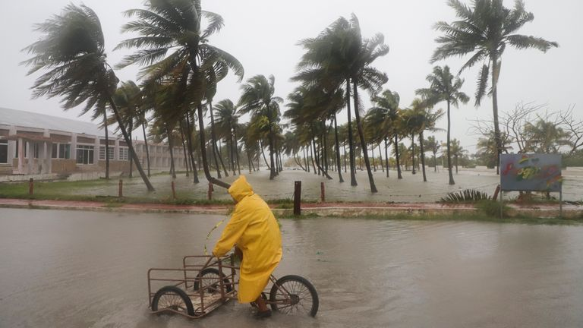
What to do when a hurricane strikes

Slide 4
