Slide 1

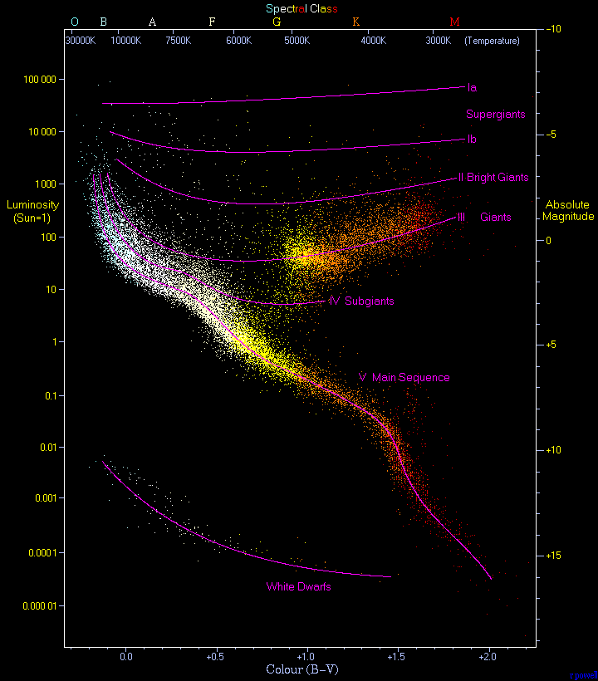
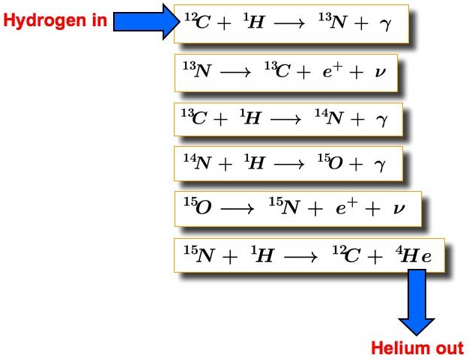

The Formation and Evolution of Blue Supergiant Stars (BSGs)
Thomas Scattergood and Natasha Jeffrey
BSC (HONS) Physics with Astrophysics
Northumbria University Newcastle, Newcastle Upon Tyne, NE1 8ST, UK
My project
BSGs are very luminous, high mass and temperature O and B type stars with main properties:
Minimum surface temperature of 11,000K
Minimum solar radius of 14 R_{ʘ}
Minimum luminosity of around 20,000L_{ʘ}
Minimum mass of 10M_{ʘ}
My project’s main aim is to research each phase of BSGs to understand phenomena that occur in its life. My objectives to achieve this are:
To compare the properties and formation conditions of BSG and solar stars
To investigate how BSG evolve into one of their death stages and the impacts they have
Analyse and compare stellar processes of BSG and solar stars
Hertzsprung-Russell diagram [1]
Initial findings
Using research as my main method of findings I have discovered that:
BSGs Form in giant molecular clouds with hydrogen densities larger than that of solar stars and radiative forces play a vital role in formation [2]
The nuclear fusion process in BSG and other high-mass stars is the CNO cycle as opposed to Proton-Proton fusion which is for low-mass stars, produces around 25MeV per cycle [3].
BSGs have characteristic strong stellar wind caused by radiative pressure in the core which leads to mass loss as material is ejected out of the star
Goes supernova once fuel runs out, If above 3M_{ʘ} then a black hole forms, if below then a neutron star forms
Next steps
Continue research into the CNO cycle and how it compares/differs to P-P fusion
Analyse mass loss of BSGs to see if it has a substantial effect on the main sequence phase using the equation:
$\log\left(\frac{dM}{dt}ν_{∞}\sqrt{R_{∗}}\right)= −10.47+1.557∗ log⁡(L_{∗})$ [5]
Compare and determine the constructive and destructive effects of supernovas and black holes caused by the death of BSGs on the local galaxies
Determine the processes that BSGs experience and compare any that also occur in other types of stars
The CNO cycle [4]
References
[1] Kaler, J., 2006. The Cambridge Encyclopedia Of Stars. 1st ed. Cambridge: Cambridge University Press, pp.99-102.
[2]Zinnecker, H. and Yorke, H., 2007. Toward Understanding Massive Star Formation. Annual Review of Astronomy and Astrophysics, 45(1), pp.11-15.
[3] Zoppi, G., 2019. Thermal and nuclear energy. pp 64
[4] Grunhut, J., n.d. Magnetic Fields In Early-Type Stars. [3] Astronomy.swin.edu.au. n.d. CNO Cycle | COSMOS.
[5] Castor, J. and Lamers, H., 1979. An atlas of theoretical P Cygni profiles. The Astrophysical Journal Supplement Series, 39, p.481.

