Slide 1
Analising the wind
Analising the wind conditions in the Netherlands
Notes:
Because kitesurfing is a part of my life

Slide 2
What time of the year is the best to practise kitesurfing?

Slide 3
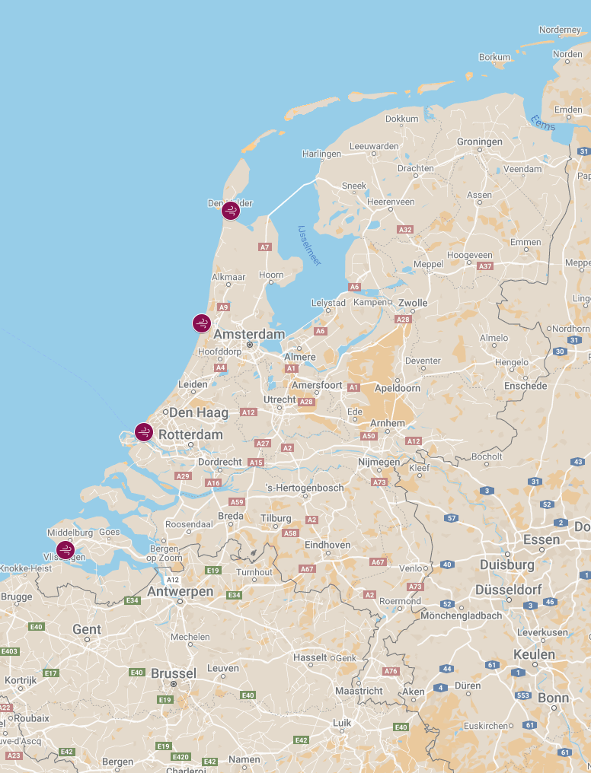
Wind data locations
Den Helder
IJmuiden
Hoek van Holland
Vlissingen
Notes:
The west coast of the netherlands

Slide 4
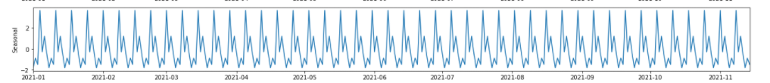
Analising the data
ARMA
Showed seasonality on (roughly) weekly basis
Can be interesting to look into this
Notes:
# We have a low P-value from the ADF-test. So, we can not confirm that the time series is in fact non-stationary..
# With more time I would have liked to perform a model where they take seasonality into account.

Slide 5
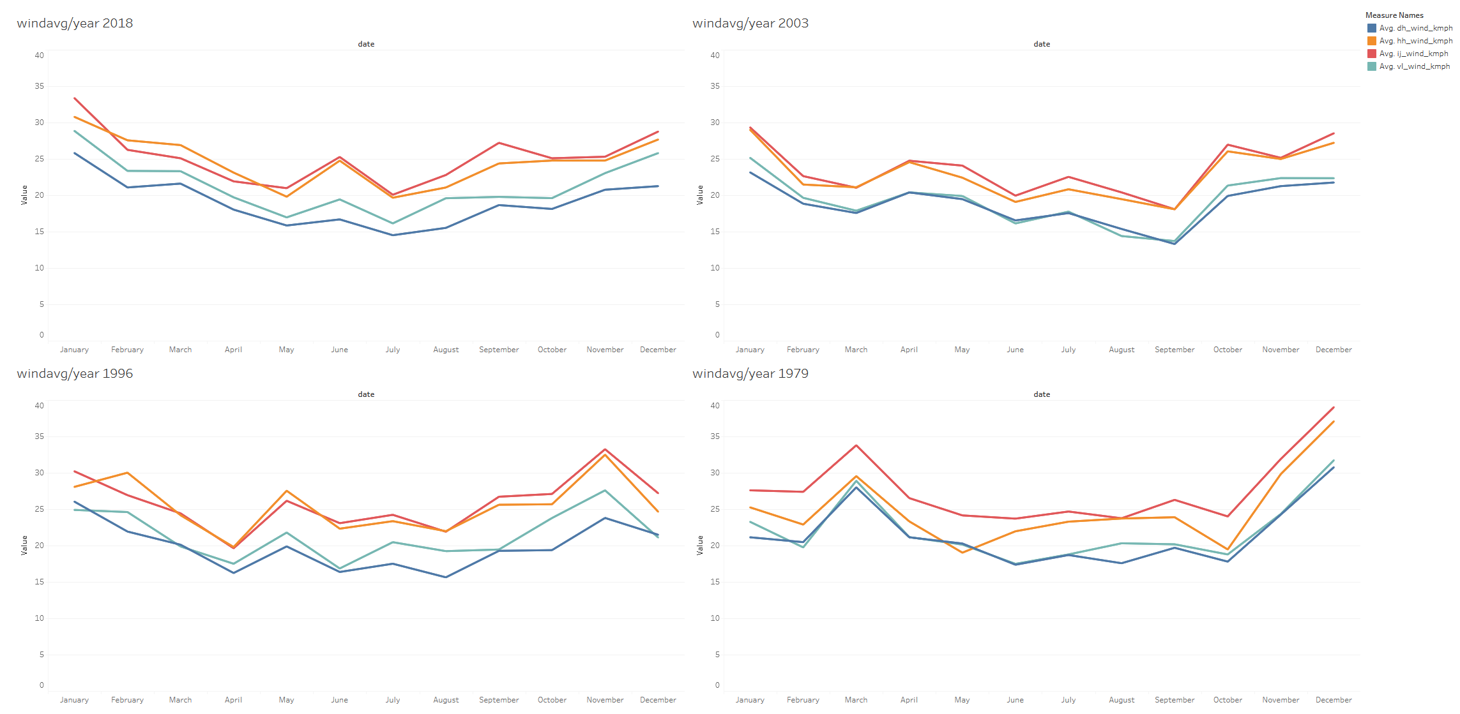
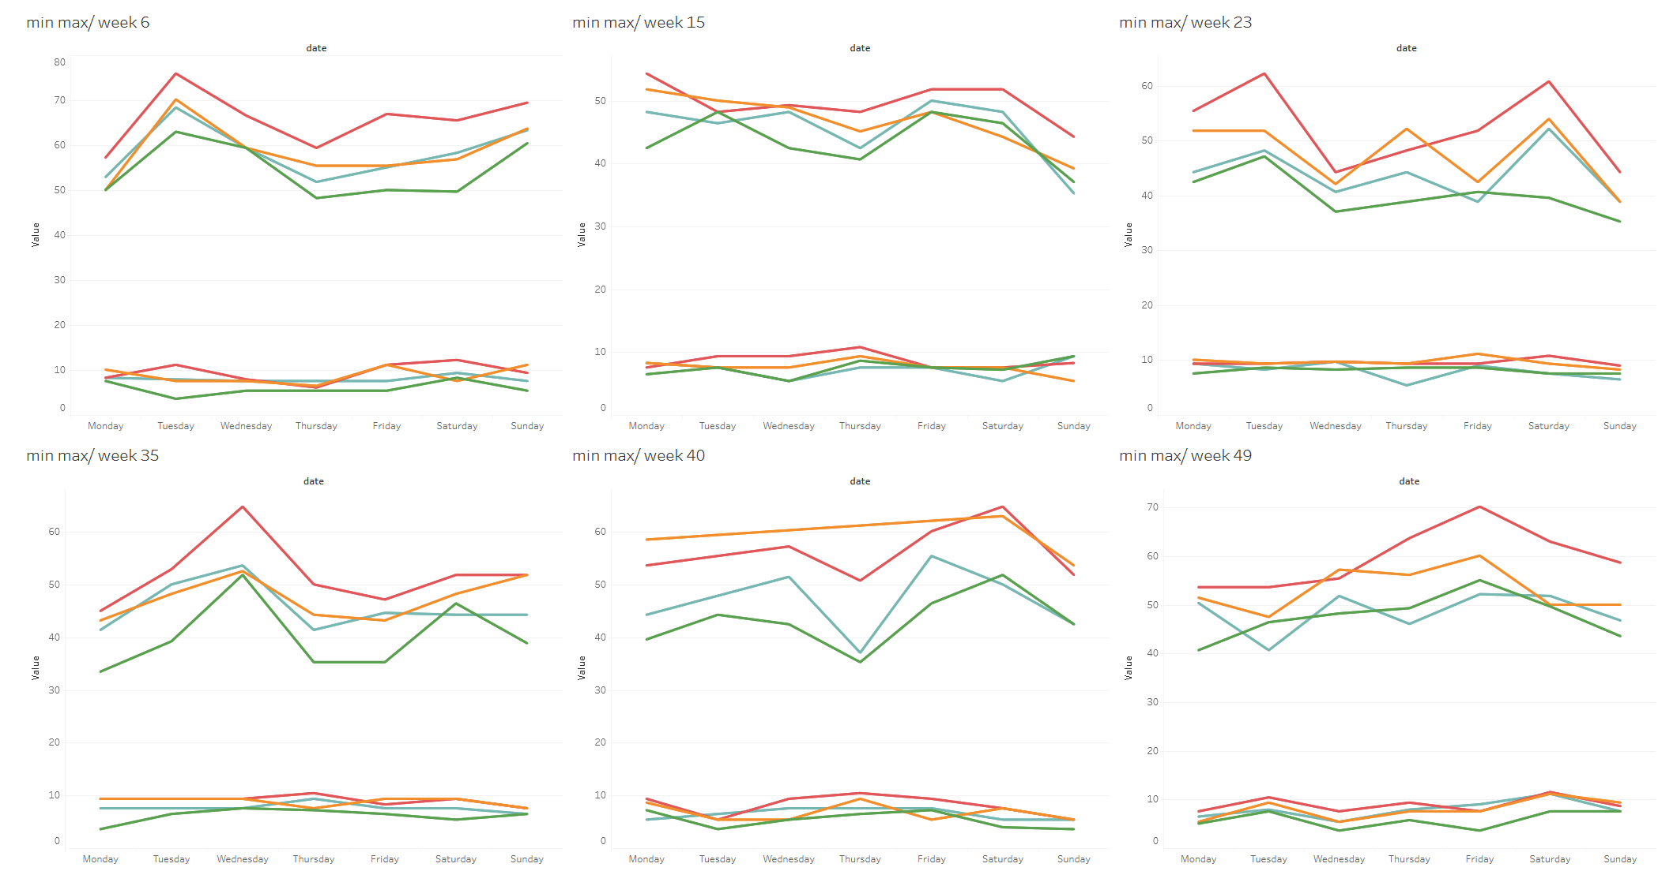
Further analysis
Notes:
To check the weekly patern, i chose random weeks from the year 2020.
There seem to ben no clear pattern yet.

Slide 6
Further analysis
Notes:
If we zoom out to yearly basis we see a clear pattern in the wind.
Here i chose 4 different years to show the pattern.

Slide 7
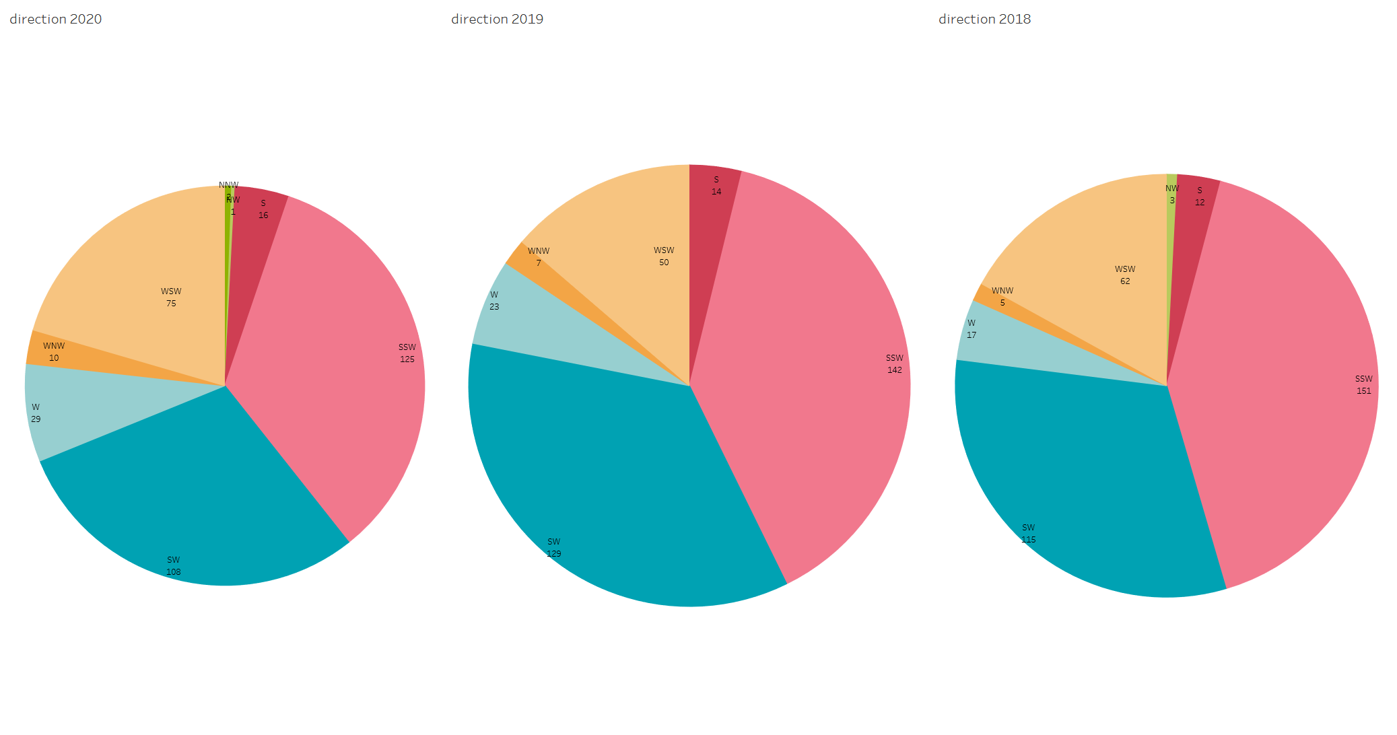
Further analysis
Notes:
Also it is impotant to look at the direction

Slide 8
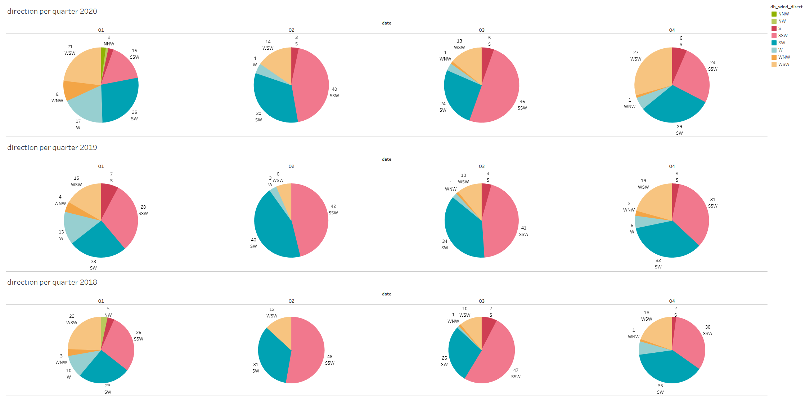
Further analysis

Slide 9
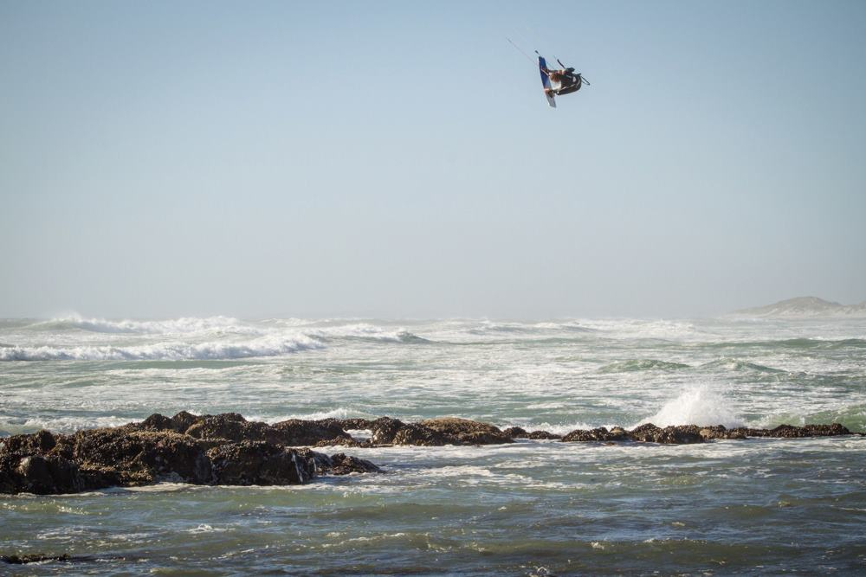
Suitable conditions
Want between 30 and 70 kmph
Good wind direction. SW till NNE
Notes:
Look at the wind under certain conditions

Slide 10
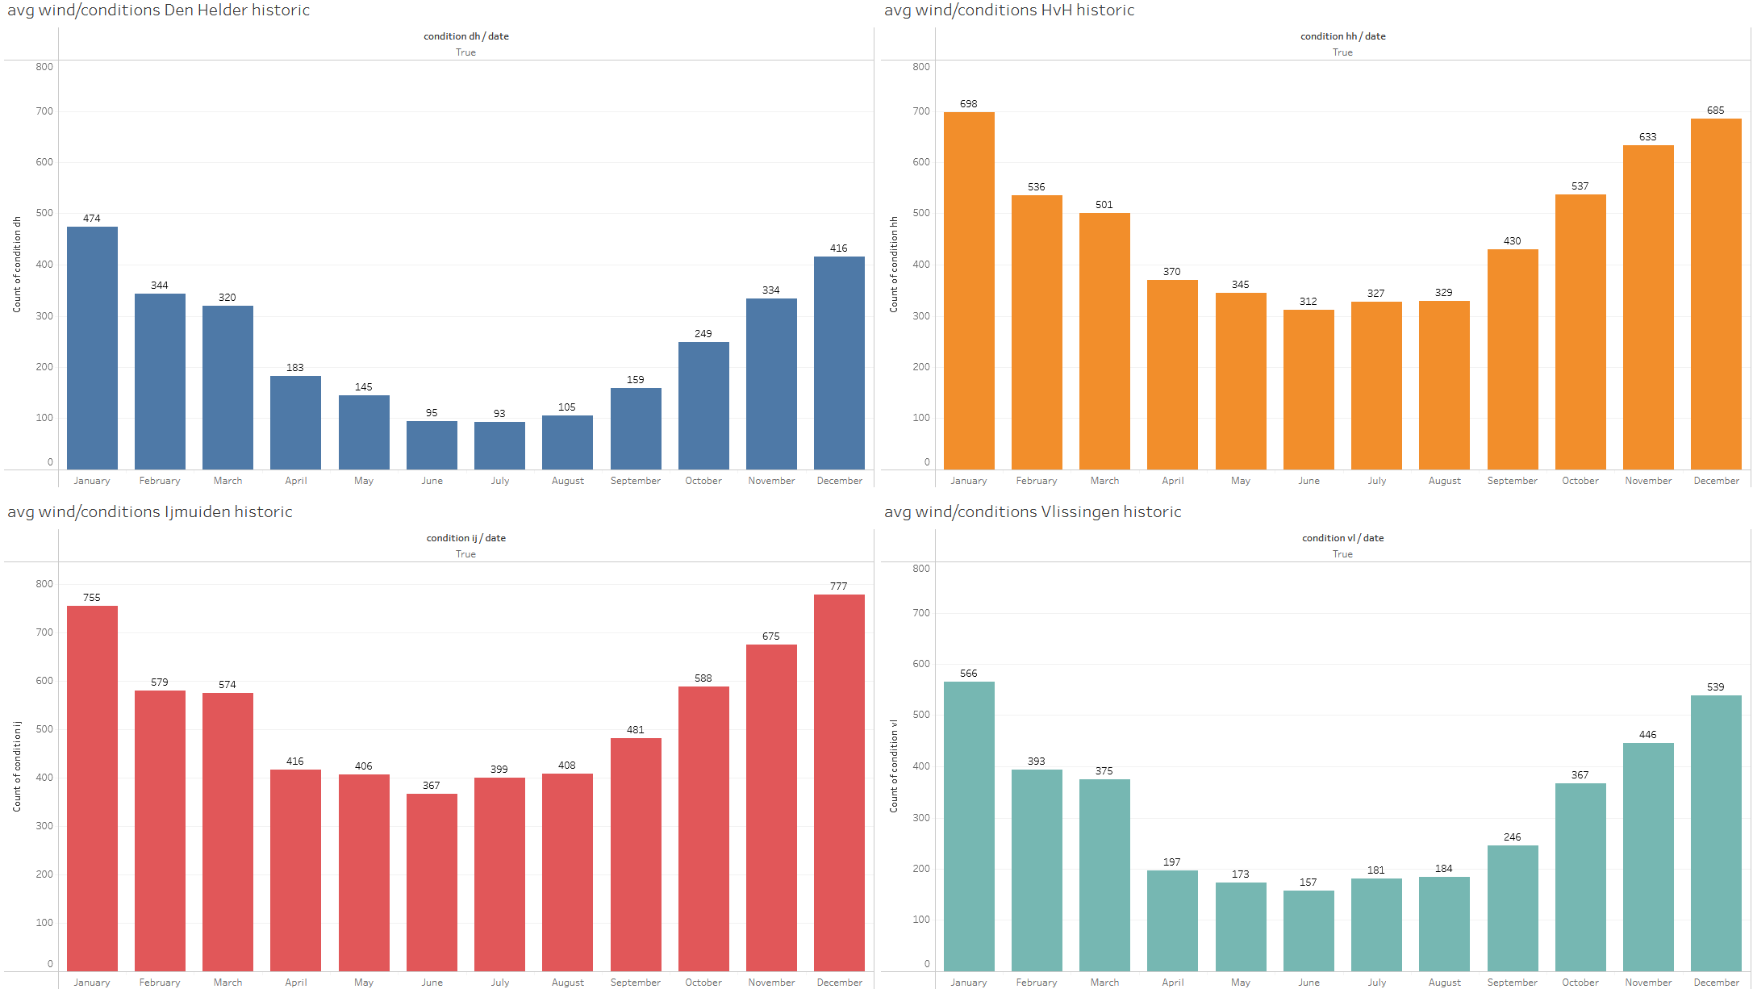
Further analysis
Notes:
Ijmuiden and hoek v holland look really good

Slide 11
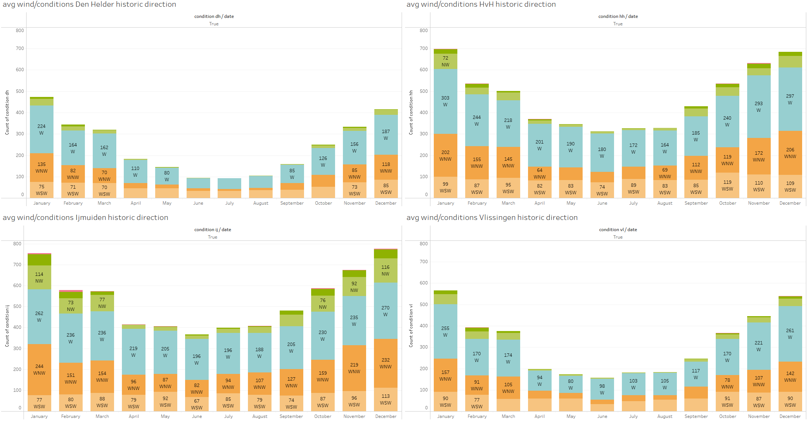
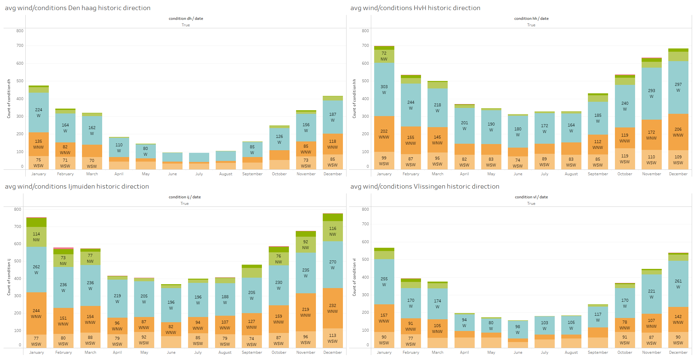
Further analysis
Notes:
W
WNW
WSW
These are on shore winds os this is good for the conditions

Slide 12
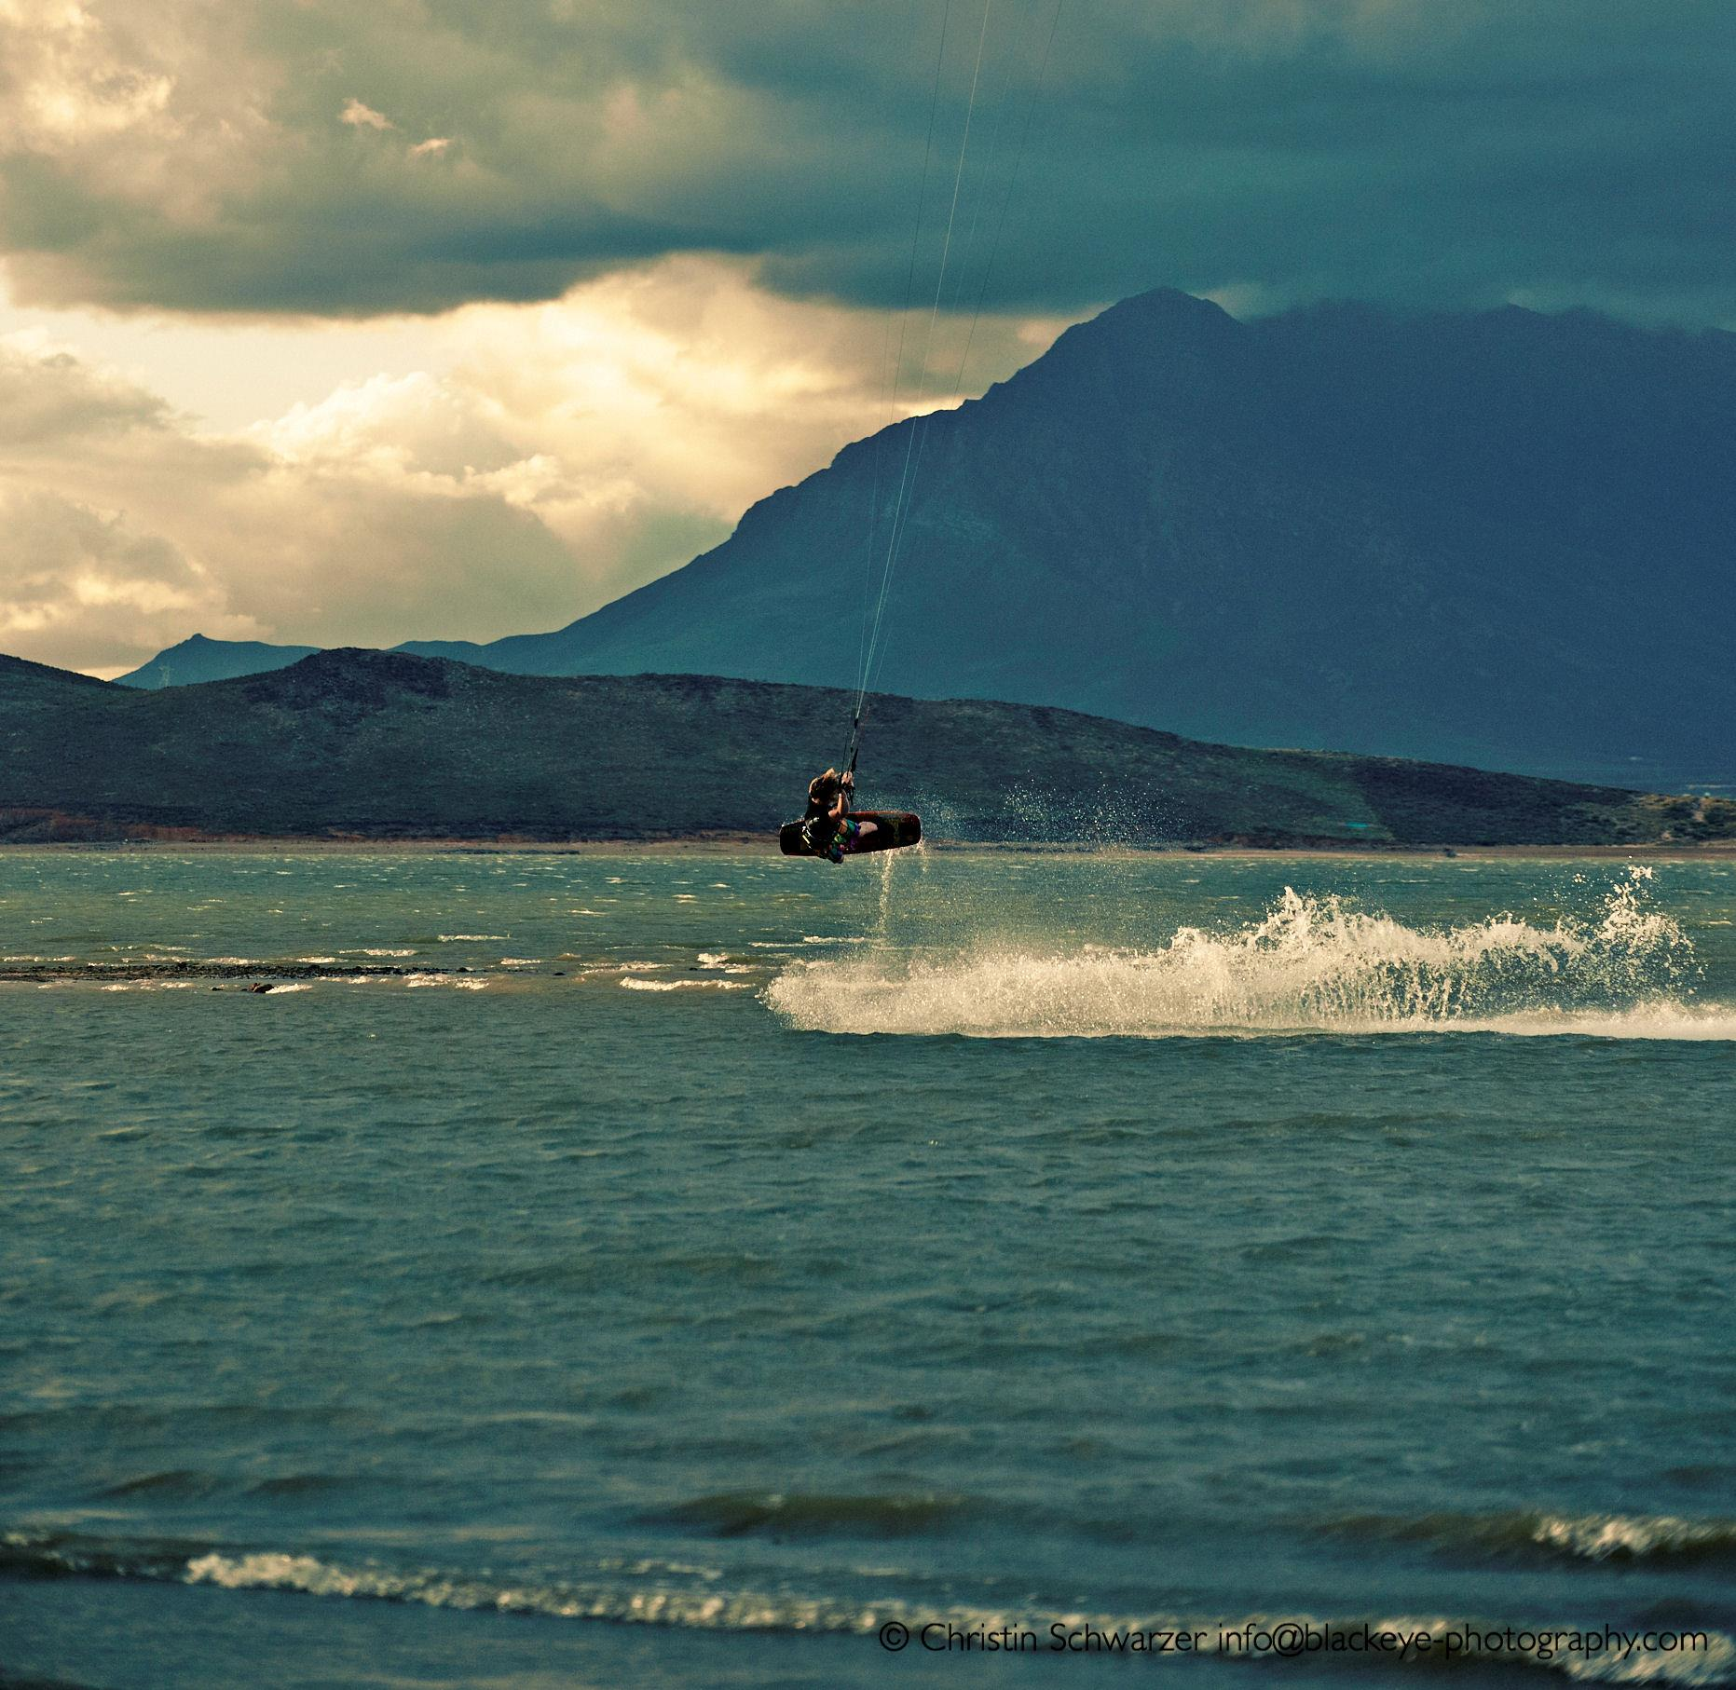
Conclusions
Best places
Best conditions
Seasonality

