Slide 1
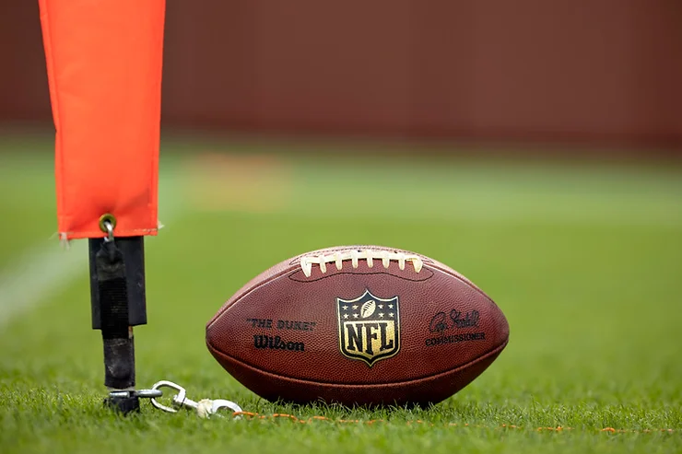
BSA Data Journalism Article: When Should NFL Teams Go for it on 4th Down?
By Tom Seifert

Slide 2
Overview
Idea
Proposal
Final Article

Slide 3
Idea
When Should NFL Teams Go for it on 4th Down?
What data can I use?
What does “should go for it” mean?
How can I use my data to assess/recommend 4th down decisions?

Slide 4
Idea
Data
Win Probability Added (WPA): change in offense’s win probability after a play
Seconds remaining: seconds remaining before a play
Yards to go: yards needed to convert 1st down before a play
Yard line: spot of ball before a play (1 to 100)
Score differential: difference in scores of 2 teams before a play

Slide 5
Proposal
Research Question
On what down and distance and area of the field should teams choose to go for it on 4th down instead of punting/kicking?
Outline
Estimate outcome probabilities & predicted WPA for each outcome
Create weighted expected WPA stats
Statistical tools & methods
Regression models in RStudio: create, evaluate, compare
Definitions

Slide 6
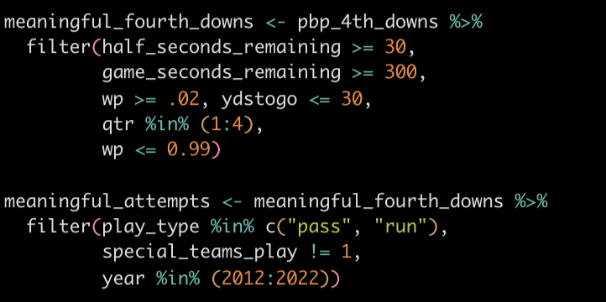
Final Project
Filtering data

Slide 7
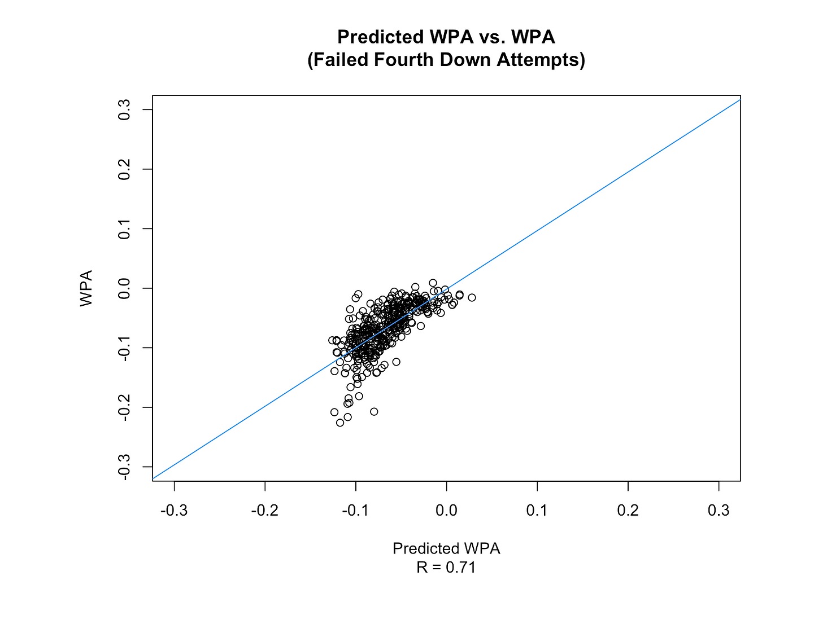
Final Project

Slide 8
Final Project
Expected Field Goal WPA (eFGWPA):
Definition: Expected WPA if a team attempts a field goal
Equation: (WPA if FGM x FGM Prob) + (WPA if FG Miss x (1 - FGM Prob))
Expected Attempt WPA (eAWPA)
Definition: Expected WPA if a team goes for it on 4th down
Equation: (WPA if Conv x Conv Prob) + (WPA if Failed x (1 - Conv Prob))

Slide 9
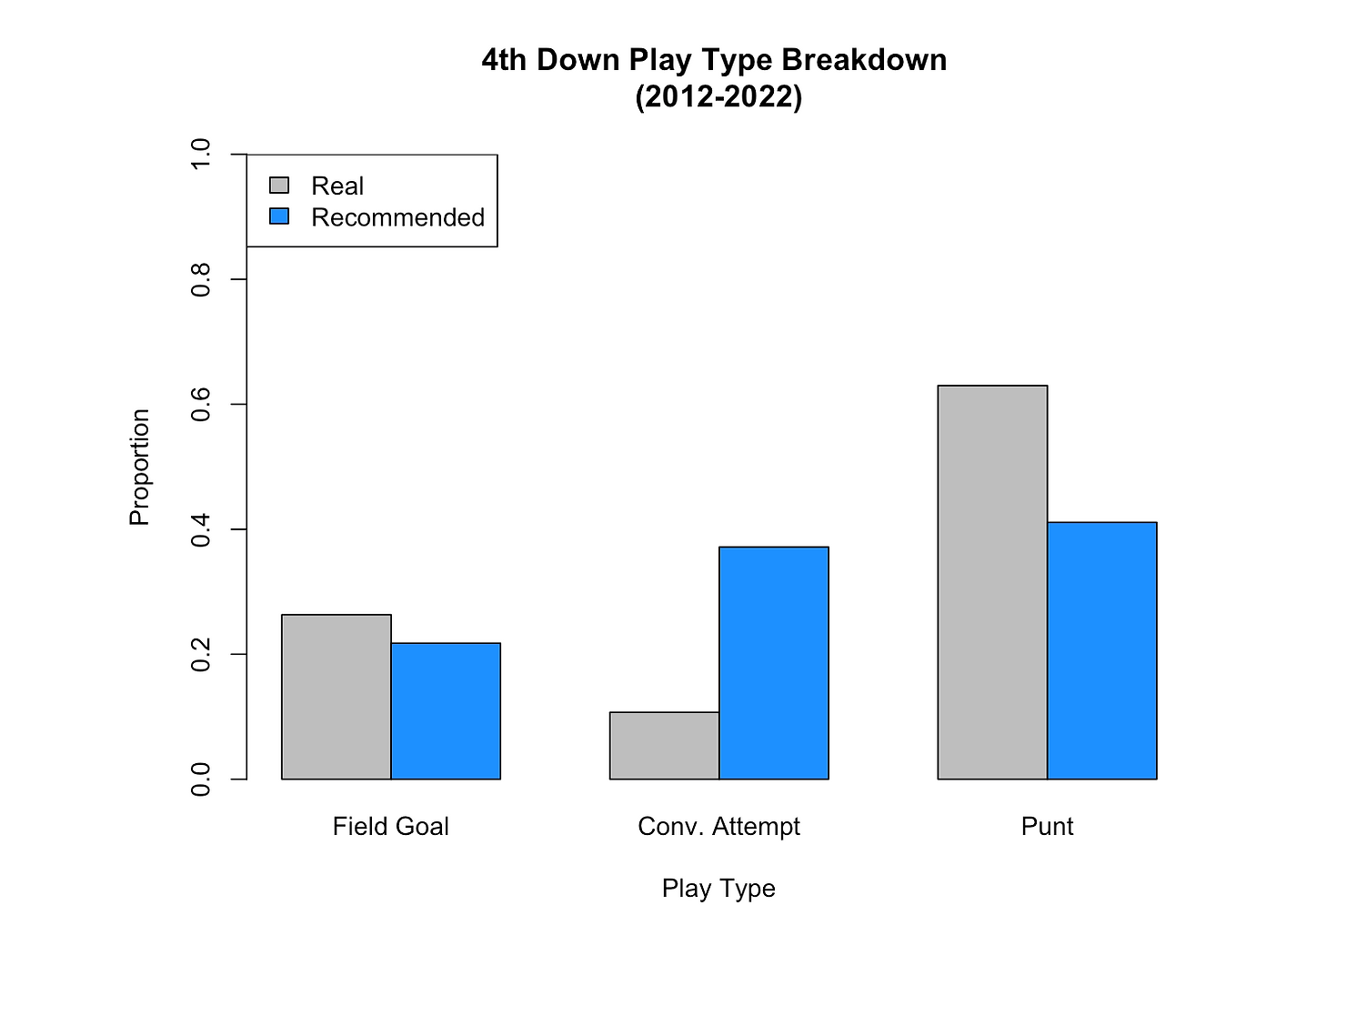
Final Project
Go for it:
eAWPA > eFGWPA
eAWPA >= 0 or yard line <= 35
Attempt a Field Goal:
eFGWPA > eAWPA
eFGWPA >= 0 or yard line <= 35
Punt:
eAWPA < 0
eFGWPA < 0
Yard line > 35

Slide 10
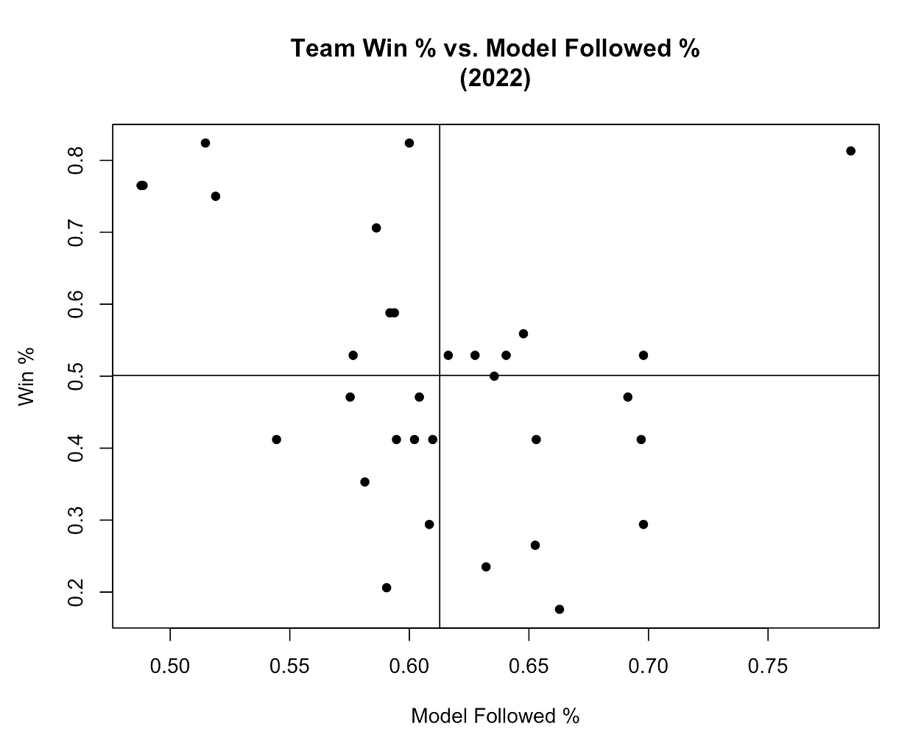
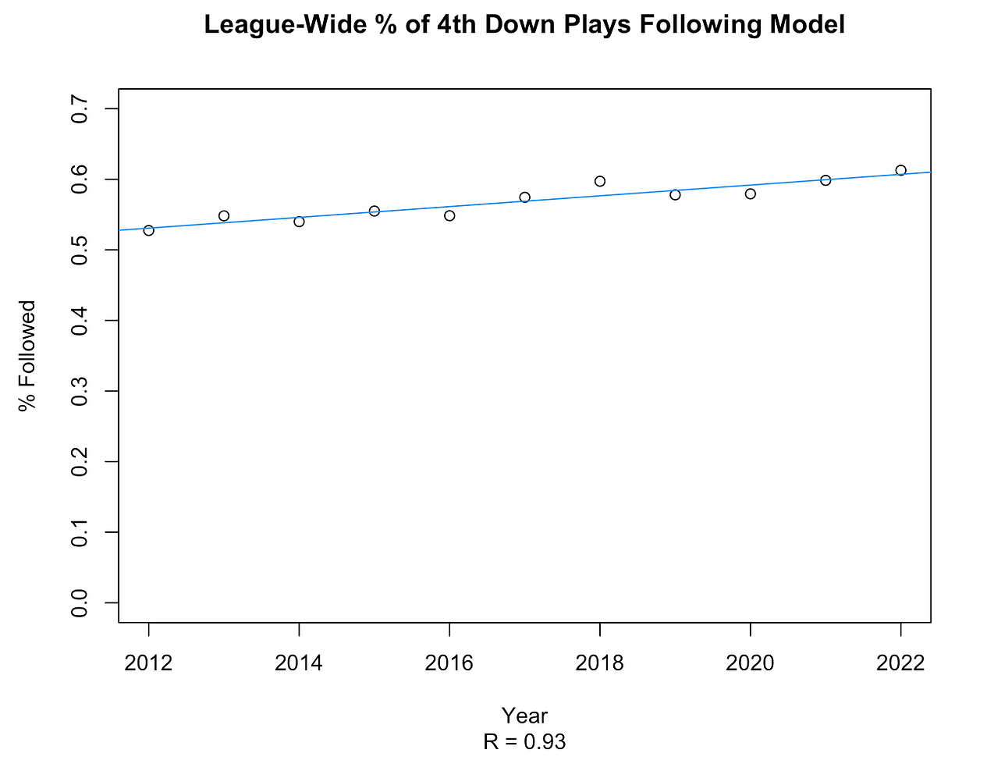
Final Project
Trends:

Slide 11
Final Project
Model neglects…
Areas of strength in certain teams/players/units
Coaching Style
If given more time I would…
Look deeper into punting
Assess change in 4th downs over time
Create interactive tool to evaluate real time 4th downs – any ideas?

Slide 12
What I learned
Pick a topic you’re curious about
Have direction, but don’t box yourself in
Stay within your data, recognize shortcomings
Have fun

Slide 13
Thank You!
Questions?

