Slide 1

Loan Defaults
The Who’s, Why’s and Where’s on Defaults
Tom Wightman – D12
Notes:
My project is about loan defaults, specifically looking who is likely to default, why they are likely and where these people they are from

Slide 2
"You’ve been hired by LendingClub...
... they want to understand who is likely to default and who they should lend to in the future."
The Brief
Notes:
This is an insight into the brief I chose, essentially
I want to identify WHO is likely to default on their loan and who the company I am working for, should lend to in the future
From this you can begin to identify business question from and for all you data spuds out there you may even be able to imagine what the analysis process looks like..
CLICK

Slide 3

• Background
• Planning
• Data quality, bias and ethical concerns
• Results
• Conclusions
• Reflection
Contents
Notes:
Presentation Scheduled for 10 mins + time for questions
Covering topics...
On a side note during presentation rehearsals to my gf she mistakenly thought my presentation was about loans with Greggs the baker ... who knows you might even get a cinnamon bun with your loan

Slide 4
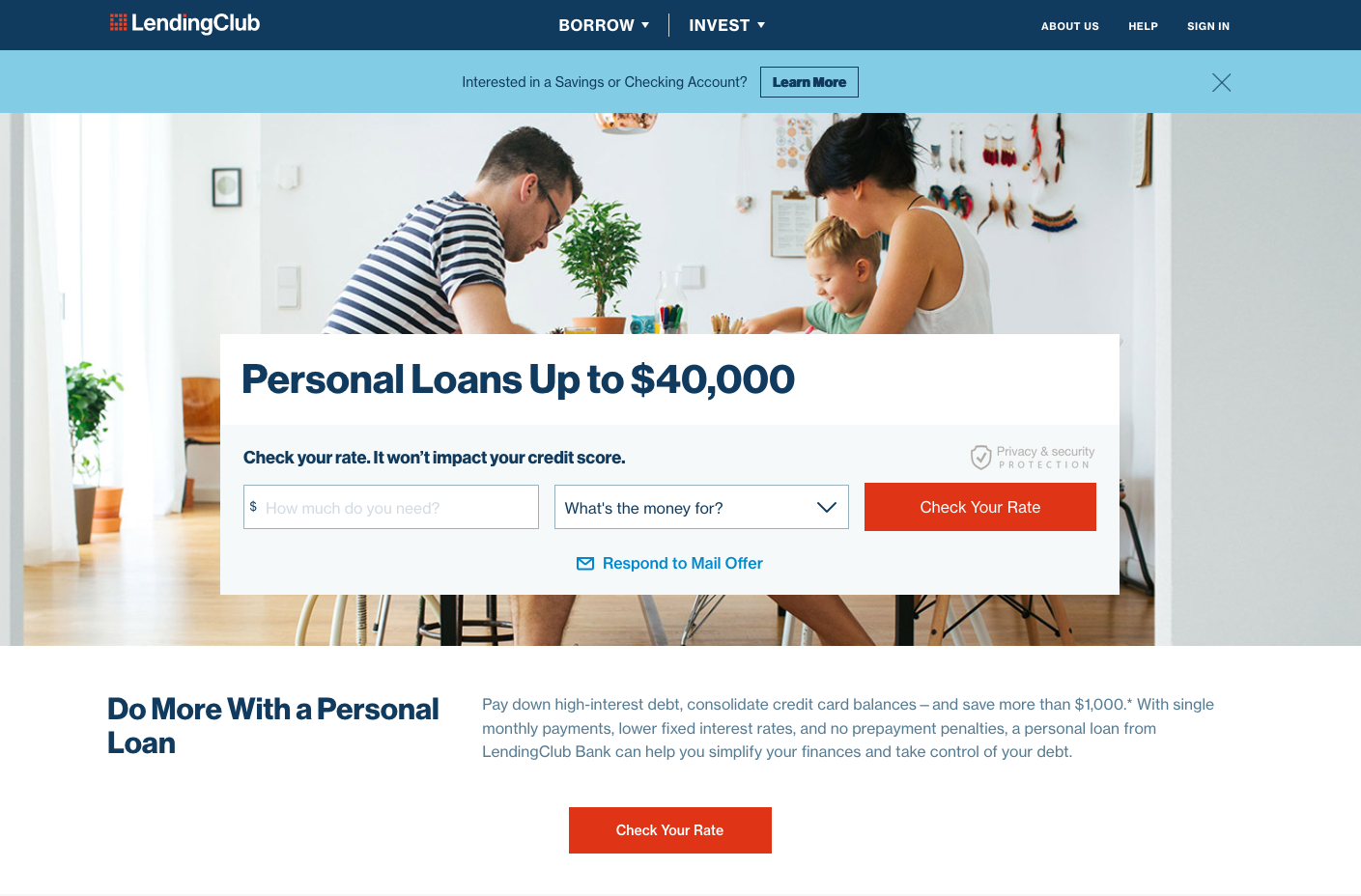
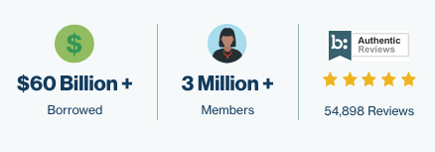


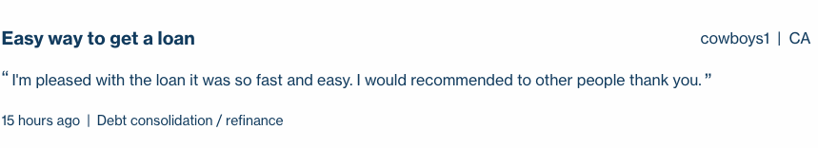
Background
Notes:
Founded - 2006
LendingClub is a peer-to-peer lending company headquartered in San Francisco, California.
CLICK
They have very enticing home page with promises of wads of cash and to get started and you only need to provide 2 pieces of information.
CLICK
- Very popular as proclaimed on their website
- Has even won some awards
- and even at 15 hours ago cowboys1 from cali has recently enjoyed his loan
>>>>>
SO?? LC are pathfinder into a new style of loaning system. Sitting between banks and consumers, essentially facilitators (middle men),

Slide 5
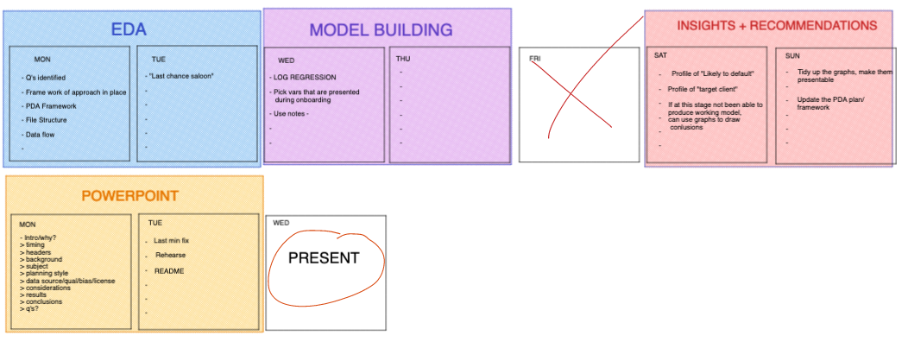
Questions
- Who is likely to default?
- Who should they lend to in the future?
The Who’s
- FICO Score (credit score)
The Why’s
- Loan Purpose
The Where’s
- Geographic location within the USA
TIMELINE
Planning
Notes:
As the great Prussian Field Marshal Helmuth von Moltke
”No Plan Survives Contact with the enemy” or words to that effect..... It certainly was true in my case, as you will find out shortly....
----CLICK
Firstly i looked at the business question and derived2 parts...
----CLICK
SO?? I deduced that if uncover the answer to one, by proxy you will uncover the answer to the other.
I then broke it down to 3 parts...
----CLICK
I chose these as I felt they best represent the answer to building a profile of the customer in order to answer the business question.
----CLICK
A timeline for my project was as follows, broken down into 4 phases...
Personal circumstances moved the timeline to the right a day or two however was not such a burden on the project. As you can see I had intended to build a model, I did however its performance was very poor and not worth including... more in the refection slides.

Slide 6
Data Sets
• All CSV files
• LendingClub customer data
• State names
• LendingClub Grades
Bias
• No immediate bias observed
Quality
• Text, Numbers, Dates, Logical (True/False)
• Missing Values, lots of!
• Before cleaning: 116 columns & 42, 538 rows
• After cleaning: 63 columns & 42, 370 rows
Ethical Implications
• Identifying information redacted
• Place of employment visible
• Customer free text “description” of reason for loan
• Business requirement
The Data
Notes:
There was 3 datasets that were all in csv format containing the customer information, full US state names and LendingClub attributed grades which where then joined together.
Quality – A volume of missing values, after cleaning the data of them I almost halfed the amout of columns in the dataset
Bias -
No immediate bias, had customer profiles representing all american states from varying incomes, home ownership and employments.
Ethical Implications –….

Slide 7
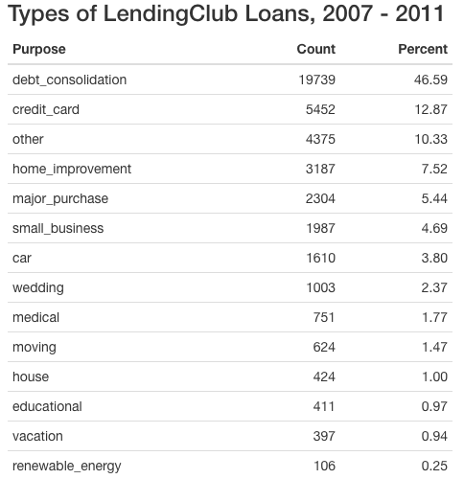
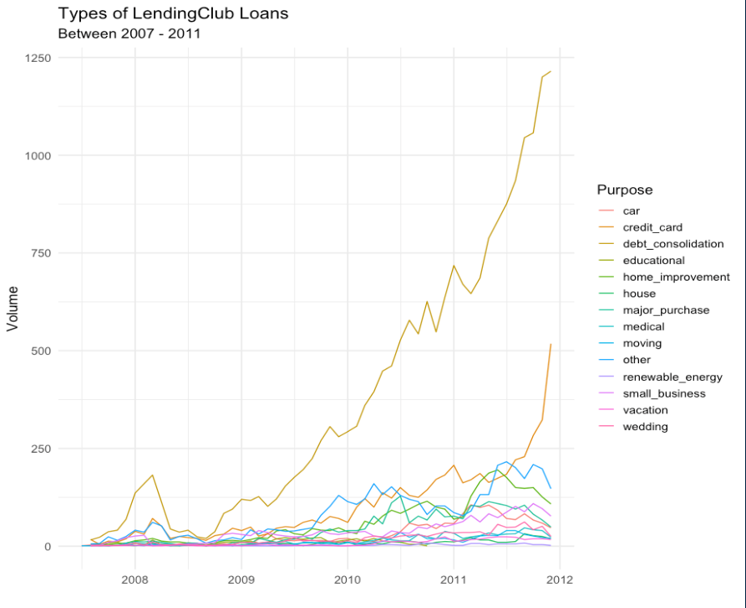
The Data: Initial Analysis
Notes:
From 2007 – late 2011 the top 3 reasons for Loans show as debt consolidation, paying off credit cards and other. Through analysis of user entered descriptions "other" is a mixture repaying debts, credit cards, home repairs, building credit and holidays.
CLICK
Line graph shows the journey of these types of loans over time – debt consolidation remained the highest throughout the time period with paying off credit cards overtaking the “other” category – CLICK- around mid 2010.
TAKEAWAY– debt consolidation remains the most popular reasons for LC Loans
Now looking back at the brief I had to find those customers most likely to default.... that meant defining a defaulted loan..... >>>

Slide 8
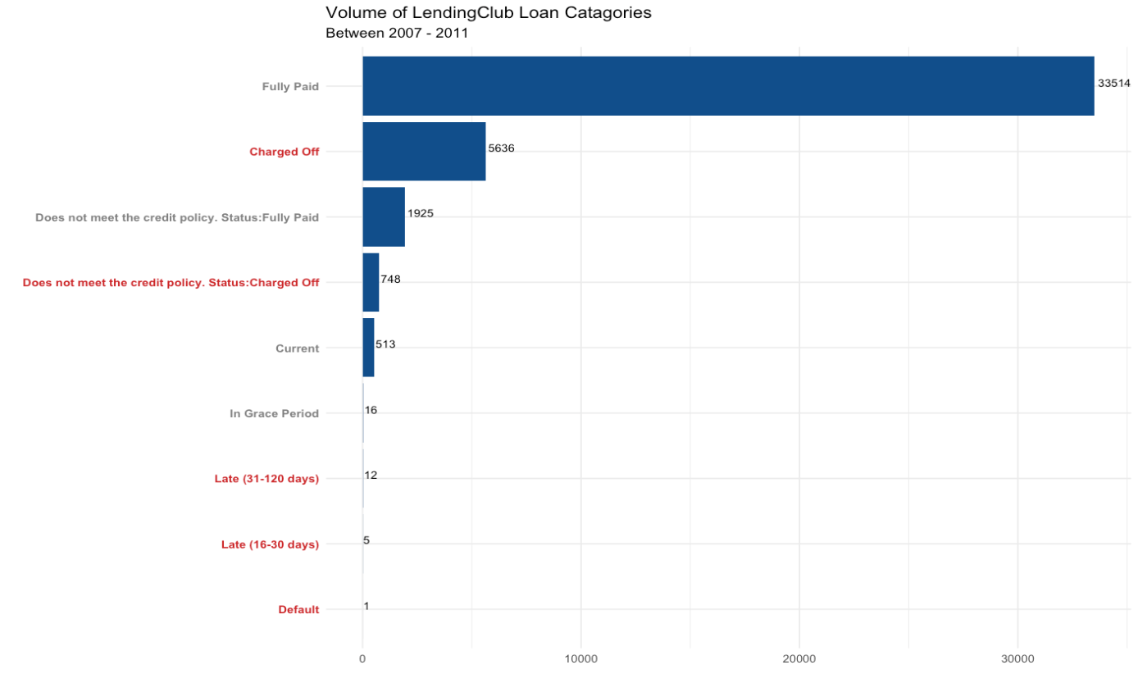
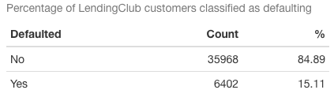
“…if you fail to make
on-time payments,
your loan can go into
default.”
www.creditkarma.co.uk
The Data: Initial Analysis
Notes:
CLICK
- Looking at the categories of loan status in the dataset,
this shows the volume of customers in each category - category down the side and volume across the bottom.
- Highlighted in red are the categories that meet the definition of a defaulted loan.
- What this gave me was a CLICK
85% non-defaults, 15% defaulted - as it stand enough data to conduct basic analysis on.
Returning to my 3 identified sub-questions, I began with Who is likely to default

Slide 9
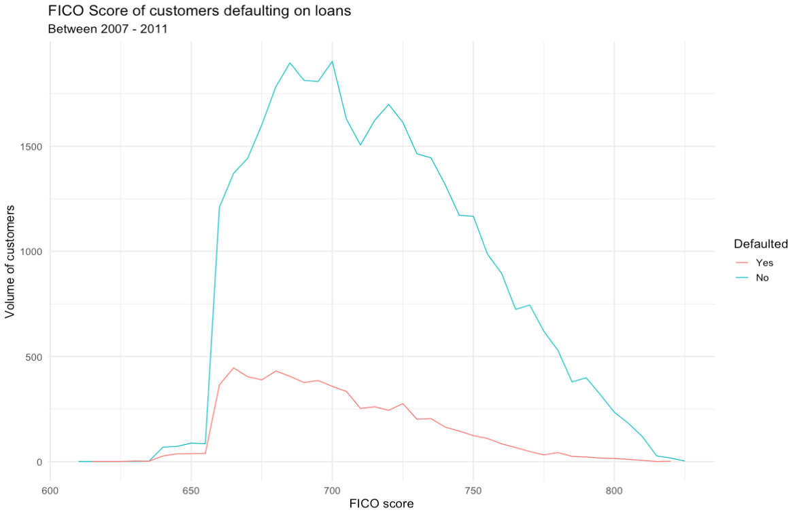
FICO Score
• Fair Isaac Corporation (FICO)
• Between 300 – 850 points
• Lenders want 670 -739 points
• FICO Range Low & High in data set, 4 points difference
Least likely to default
Most likely to default
Defaulted Loans, The Who’s:
FICO SCORE (credit score)
Notes:
FICO Score,
Is a credit score created by the Fair Isaac Corporation
Between 300 – 850 points,
Scores of 670 -739 indicate “good credit history” for lenders
FICO Scoer in data set… so chose to have a lower tolerance for defaulting
CLICK - CLICK-
Line graph shows FICO Score of customers defaulting on loans, with volume of customers on the left, score on the bottom and a legend denoting orange has defaulted and blue not defaulted
Describing both lines propotionally the Fico score starts here at 615, gradually increases to 660 where it dramatically increases. This appears to be lendingclubs lower tolerance for “good credit”...
The trend then peaks and begins a dragged out decline on both lines.
SO? – CLICK -
https://www.investopedia.com/terms/f/ficoscore.asphttps://
www.investopedia.com/terms/f/ficoscore.asp

Slide 10
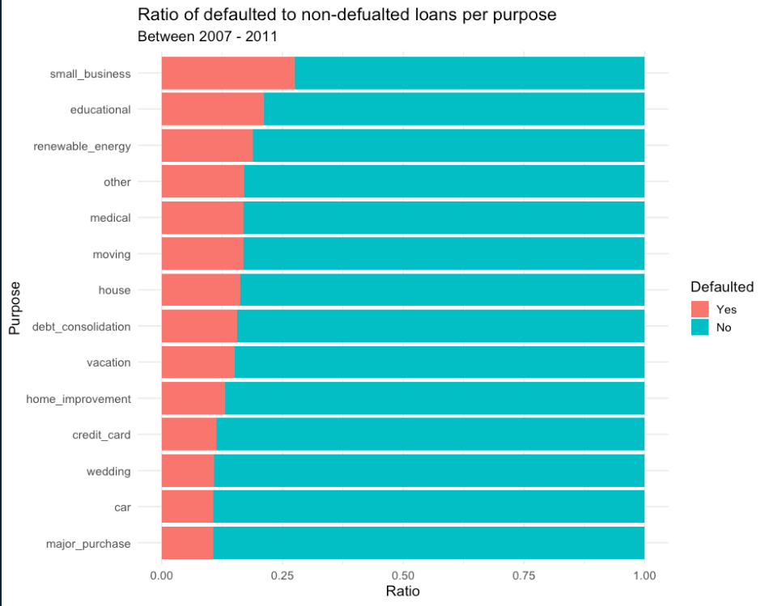
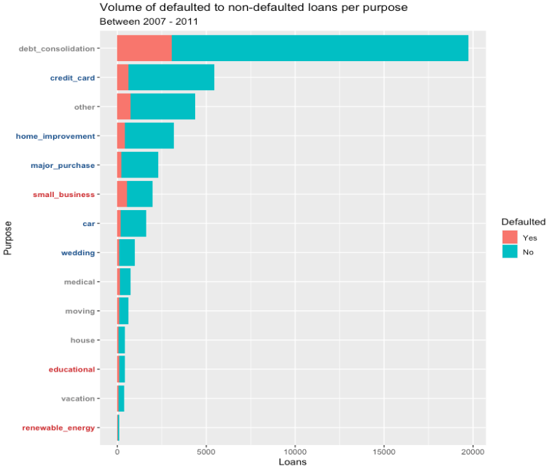
High risk of default
Least likely to default
Medium risk of default
Most likely to default
Low risk of default
Defaulted Loans, The Why’s:
LOAN PURPOSE
Notes:
Looking at the ratios of defaulted to non-defaulted loans per purpose with purpose on the left and ratio along the bottom, we can see that loans for small businesses, loans to pay off education fees and loans used for the creating of renewable energy sources are the top of the chart. In fact you can identify sections within the data, showing roughly 3 main areas of risk-
CLICK- from high / medium / low.
CLICK –
Reflected in the Volume of defaulted to non-defaulted loans plot, with purpose on the left and number of loans on the bottom, is a distribution that shows the top 6 purposes for a loan actually falling into the low to medium risk categories - this is great for LC as the Majority of their customers are using loans for reasons less likely to default.
However, -CLICK- as “other” is in the upper limit of medium risk I have chosen to omit “other” from the profile of a customer less likely to default. - CLICK-
With debt consolidation being at the bottom end of medium risk and with the volume almost as much as the other 13 purposes combined, it would be detrimental for profits to exclude this from a positive customer profile.
CLICK - SO, the least likely to default based on default ratios and risk categories, Least likely to default are.....
CLICK most likely to default are....

Slide 11
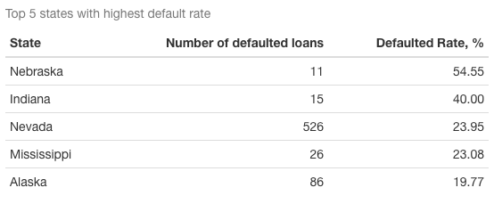
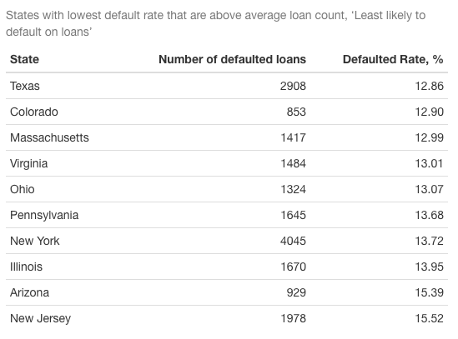
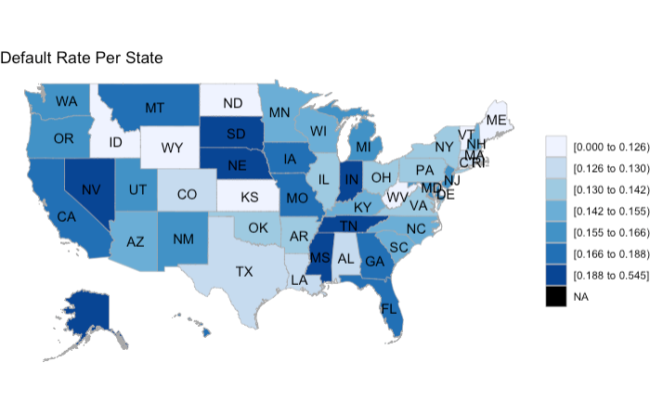
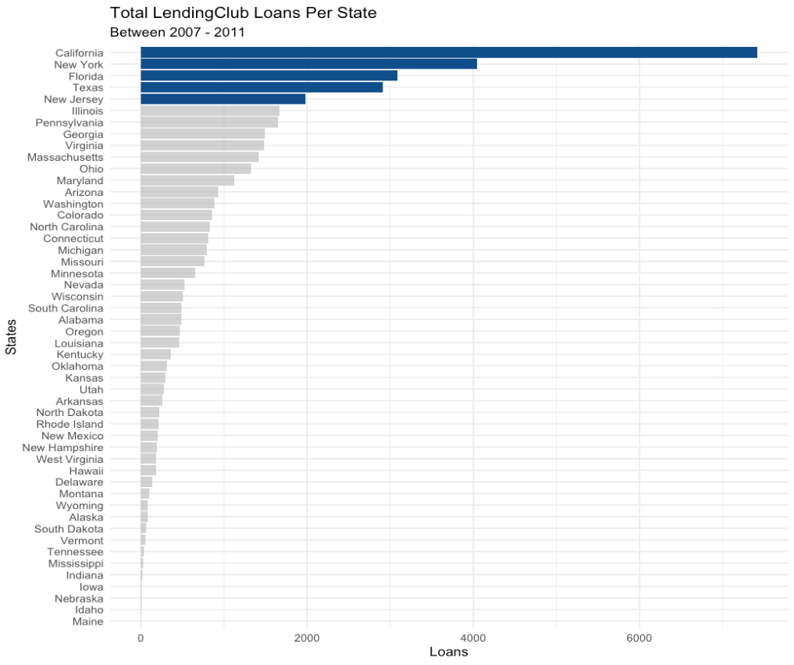
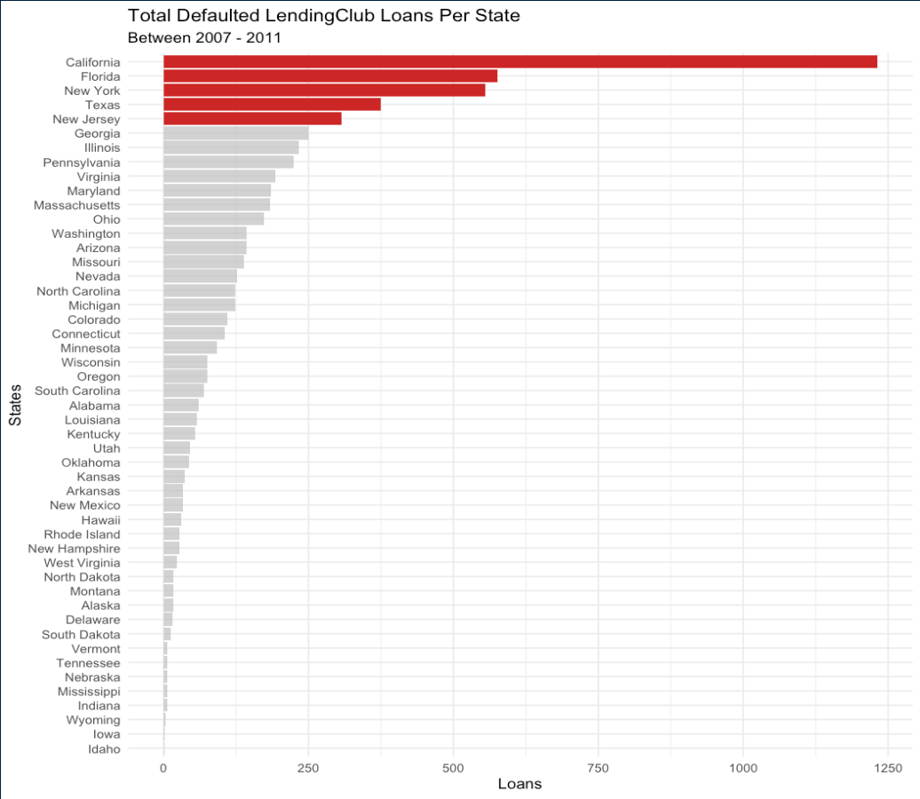
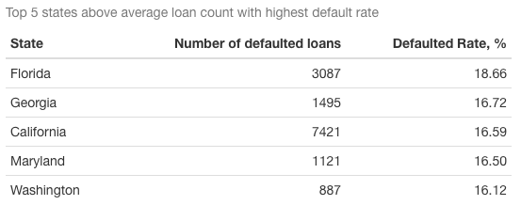
Least likely to default
Most likely to default
Defaulted Loans, The Where’s:
GEOGRAPHIC LOCATION
Notes:
Highest amount of loans taken out come from Cal / NY / Flor / Tex / New Jer however this could be proportional to the population of those areas
CLICK - Filtering those on defaulted loans there is no surprise the highest number of defaults were the same top 5 stats, SO To get a better representation at defaults, I looked at the default rate...
CLICK
- Map - ratio of defaults per state ( darker the area the higher default ratio) - Immediately you can see states such at Nebraska, Indiana, Nevada Mississippi and Alaska floating bottom left have the highest ratio of defaults, however I felt was is not truly accurate....
- CLICK
- ... because as you can see the loan counts are not all proportionate to each other : Nebraska having 6/11 customers default could be giving an unfair representation of the state, so what I did was...
- CLICK
- highlight the top 5 states above the average loan count (847 loans) with the highest default rate.
- CLICK
- I did the same with but with the lowest default rate
- SO??? - CLICK - the states denoted are most and least likely to default..

Slide 12
Customer Profile
Possibly most likely default
State: California, Maryland, Washington, Florida and Georgia
Purpose: Small Business, Educational Loans, Renewable energies
Income:
Possibly least likely to default
State: New Jersey, Texas, New York, Pennsylvania, Arizona, Ohio, Massachusetts, Virginia, Colorado, Illinoi
Purpose: Debt Consolidation, Credit Card, Home Improvement, Major Purchase
Income:
Conclusions

Slide 13
Challenges
• Understanding the data to prepare for model building
• Model planning/creation
Change in approach
• Use statistical significance testing to quantify findings
• Identify more correlated variables to defaulting
• Model knowledge and experience
Reflection
Notes:
Chose this brief because i am really fascinated by models and the predictive power they have, I wasnt fully confident with them after the lectures so wanted to challenge myself.

Slide 14
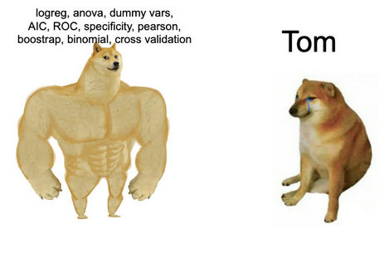
model building
Questions

