Slide 1

Loan Defaults
The Who’s, Why’s and Where’s
Tom Wightman – D12

Slide 2
"You’ve been hired by LendingClub, an online loan provider to help with some problems their business has been facing.
They are concerned about the default rate on their loans.
They want to understand who is likely to default and who they should lend to in the future."
The Brief
Notes:
From this you can begin to identify business question from and for all you data spuds out there you may even be able to imagine what the analysis process may even look like.

Slide 3

• Background
• Planning
• Data quality, bias and ethical concerns
• Results
• Conclusions
• Reflection
Contents
Notes:
Scheduled for 10 mins + time for questions
During rehearsals at this point in the pres, my gf mistakenly thought my presentation was about loans with Greggs the baker ... who knows you might even get a cinnamon bun with your loan

Slide 4

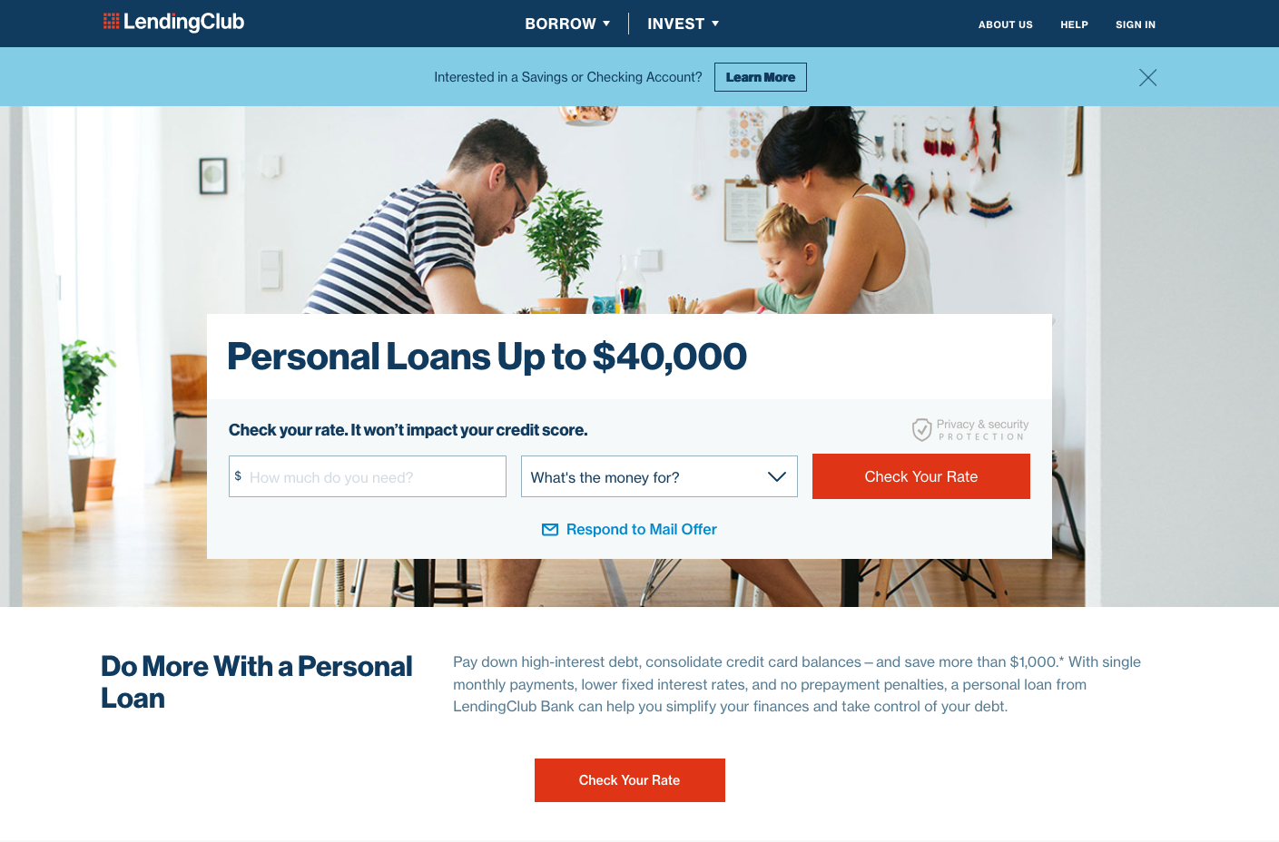
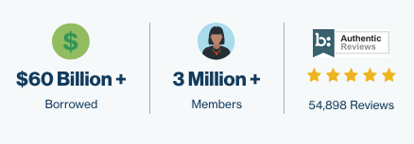

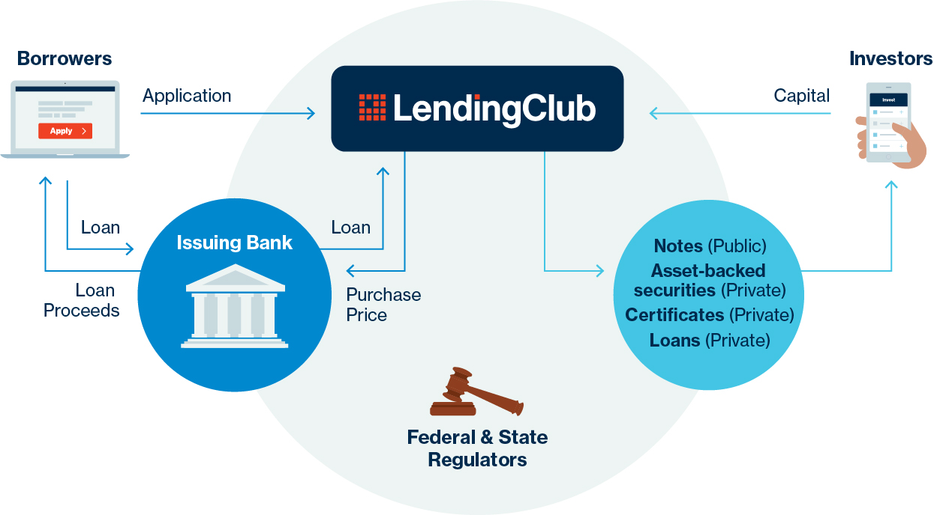
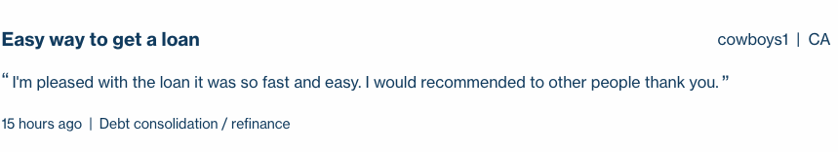
Notes:
LC homepage....
Founded - 2006
Employees - 1,837 (2017)
LendingClub is a peer-to-peer lending company headquartered in San Francisco, California. It was the first peer-to-peer lender to register its offerings as securities with the Securities and Exchange Commission, and to offer loan trading on a secondary market.
SO?? THE pathfinder into a new style of loaning system.
- Very popular as proclaimed on their website
- Has even won some awards
- and even at 15 hours ago cowboys1 from cali has recently enjoyed his loan
WORKFLOW -
As you can see, peer to peer .. customers apply to LC, LC receives the money from investors, the particulars of the loan go to the issuing bank for approval all while being regulated by the state and federal authorities.
SO?? LC are facilitators (middle men),

Slide 5
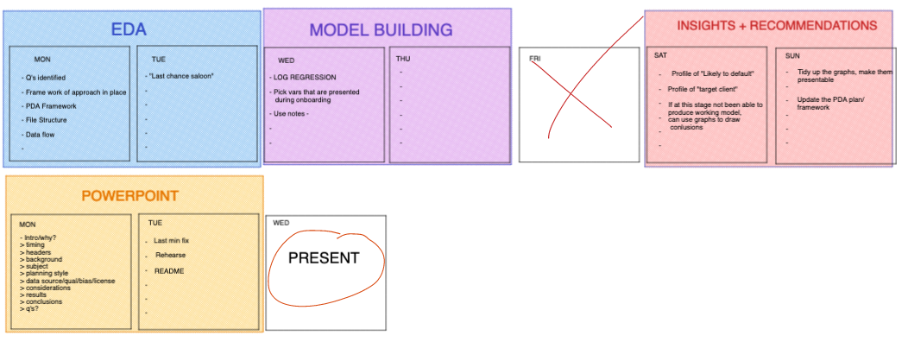
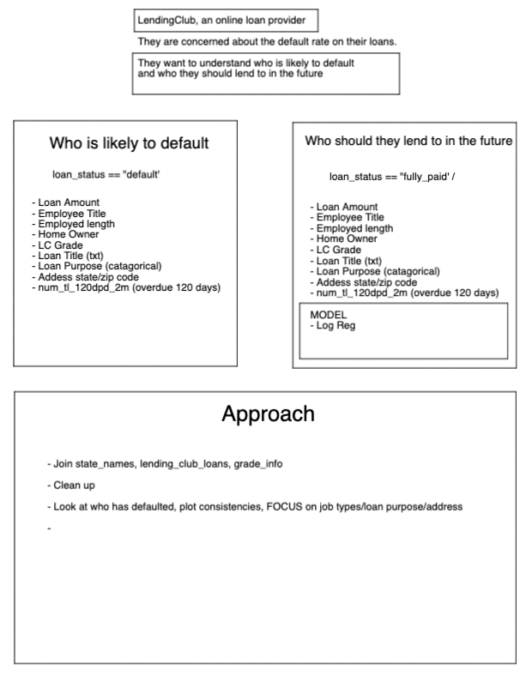
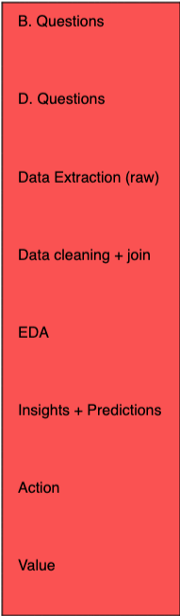
Planning
Notes:
As the great Prussian Field Marshal Helmuth von Moltke the Elder
”No Plan Survives Contact with the enemy” or words to that effect..... It certainly was true in my case, as you will find out
- Chose this brief because i am really fascinated by models and the predictive power they have, I wasnt fully confident with them after the lectures so wanted to challenge myself.
- Done on excalidraw : Broke the brief down into 2 q's......
- Used a Basic analysis workflow for the approach
- Calender for the week - 4 phases....

Slide 6
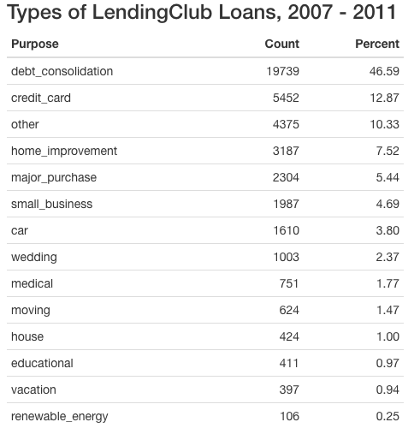
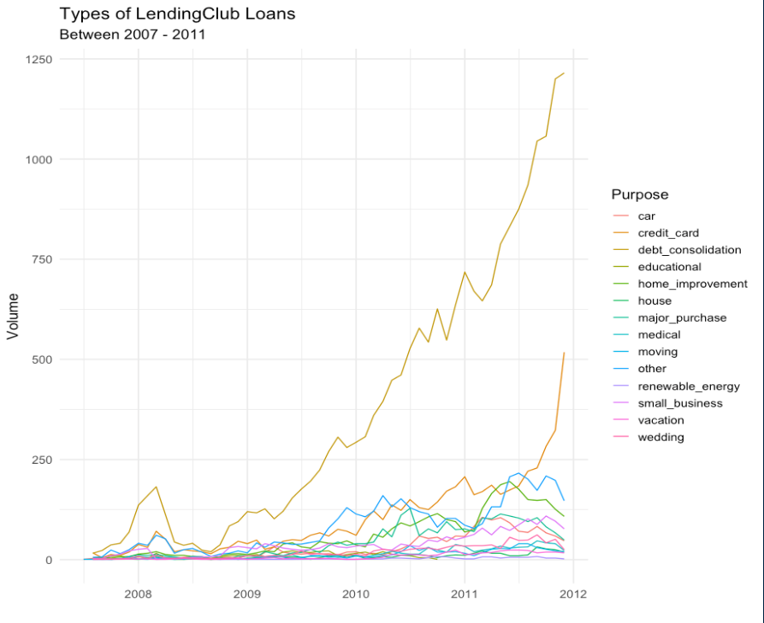
Formats
• lending_club_loans.csv : Internal
• state_names_info.csv : External
• grade_info.csv : Internal
Variable | Type | Sub-type | Example
loan_amnt | Numerical | dbl | 7500
payment_plan | Catergorical | chr | y
initial_list_status | Boolean | lgl | False
issue_d | Date | chr | Dec-2011
Quality
• 116 columns & 42, 538 rows raw
• 63 columns & 42, 370 rows after cleaning
• NA’s… lots of!
Ethical Implications
• Identifying information (zip_code) redacted
• Place of employment visible
• Customer free text “description” of reason for loan – potentially identifying
• Business requirement
Bias
• Customers from all backgrounds – no immediate bias observed
Data
Notes:
Formats –
3 x csv files in order of largest to smallest depicting if they are from the company or externally provided - supplimentary as states were abbreviated in dataset
Table -
Variable examples listing multiple data types – I had to remove a large number of Boolean as they were mainly populated with NA/s – considerations were made to customers possibly never experiencing the variable description, however as all NA/s decided to remove
Quality –
As seen almost half variables were removed, however still large amounts for model building – I then broke this down further into an “onramp data set” (19) and a ”background check data set”(17),
Bias -
No immediate bias, had customer profiles representing all american states from varying incomes, home ownership and employments.
Ethical Implications –
Data is made up of mainly these purposes….
Credit card and debt consolidation are the only 2 categories to increase in loan volume from the late 2012… potential explanation is due to the financial crisis with USA experienced with the debt-to-GDP ratio 100%, higher than at any time since World War II. Plus according to the myan calendar it was the end of the world so who knows…

Slide 7
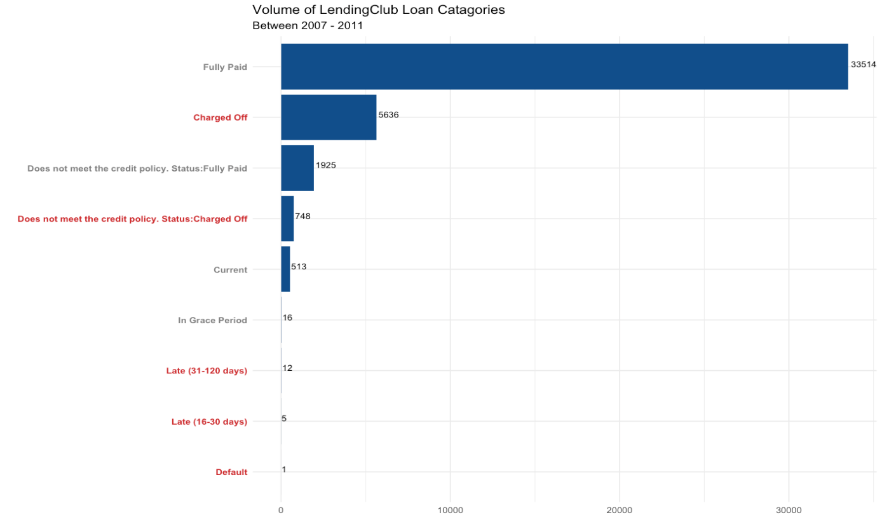
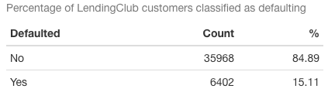
Results - Defaults
Notes:
Defining Defualted - When you borrow money from a lender, you make a promise to repay the loan. So if you fail to make on-time payments, your loan can go into default. Default can occur immediately after a missed payment or months later, as the exact timeline will depend on your loan terms and applicable law - https://www.creditkarma.co.uk/insights/i/what-happens-if-you-default-on-a-loan/
about 15% of customers are either charged off, late > 16days or have defaulted

Slide 8
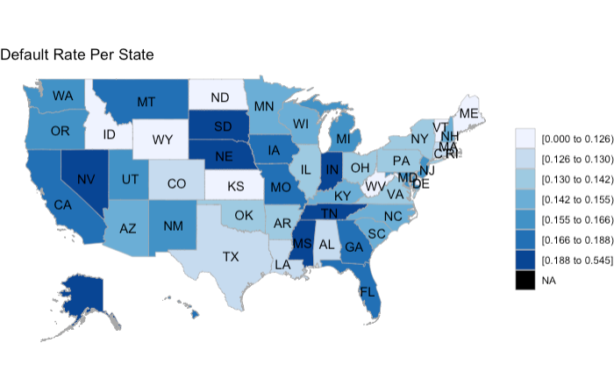
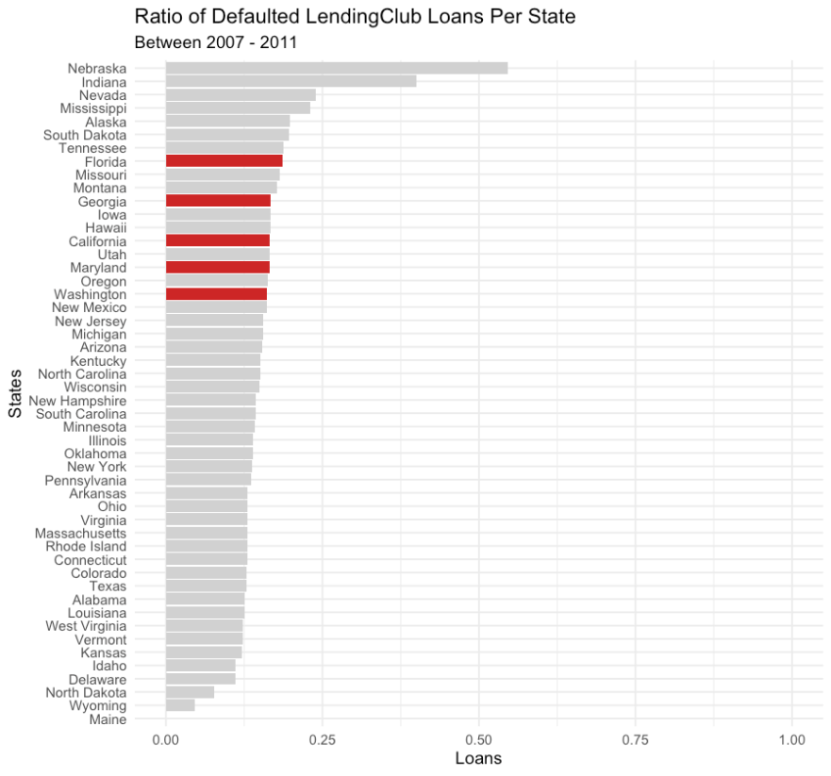
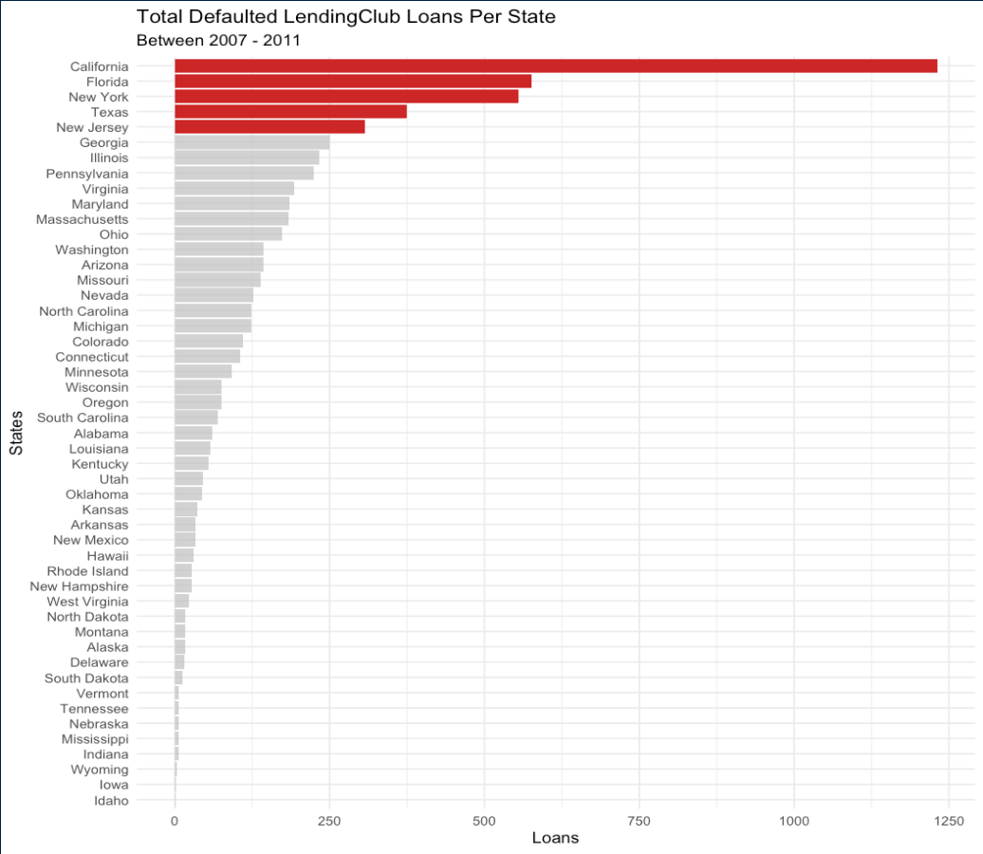
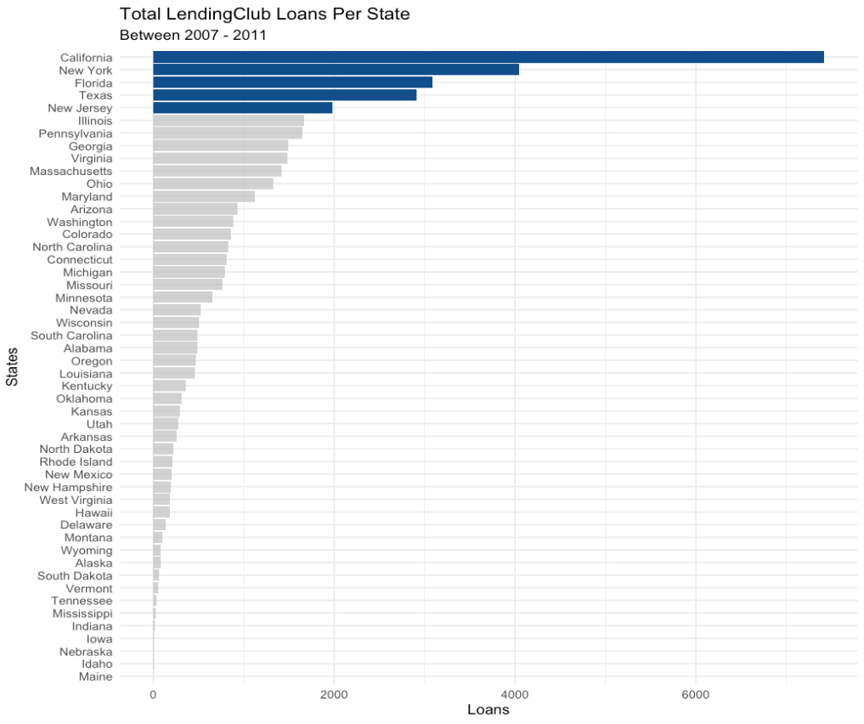
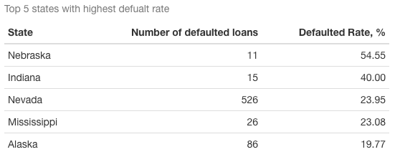
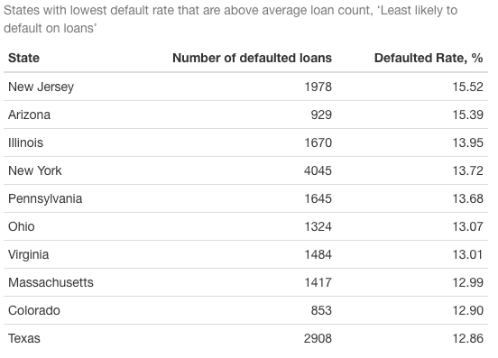
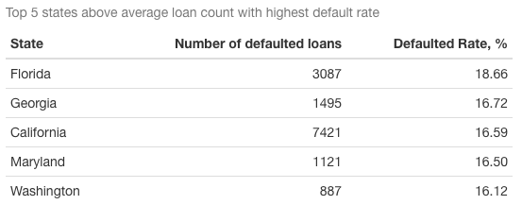
Results – Geography
Notes:
- Highest amount of loans taken out come from Cal / NY / Flor / Tex / New Jer however this could be proportional to the population of those areas -
# 1. California - 39,538,223
# 2. Texas - 29,145,505
# 3. Florida - 21,538,187
# 4. New York - 20,201,249
- No surprise with highest defaults - there is some change in order but negligible . To get a better representation at defaults, looked at the rate...
- Map - ratio of defaults per state ( darker the area the higher default ratio) - this is not truly accurate....
- ... because as you can see the loan counts are not all proportionate to each other : Nebraska having 5/11 customers default could be giving an unfair representation of the state, so what I did was...
- highlight the top 5 states with highest default rate with a count of loans more than the average count of loans per state, 847. This was to give a fairer result.
SO??
Customers who are from the top 5 states highlighted in red COULD be more liable to default on their loans from LC -
- Customers who are less likely are as follows

Slide 9
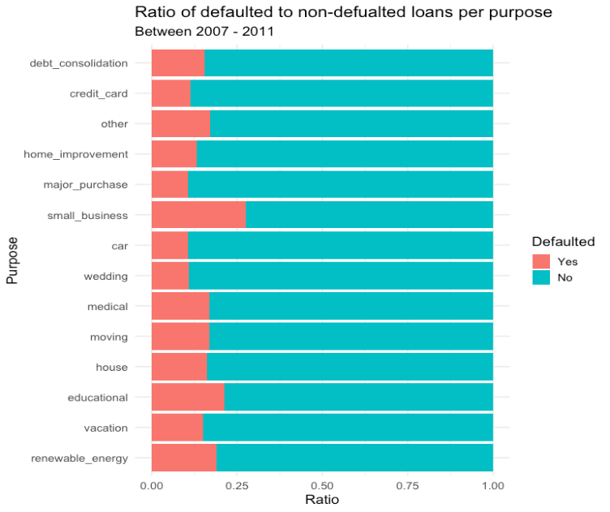
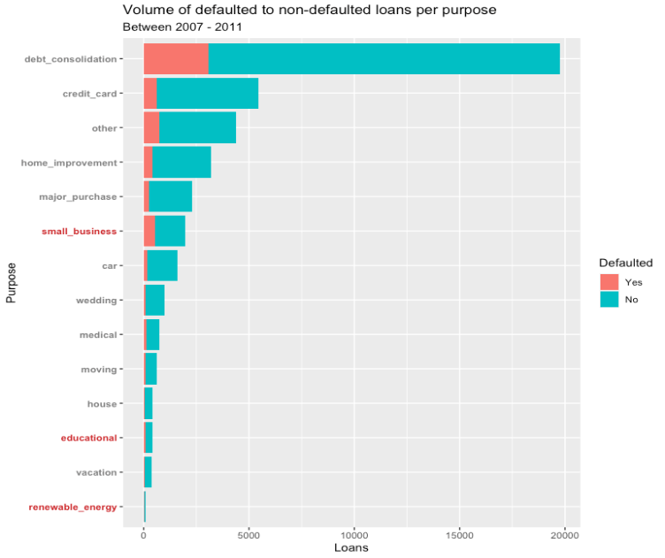
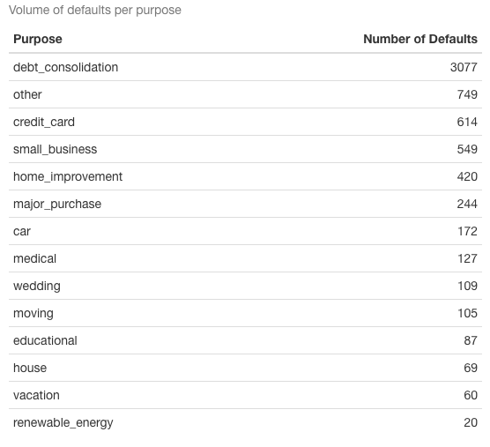
Results – Purpose
Notes:
# shows that other category is a mixture of repaying debts, credit cards, repairs, building credit, for family members /friends

Slide 10
Results – Geography

Slide 11
Results – Geography
Notes:
From this you can begin to identify business question from and for all you data spuds out there you may even be able to imagine what the analysis process may even look like.

Slide 12
Results – Geography
Notes:
From this you can begin to identify business question from and for all you data spuds out there you may even be able to imagine what the analysis process may even look like.

Slide 13
Results – Geography
Notes:
From this you can begin to identify business question from and for all you data spuds out there you may even be able to imagine what the analysis process may even look like.

Slide 14
Customer Profile
Possibly most likely default
State: California, Maryland, Washington, Florida and Georgia
Purpose:
Income:
Home owner:
Employment length:
Possibly least likely to default
State: New Jersey, Illinoi, New York, Pennsylvania, Arizona, Ohio, Massachusetts, Virginia, Colorado, Texas
Purpose:
Income:
Home owner:
Employment length:
Conclusions
Notes:
From this you can begin to identify business question from and for all you data spuds out there you may even be able to imagine what the analysis process may even look like.

Slide 15
Reflection
Notes:
From this you can begin to identify business question from and for all you data spuds out there you may even be able to imagine what the analysis process may even look like.

Slide 16
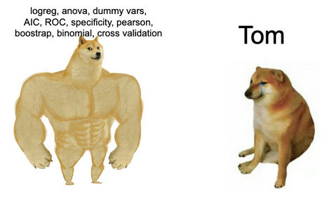
Questions

