Slide 1

Loan Defaults
The Who’s, Why’s and Where’s
Tom Wightman – D12

Slide 2
"You’ve been hired by LendingClub, an online loan provider to help with some problems their business has been facing.
They are concerned about the default rate on their loans.
They want to understand who is likely to default and who they should lend to in the future."
The Brief
Notes:
From this you can begin to identify business question from and for all you data spuds out there you may even be able to imagine what the analysis process may even look like.

Slide 3

• Background
• Planning
• Data quality, bias and ethical concerns
• Results
• Recommendations
Contents
Notes:
Scheduled for 10 mins + time for questions
During rehearsals at this point in the pres, my gf mistakenly thought my presentation was about loans with Greggs the baker ... who knows you might even get a cinnamon bun with your loan

Slide 4

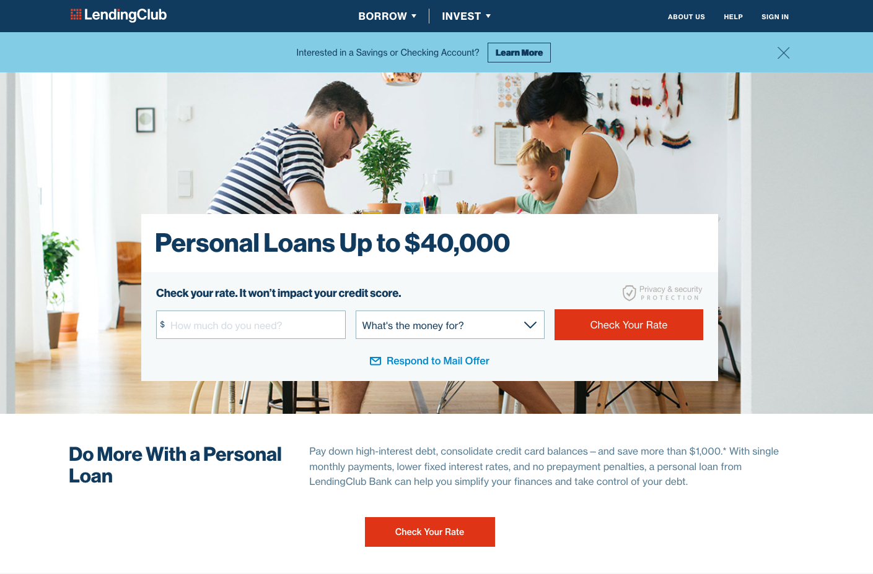
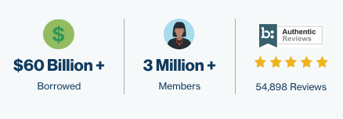
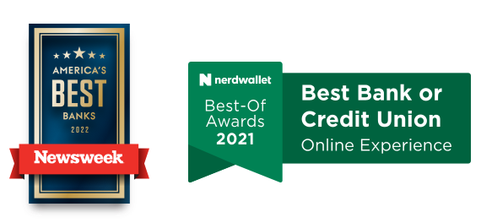
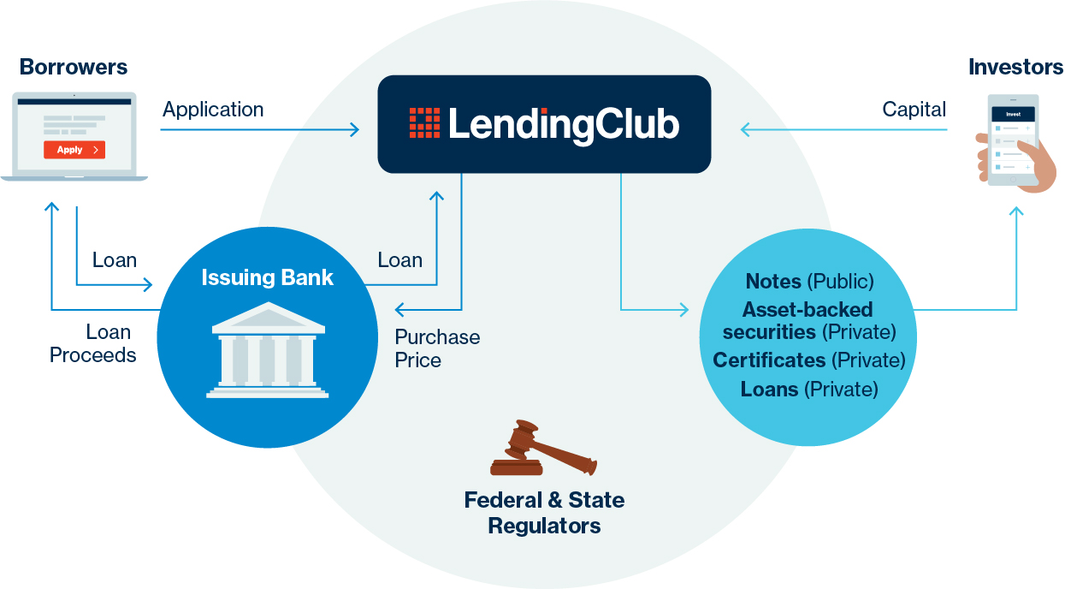
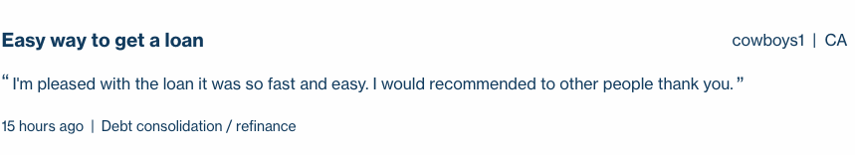
Notes:
LC homepage....
Founded - 2006
Employees - 1,837 (2017)
LendingClub is a peer-to-peer lending company headquartered in San Francisco, California. It was the first peer-to-peer lender to register its offerings as securities with the Securities and Exchange Commission, and to offer loan trading on a secondary market.
SO?? THE pathfinder into a new style of loaning system.
- Very popular as proclaimed on their website
- Has even won some awards
- and even at 15 hours ago cowboys1 from cali has recently enjoyed his loan
WORKFLOW -
As you can see, peer to peer .. customers apply to LC, LC receives the money from investors, the particulars of the loan go to the issuing bank for approval all while being regulated by the state and federal authorities.
SO?? LC are facilitators (middle men),

Slide 5
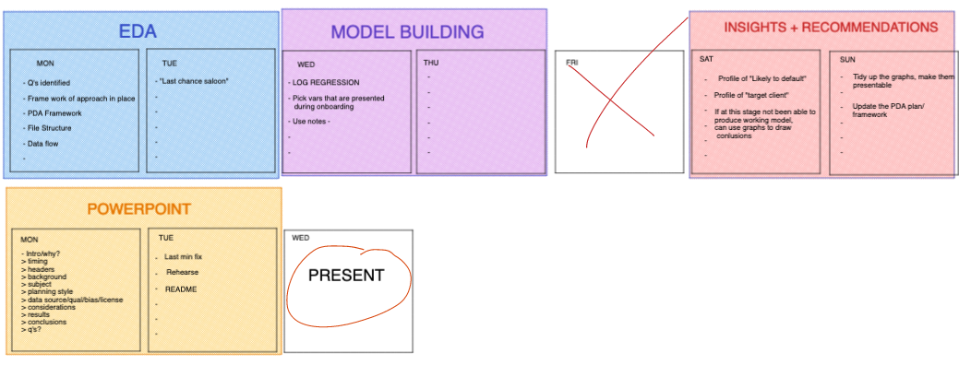
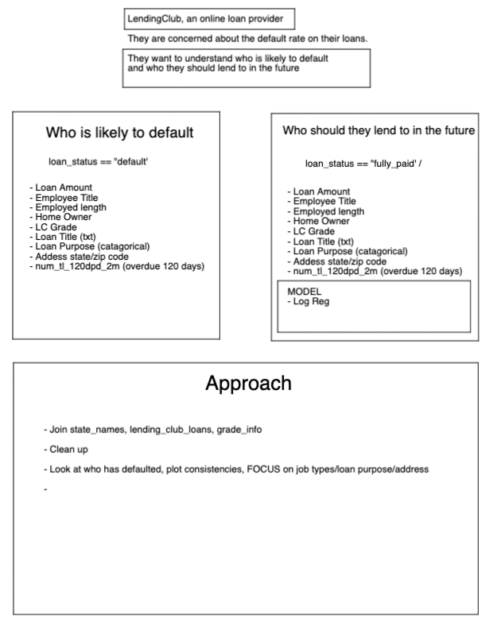
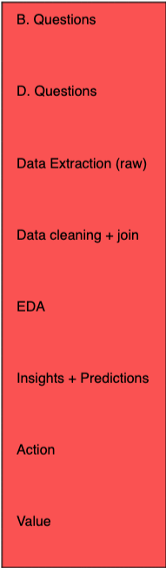
Planning
Notes:
As the great Prussian Field Marshal Helmuth von Moltke the Elder
”No Plan Survives Contact with the enemy” or words to that effect..... It certainly was true in my case, as you will find out
- Chose this brief because i am really fascinated by models and the predictive power they have, I wasnt fully confident with them after the lectures so wanted to challenge myself.
- Done on excalidraw : Broke the brief down into 2 q's......
- Used a Basic analysis workflow for the approach
- Calender for the week - 4 phases....

Slide 6
Formats
• lending_club_loans.csv : Internal
• state_names_info.csv : External
• grade_info.csv : Internal
Variable | Type | Sub-type | Example
loan_amnt | Numerical | dbl | 7500
payment_plan | Catergorical | chr | y
initial_list_status | Boolean | lgl | False
issue_d | Date | chr | Dec-2011
Quality
• 116 columns & 42, 538 rows raw
• 63 columns & 42, 370 rows after cleaning
• NA’s… lots of!
Ethical Implications
• Identifying information (zip_code) redacted
• Place of employment visible
• Customer free text “description” of reason for loan – potentially identifying
• Business requirement
Bias
• Customers from all backgrounds – no immediate bias observed
Data
Notes:
Formats –
3 x csv files in order of largest to smallest depicting if they are from the company or externally provided - supplimentary as states were abbreviated in dataset
Table -
Variable examples listing multiple data types – I had to remove a large number of Boolean as they were mainly populated with NA/s – considerations were made to customers possibly never experiencing the variable description, however as all NA/s decided to remove
Quality –
As seen almost half variables were removed, however still large amounts for model building – I then broke this down further into an “onramp data set” (19) and a ”background check data set”(17),
Bias -
No immediate bias, had customer profiles representing all american states from varying incomes, home ownership and employments.
Ethical Implications -

Slide 7
Results

Slide 11
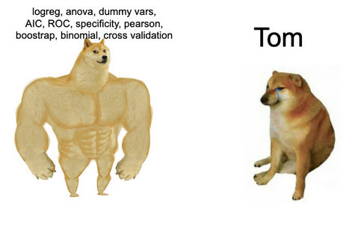
Recommendations

Slide 12
Questions

