Slide 1

Loan Defaults
The Who’s, Why’s and Where’s
Tom Wightman – D12

Slide 2
"You’ve been hired by LendingClub, an online loan provider to help with some problems their business has been facing.
They are concerned about the default rate on their loans.
They want to understand who is likely to default and who they should lend to in the future."
The Brief

Slide 3

• Background
• Planning
• Data quality, bias and privacy concerns
• Results
• Recommendations
Contents
Notes:
Scheduled for 10 mins + time for questions
During rehearsals at this point in the pres, my gf mistakenly thought my presentation was about loans with Greggs the baker due to the likeness with the image at the bottom right of the screen -

Slide 4

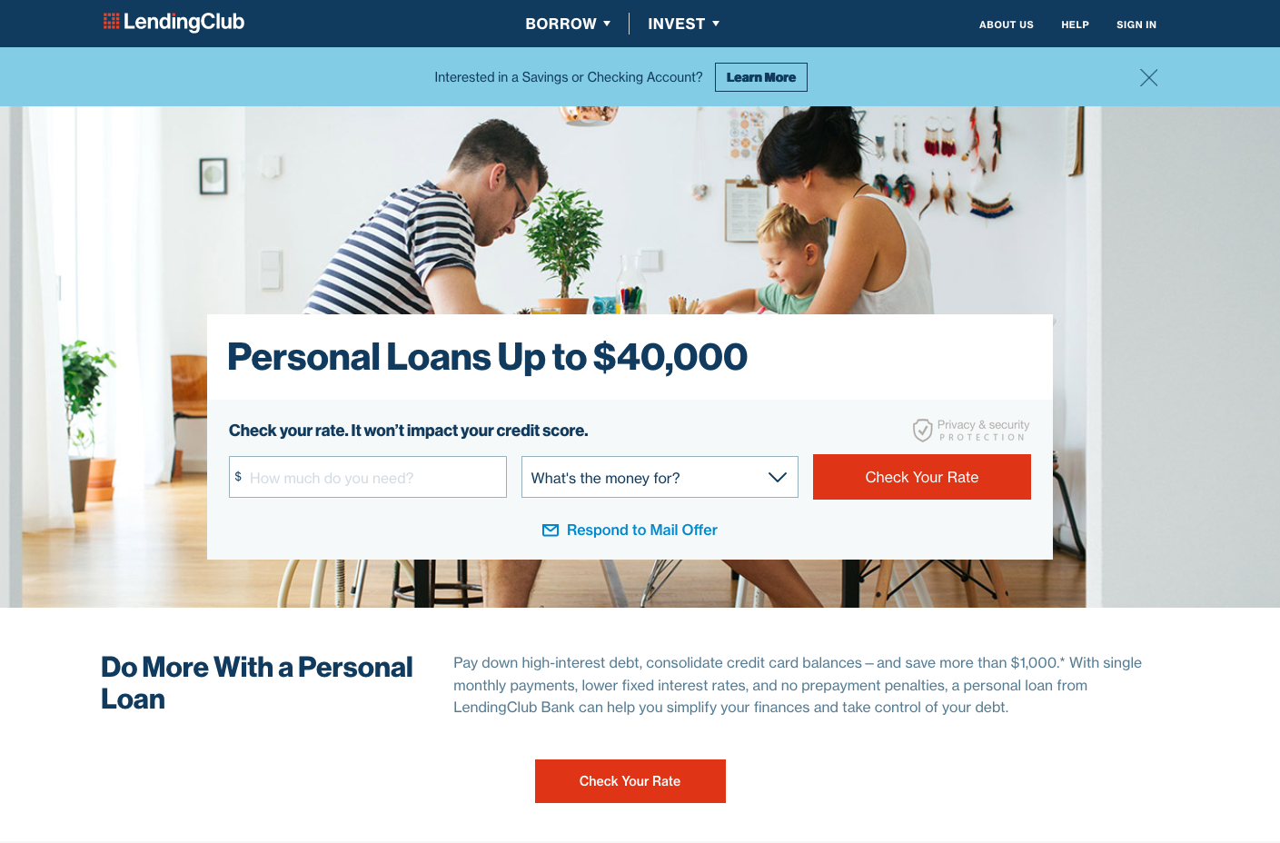
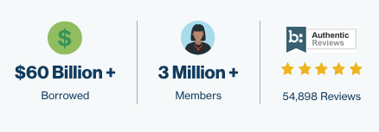

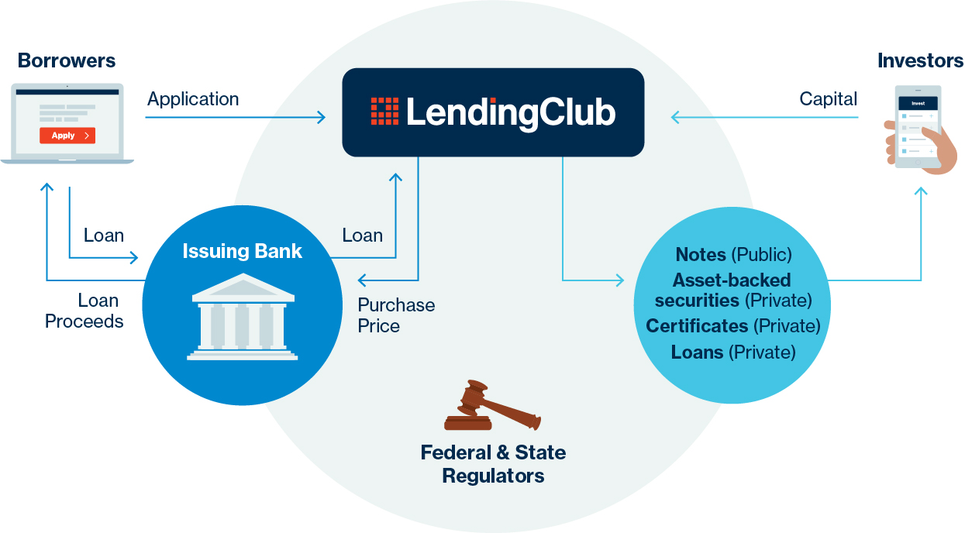
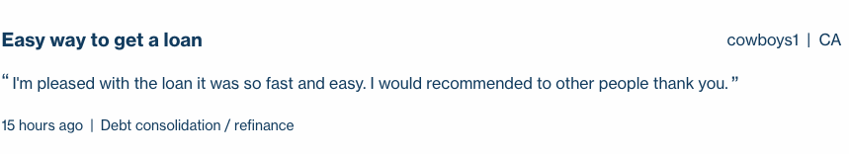
Notes:
Founded - 2006
Employees - 1,837 (2017)
LendingClub is a peer-to-peer lending company headquartered in San Francisco, California. It was the first peer-to-peer lender to register its offerings as securities with the Securities and Exchange Commission, and to offer loan trading on a secondary market.
SO?? THE pathfinder into a new style of loaning system.
- Very popular as proclaimed on their website
- Has even won some awards
- cowboys1 from cali very recently has enjoyed his loan
WORKFLOW - LC are facilitators (middle men)

Slide 5
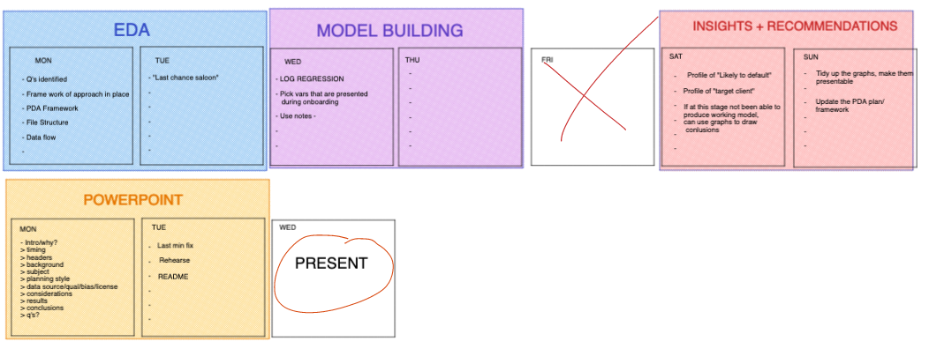
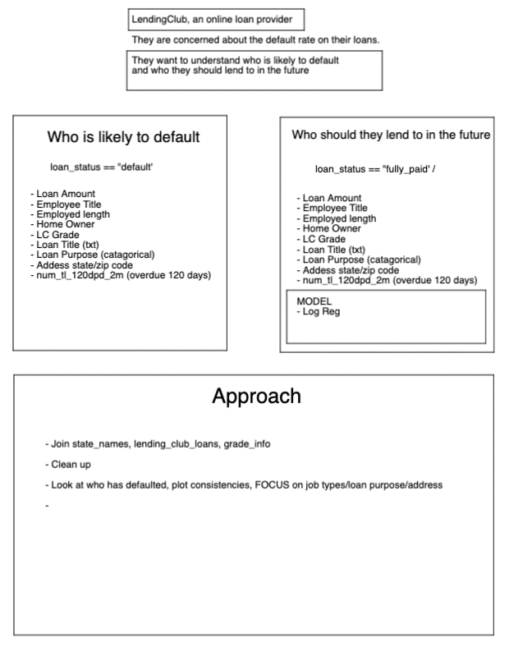
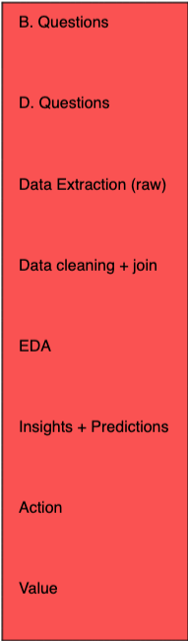
Planning
Notes:
As the great Prussian Field Marshal Helmuth von Moltke the Elder
”No Plan Survives Contact with the enemy”

Slide 6
Data

Slide 7
Results

