Slide 1

CS 245 Project Presentation:
Project 5: Dynamic Graph Neural Networks For Monitoring Pandemics And Risk Factors
Team Ideas:
Chenyang Wang, Danfeng Guo, Haochen Yin, Huiling Huang, Panqiu Tang, Yijing Zhou
University of California, Los Angeles

Slide 2
Directory
Introduction
Method
Dataset
Experiments
Conclusion and Future Works

Slide 3

Introduction - The COVID-19 Pandemic
COVID-19 is an infectious disease caused by SARS-CoV-2. The disease was first discovered in Wuhan City, China at the end of 2019. Since then, the disease has spread and spread rapidly in various countries around the world.The recent outbreak of COVID-19 has affected the entire world: millions of people have died, tens of millions have been infected, and hundreds of millions of people’s lives have been drastically changed.
COVID-19 has already become the biggest challenge to global healthcare system. From the early days of the pandemic, people have clearly known that it is highly contagious, and human mobility has greatly facilitated its spread. The disease transmission model of COVID-19 established by data science may be a good solution to help the government slow down and even stop the spread of the plague.

Slide 4
Introduction - Task
construct graph from different dataset as input to our Neural Networks
build different pandemic prediction models based on Graphical Neural Networks (GNNs)
compare the performance of these models and select the best one

Slide 5
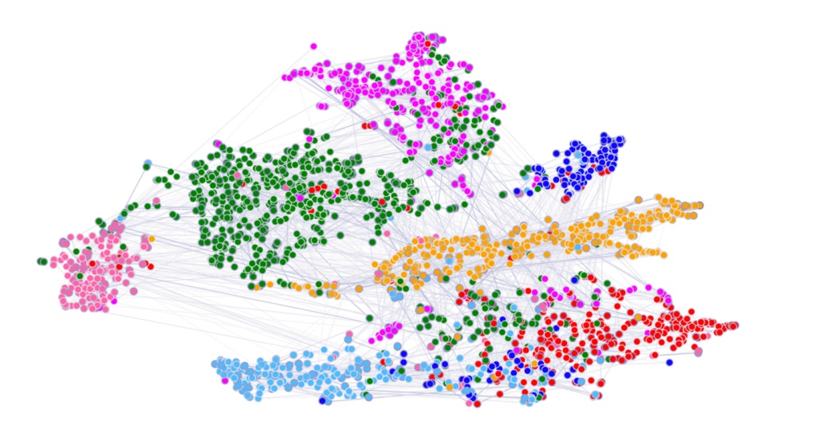
Introduction - The Graph Neural Networks
GNNs have received a lot of attention in the past years and have been applied to a wide variety of tasks, including node classification (Kipf and Welling 2017), graph classification (Morris et al. 2019) and text categorization (Nikolentzos, Tixier, and Vazirgiannis 2020). GNNs capitalize on the concept of message passing over graphs. That is, at every iteration, the representation of each vertex is updated based on messages received from its neighbors.

Slide 6
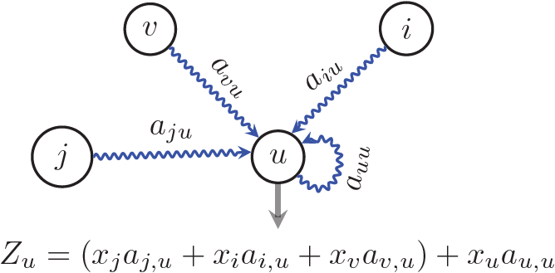
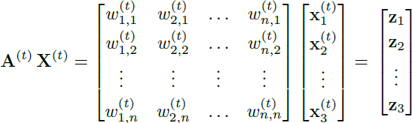
Method - Graph Construction
G = (V, E):
w – the weight of the edge (v; u) from vertex v to vertex u – the number of people that moved from region v to region u
x – a vector of node attributes – the number of cases for each one of the past d days in region u
A – the adjacency matrix of G – a matrix whose rows contain the attributes of the different regions.
z – a vector that combines the mobility within and towards region u with the number of reported cases both in u and in all the other regions.
Example of the message passing.

Slide 7

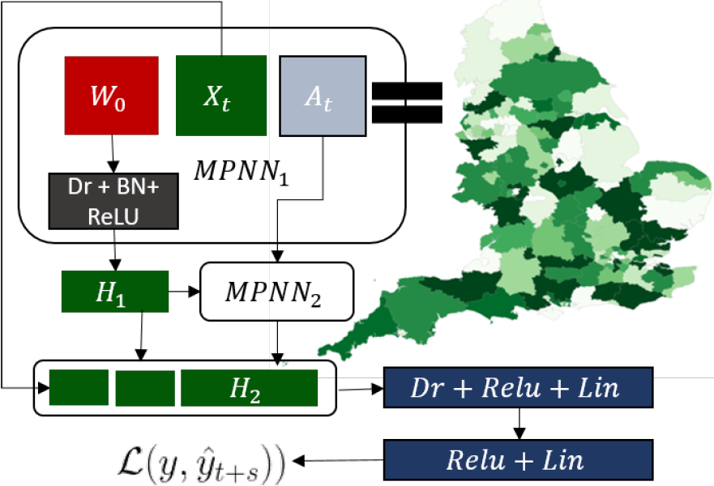
Method – Models - MPNN

Slide 8
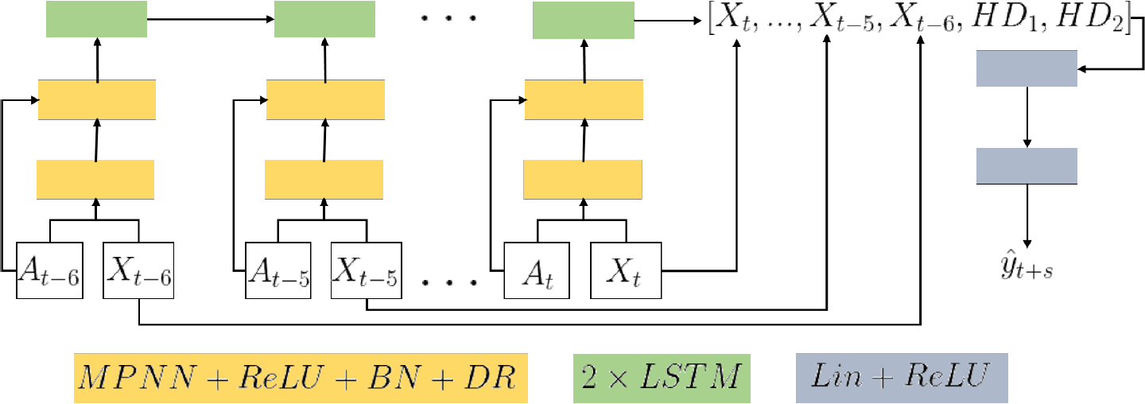
Method – Models – MPNN + LSTM

Slide 9
Dataset
Major source of the data comes from:
- SafeGraph Mobility Data
- CDC pandemic trackers

Slide 10
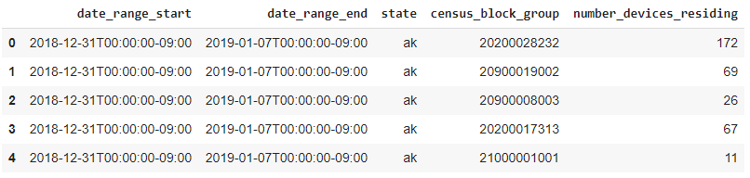
SafeGraph Mobility Data
contains a rich set of information that can provides us means to estimate "mobility" among regions
Example of home panel information:

Slide 11
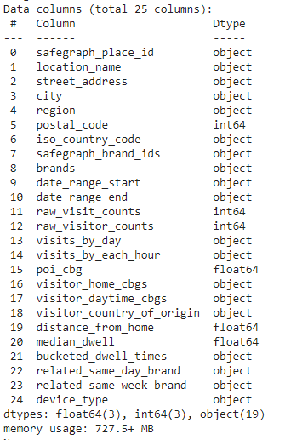
SafeGraph Mobility Data
Schema of the main weekly patterns dataset:
data is gathered at Point-of-Interest level
e.g. McDonald's in Phenix City, AL
visitor_home_cbgs
A mapping of census block groups to the number of visitors to the POI whose home is in that census block group.
{"360610112021": 603, "460610112021": 243, "560610112021": 106, "660610112021": 87, "660610112021": 51}
Internal mobility (inside the state)
External mobility (between state)
Assumption
we can transform visitor_home_cbgs as our primary mobility estimation and estimate mobility of a state by aggregating all the POIs in that state

Slide 12
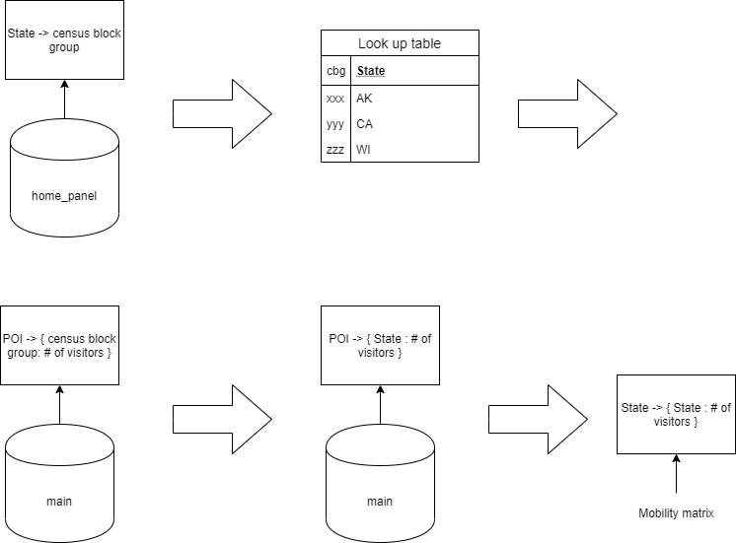
SafeGraph Mobility Data

Slide 13
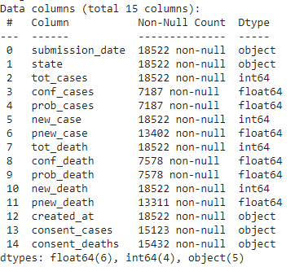
CDC Pandemic tracker
contains daily statistics of COVID-19 across all U.S. states and territory
Schema of CDC pandemic dataset:
A few caveats
there are two categorical feature
consent_cases
consent_deaths
skewed probable and confirmed cases/deaths
surprisingly, we have also found negative values
This aggregate dataset is structured to include daily numbers of confirmed and probable case and deaths reported to CDC by states over time. Because these provisional counts are subject to change, including updates to data reported previously, adjustments can occur. These adjustments can result in fewer total numbers of cases and deaths compared with the previous data, which means that new numbers of cases or deaths can include negative values that reflect such adjustments.

Slide 14
CDC Pandemic tracker
We've decided to focus on new_case feature only to avoid skewed columns
For the negative values
We've replaced all the negative values to 0

Slide 15
Experiments - Design
For Day N:
Input: Daily new cases from Day N-6 to Day N
Mobility Data of Day N
Output: Daily new cases on Day N+6, N+10, N+14, N+18, N+22
Process:
For test date T = D : Total num of dates:
Initialize model
Train model with data from Day 0 to Day T - 11
Eval with data from Day T - 10 to Day T - 1
Test on Day T
Average test results

Slide 16
Results
In terms of error:
 | Day 6 | Day 10 | Day 14 | Day 18 | Day 22
MPNN | 9022 | 10919 | 12963 | 14003 | 15497
LSTM | 17991 | 18009 | 17922 | 17884 | 18037
MPNN+LSTM | 7239 | 7217 | 7084 | 7048 | 7218
Note that these are the sum of errors, the average error for each state can be computed as: error/number of states

Slide 17
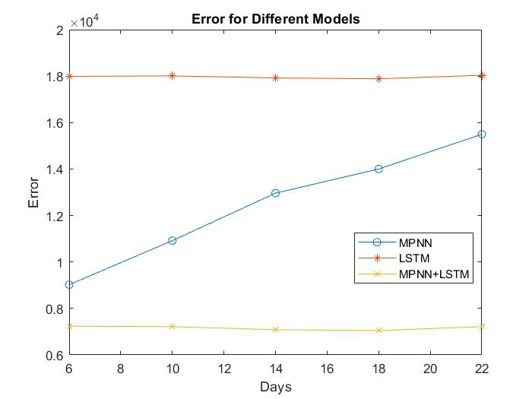
Results

Slide 18
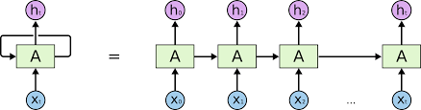
Results
In traditional RNN structures, closest token has the most powerful influence
The paper used hidden layer of Day N as the input of regressor
Who says Day N's data is the most important?

Slide 19
Results
LSTM with attention, use weighted sum of hidden as regressor input
Transformer
 | Day 6 | Day 10 | Day 14 | Day 18 | Day 22
MPNN+LSTM | 7239 | 7217 | 7084 | 7048 | 7218
MPNN+LSTM+Attn | 7391 | 7087 | 6927 | 6983 | 7018
MPNN+TSFM | 7569 | 7237 | 7047 | 7050 | 7048
Avg softmax weight: 0.141:0.139:0.146:0.143:0.142:0.143:0.145:

Slide 20
Conclusion & Discussion
Conclusion:
Built a pandemic pred model based on GCN-RNN
Discussion:
Pair each day’s case & mobility as input
Look into how granularity affects
Traveling between states may be limited

Slide 21
Thank you all for listening!

Slide 22
Q&A

