Slide 1
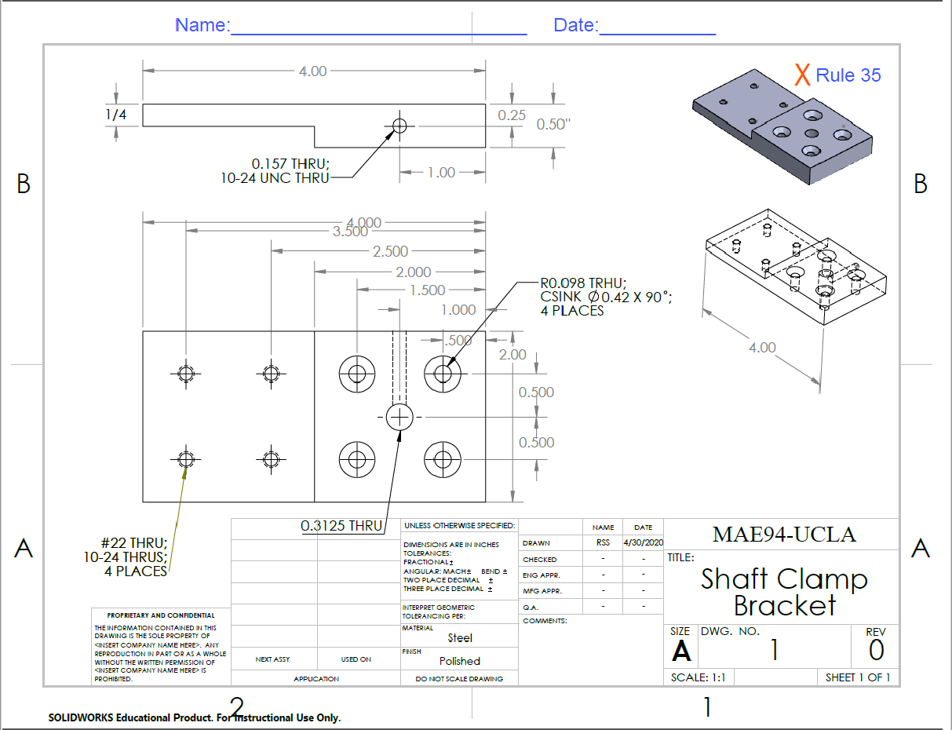
Chenyang Wang
07/26/2020
X Rule 33
X Rule 10
X Rule 30
X Rule 12
X Rule 18
X Rule 9
X Rule 8
X Rule 2
X Rule 1
X Rule 16
X Rule 30

