Slide 1
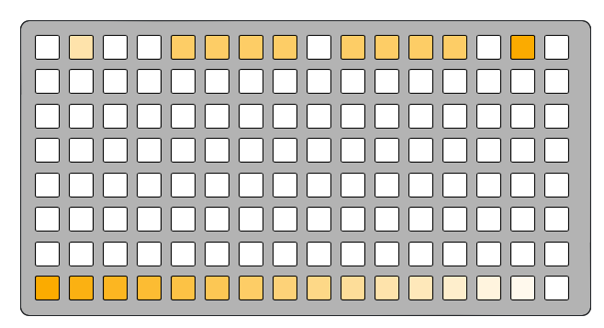
Chrome
Page select
Pattern looper
Recalls
Delete
Master volume

Slide 2
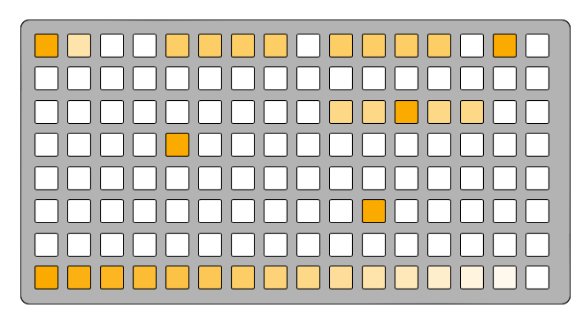
Tracks
Track 1
Track 2
Track 3
Track 4
Track 5
Track 6

Slide 3
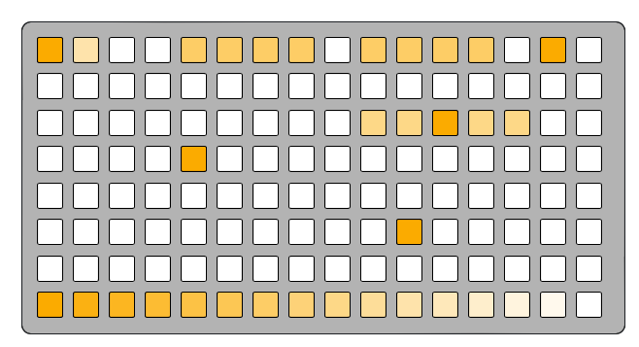
Title page

Slide 4
CUT page
Page 1: CUT
Looping playhead
Playheads

Slide 5
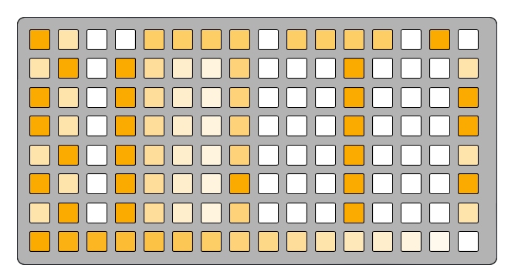

REC page
Page 2: REC/MIX

Slide 6
REC page
Arm for recording
Chan 1
Chan 2

Slide 7
REC page
Mixer
Max
Min
Unity

Slide 8
REC page
Toggle reverse

Slide 9
REC page
Recording/playback speed
Speed options:
1/4x 1/2x 2/3x 1x 3/2x 2x 4x

Slide 10
REC page
Toggle playback
Hold to toggle gated playback

