Slide 1
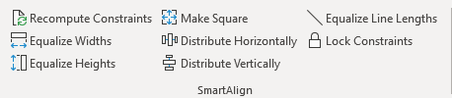
Smart Align
UI Constraint Inference in PowerPoint
Tom Wildenhain, Yunqiu Guo

Slide 2
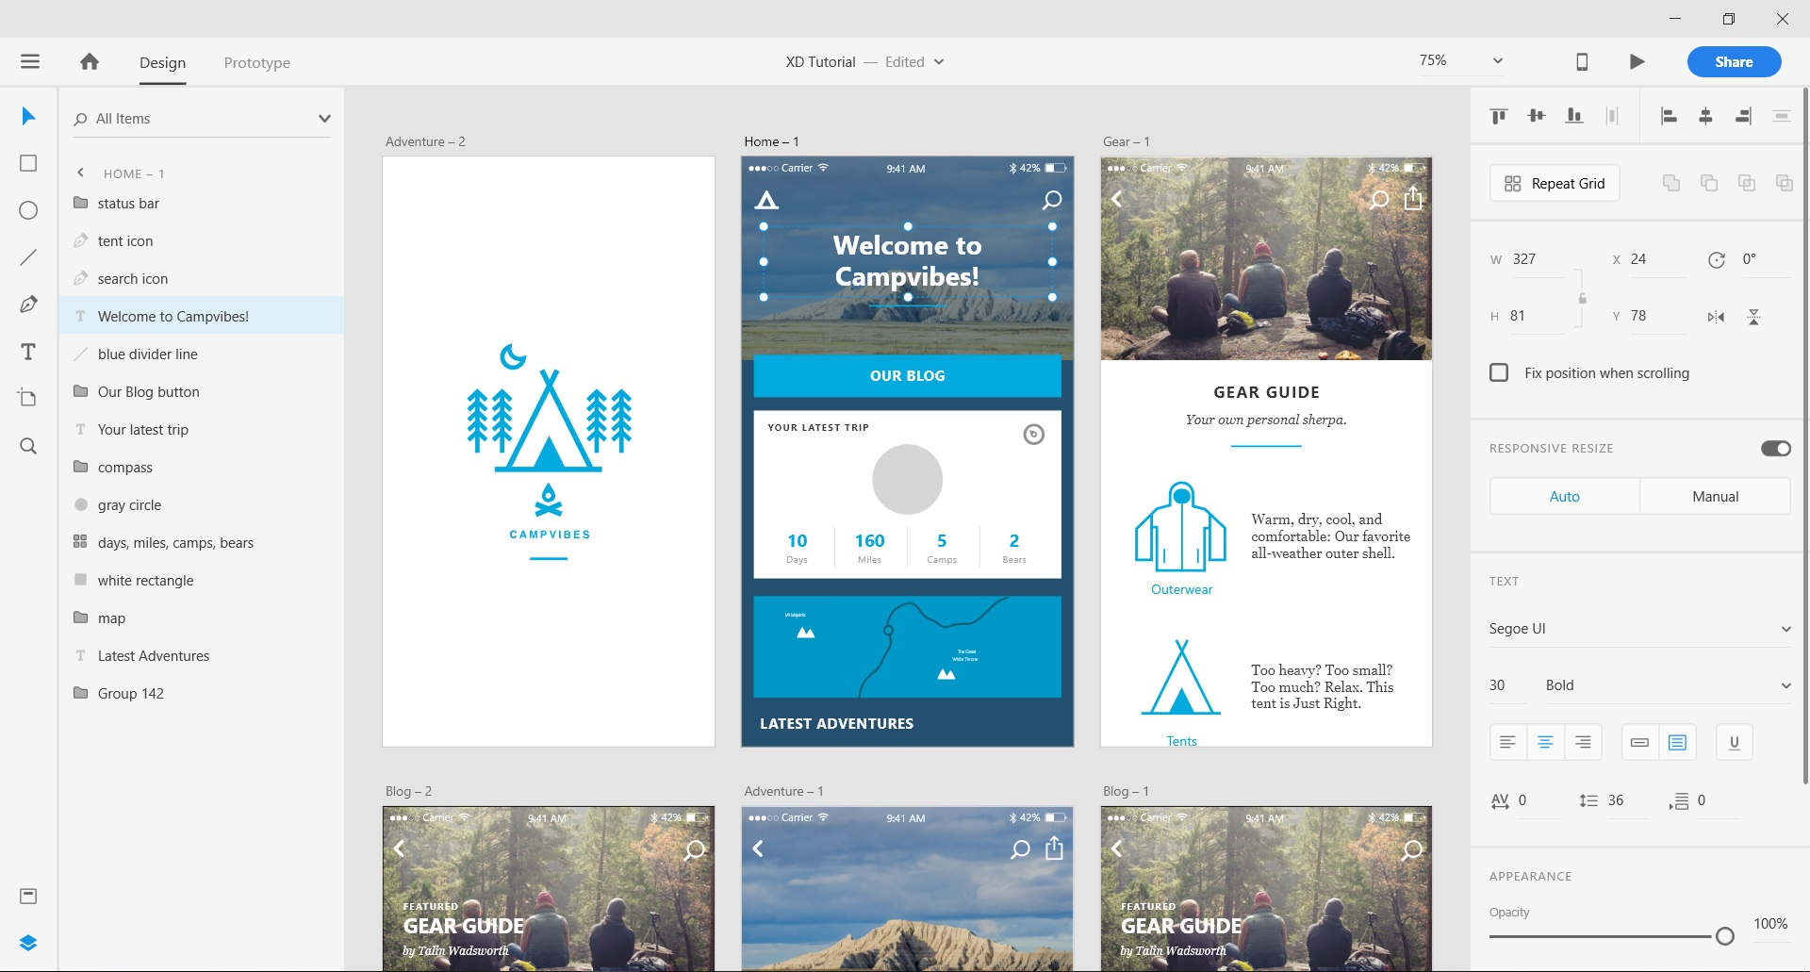
Sketching UI is fun.

Slide 3
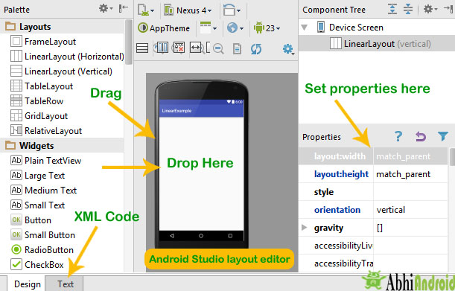
Implementing UI is not.

Slide 4
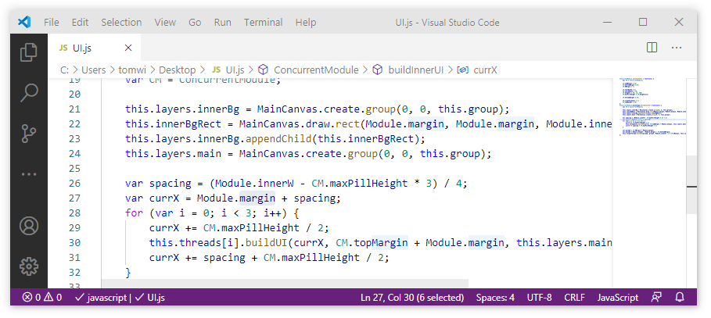
Raw code
Works but is a pain

Slide 5
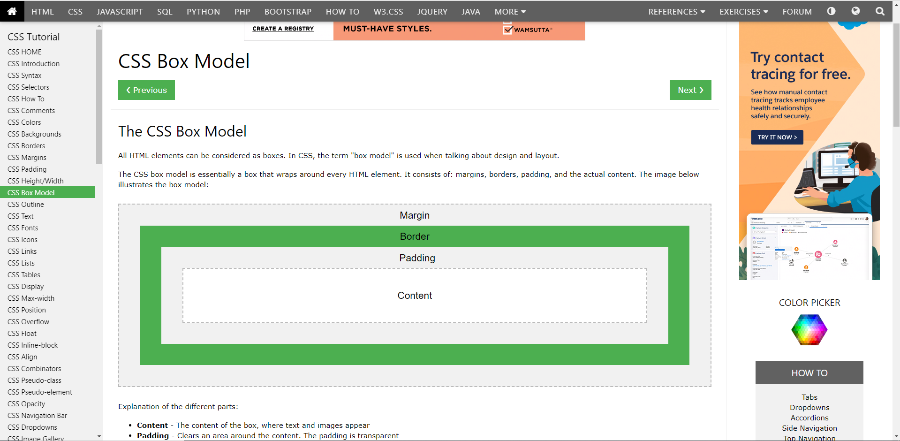
Nested layout elements
So many boxes!

Slide 6
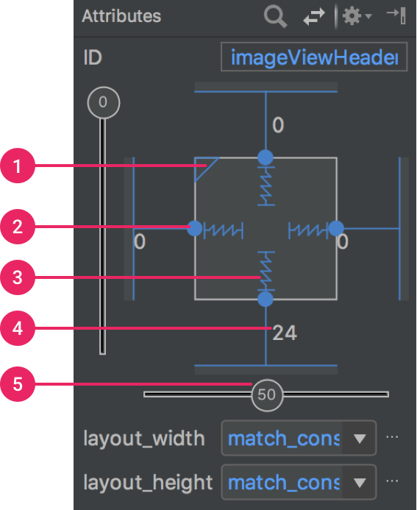
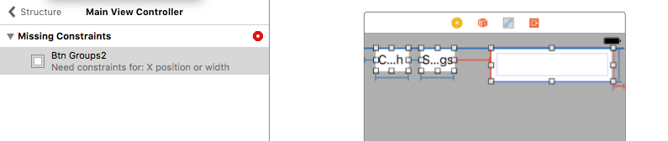
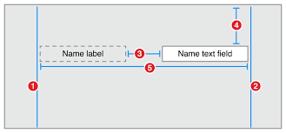
Constraints
Tedious and difficult to debug.

Slide 7
9 Elements
× 4 Constraints per element

Slide 8
9 Elements
× 4 Constraints per element
36 Potential errors

Slide 9
Idea: Constraint Inference

Slide 10
Idea: Constraint Inference
Problem: inferring constraints from a static image is hard

Slide 11
Idea: Constraint Inference
Problem: inferring constraints from a static image is hard

Slide 12
Idea: Constraint Inference
Problem: inferring constraints from a static image is hard
Solution: pay attention to the editing steps

Slide 13
Demo
Notes:
--- Constraints --- Rectangle 32: {width = "1*Var2163//1", height = "1*Var304//1", x = "1*Var2162//1", y = "1*Var2164//1"} Rectangle 33: {width = "1*Var2163//1", height = "1*Var304//1", x = "1*Var2165//1", y = "1*Var2164//1"} --- Variables (Count=5) --- Var304 = 60 Var2162 = 186.75 Var2163 = 135.75 Var2164 = 151.5 Var2165 = 337.5

Slide 14
Advantages:
No over/under-constrained elements
Usable at design time
Requires only 1 example
Notes:
--- Constraints --- TextBox 1: {width = "2*Var1225+1*Var1226+-2*Var116//1", height = "1*Var119//1", x = "1*Var116//1", y = "1*Var118//1"} Rectangle 2: {width = "1*Var3599//1", height = "1*Var3601//1", x = "1*Var3598//1", y = "1*Var3600//1"} Rectangle 3: {width = "1*Var3599//1", height = "1*Var3601//1", x = "1*Var3603//1", y = "1*Var3600//1"} --- Variables (Count=10) --- Var116 = 154.6671 Var118 = 35.84764 Var119 = 60.58591 Var1225 = 218.2041 Var1226 = 533.7256 Var3598 = 149.25 Var3599 = 189.75 Var3600 = 137.25 Var3601 = 108.75 Var3603 = 358.5

Slide 15
Limitations:
Some ambiguity in implied constraints
Generated algebraic constraints are not super readable
C
Height - C
Height
Height - C
C
OR
Notes:
--- Constraints --- TextBox 1: {width = "2*Var1225+1*Var1226+-2*Var116//1", height = "1*Var119//1", x = "1*Var116//1", y = "1*Var118//1"} Rectangle 2: {width = "1*Var3599//1", height = "1*Var3601//1", x = "1*Var3598//1", y = "1*Var3600//1"} Rectangle 3: {width = "1*Var3599//1", height = "1*Var3601//1", x = "1*Var3603//1", y = "1*Var3600//1"} --- Variables (Count=10) --- Var116 = 154.6671 Var118 = 35.84764 Var119 = 60.58591 Var1225 = 218.2041 Var1226 = 533.7256 Var3598 = 149.25 Var3599 = 189.75 Var3600 = 137.25 Var3601 = 108.75 Var3603 = 358.5

Slide 16
Future improvements:
Constraint prioritization
UI Validity heuristics
Notes:
--- Constraints --- TextBox 1: {width = "2*Var1225+1*Var1226+-2*Var116//1", height = "1*Var119//1", x = "1*Var116//1", y = "1*Var118//1"} Rectangle 2: {width = "1*Var3599//1", height = "1*Var3601//1", x = "1*Var3598//1", y = "1*Var3600//1"} Rectangle 3: {width = "1*Var3599//1", height = "1*Var3601//1", x = "1*Var3603//1", y = "1*Var3600//1"} --- Variables (Count=10) --- Var116 = 154.6671 Var118 = 35.84764 Var119 = 60.58591 Var1225 = 218.2041 Var1226 = 533.7256 Var3598 = 149.25 Var3599 = 189.75 Var3600 = 137.25 Var3601 = 108.75 Var3603 = 358.5

Slide 17

Thanks!
https://github.com/TomWildenhain-Microsoft/FlashSketch
Notes:
--- Constraints --- TextBox 1: {width = "2*Var1225+1*Var1226+-2*Var116//1", height = "1*Var119//1", x = "1*Var116//1", y = "1*Var118//1"} Rectangle 2: {width = "1*Var3599//1", height = "1*Var3601//1", x = "1*Var3598//1", y = "1*Var3600//1"} Rectangle 3: {width = "1*Var3599//1", height = "1*Var3601//1", x = "1*Var3603//1", y = "1*Var3600//1"} --- Variables (Count=10) --- Var116 = 154.6671 Var118 = 35.84764 Var119 = 60.58591 Var1225 = 218.2041 Var1226 = 533.7256 Var3598 = 149.25 Var3599 = 189.75 Var3600 = 137.25 Var3601 = 108.75 Var3603 = 358.5

