Slide 1
Object Oriented Software Development
6. Arrays and collections

Slide 2
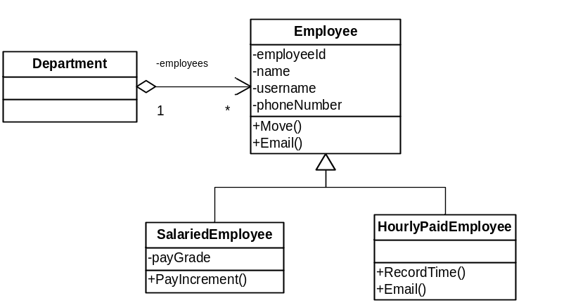
One-to-many relationships
A department can have many employees in it
One-to-many “has-a” relationship
“has-a” relationship is
implemented with instance variable
This variable must be able to hold a collection of Employee objects
Object Oriented Software Development 6. Arrays and collections
<number>

Slide 3
Collections of data
Most software applications need to work with collections of similar objects, for example:
  List of transactions to display in a bank application
  List of sprites in a game
Often need to perform actions such as:
  Listing all the objects in a collection
  Adding and removing objects
  Finding a specific object in a collection
Object Oriented Software Development 6. Arrays and collections
<number>

Slide 4
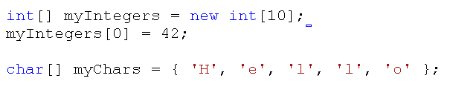
Arrays
Simple way of storing collection of objects of the same type
Contents can be any type, including reference types and value types
Arrays are stored on the heap
If content type is a reference type, the array stores references to objects
Object Oriented Software Development 6. Arrays and collections
<number>

Slide 5
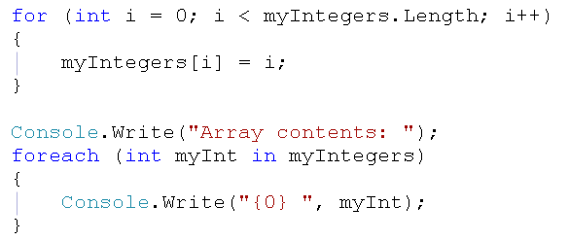
Looping through an array
for and foreach loops:
foreach loop works with any collection which implements an interface called IEnumerable
We will look at this again later
Object Oriented Software Development 6. Arrays and collections
<number>

Slide 6
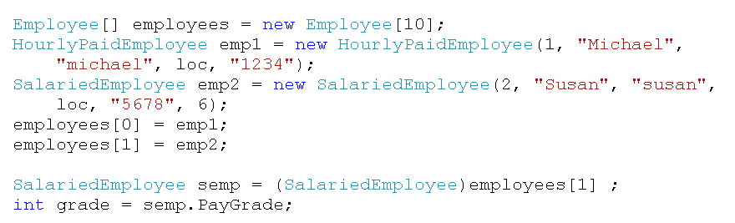
Arrays and polymorphism
An array can store instances of its declared type or subclasses of that type
May need to cast to get object back out as its original type
Object Oriented Software Development 6. Arrays and collections
<number>

Slide 7
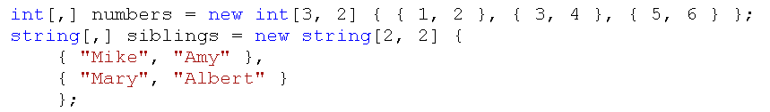
More than one dimension
Arrays can have two dimensions
Can have more than two dimensions
Can be rectangular or jagged
  Jagged array = array of arrays
  Arrays may be different sizes
Object Oriented Software Development 6. Arrays and collections
<number>

Slide 8
Limitations of arrays
Once created, the size of an array is fixed
Array does not provide ways of adding, removing or finding elements
To use an array you need to write code to access elements
Often better to use classes which are designed to store data and provide methods for accessing the data
Data structures, or collections
Object Oriented Software Development 6. Arrays and collections
<number>

Slide 9
Abstract data types
An ADT is a specification for the set of operations which can be performed on the data stored in a data structure
“Abstract” because the specification is independent of the concrete implementation
Could have many implementations of the same ADT which work differently “under the hood”
We will look first at the list ADT and two ways of implementing it
Object Oriented Software Development 6. Arrays and collections
<number>

Slide 10
List
A list is a sequential data structure
Addition and removals can be made at any position in the list
Lists are normally in the form of a₁,a₂,a₃.....a_{n}. The size of this list is n.
The first element of the list is a₁,and the last element is a_{n}
The position of element a_{i} in a list is i.
Object Oriented Software Development 6. Arrays and collections
<number>

Slide 11
List operations
A list data structure should be able to provide the following operations:
  Create a list
  Find an item in the list
  Insert an item in the list
  Modify an item in the list
  Delete an item from the list
  Check whether list is full/empty
  Traverse the list
Object Oriented Software Development 6. Arrays and collections
<number>

Slide 12
Lists example
CollectionsDemo solution
CollectionsDemo and SimpleCollections projects
  Data structures in separate project from program – can easily be reused by other programs
  SimpleCollections is a class library project
CollectionsDemo – Program.cs
SimpleCollections – ISimpleList.cs, SimpleArrayList.cs, SimpleLinkedList.cs
Object Oriented Software Development 6. Arrays and collections
<number>

Slide 13
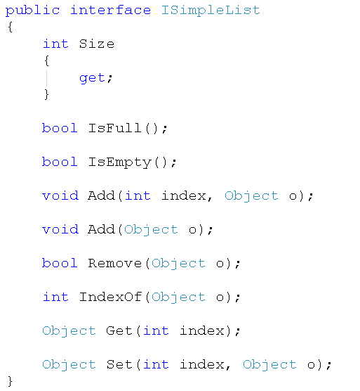
Implementing a list
We can express these requirements as an interface
Lists will implement this interface
Object Oriented Software Development 6. Arrays and collections
<number>

Slide 14
Data type of items
Note that in interface code, the item type is Object
Polymorphism – each list item can be:
  An instance of Object
  An instance of any type which derives from object...
  ...which is essentially any type at all as all types in .NET derive from Object
Reusable – can be used to store any type of items in any application
Object Oriented Software Development 6. Arrays and collections
<number>

Slide 15
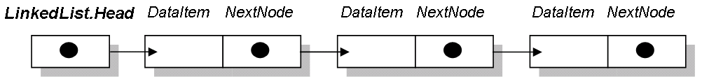
Implementation details
There are two common ways of actually storing the data in a list
ArrayList
  Items are stored in an array
LinkedList
  Items are stored as a chain of connected nodes
  Each node has a data item and a reference to the next node
Object Oriented Software Development 6. Arrays and collections
<number>

Slide 16
Does it matter which one?
Both versions can be written to implement the interface, and both will work perfectly well
In fact, we don’t even need to write our own implementations as the .NET Framework library already has a wide selection of tried and test collection classes, including lists
But, different implementations have different performance in particular situations
Need to understand characteristics of structures to make the best choice
Object Oriented Software Development 6. Arrays and collections
<number>

Slide 17
Simple implementations
We will look at the code for simplified implementations of ArrayList and LinkedList
This will help us to understand how the two versions work and identify where there might be performance differences
Wouldn’t use these in real programs – Framework versions are more complex, but more capable and robust
Use Framework classes unless you need specific custom functionality
Object Oriented Software Development 6. Arrays and collections
<number>

Slide 18
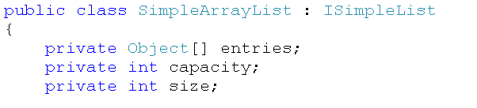
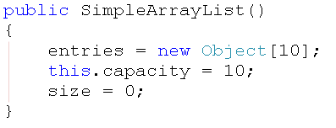
SimpleArrayList
Items stored in array of type Object
Capacity is the number of items which can be stored
Size is the number of items currently stored
constructor
instance variables
Object Oriented Software Development 6. Arrays and collections
<number>

Slide 19
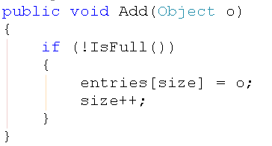
Adding items to SimpleArrayList
Adding a new item at the end of the list is simple
Number of items stored so far = size
Index of last stored = size - 1
Store the new item at index = size
Object Oriented Software Development 6. Arrays and collections
<number>

Slide 20
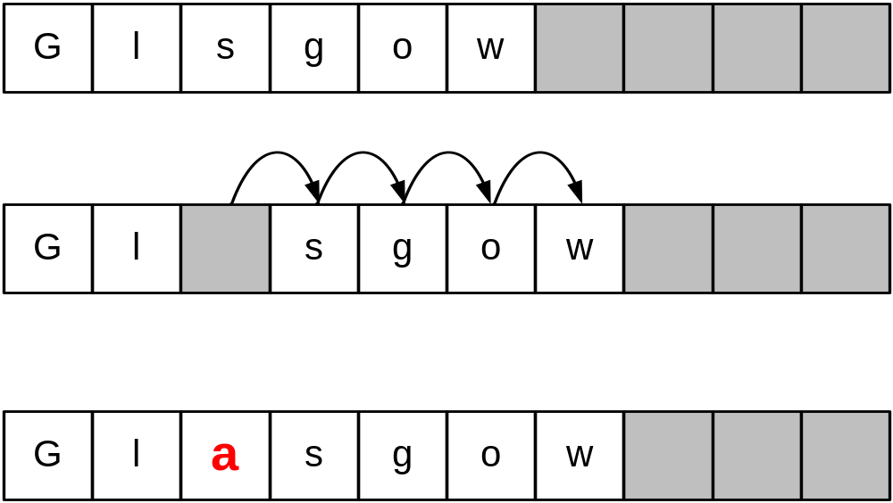
Adding items to SimpleArrayList
Adding a new item at a specified index involves more work
Need to shuffle items up to make space
Object Oriented Software Development 6. Arrays and collections
<number>

Slide 21
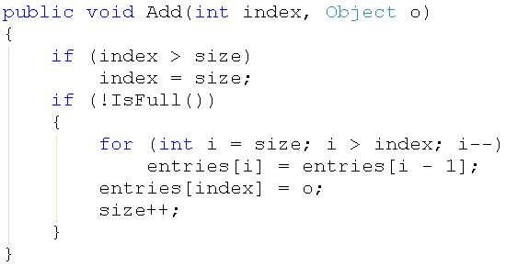
Adding items to SimpleArrayList
Start at first empty position (size)
Copy previous entry into current one
Move down one position
Copy previous entry into current one
Repeat until target
position reached
Put new item in
target position
Object Oriented Software Development 6. Arrays and collections
<number>

Slide 22

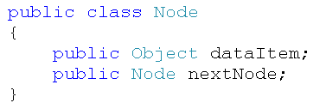
SimpleLinkedList
Each item is stored in an object of type Node
Contains item and reference to next Node
List only needs reference to first Node, can find others from there by following references
No capacity limit, list can grow
constructor
Node class
reference to head node, initially set to null by constructor
Object Oriented Software Development 6. Arrays and collections
<number>

Slide 23
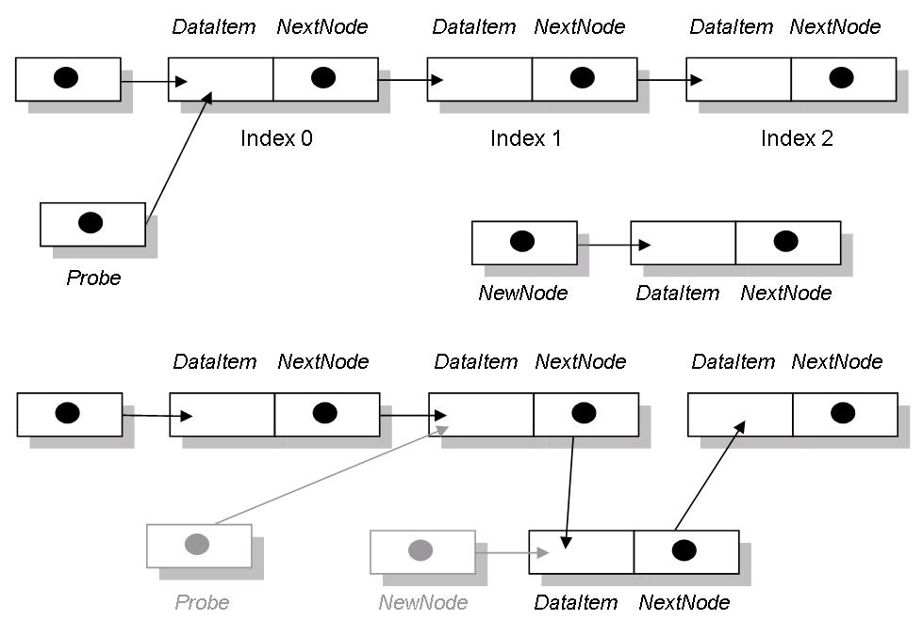
Adding items to SimpleLinkedList
To add a new item at a specified index break chain at target position and insert new node
new item to be added at index 2
probe follows chain to find target node
new item inserted
Object Oriented Software Development 6. Arrays and collections
<number>

Slide 24
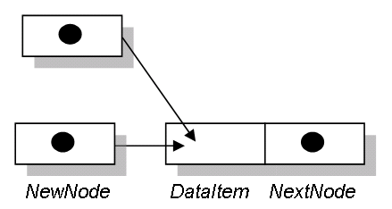
Adding items to SimpleLinkedList
Special case when inserting first item in empty list
  Simply set head to point to new node
Adding at end is not a particularly special case
  Need to probe all the way along the list to find last item then insert new node
head of list, initially null
Object Oriented Software Development 6. Arrays and collections
<number>

Slide 25
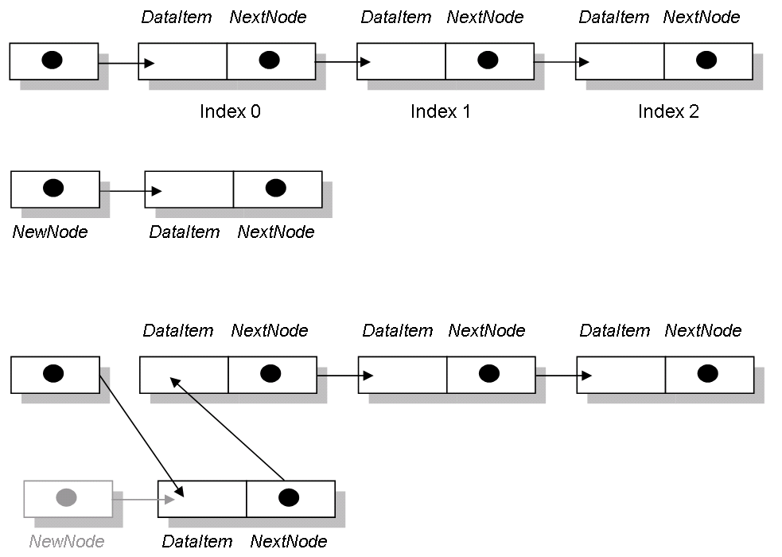
Adding items to SimpleLinkedList
Special case when inserting at start of list
Object Oriented Software Development 6. Arrays and collections
<number>

Slide 26
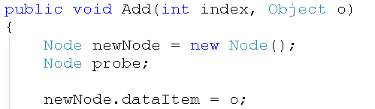
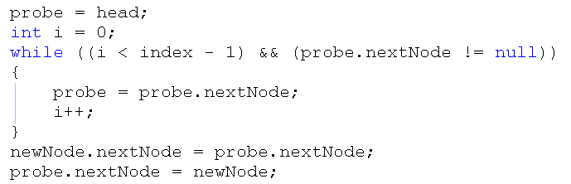
Adding items to SimpleLinkedList
Implementation for general case
Object Oriented Software Development 6. Arrays and collections
<number>

Slide 27
Other operations
How would deleting be implemented in each case?
How would searching be implemented?
How would modifying be implemented?
Look at sample code to see how other operations are implemented
Object Oriented Software Development 6. Arrays and collections
<number>

Slide 28
Which list should we use?
Need to judge likely effect of list characteristics on performance
  Real applications may store a large number of data
  Consider the way the data will be added and accessed
Will new items be added frequently?
Where in the list will they be added?
Will we need to access items frequently?
Where in the list will we need to access items?
Object Oriented Software Development 6. Arrays and collections
<number>

Slide 29
ArrayList
Time to access does not depend on the size of the list
To add an element at the end of the list, the time taken does not depend on the size
Time taken to add an element at any other point in the list does depend on the size
Additions near the start of the list take longer than additions near the middle or end
Deletes near the start of the list take longer
Object Oriented Software Development 6. Arrays and collections
<number>

Slide 30
LinkedList
Time to access an element depends on the index because each element of the list must be traversed until the required index is found
Time to add an element does not depend on the size of the list, as no shifts are required
Time to add does depend on the index
Additions near the end of the list take longer than additions near the middle or start
Deletes near the end of the list take longer
Object Oriented Software Development 6. Arrays and collections
<number>

Slide 31
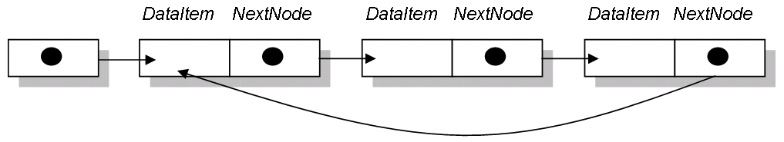
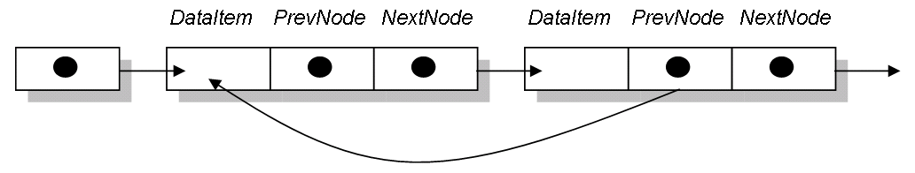
Variations on LinkedList
Circularly linked list
  The tail of the list always points to the head
  Can start anywhere and reach whole list
Doubly linked list
  Permits searching in both directions
Object Oriented Software Development 6. Arrays and collections
<number>

Slide 32
Capacity of lists
LinkedList is dynamic
  No limit on capacity
ArrayList is static
  Capacity defined by length of underlying array
  Could be a big disadvantage, but...
.NET Framework implementation of ArrayList can resize itself dynamically
When array gets close to being full the ArrayList creates a new, larger array and copies items into it
Object Oriented Software Development 6. Arrays and collections
<number>

Slide 33
Traversing a collection
Traversing means passing through the collection visiting each item in turn
The details of how this works depend on the way the collection is implemented
Traversing an ArrayList simply involves passing along the array
Traversing a LinkedList involves following references to reach each node
Collection should provide a way of traversing
Object Oriented Software Development 6. Arrays and collections
<number>

Slide 34
foreach loop and IEnumerable
In C# the foreach-in loop is the most convenient way to traverse a collection
Collection must implement IEnumerable interface
  arrays and most .NET collections do so
Defines a contract - if a collection type implements IEnumerable interface then it agrees to provide the mechanism which can enumerate, or loop though, the collection
Object Oriented Software Development 6. Arrays and collections
<number>

Slide 35
More data structures
Lists are suitable for many applications
However, there are other data structures which have characteristics which make them more suited to specific applications, including:
  Stack
  Queue
  Dictionary
Object Oriented Software Development 6. Arrays and collections
<number>

Slide 36
Stack ADT
A stack is a special case of a list
Addition and removals can only be made at one end
Last-in, first-out (LIFO)
Push - adds a new item onto the stack
Pop – removes and returns last item added
Can be implemented with array or linked list
Object Oriented Software Development 6. Arrays and collections
<number>

Slide 37
Stack applications
Page visited history in a Web browser
Undo sequence in a text editor
Reversing a string
Method calls – memory stack
Balancing symbols – e.g. check for matching brackets in a C# code file
Object Oriented Software Development 6. Arrays and collections
<number>

Slide 38
Queue ADT
A queue is also special case of a list
Addition can only be made at the tail and removals made at the head
First-in, first-out (FIFO)
Enqueue - adds a new item onto the queue
Dequeue – removes and returns first item added
Can be implemented with array or linked list
Object Oriented Software Development 6. Arrays and collections
<number>

Slide 39
Queue applications
Waiting lists
Message queues
Access to shared resources, e.g. printer
Buffers for transferring data asynchronously e.g., file IO, sockets
Object Oriented Software Development 6. Arrays and collections
<number>

Slide 40
Dictionary ADT
A dictionary is a searchable collection of key-item pairs
Also known as map, associative list
Keys are used to locate items
Collection can be sorted or unsorted
May or may not allow more than one item with the same key – depends on implementation
Object Oriented Software Development 6. Arrays and collections
<number>

Slide 41
Dictionary operations
Put(key, item) - add a new key/item pair
Get(key) – get the item with the specified key
Set(key, item) – set the item for the specified key
Remove(key) – remove the item with the specified key
ContainsKey(key) – check whether the specified key exists
Object Oriented Software Development 6. Arrays and collections
<number>

Slide 42
Dictionary data types
Most reusable case is when key and item data types are both Object
Can store any type and use any type as key because of polymorphism
Sometimes it is convenient to have a customised implementation restricted to specific data types
  e.g. .NET Framework includes a StringDictionary class
Object Oriented Software Development 6. Arrays and collections
<number>

Slide 43
Dictionary as hash table
Dictionary ADT can be implemented as arrays of keys/values
Position where new entry is stored based on hash value computed from key
Allows fast look-ups – compute hash of target key and go directly to associated position in array
Dictionary can also be implemented as a binary tree which stores keys in order
Object Oriented Software Development 6. Arrays and collections
<number>

Slide 44
More data structures (again)
There are other ADTs which we will not look at here, but which are useful in certain situations, including:
  Set
  Tree
  Graph
Object Oriented Software Development 6. Arrays and collections
<number>

Slide 45
Framework collections
The .NET framework provides a range of ADT implementations, or collections
  System.Collections.Generic namespace contains the most widely used collections, which are generic collections
Use framework collection where possible instead of writing your own
Consider characteristics and likely impact on performance when choosing
  e.g. List (array-based) or LinkedList
Object Oriented Software Development 6. Arrays and collections
<number>

Slide 46
Non-generic collections
The collections we have seen store items of type Object
  Can store any type, as all .NET types are derived from object – polymorphism
  Need boxing/unboxing when storing value types, and need to cast to type when retrieving, which is inefficient
There are non-generic collections like this in the System.Collections namespace, but choose generic versions when available
Object Oriented Software Development 6. Arrays and collections
<number>

Slide 47
Generic collections
Generic collections allow you to specify the type of item to be stored in the collection
Same collection class can be re-used to store many different types, but no need for boxing/unboxing or casting
You can see an example of a generic List implementation in CollectionsDemo
List of DateTime objects – generic type specified in <brackets>
Object Oriented Software Development 6. Arrays and collections
<number>

Slide 48
Framework collections example
FrameworkCollectionsDemo solution
ListGenericDemo project
Program.cs
DictionaryGenericDemo project
Program.cs
Object Oriented Software Development 6. Arrays and collections
<number>

Slide 49

Using List<T>
Create
Add
Get value
Iterate
Object Oriented Software Development 6. Arrays and collections
<number>

Slide 50
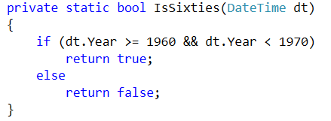
Finding items with predicates
The Find methods of List use Predicates
A Predicate is a function which takes an item as a parameter and returns true or false depending on whether the item meets a condition, for example:
Predicate function can be defined by a method which returns bool
Object Oriented Software Development 6. Arrays and collections
<number>

Slide 51
Lambda expressions
A lambda expression is a convenient shorthand way of writing a function
Gives a compact way of defining a predicate (or any other function, not limited to functions which return bool)
Same function as before:
    d => (d.Year >= 1960 && d.Year < 1970)
parameter
expression which evaluates to true or false for a given value of the parameter
Note – lambda expressions have many other uses in C# programs
Specific to .NET now, but being introduced in other languages, e.g. Java
Object Oriented Software Development 6. Arrays and collections
<number>

Slide 52
Using the Find methods
Both of the following use predicates to find an item or items in a List
  Both will find dates in the 1960s
Explicit function (also known as a delegate) defined on previous slide
Lambda expression
Object Oriented Software Development 6. Arrays and collections
<number>

Slide 53
FindIndex and Remove
To remove a specific item, first find its index, or position in the List, then remove the item at that index
Can remove all items which match a predicate
Object Oriented Software Development 6. Arrays and collections
<number>

Slide 54
Other methods in List
MSDN documentation shows that there are many other methods in the list class
For example IndexOf
  uses a different approach to searching for item
  may need to be told what it means for two objects of the list type to be equal
  Obvious for strings, integers, but what about more complex types?
  Need to override Equals method in List type or define comparer
Object Oriented Software Development 6. Arrays and collections
<number>

Slide 55
Using Dictionary<T,U>
Create
Add
Get value
Remove
Note that .NET implementation uses Add rather than Put, and array-like index notation for lookup rather than Get
Object Oriented Software Development 6. Arrays and collections
<number>

Slide 56


Using Dictionary<T,U>
Get value safely
  Will get error if you try to get value for key which is not present
  Use ContainsKey to check before getting
  or use TryGetValue to suppress error
uses out parameter to set value of variable directly if key found, or set default/null of not found
Object Oriented Software Development 6. Arrays and collections
<number>

Slide 57


Using Dictionary<T,U>
Iterate
  Iterate through Dictionary as KeyValuePair collection
  Get dictionary values from Values property(can get Keys similarly)
could also use implicit type: var entry in dict
Object Oriented Software Development 6. Arrays and collections
<number>

Slide 58
Further reading
These examples show only a selection of the methods available in List and Dictionary
Refer to MSDN documentation when using these types for full capabilities
  http://msdn.microsoft.com/en-us/library/6sh2ey19.aspx
  http://msdn.microsoft.com/en-us/library/xfhwa508.aspx
Object Oriented Software Development 6. Arrays and collections
<number>

Slide 59
Further reading
There are other collection types
Many sources of information online
Recommended:
  An Extensive Examination of Data Structures using C# 2.0 (MSDN) http://msdn.microsoft.com/en-us/library/ms364091%28v=VS.80%29.aspx
Object Oriented Software Development 6. Arrays and collections
<number>

Slide 60
Further reading
The code in the CollectionsDemo download contains example implementations of the following collection types:
  Stack
  Queue
  Dictionary – see extra slides for information on ways to implement a Dictionary
Implementation details of these will not be in the exam
Object Oriented Software Development 6. Arrays and collections
<number>

Slide 61
What’s next?
We will go on to look in detail at how to implement a UML model using C# classes, and how collections can help with this
Object Oriented Software Development 6. Arrays and collections
<number>

