Slide 1
Object Oriented Software Development
8. Exceptions, testing and debugging

Slide 2
Writing high quality software
Programs should handle unexpected error conditions in a controlled way
  Report or log error as appropriate
  Don’t “crash”
Programs should be thoroughly tested
  Prove that requirements are met
  Program can run without error but still produce incorrect behaviour
  Continuously test “units” of code and integration of units throughout development
Object Oriented Software Development 8. Exceptions, testing and debugging
<number>

Slide 3
Support for the programmer
Exception handling in programming language provides a way to deal with error conditions
Unit testing tools provide support for continuous testing
Debugging tools provide support for tracing through code as it runs to diagnose error conditions or incorrect behaviour
Object Oriented Software Development 8. Exceptions, testing and debugging
<number>

Slide 4
Run-time errors
“Anything that can go wrong, will go wrong” (Murphy’s law)
Many things can, and do, go wrong when a computer program runs, for example when it:
  attempts to open a file that doesn’t exist
  tries to convert a string to a numeric type
  performs a calculation which divides by zero
  tries to send a message to a null object reference
If error is not handled, program will crash
Object Oriented Software Development 8. Exceptions, testing and debugging
<number>

Slide 5
What are exceptions?
In C# (and other languages) when a run-time error occurs an exception is generated
Usually say exception is thrown
An exception is an object that contains information about a run-time error
Exception-handling involves writing code which is executed when an exception is thrown
Interrupts normal flow of execution
Object Oriented Software Development 8. Exceptions, testing and debugging
<number>

Slide 6
Exceptions examples
SimpleExceptions project
Program.cs
InfoSaver.cs
Object Oriented Software Development 8. Exceptions, testing and debugging
<number>

Slide 7
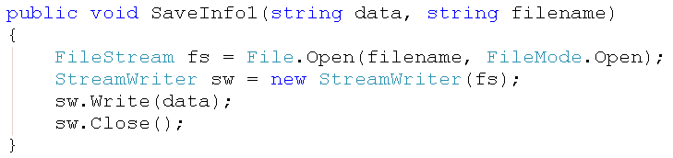
Exception handling
This code tries to open a file
Will cause an error if the file does not exist
this code opens access to a file (FileStream) and creates an object which can write to the file (StreamWriter)
closing the StreamWriter also closes the FileStream
Object Oriented Software Development 8. Exceptions, testing and debugging
<number>

Slide 8
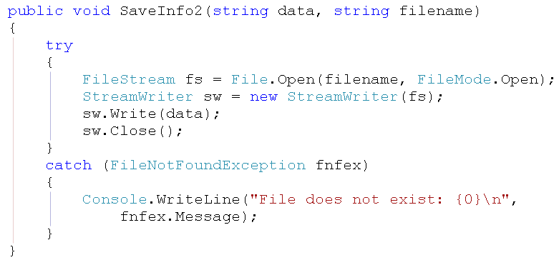
try-catch block
Wrap code in try block and catch exception
Catch block can print message, log error, etc.
Object Oriented Software Development 8. Exceptions, testing and debugging
<number>

Slide 9
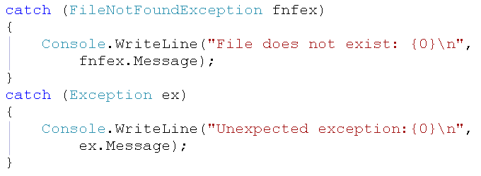
Multiple catch blocks
Exception classes are all derived from Exception
Can catch different exception types
Usually catch most specific first
this will catch any exception as all exceptions derive from Exception
Object Oriented Software Development 8. Exceptions, testing and debugging
<number>

Slide 10
System resources
Files, database connections, etc are system resources
Should be closed when no longer needed
Exception occurring can prevent code which closes resources being reached
Resources not released back to system
Files can become unavailable, system can become unstable, etc.
Need to clean up resources after exceptions
Object Oriented Software Development 8. Exceptions, testing and debugging
<number>

Slide 11
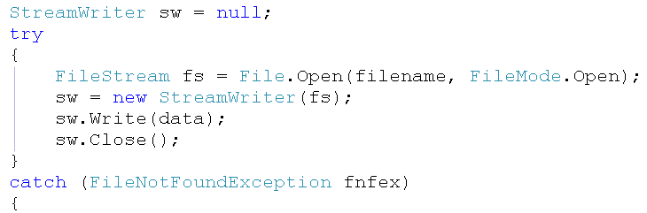
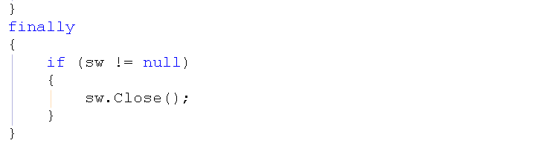
Cleaning up afterwards
could get exception while writing data even if file opens successfully
close file normally – this code might not be reached
...
finally block will always execute
need to declare resource outside try block so that it is in scope in finally block
Object Oriented Software Development 8. Exceptions, testing and debugging
<number>

Slide 12
Should we catch exception immediately?
Wrapping code in try-catch means exception is handled immediately
This will prevent program crashing, but may not be the most useful behaviour
For example, does the user need to know about the error?
We don’t necessarily want to suppress error
Can opt to handle exception elsewhere, e.g. in user interface code
Object Oriented Software Development 8. Exceptions, testing and debugging
<number>

Slide 13
Exceptions in class library code
Class library code may be used by many different programs
Each program may have its own way of making users aware of error situations or of logging errors
Class library code should not usually handle exceptions completely
Should pass them onto program to handle
Object Oriented Software Development 8. Exceptions, testing and debugging
<number>

Slide 14
Options for handling an exception
Handle the exception condition immediately
Pass on the unhandled exception to the calling class
Handle and rethrow the exception to be handled by the calling class
Throw a new exception to be handled by the calling class
Object Oriented Software Development 8. Exceptions, testing and debugging
<number>

Slide 15
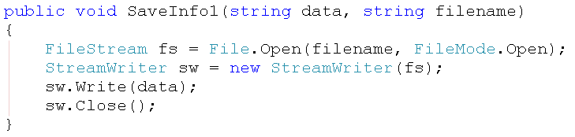
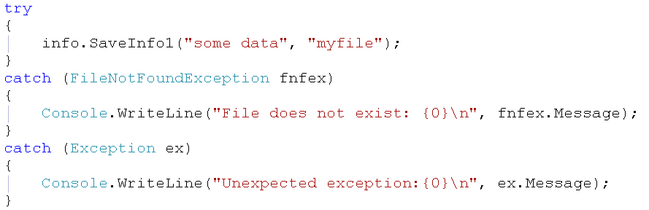
Passing on an exception
method in class, does not
handle exception
calling method, in Main class, handles exception and reports it to user
Object Oriented Software Development 8. Exceptions, testing and debugging
<number>

Slide 16
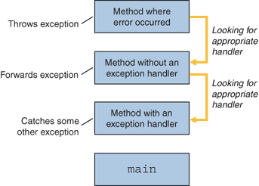
Exceptions and the call stack
If no suitable exception handler is found, program will exit due to unhandled exception
Object Oriented Software Development 8. Exceptions, testing and debugging
<number>

Slide 17
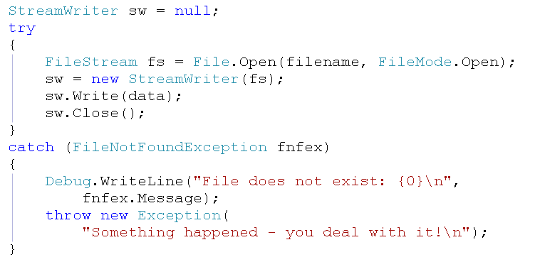
Throwing a new exception
may want to log exception
then create a new exception
object to pass on to calling class
Object Oriented Software Development 8. Exceptions, testing and debugging
<number>

Slide 18
Cleaning up (again)
Difficult for calling class to clean up resources used by called method
Can use try-finally in called method
Doesn’t catch exception, but finally block will always execute even if exception occurs
More convenient shorthand for this in C# with using key word
Other languages have similar constructs
Object Oriented Software Development 8. Exceptions, testing and debugging
<number>

Slide 19
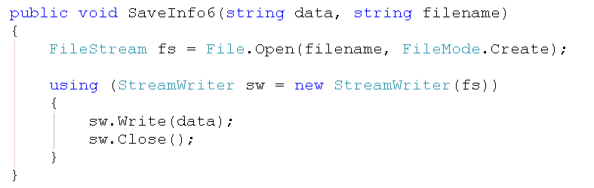
Cleaning up with using
resources opened here will be closed properly even if exception occurs inside using block, as long as resource class implements IDisposable interface
Object Oriented Software Development 8. Exceptions, testing and debugging
<number>

Slide 20
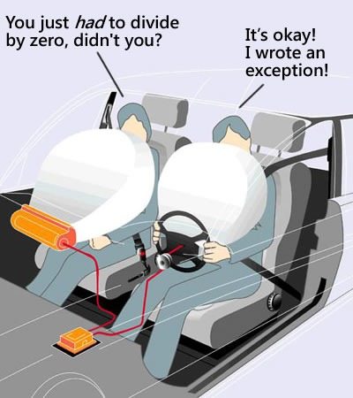
Don’t overuse exceptions
Handling exceptions incurs overhead, so only use exceptions to deal with exceptional situations
  a state that occurs infrequently or unexpectedly
Don’t rely on exceptions for predictable error conditions
  for example, check whether the number is zero before dividing
http://blogs.msdn.com/b/cdndevs/archive/2009/08/04/exceptions-the-airbags-of-code.aspx
Object Oriented Software Development 8. Exceptions, testing and debugging
<number>

Slide 21
Throwing your own exceptions
You can use the exceptions mechanism to indicate and handle error conditions which don’t crash the program, but do break your program’s business rules
For example:
  Invalid password entered
  Attempt to withdraw more than specified limit from a bank account
Object Oriented Software Development 8. Exceptions, testing and debugging
<number>

Slide 22
A custom exception class
Exception class to be used by a bank account class
OverdrawnException class, derived from Exception
Business rule is that customer cannot withdraw an amount which would leave a negative balance in the account
Exception is used to indicate a situation where this rule has been violated
Object Oriented Software Development 8. Exceptions, testing and debugging
<number>

Slide 23
Custom exception examples
CustomException project
Account.cs
OverdrawnException.cs
Object Oriented Software Development 8. Exceptions, testing and debugging
<number>

Slide 24
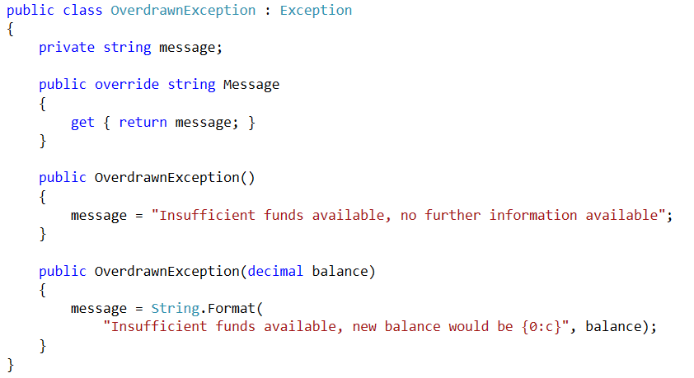
OverdrawnException class
can override Message property of Exception
can pass relevant information into exception object
Object Oriented Software Development 8. Exceptions, testing and debugging
<number>

Slide 25
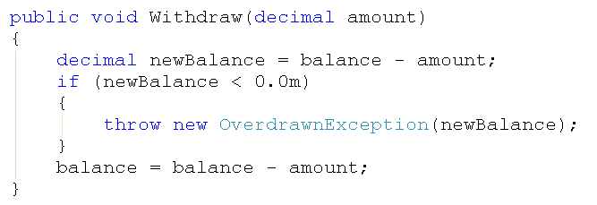
Throwing the exception
Exception is thrown in Withdraw method of Account class if rule violated
Object Oriented Software Development 8. Exceptions, testing and debugging
<number>

Slide 26
Why throw an exception?
Account class could choose to simply not perform the withdrawal if rule violated
That wouldn’t alert the user to the problem or give the user an opportunity to correct it
However, Account class cannot, and should not, communicate with the user
Throws exception which the user interface can handle in its own way
Object Oriented Software Development 8. Exceptions, testing and debugging
<number>

Slide 27
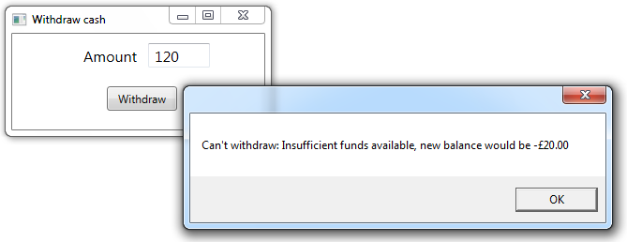
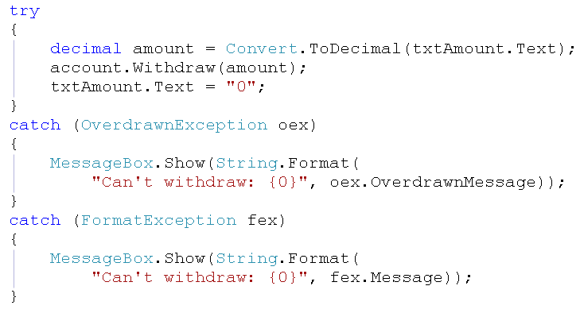
Handling exception in UI
this code runs when Withdraw button is clicked – initial balance is £100
can handle other exceptions here too
Object Oriented Software Development 8. Exceptions, testing and debugging
<number>

Slide 28
Testing
Software must be comprehensively tested to check that it meets the specified requirements and works correctly
Different types of testing meet different purposes as development proceeds, including:
  Unit testing of individual components during development
  Integration testing as major components are put together
  System testing against specification
  Acceptance testing by client/users
Object Oriented Software Development 8. Exceptions, testing and debugging
<number>

Slide 29
Levels of testing
Client needs
Acceptance testing
Requirements
System
testing
DEVELOPMENT
TESTING
Design
Integration testing
Code
Unit testing
Object Oriented Software Development 8. Exceptions, testing and debugging
<number>

Slide 30
System testing
Testing of behaviour of a complete and fully integrated software product
Based on a software requirements specification
Documented as test plan/log consisting of test cases:
Test Case ID | Test description | Test data | Expected result | Actual result | Pass/fail
Object Oriented Software Development 8. Exceptions, testing and debugging
<number>

Slide 31
Unit testing
The process of testing individual classes is known as unit testing
Continuous process during, and even before, development
Test-Driven Development process involves writing tests first, then developing code until tests are passed
There is support for unit testing in most modern languages
Object Oriented Software Development 8. Exceptions, testing and debugging
<number>

Slide 32
Unit testing
Tests should be written to exercise the significant behaviour of all classes
Unit tests can be repeated as we continue to develop each class and integrate classes
Make sure that we don’t inadvertently break a part of a class which was working correctly
Make sure changing one class does not break another class which depends on it
This is known as regression testing
Object Oriented Software Development 8. Exceptions, testing and debugging
<number>

Slide 33
Unit testing example
OrderSystem project
Order.cs
Object Oriented Software Development 8. Exceptions, testing and debugging
<number>

Slide 34
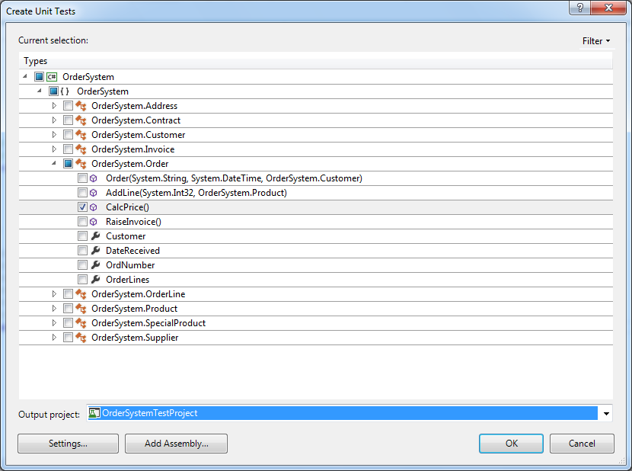
Visual Studio test project
Create Unit Tests option in Visual Studio
Allows you to select what to test
Here, we will
test that the
CalcPrice method
of Order calculates
correctly
By default,
creates a separate
test project
Object Oriented Software Development 8. Exceptions, testing and debugging
<number>

Slide 35
Create Unit Tests in VS2012
Create Unit Tests option may not be enabled on your VS2012 installation (was enabled by default in previous versions)
See the following to enable it (solution 2 is simpler)
  http://dl.my/2013/enable-create-unit-tests-on-visual-studio-2012/
See the following to create tests without this option
  http://msdn.microsoft.com/en-us/library/ms182532.aspx
Object Oriented Software Development 8. Exceptions, testing and debugging
<number>

Slide 36
Test class
By default, has a name based on name of class to be tested
Order class -> OrderTest test class
Each test is defined by a test method, e.g. CalcPriceTest
Basic code for test methods is generated, but needs to be edited to create meaningful tests
Success/failure defined with Assert statements
Object Oriented Software Development 8. Exceptions, testing and debugging
<number>

Slide 37
Arrange, Act, Assert
Meaningful test requires three steps
  Arrange
    Create object(s) needed for method under test to run
    An instance of the class to which method belongs, and possibly some related objects
    Create minimal objects, don’t set properties which are not relevant to test
  Act
    Call the method under test
  Assert
    Make an assertion about the result of the method call
Object Oriented Software Development 8. Exceptions, testing and debugging
<number>

Slide 38
Assertions
Assertion is a statement which is either true or false
This asserts that the value of result is 72 (decimal value)
If assertion(s) in test method true, then test passes
If any assertion in test method is false, then test fails
Object Oriented Software Development 8. Exceptions, testing and debugging
<number>

Slide 39
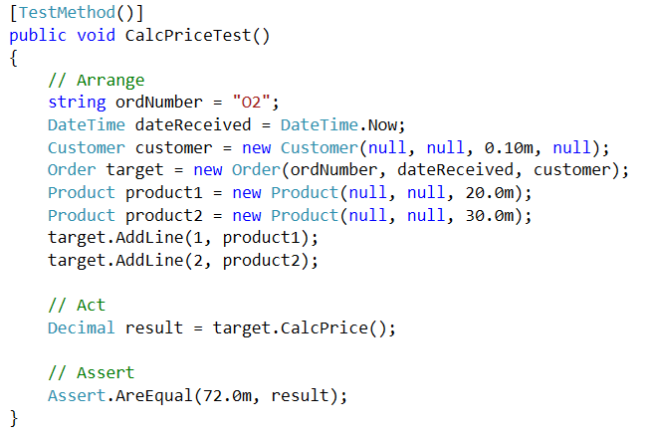
Test method
this test creates an Order with two lines – we don’t need to set all attributes of related objects as the calculation only uses the customer discount and product prices
expected order price for these objects: 1 x £20 + 2 x £30 = £80, customer has 10% discount, so final result should be 80 – 8 = £72
test will pass if result = 72, and fail otherwise
Object Oriented Software Development 8. Exceptions, testing and debugging
<number>

Slide 40
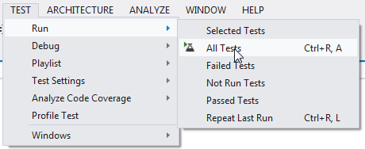
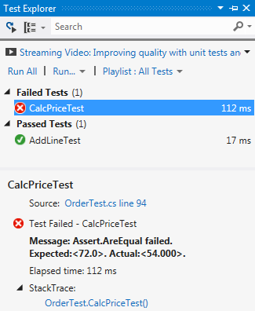
Running tests
two tests in this test run – one has failed
Object Oriented Software Development 8. Exceptions, testing and debugging
<number>

Slide 41
Designing and naming tests
Don’t always have exactly one test method for each method in class under test
May want to test result of same method under different conditions
Can give more descriptive names to test methods, for example (for Account class):
  Withdraw_WithSufficientFunds_ShouldUpdateBalance
  Withdraw_WithInsufficientFunds_ShouldThrowException
Object Oriented Software Development 8. Exceptions, testing and debugging
<number>

Slide 42
Bugs
Situations where a program does not behave as expected are known as bugs
Can be errors which halt the program or simply incorrect behaviour
All forms of testing can discover bugs
Most bugs should be discovered before release but fixing bugs is also part of post-release maintenance
Object Oriented Software Development 8. Exceptions, testing and debugging
<number>

Slide 43
Bug-tracking
Teams often use bug-tracking systems
  Testers can report bugs they discover
  Each bug is assigned to a particular developer to resolve
  Developer records resolution of each bug
Often used with version control
  Central copy of code, each developer “checks out” a part to work on and “checks in” new code
  All versions kept, can roll back and define numbered builds and release versions
Object Oriented Software Development 8. Exceptions, testing and debugging
<number>

Slide 44
Debugging
Testing can find bugs, but doesn’t fix them
Developer must examine code to find source of error or test failure
Debugger is a tool which allows you to break program execution at a specific point, step through code line-by-line and watch the values of variables which may help diagnose the cause of the problem
Most IDEs include debugging tools
Object Oriented Software Development 8. Exceptions, testing and debugging
<number>

Slide 45
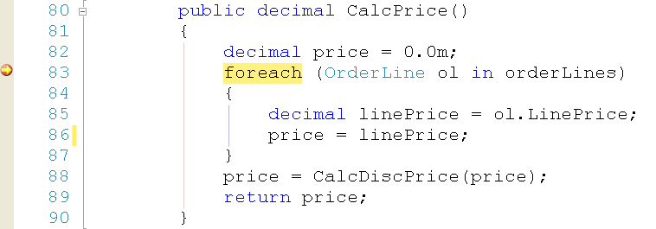
Example
The unit test for CalcPrice in Order failed – set a breakpoint in this method and debug
Choose Debug rather than Start Without Debugging
click in margin to set breakpoint – program halts which it reaches first breakpoint
Object Oriented Software Development 8. Exceptions, testing and debugging
<number>

Slide 46
Debugger options
Continue – go on to next breakpoint if any more are set
Stop Debugging – end execution immediately
Step Into – go to next statement, if statement is method call then go to first line of method
Step Over – go to next statement, do not step into a called method
Step Out – run to end of current method and stop at next statement of calling method
Object Oriented Software Development 8. Exceptions, testing and debugging
<number>

Slide 47

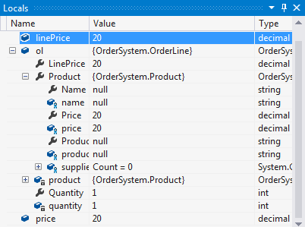
Watching variables
Enter variable names in Watch window
Locals window shows all variables in scope
Can “dig into” structure
of objects
OrderLine object, includes LinePrice, Product, Quantity properties
Product is an object, includes Name, Price, ProductID properties
Object Oriented Software Development 8. Exceptions, testing and debugging
<number>

Slide 48
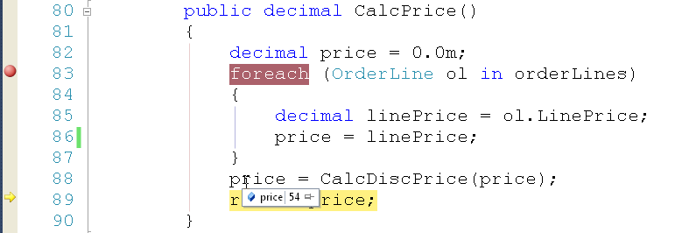
Quick watch
Visual Studio also allows you to hover the cursor over any variable which is in scope where the execution is stopped, and its value is shown
Object Oriented Software Development 8. Exceptions, testing and debugging
<number>

Slide 49
Debugging in practice
Tools help, but experience helps more
Need to be able to understand the program
Need to identify most useful place in program to set breakpoints
Need to identify critical variables to watch
If bug symptom is an error, experience of common exceptions and error messages can help identify likely causes
Object Oriented Software Development 8. Exceptions, testing and debugging
<number>

Slide 50
What’s next?
You now know how to write robust C# classes to implement the model for a system. You will go on learn how to create a graphical user interface which allows people to interact with the system
Object Oriented Software Development 8. Exceptions, testing and debugging
<number>

