Slide 1
Simulation of RFID Smart Shopping System in the Supermarket
Student: Toma Joksimović
Professor: Nebojša Bačanin Džakula
Course: Internet Software Architecture

Slide 2
Introduction
This is the simulation of innovative system that could be implemented in the supermarkets all over the world.
Instead of using personal cards, clients would use baskets that have RFID scanner in themselves, and every instance of article would have its own RFID number, even if there are more same articles, but every instance should have own RFID number, for easier (re)scanning.

Slide 3
Introduction
Client can take article out and put it back on the shelf, RFID scanner will automatically rescan an article, because it will find an article in list that is given to specific basket which is currently in use.
Also, the client can put in the basket an article that is from totally different shop, scanner will not recognize it, and it won’t be appended to the total price for that basket.
On the Cash desk there is also RFID scanner that should scan the id number of every Shopping basket, and by scanning if its active, it will just throw the bill to the client.

Slide 4
Implementation
Application is programmed as Spring application with few types of Dependency Injection and one example of Autowired injection in to the object.
There are 6 Java classes, one of them is main class with main method and it is MarketServer.java.
It is not real client-server application, instead of that is simulation, because in the real life, server won’t actually ask for every moment what client want, instead of that client will by his own decision buy or take back what he wants, and go in which he wants category.

Slide 5
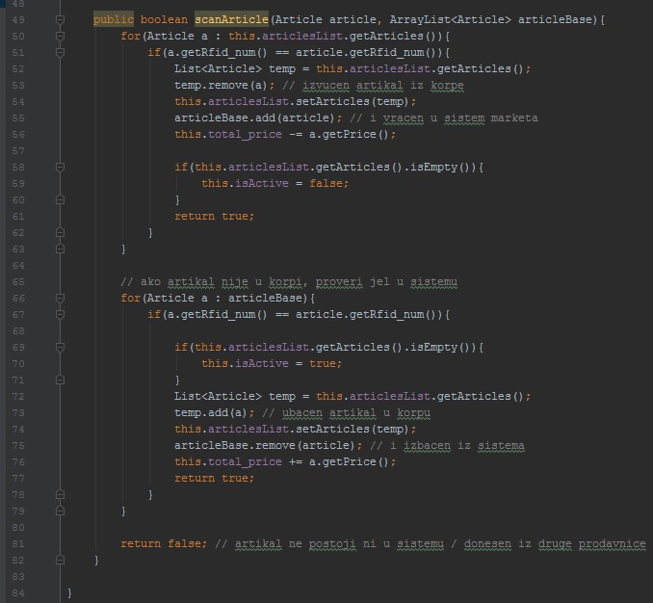
Implementation
scanArticle() is one of the most important methods in this class and generally, by the way we don’t have too many methods in whole application. scanArticle() method simulate scanner on the basket. There are 3 cases generally:
1) In first loop we check if article is taked out from the basket and in that case we should rescan it, so remove from basket list and add back to system list.
2) In second loop we check if article is put in the basket, so we shuld scan it, add to basket list and remove from system list.
3) If article is not in the system and in the basket so it is from another shop and ignore it

Slide 6
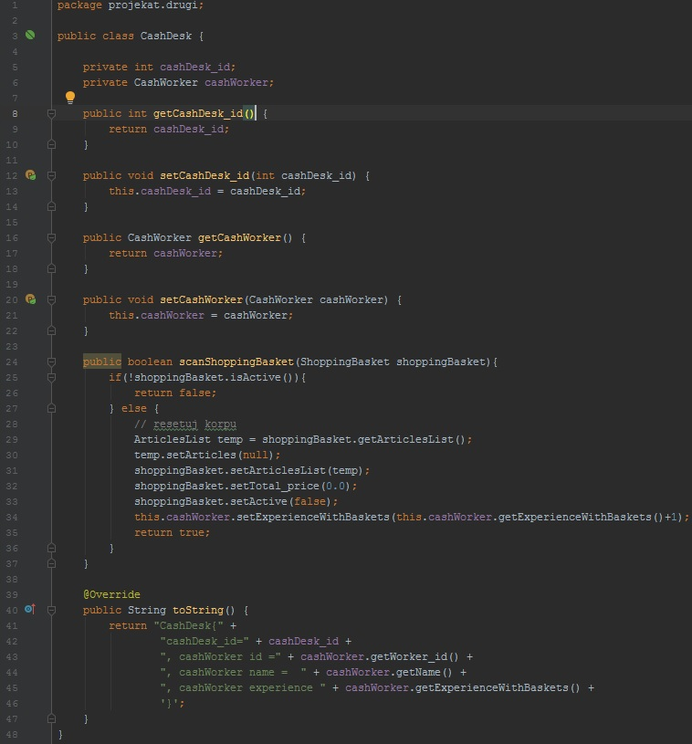
Implementation
CashDesk class will build concrete desk object. This object has its own id and CashWorker object.
It doesn’t have constructors because we use setter injection for making Cash Desk objects and object injection with separate or inner bean injecting Cash Worker bean in Cash Desk object as property, and there also other getters and setters.
Also we have one more important method which simulate scanning of basket. There are 2 cases:
1) Basket is not active so there is nothing in it and Cash Worker can’t make the bill.
2) Basket is active so we reset all attributes in the basket, gain Worker experience and make bill after that.

Slide 7
Implementation
On the next slide is an implementation of MarketServer class with main method on the left side and on the right side there is xml configuration file for Spring with application context and beans.
At the beginning we have simulation of the database with Hash Map that stores categories as keys and articles in lists as values.
First example presents setter injection where we set attributes via properties in xml file.
Second example shows Constructor Injection via constructor-arg tags with type attribute where we put type of the argument.
While getting instances of articles, we will immediately add them into the list and at the end put list in the hash map.

Slide 8
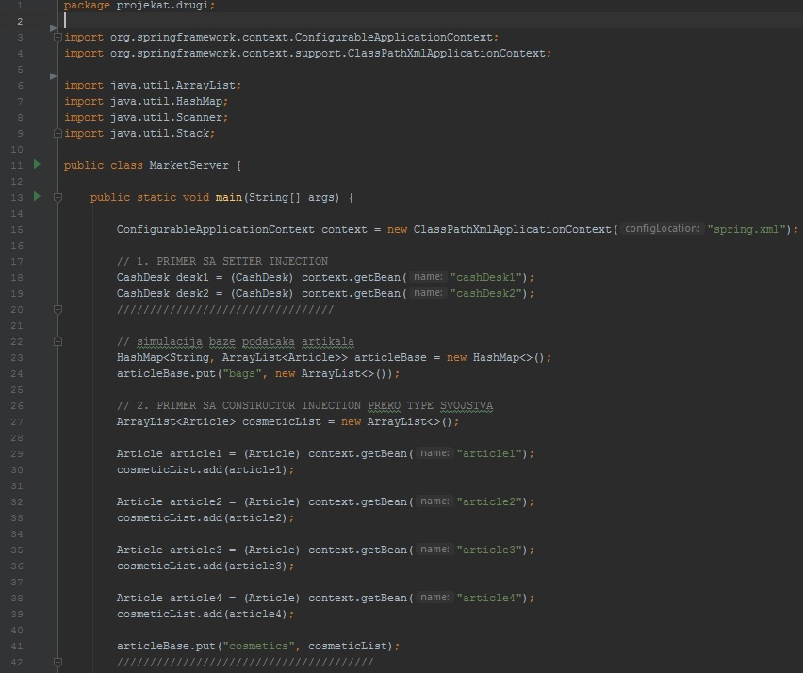
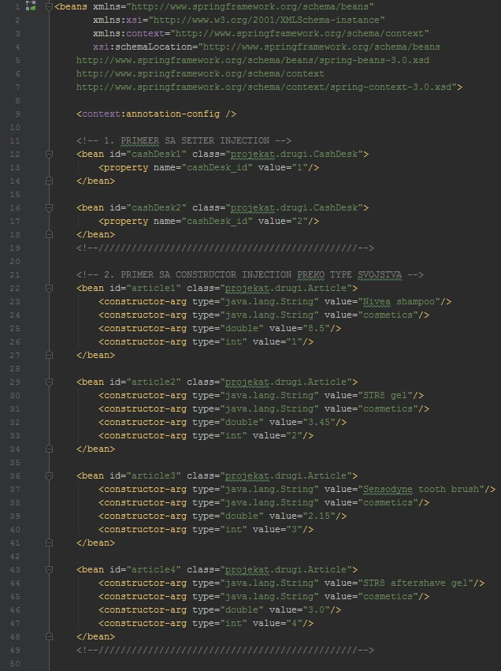
Implementation

Slide 9
Functionalities
There are some primary functionalities that this system offers:
3.1 (Re)Scanning articles and automatically adding/removing them in basket list, also with real time editing price.
3.2 Showing lists of:
- categories,
- articles per category,
- desks,
- taken articles.
3.3 Scanning shopping baksets, so it will imidiately now which articles are taken, and total price, just by one scan on the Cash Desk. It will after automatically reset all data in the basket and gain worker experience.

Slide 10
Conclusion
This is an innovative and modified RFID system for modern supermarkets. This just brief simulation of control flow of the whole system. It can however be refactored and optimized to work concurrently and fastly as real time system.
It would reduce waiting queues and time for waiting to pay, also it would make work for Cash Workers easier, faster and more efficient.
Also some additional functionalities can be added such as requesting from user to enter maximum amount of money he wants to spend, and remind him if he overstep that amount.

Slide 11
Questions?

