Slide 1

Bid for UVA Patrol System
Team 2018-10

Slide 2
Preface
Dear Tenderee，
This PowerPoint is the display of our bid, which can help you understand our ideas more clearly. However, some of the details have been omitted in the PowerPoint. So please check the bid document for all the context. Thank you!

Slide 3
01.
Introduction
02.
Project Overview
03.
Program Development
CONTENTS
04.
Schedule

Slide 4
01.Introduction

Slide 5
1.1 Team Overview
Members of our team generally have the ability and experience of using programming languages such as Java, c, c++, python and have a strong interest in machine learning, artificial intelligence, hardware and software development. Some of the team members have participated in computer competitions and won awards.
There are six members in the team, including a team leader. Everyone has unique advantages as well as clear logic, good understanding and expression skills. When work arrangements are in need, it is generally up to each member to come up with their own ideas, and then analyze them together. The final choice will made by group leader and the tasks will be assigned reasonably to everyone according to their interests and abilities. Therefore, our team is able to complete the project correctly and efficiently.

Slide 6


1.2 Individual Description
Runyu ZHANG
Yinglun LI
Zeyu ZHANG
Team Leader
Familiar with C, C++, Python, Java and have experience of writing programs in these languages.
Participated in robot competitions.
-Third prize in national robot competitions in high school and university.
-Second place in the Hong Kong Robot Track
Obstacle Race.
Excellent decision making and leadership.
Interested in artificial intelligence and machine learning fields.
Skilled in using C and Java and have studied Python and Swift.
Have experience in program
development.
-Participated in a smart medical system development.
-Participated in the design and production of some web multimedia.
Second Prize in the Computer and Multimedia Design Competition of the city.
Great understanding in code specification.
Strong aesthetic and design skills.
Familiar with C, Java and Database establishment. Self-learned Python foundation.
Worked as an IT intern at an educational institution.
Interested in machine learning, robot programming and AI.
Good understanding and communication ability.

Slide 7

1.2 Individual Description
Danyun WANG
Huixing REN
Qichen ZHANG
Familiar with C, Java and Database establishment.
Worked as an assistant of customer manager at the Bank of Communication.
Interested in machine learning and AI field.
Good understanding and learning ability.
Strong aesthetic and design skills.
Familiar with C, Java and Haskell.
Have teaching experience in C language.
Have good program skills and motivated to learn new knowledge
Great understanding and learning ability.
Strong aesthetic and design skills.
Familiar with C, Java, Haskell and Database establishment.
Having experience in summer research in Neural networks.
Interested in machine learning, robot programming and AI.
Good understanding and communication ability.
Strong sense of responsibility.

Slide 8
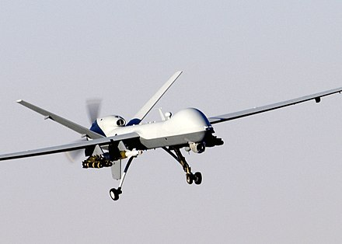

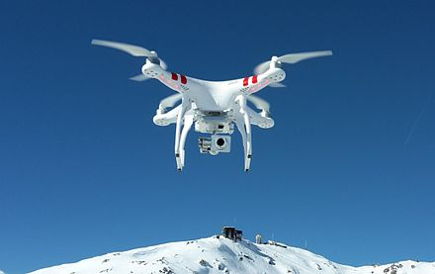
1.3 Background of UAV Tracking
An unmanned aerial vehicle (UAV), commonly known as a drone, is an aircraft without a human pilot aboard. UAVs are a component of an unmanned aircraft system (UAS); which include a UAV, a ground-based controller, and a system of communications between the two.
A General Atomics MQ-9 Reaper, a hunter-killer surveillance UAV
The flight of UAVs may operate with various degrees of autonomy: either under remote control by a human operator or autonomously by onboard computers..
A DJI Phantom UAV for commercial and recreational aerial photography

Slide 9
02. Project Overview

Slide 10
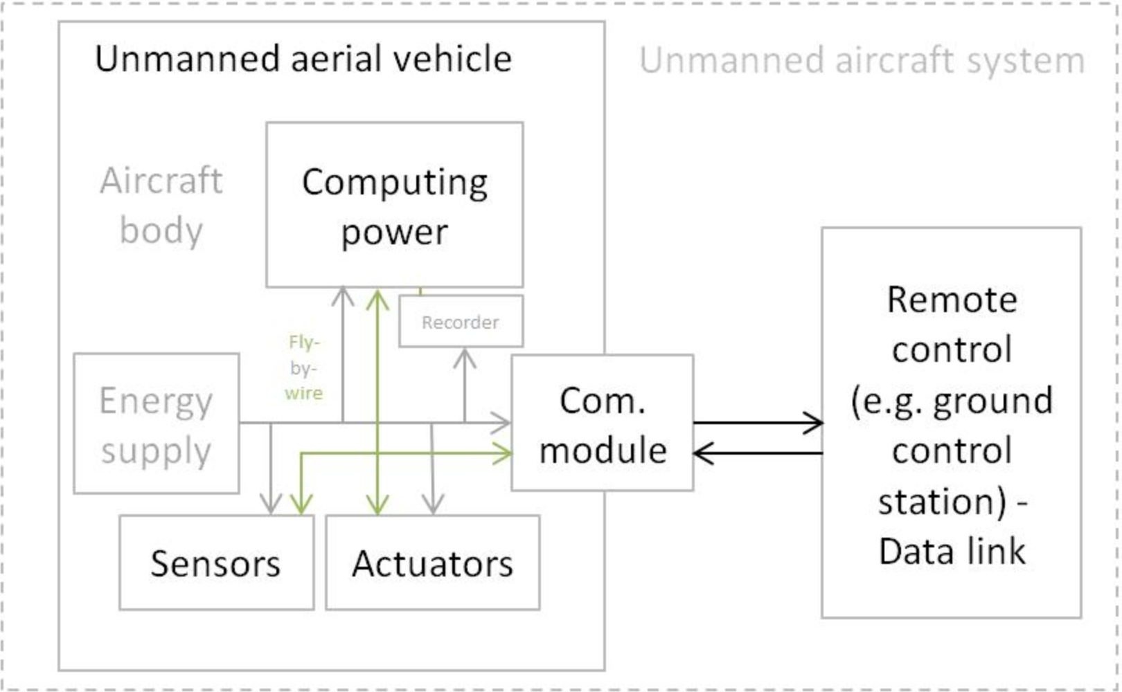


2.1 Project Description
UVA Patrol System

Slide 11

2.1 Project Description
Defining UAV Patrol system
Manned and unmanned aircraft of the same type generally have recognizably similar physical components. The main exceptions are the cockpit and environmental control system or life support system. Some UAVs carry payloads (such as a camera) that weigh considerably less than an adult human, and as a result can be considerably smaller. Though they carry heavy payloads, weaponized military UAVs are lighter than their manned counterparts with comparable armaments.
Small civilian UAVs have no life-critical systems, and can thus be built out of lighter but less sturdy materials and shapes, and can use less robustly tested electronic control systems. For small UAVs, the quadcopter design has become popular, though this layout is rarely used for manned aircraft. Miniaturization means that less-powerful propulsion technologies can be used that are not feasible for manned aircraft, such as small electric motors and batteries.
Control systems for UAVs are often different than manned craft. For remote human control, a camera and video link almost always replace the cockpit windows; radio-transmitted digital commands replace physical cockpit controls. Autopilot software is used on both manned and unmanned aircraft, with varying feature sets.

Slide 12
2.1.1 Elements of Technology
Webpage
Camera and Dji UAV
-Html5
-Css3
-Javascript visual stdio code
-Linux(Ubuntu)
-Manifold programming
-Dji Onboard SDK
-Python(Pycharm)
Video Stream Process
-Python2.7/Python3

Slide 13
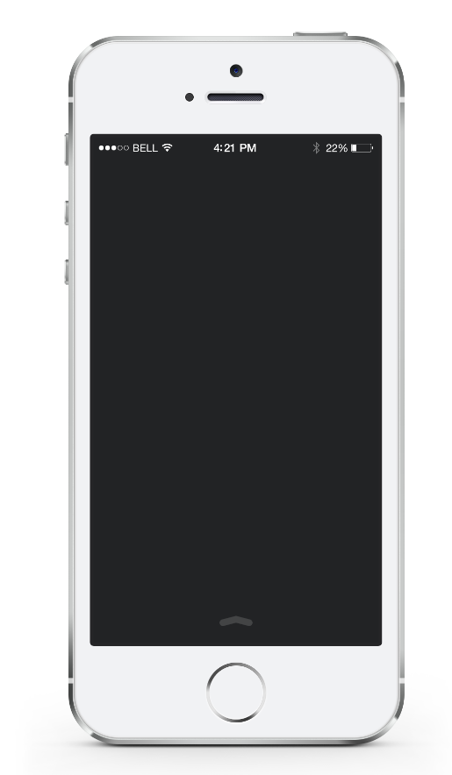

2.2 Relevant Technology used in Relevant Projects
Develop
Environment
Equipment
-Raspberry Pi
-USB camera
-JoyStick
-Arduino UNO
-Mac OS(pycharm)
-Linux(Geany)

Slide 14
03.Program Development

Slide 15
3.1 Requirements
Users ask the basic control to UAV on the ground by using the webpages such as take off, landing, position control through SDK. Besides, the petrol system are essential based automatic object recognition module from videos taken by an UAV onboard camera.

Slide 16
3.2 Software Approaches and Methods
We would divide the whole project into two parts. 1. The webpages and the connection and transfer between the control machine and UAV steadily. 2. the video stream collect, transfer, process and analysis the fly control system. We will apply agile development. We have six students who are in the small teams, with small budgets. Agile methods exist to be flexible about the SE stages, there are times when it is good to plan, which gives us possibilities to fix our problem.

Slide 17
3.3 Website and Algorithm Design
In the webpage, the basic function should be fixed for many times and improve its stability. Besides, the connection between the base ground equipment and the UAV is a serious problem in the project.
Considering about the process unit power on the UAV and the camera video stream quality, we need try best to improve the code quality and frame clear and easy. Using less resources algorithm may be a considerable solution.

Slide 18
3.4 Coding
Coding is very important. Well coding means “easy to maintain”. In order to code to certain standards, we will coding according to certain strategies and keep good coding manners. One student will be the manager and other five students will be in charge of different developing parts, but all of us will have enough ideas of the whole situation. We will communicate frequently, and be sure that all of people meet the requirements. Besides, the third parts libraries are our main aim to follow them and find some key point to equip on our projects.

Slide 19
3.5 Debugging
Debugging is a social, multi-faceted skill. So, we should first find bugs, try and reproduce it. We may use some debugging strategy such as binary search and hypothesis testing. Also, we may use a bug tracker which records data to help us judge the defect. Our group will print out the code and do a group code inspection twice a week or once a month.

Slide 20
3.6 Testing
First, we will build a test plan that developers can use it to test code before delivering it and managers can use it to estimate testing workload, and schedule it and include it in the budget. We may use Unit Testing to test the individual pieces and Integration Testing when we test combinations of pieces. Following are the Release Testing and Acceptance Testing. We will consider the result and may need to change our framework until the acceptance goes very successfully. Finally, the actually flying test is essential and we would try our best to take more time on that project.

Slide 21
04.Schedule

Slide 22



Important Dates
22:00
10/10/2018
13/11/2018
11/4/2019
15/10/2018
31/10/2018
Project Bids
Equipment
Requests
Project Set Up
and
Running
Medium
Reports
Final Reports
Open Day

Slide 23
Thanks for watching!

