Slide 1
Face Capturing with Decoration Details
Team2018-10
Runyu ZHANG Qichen ZHANG Yinglun LI
Huizinga REN Zeyu ZHANG Danyun WANG

Slide 2
Outline
Why choose us
good ability to implement the project
good understanding of the project
Preliminary preparation

Slide 3
Good Ability
CVs of Team Members
Good cooperation ability

Slide 4
CVs of Team Members
Runyu ZHANG (Team leader)
Familiar with C, C++, Python, Java and have experience of writing programs in these languages.
Participated in robot competitions.
-Third prize in national robot competitions in high school and university.
-Second place in the Hong Kong Robot Track Obstacle Race.
Excellent decision making and leadership.
Interested in artificial intelligence and machine learning fields.

Slide 5
CVs of Team Members
Yinglun LI
Skilled in using C and Java and have studied Python and Swift.
Have experience in program development.
-Participated in a smart medical system development.
-Participated in the design and production of some web multimedia.
Second Prize in the Computer and Multimedia Design Competition of the city.
Great understanding in code specification.
Strong aesthetic and design skills.

Slide 6
CVs of Team Members
Zeyu ZHANG
Familiar with C, Java and Database establishment. Self-learned Python foundation.
Worked as an IT intern at an educational institution.
Interested in machine learning, robot programming and AI.
Good understanding and communication ability.
Strong sense of responsibility.

Slide 7
CVs of Team Members
Qichen ZHANG
Familiar with C, Java, Haskell and Database establishment.
Having experience in summer research in Neural networks.
Interested in machine learning, robot programming and AI.
Good understanding and communication ability.
Strong sense of responsibility.

Slide 8
CVs of Team Members
Huixing REN
Familiar with C, Java and Haskell.
Have teaching experience in C language.
Have good program skills and motivated to learn new knowledge
Great understanding and learning ability.

Slide 9
CVs of Team Members
Danyun WANG
Familiar with C, Java and Database establishment.
Worked as an assistant of customer manager at the Bank of Communication.
Interested in machine learning and AI field.
Good understanding and learning ability.
Strong aesthetic and design skills.

Slide 10
Good cooperation ability
There are six members in the team, including a team leader.
Everyone has unique advantages as well as clear logic, good
understanding and expression skills. When work arrangements are needed, it is generally up to each member to come up with their own ideas, and then analyze them together. The final choice will made by group leader and the tasks will be assigned reasonably to everyone according to their interests and abilities. Therefore, our group is able to complete the project correctly and efficiently.

Slide 11
Good Understanding of The Project
Definition of Key Concepts
Face detection
Facial landmark detection
Image processing

Slide 12
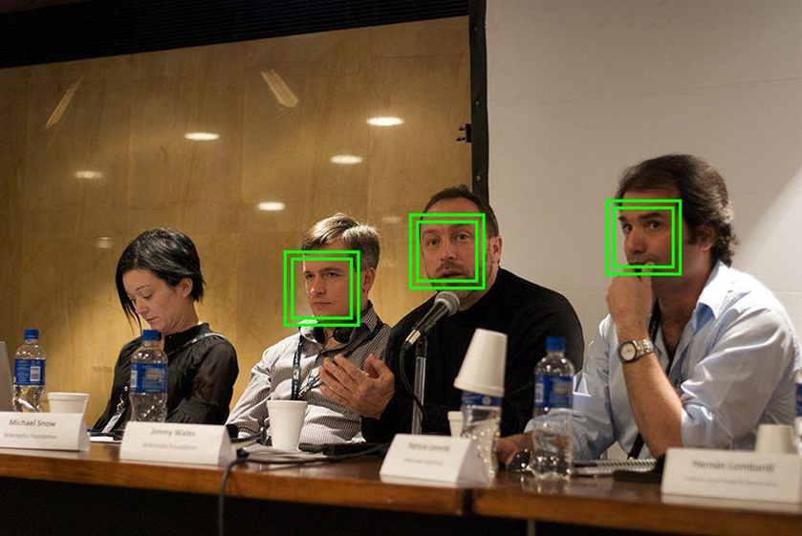
Face Detection
Face detection is a computer technology being used in a variety of applications that identifies human faces in digital images. It’s algorithms focus on the detection of frontal human faces and can be regarded as a specific case of object-class detection. Face detection can be used in many fields. For example, some recent digital cameras use face detection for autofocus.

Slide 13
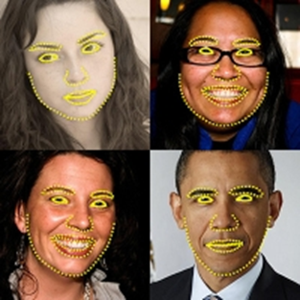
Facial Landmark Detection
When we detect the face, further, we can identify different parts of the face such as the eyes, nose and mouth. This recognition technique is facial landmark detection, which is also called as face feature detection or facial keypoint detection.

Slide 14
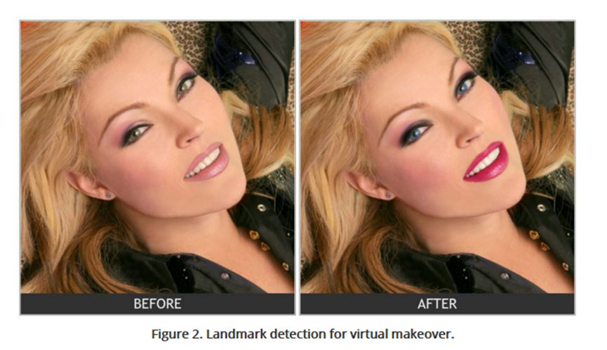
Image processing
In computer science, digital image processing is the use of computer algorithms to perform image processing on digital images. For our project, it’s a useful technique to add decoration to the face after we detected the position of the face and facial features.

Slide 15
Preliminary Preparation
We find a useful library that may helpful for us to implement face capturing.
Dlib is an open source library that contains many algorithms in machine learning, computer vision, image processing, and linear algebra. We can use it to achieve face detection and facial landmark detection.

Slide 16
Summary
In summary, we have good programming skills and teamwork skills, have a good understanding of the project and did a full preliminary investigation. Choosing our team will be a good choice.

Slide 17
Thank You

