Slide 1

Natural Language Processing – TP1
Florian Hetzel EE10945
Hugo Silva PG50416
Tomás Lima PG50788
Teachers:
José Almeida
Luís Cunha

Slide 2
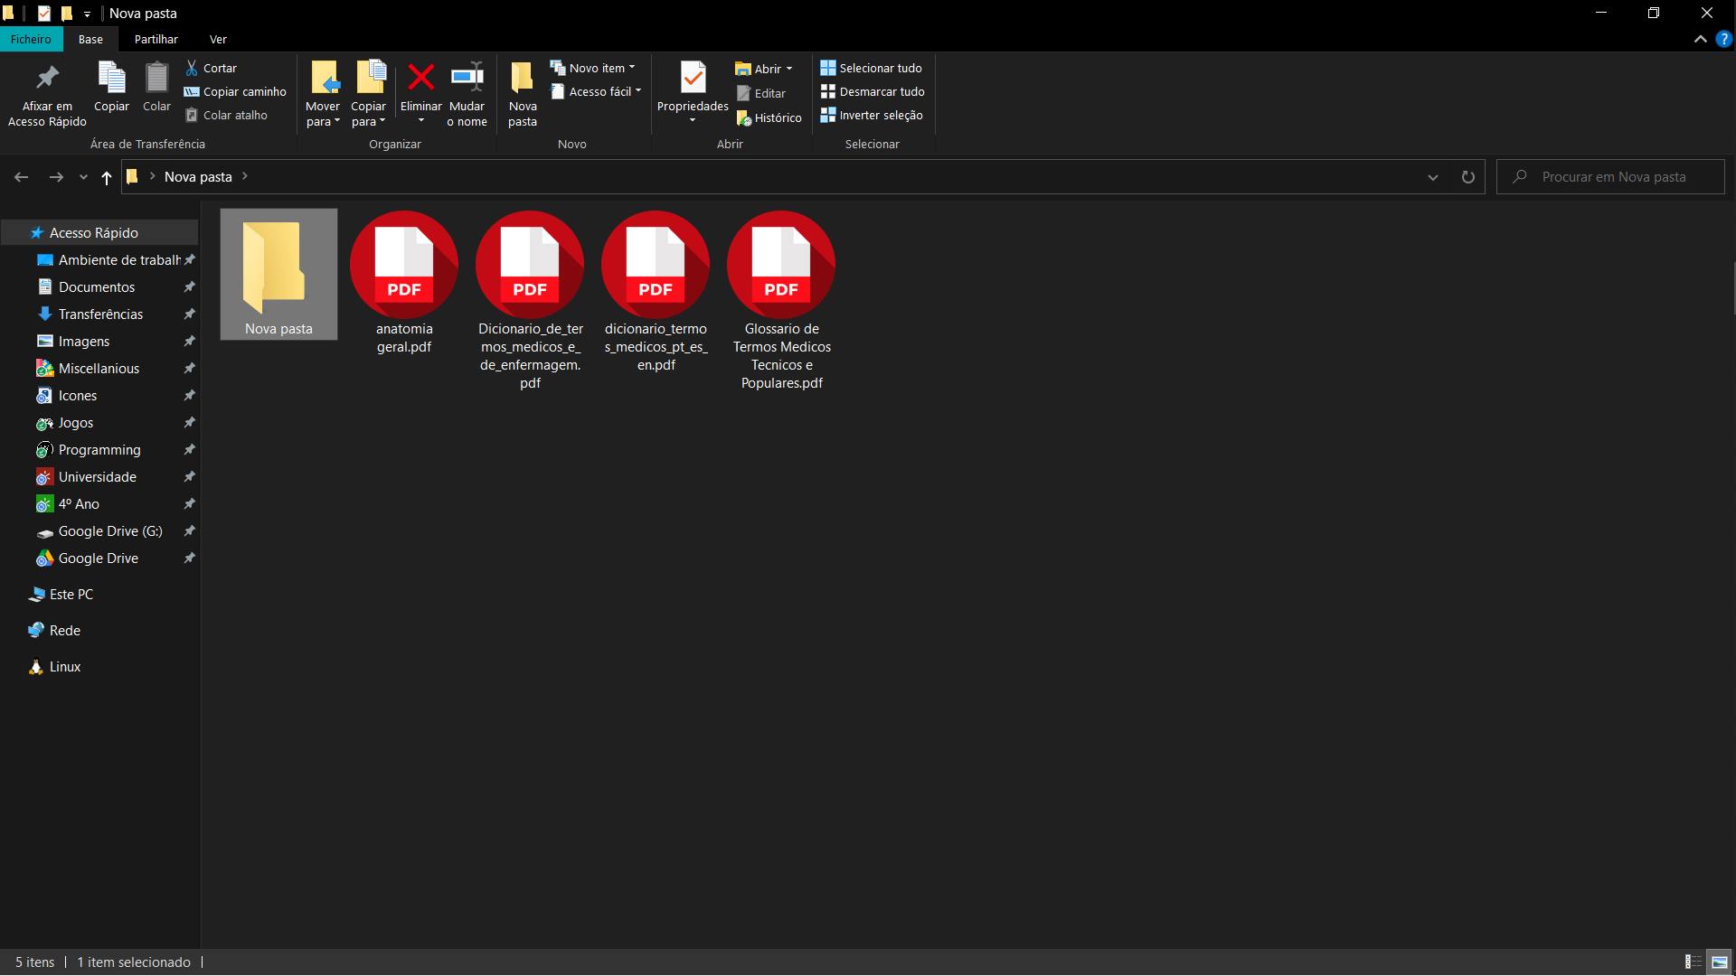




PDF Files

Slide 3




Basic Work Flow
Exceptions
Patterns
Code

Slide 4
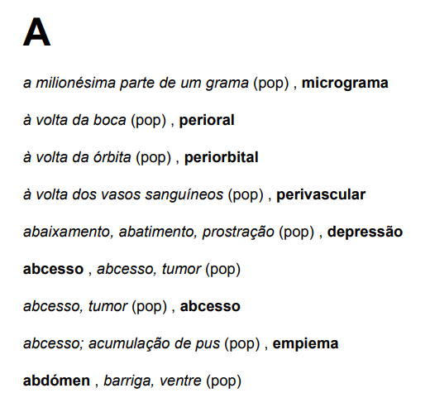
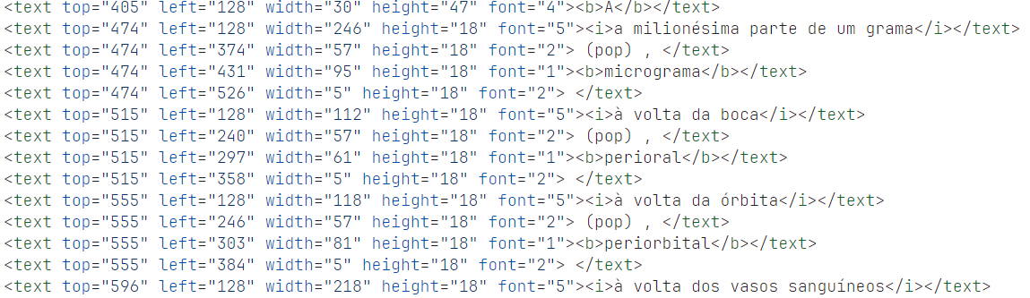
Example: Glossario de Termos Medicos Tecnicos e Populares.pdf
PDF
Section has
font=4 (or 6)
Terms and descriptions
have no order
Description: italic and followed
by a text with “(pop)”
XML
Terms: bold

Slide 5
Section has font=4 (or 6):
r'<.+font="[46]".+\n'
Terms: bold
r'.+?<b>(.+)</b>.+?\n', r'#T=\1\n'
Patterns
Description: italic and followed by a text with “(pop)”
r'(.+?<i>.+?)</i>.+?\n.+?<i>(.+?\n)', r'\1 \2'
r'.+?<i>(.+)</i>.+?\n', r'#D=\1\n'

Slide 6
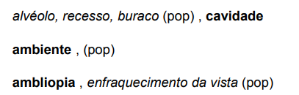
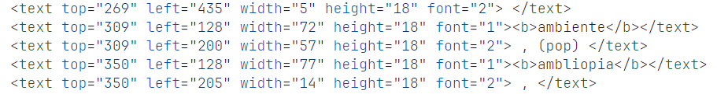
Exceptions
Some descriptions have the “(pop)” within them
r'(<.+?>)(.+?) \(pop\)(<.+?>)', r'\1<i>\2</i>\3\n\1(pop)\3'
Some terms don’t have descriptions
r'(<.+>)<b>(.+)</b>(.+)\n(<.+>\(pop\)<.+>)\n'

Slide 7
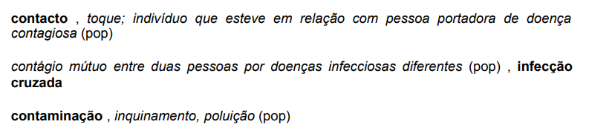
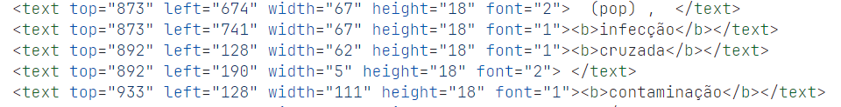
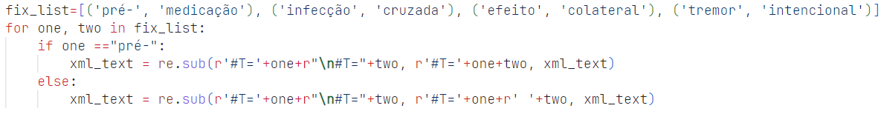
Exceptions
Some terms got separated by a new line

Slide 8
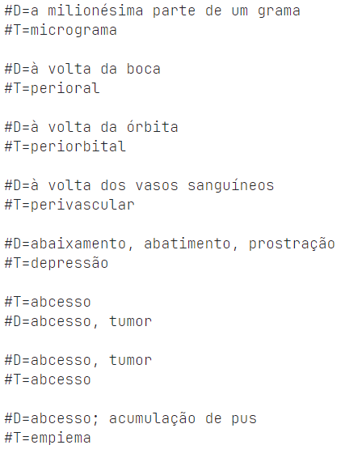
Text to dictionary

Slide 9
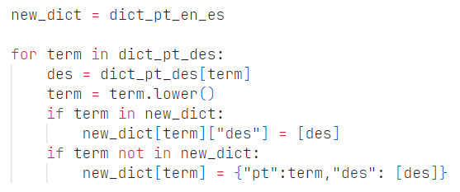
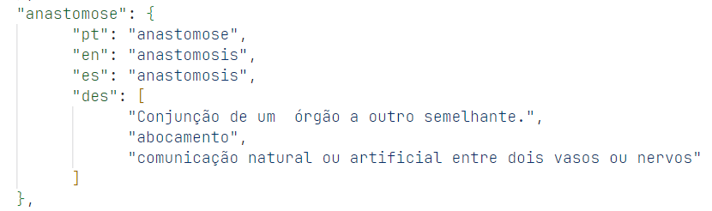
Join the JSON files

Slide 10
Natural Language Processing – TP1
Florian Hetzel EE10945
Hugo Silva PG50416
Tomás Lima PG50788
Teachers:
José Almeida
Luís Cunha

