Slide 1
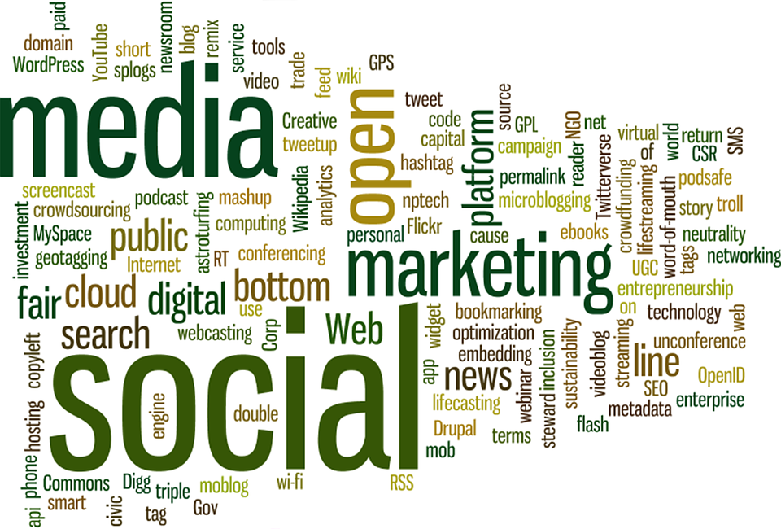

MAJOR PROJECT
Unified Emotion Analysis: A Multi-Modal Approach
Rishabh Mahendroo(2100840)
Shatakshi Tiwari(2100851)
Mohd. Ayan Ali(2100829)
Shubhangi(2100857)
Under the guidance of Dr. Ashish Negi

Slide 2

Contents:
Introduction
Problem Statement
Dataset used
Data Preprocessing
Model Building and Evaluation
Real World Use-Cases
Model Deployment
Conclusions

Slide 3
Introduction:
Emotions influence human decisions, communication, and behavior.
In digital interactions, understanding emotional cues helps improve user experience.
Emotion recognition enables smarter AI systems in fields like:
Healthcare
Mental health tracking
Customer support
Education and training
Traditional systems rely on single modalities (e.g., only text) which can miss important signals.

Slide 4
Real-World Use Cases of Emotion Recognition:
🎧 Virtual Assistants (Alexa, Siri) – Adapting responses based on tone.
🎓 E-Learning – Tracking student engagement through face/speech.
💬 Customer Support – Escalating angry or frustrated users to human agents.
🧠 Mental Health Monitoring – Detecting depression or stress from voice/text.
🎮 Gaming – Adapting game difficulty based on player frustration.

Slide 5
Our Focused Problem & Solution:
We propose “Unified Emotion Analysis – A Multimodal Approach” to detect human emotion using:
🧑‍💻 Text (chat or reviews)
🧑 Facial expressions (via image)
🎤 Voice tone (via audio)
The system fuses predictions and takes intelligent action, like:
Determining user sentiment across modes
Escalating to a human if intense emotion is detected
Real-world use case implemented: Emotion-Aware Customer Support System
.

Slide 6
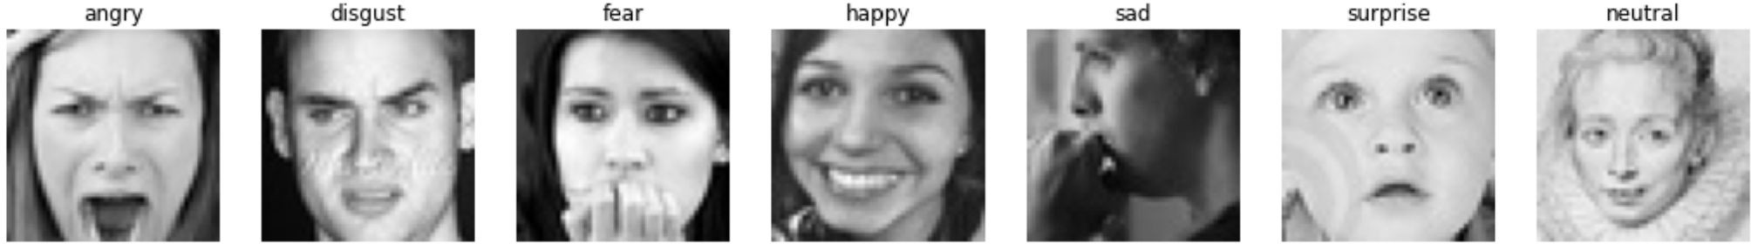
Dataset used: For Facial Recognition
We have utilized the FER 2013 dataset provided on Kaggle.
The data consists of 48x48 pixel grayscale images of faces. The faces have been automatically registered so that the face is more or less centered and occupies about the same amount of space in each image.
The training set consists of 28,709 examples and the public test set consists of 3,589 examples.

Slide 7
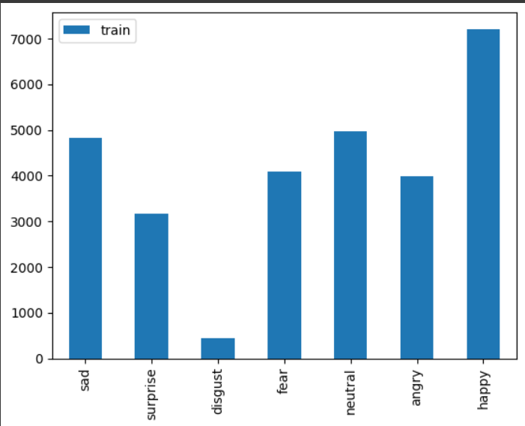
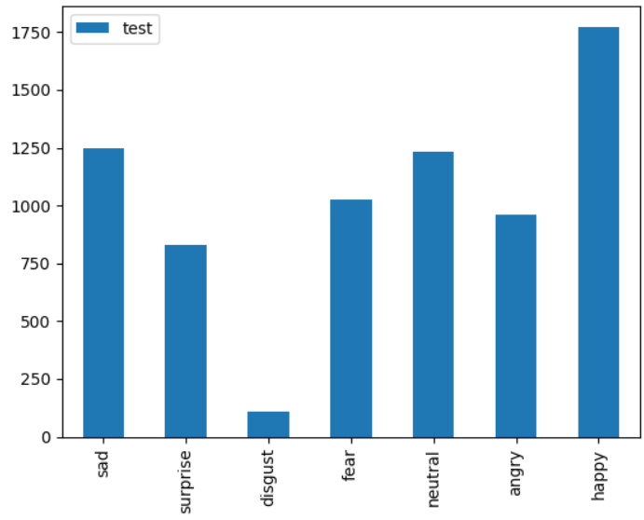
Dataset Analysis:
For Facial Emotion Recognition

Slide 8
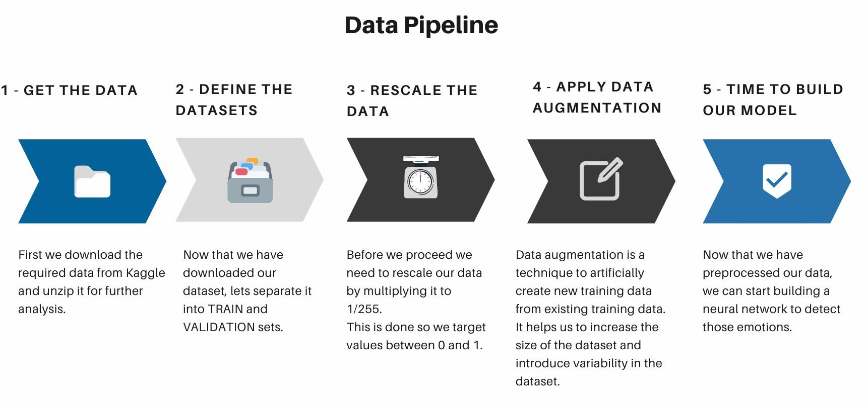
Data Preprocessing:
For Facial Emotion Recognition

Slide 9
Model Building and Evaluation:
Convolutional Neural Network (CNN):
A neural network is a way for a computer to process data input. They’re inspired by biological processes found in human and animal brains. Neural networks are comprised of various layers of ‘nodes’ or ‘artificial neurons’. Each node processes the input and communicates with the other nodes.In this way, input filters through the processing of a neural network to create the output, or answer.
Convolutional neural networks were inspired by animal vision. The way the nodes in a CNN communicate with each other resembles the way some animals see the world.
So, rather than taking everything in as a whole, small areas of an image are taken. And these small areas overlap to cover the whole image.

Slide 10
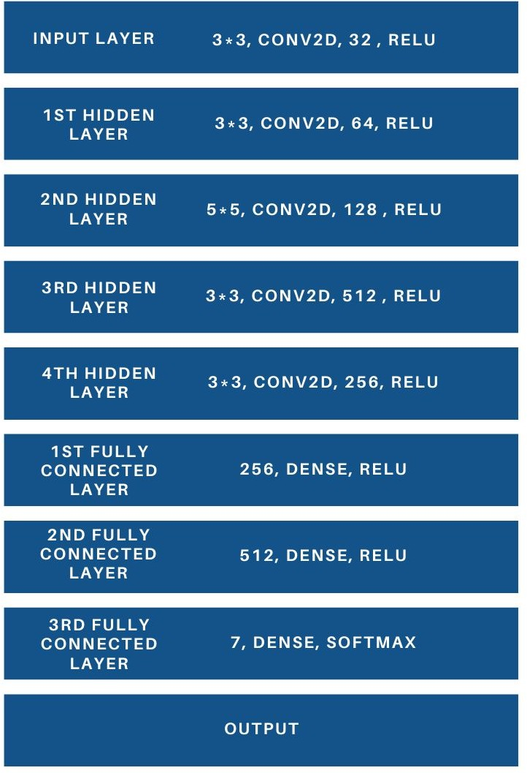
Model 1: Custom CNN model for recognizing facial emotions:
To achieve our aim to recognize the facial emotions of a user, we created a CNN model using Keras and Tensorflow libraries.
The neural network contained an input layer, four hidden layers, and three fully-connected layers to process the image data and predict the emotions.
In between each layer, a Max Pooling and Dropout layer was added for downsampling the data and preventing our model from overfitting.

Slide 11
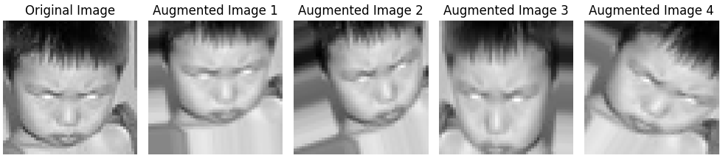
Model 2:Image Augmentation:
Image augmentation involves creating new training samples from the existing data using transformations. This helps improve the robustness and generalization of the model. Common techniques include:
Rotation: Rotating the image by a certain angle.
Translation: Shifting the image along the x or y axis.
Scaling: Zooming in or out.
.
.

Slide 12
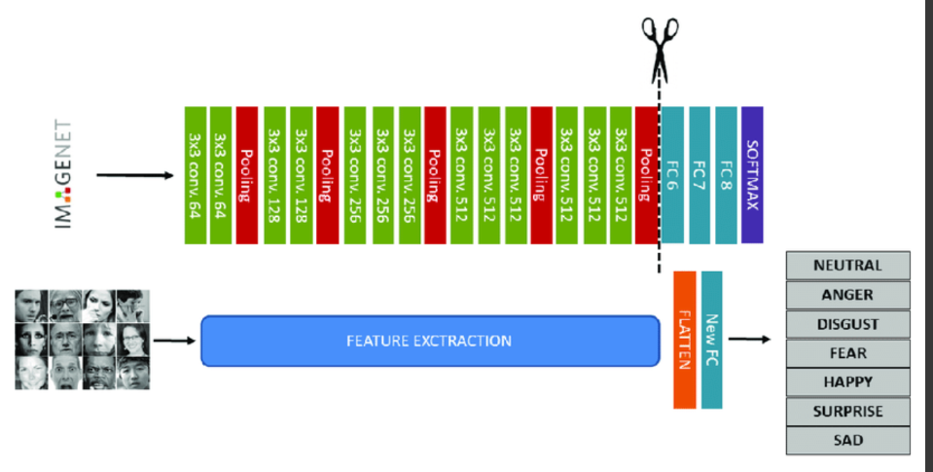
Model 3: Transfer Learning VGG Architecture

Slide 13
VGG (Visual Geometry Group) Network is a type of CNN architecture proposed by the Visual Geometry Group at the University of Oxford. VGG is known for its simplicity and depth, consisting of:
VGG16 and VGG19: Refers to the number of layers (16 and 19 respectively).
Convolutional layers: Use small 3x3 filters throughout the network.
Pooling layers: Typically 2x2 max pooling.
Fully connected layers: Usually three fully connected layers at the end, followed by a softmax layer for classification.
The VGG network is particularly known for achieving high accuracy in image classification tasks while maintaining a simple and uniform architecture.

Slide 14
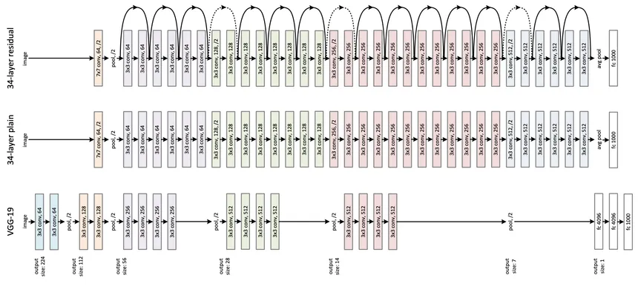
Model 4: Transfer Learning – ResNet50

Slide 15
ResNet (Residual Network) is a CNN architecture that introduced the concept of residual learning. ResNet50 refers to a 50-layer deep network. Key features include:
Residual blocks: Each block has a shortcut or skip connection that bypasses one or more layers. This helps mitigate the vanishing gradient problem and allows for training much deeper networks.
Bottleneck design: Uses 1x1 convolutions to reduce the dimensionality before applying 3x3 convolutions, making the model more efficient.
Global average pooling: Instead of fully connected layers, ResNet often uses global average pooling followed by a softmax layer.
ResNet50 is widely used for its balance between depth and computational efficiency, often outperforming simpler models on complex tasks like image recognition and classification.

Slide 16
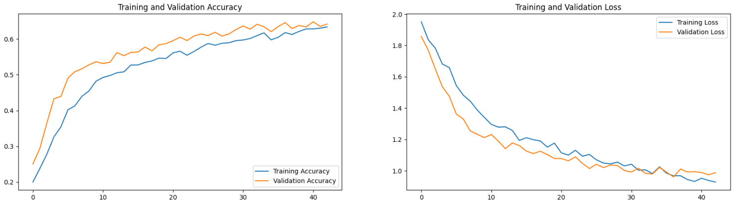
Plots for accuracy and loss.
The created model was run for 39 epochs in order to get an accuracy of 62.61% on training set and 67.38% on validation set.
The training and validation loss was reduced to 0.5469 and 2.0118.

Slide 17
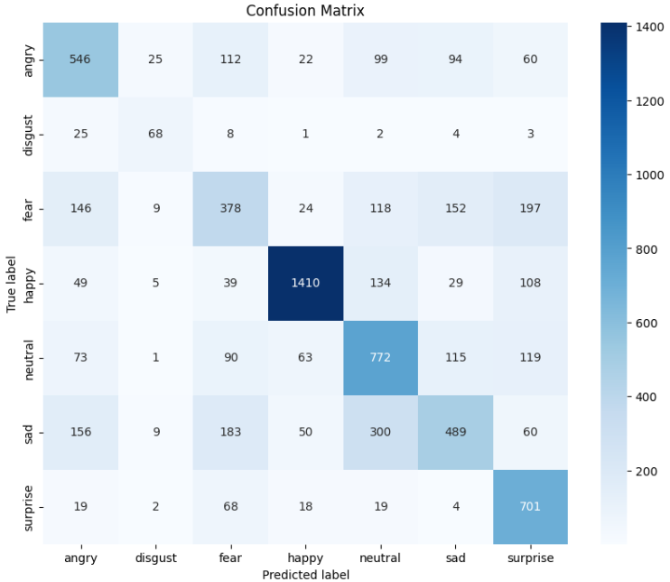
Confusion Matrix.
From the confusion matrix, we saw; that the model accurately predicts most classes, but the performance is comparatively lower in classes angry and fear. Less amount of data present for these classes might be the reason for this.

Slide 18
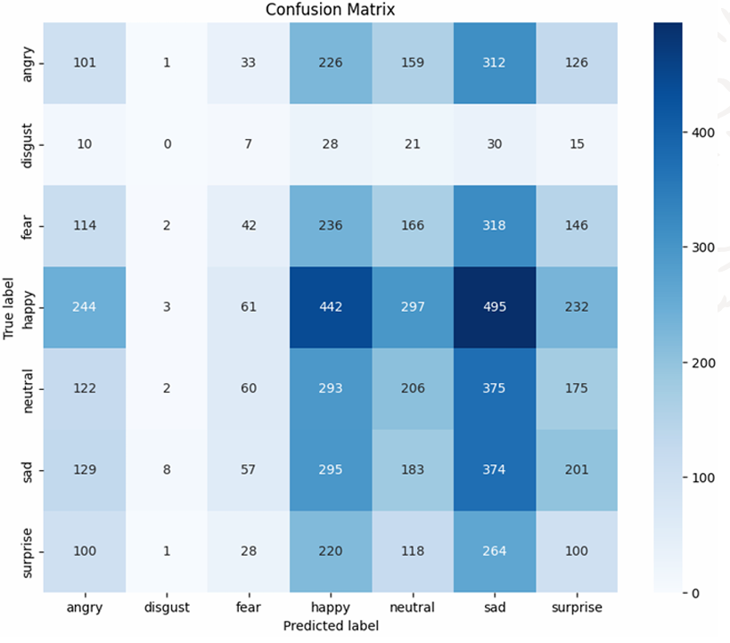
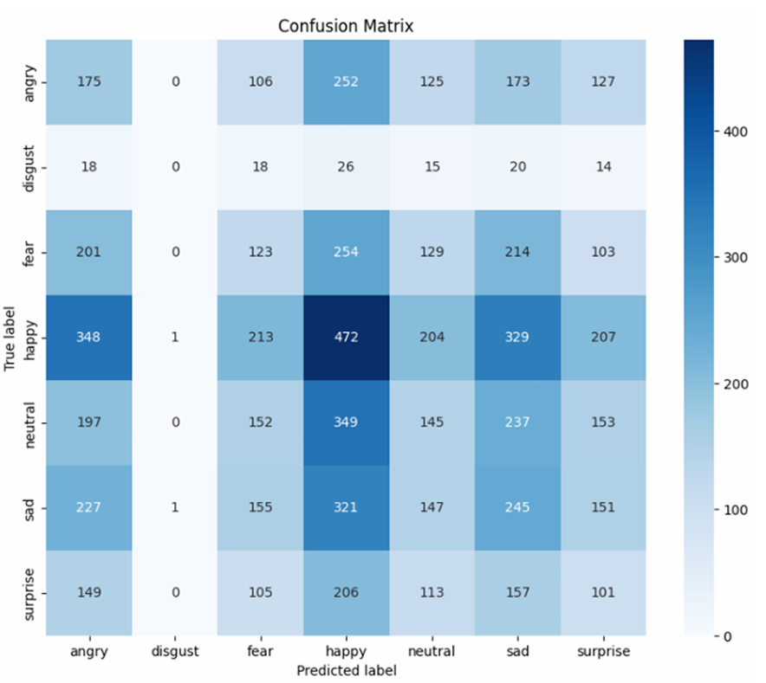
Comparative Analysis of all 4 models tested:
Model-1
Model-2

Slide 19
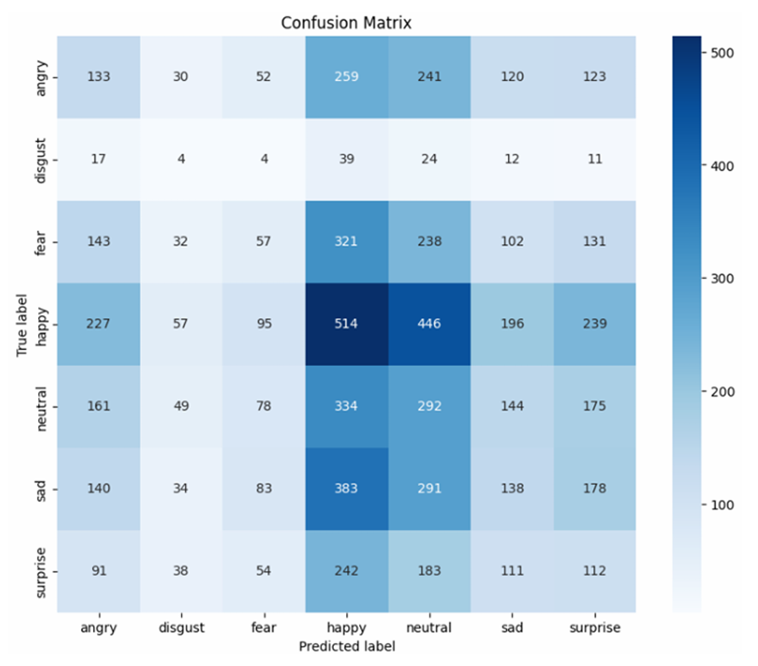
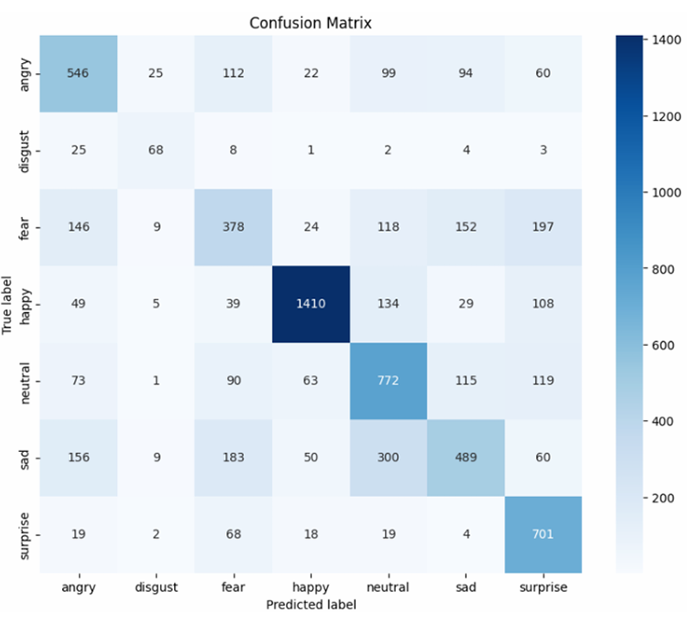
Model-3
Model-4

Slide 20
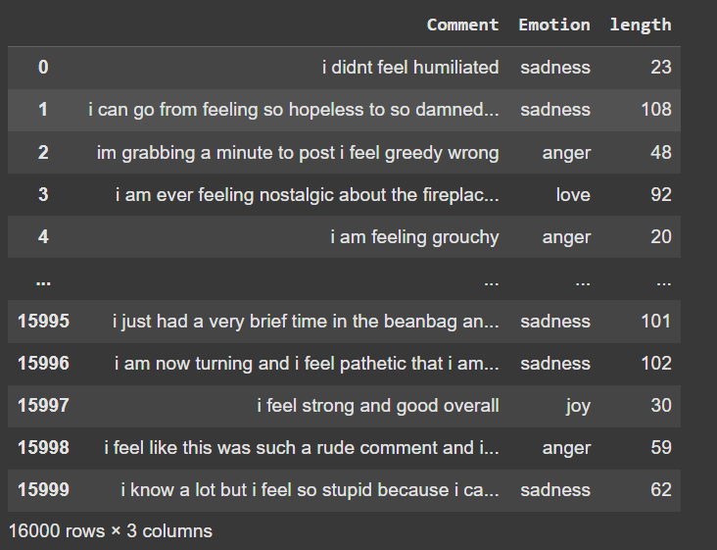
Dataset used: For Text Emotion Recognition
Dataset Description
Data Statistics
Size: 16,000 annotated sentences
Format: Text-emotion pairs
Structure: Semicolon-separated (.txt format)
Emotion Classes
Six basic emotions:
Love
Joy
Anger
Sadness
Fear
Surprise
Data Format Example
Input sentence → Corresponding emotion label

Slide 21
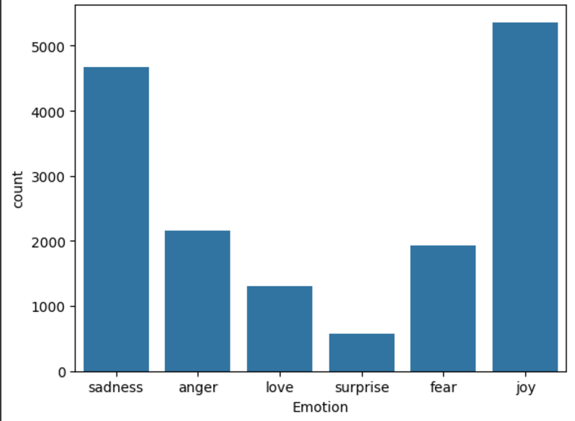
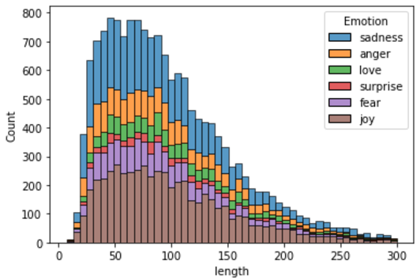
Dataset Analysis:
For Text Emotion
Data Distribution

Slide 22
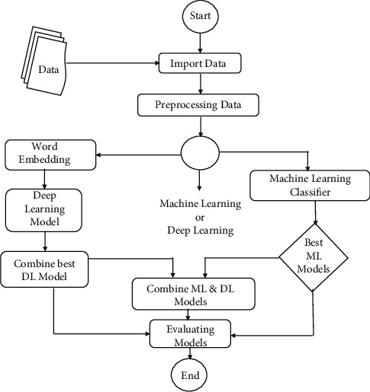
Workflow
Workflow of Text-Emotion Analysis

Slide 23
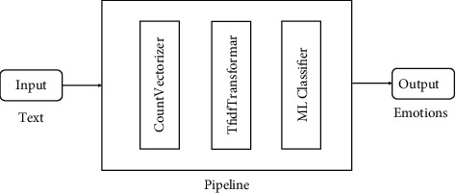
Model Building and Evaluation:
For Text Emotion Recognition
Machine Learning Techniques
Techniques Used
Multinomial Naive Bayes
Logistic Regression (Best-performing model)
Support Vector Machine (SVM)
Evaluation Metrics
The following metrics were used to assess the performance of each model:
Accuracy
Precision
Recall
F1-Score

Slide 24
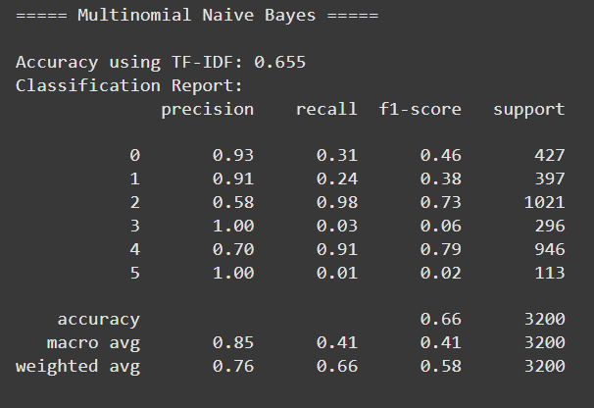
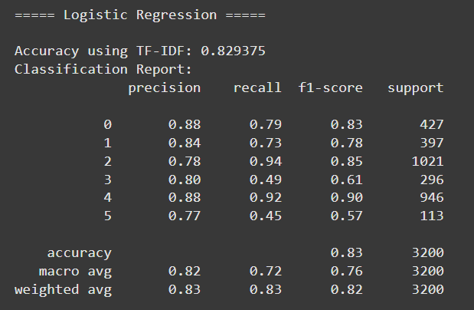

Slide 25
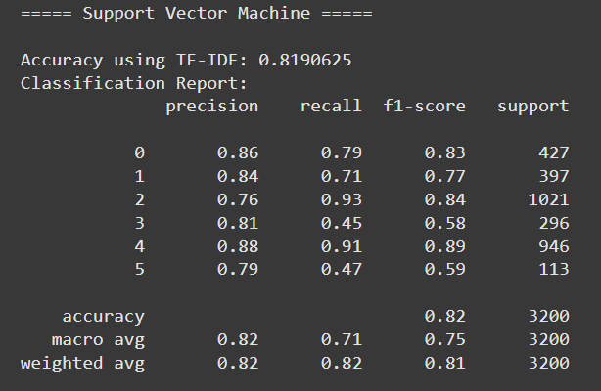
Conclusion
Logistic Regression was selected as the final model due to its superior performance across all metrics.
It demonstrated the highest accuracy and balanced precision, recall, and F1-score, making it optimal for the task.

Slide 26
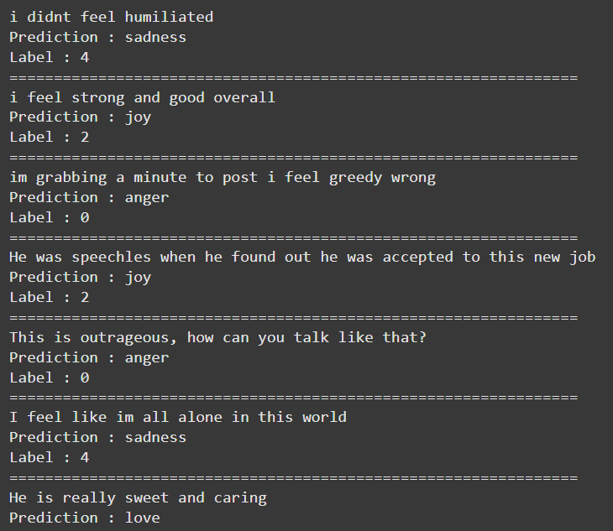
Model Testing

Slide 27
Text Preprocessing for Deep Learning
1. Text Cleaning
Objective: Clean text to focus on meaningful content.
Steps: Lowercasing, removing special characters, stop-word removal, tokenization, and lemmatization.
2. Text Encoding
Technique Used: TF-IDF
Converts text into numerical vectors based on word importance.
3. Padding
Objective: Ensure uniform input size for LSTM.
Zero Padding: Adds zeros to shorter sequences to match the longest one.

Slide 28
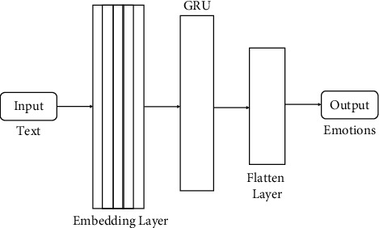
Model Building and Evaluation:
For Text Emotion Recognition
Deep Learning Techniques
Model Used: Long Short-Term Memory
LSTMs are ideal for sequential data like text as they capture long-term dependencies effectively.
They address the vanishing gradient problem common in traditional RNNs.
Feature Extraction: TF-IDF
Term Frequency-Inverse Document Frequency (TF-IDF):
Measures the importance of words in a document relative to a corpus.
Converts text data into numerical vectors suitable for LSTM processing.

Slide 29
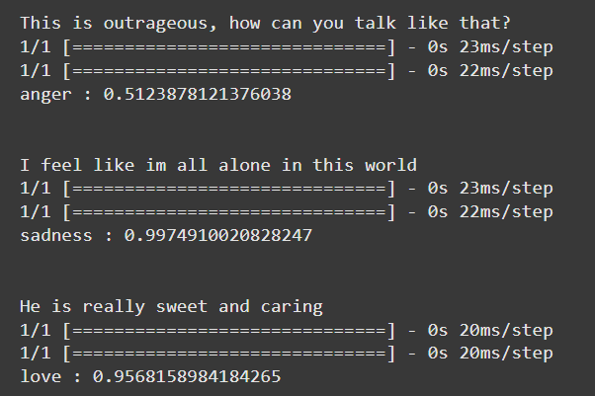
Model Testing

Slide 30
Speech Emotion Recognition
Model Used: Wav2Vec2-based Emotion Classifier
Based on Wav2Vec2.0 – a state-of-the-art transformer-based model for audio feature extraction.
Fine-tuned on emotional speech datasets.
We used a pretrained model from Hugging Face:
prithivMLmods/Speech-Emotion-Classification

Slide 31
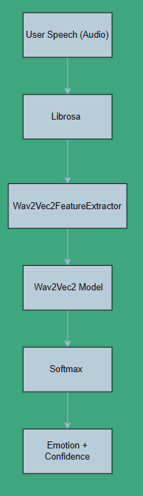
Working Pipeline:

Slide 32
Real-World Use Case — Smart Customer Support System
Many companies use AI chatbots and virtual assistants for customer support.
However, bots often fail to understand customer emotions, especially when users are frustrated, angry, or upset.
Our system integrates Text, Facial, and Speech Emotion Recognition to detect emotion intensity.
Based on detected emotions, the system decides whether:
🤖 The bot can handle the situation, or
🧑‍💼 It must be escalated to a human agent.

Slide 33
Conclusions:
We developed a unified multimodal system that can detect human emotions through text, speech, and facial expressions.
The system intelligently fuses confidence scores from available inputs to assess user emotion.
It simulates a real-world customer support scenario, where emotion intensity determines if a bot is sufficient or a human agent is needed.
Our approach demonstrates how combining multiple modalities leads to more reliable and realistic emotion recognition.

Slide 34
Future Scope:
🎯 Fine-Grained Emotion Intensity Detection Go beyond classification to detect levels like "mild anger" vs "extreme anger".
🧠 Multimodal Deep Fusion Replace rule-based fusion with a trained neural network that learns how to weight modalities dynamically.
🌍 Multilingual & Cross-cultural Support Extend emotion recognition for non-English text and diverse speech and facial expressions.
📱 Deployment in Real Systems Integrate with actual chatbots or IVR systems to perform real-time emotional analysis in live settings.

Slide 35
Challenges Faced:
💬 Varying Input Modalities Handling cases where only one or two modalities are available, requiring flexible logic.
🧪 Lack of Unified Dataset Most emotion datasets are unimodal — combining models from separate datasets introduced normalization and fusion complexity.
🎵 Speech Emotion Ambiguity Some tones are hard to classify without contextual words (e.g., sarcasm or calm anger).
📉 Model Generalization Pretrained models may not perform consistently across all demographics or accents.

Slide 36





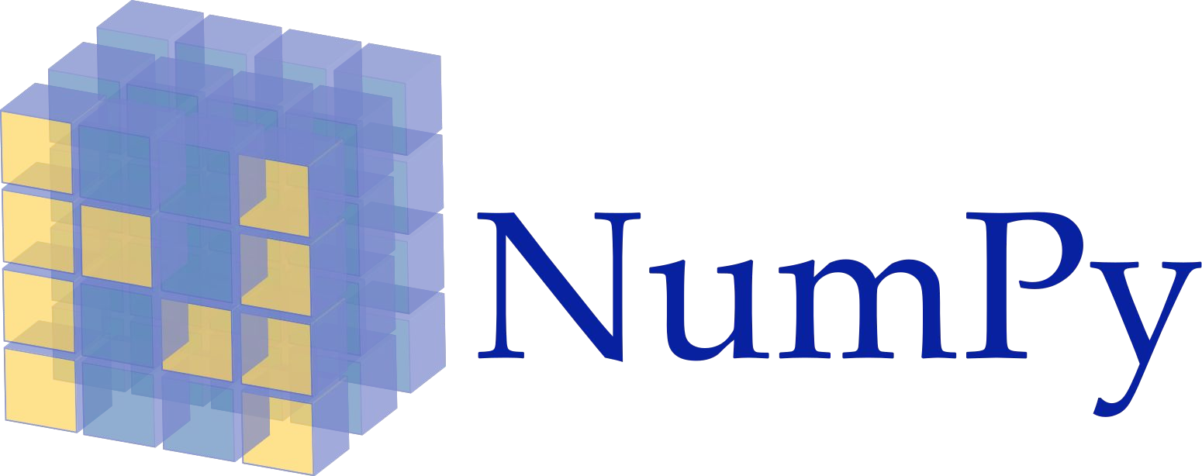

Dependencies:
The following python libraries were used to successfully build and deploy our model:
TensorFlow
Keras

Slide 37
References:
He, K., Zhang, X., Ren, S., & Sun, J. (2016). "Deep Residual Learning for Image Recognition." CVPR.
Vaswani, A., et al. (2017). "Attention Is All You Need." NeurIPS.
Mikolov, T., et al. (2013). "Efficient Estimation of Word Representations in Vector Space." https://arxiv.org/abs/1301.3781

Slide 38
Thank You.

