Slide 1

ICAI 2026 · 9TH INTERNATIONAL CONFERENCE ON APPLIED INFORMATICS
Accent-Based Evaluation of
Speech Anti-spoofing
Countermeasures
Across Multiple Languages
Jaime Arturo Hurtado Romero · Tomás Acosta Bernal · Rubén Francisco Manrique
FLAG Lab · Department of Systems and Computing Engineering · Universidad de los Andes, Bogotá, Colombia
Orlando, FL · October 2026 · Springer CCIS
Notes:
COVER — dark. Read the title, then get off it fast. Drop the real Uniandes lockup into the dashed slot (white/negative version). Yellow is used exactly once here, on the word that names the paper's object of study.

Slide 2
THE HOOK · SAY IT, THEN PAUSE
Your mother calls.
She needs
$1,500, now.
It is her voice.
— and it is not her.
Notes:
STATEMENT layout — one idea, huge type, nothing else on the slide. Use for the opening hook and for the single biggest finding. Deliver the line, then stay silent for 2 seconds before advancing. Max ~12 words.

Slide 3

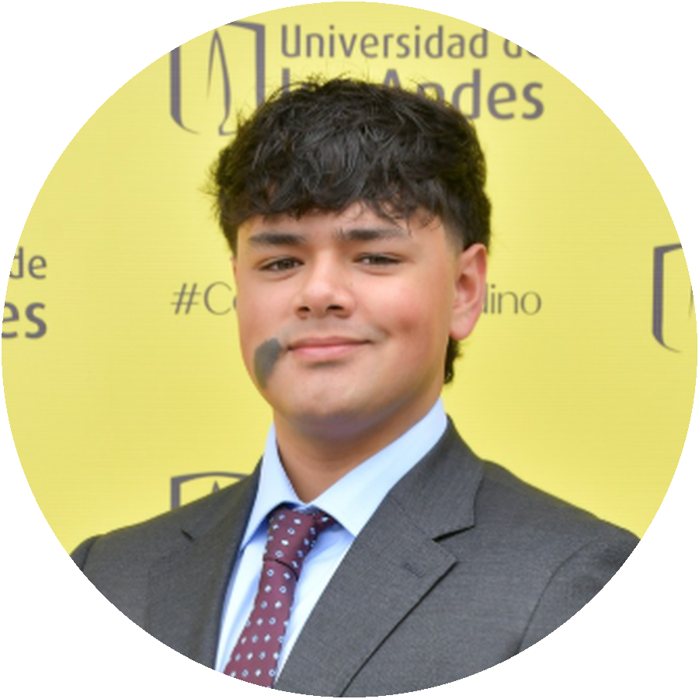

WHO IS TALKING
Tomás Acosta Bernal
AI Lead Engineer
Konecto — voice agents, RAG and LLM systems in production
Researcher
FLAG Lab, Universidad de los Andes — speech anti-spoofing
Teaching assistant
Natural Language Processing, Universidad de los Andes
This talk is the first author's work. I present it, and I build on it.
UNIVERSIDAD DE LOS ANDES · FLAG LAB
03
Notes:
SPEAKER layout — 20 seconds, no more. Circle photo + three one-line roles. The closing line sets expectations: you are presenting Jaime's paper and extending it.

Slide 4
WHAT WE WILL DO IN 15 MINUTES
Four moves, one conclusion
01
The attack
02
The collapse
What a voice deepfake actually is, and the two ways to build one
English-trained detectors meet Spanish speech
03
The culprit
04
What survives
Decomposing the failure by attack family
Bilingual training, and what is left after it
UNIVERSIDAD DE LOS ANDES · FLAG LAB
04
Notes:
AGENDA layout — 2x2. Four items maximum; the talk is 15 minutes. Numbers in deep amber so the yellow never has to carry text weight.

Slide 5
01
The attack
text-to-speech · voice conversion · why one of them is the dangerous one
Notes:
SECTION DIVIDER — dark, ghosted number, three-word subtitle. These are the breathing points: pause here, let the room reset. Four of these in the deck.

Slide 6
BLOCK 01 · THE ATTACK
Two ways to fake a voice
TTS
VC
?
Text-to-speech
Voice conversion
Why it matters
Writes the waveform from text. The speaker never said it — the vocoder invented it.
Takes a real recording and rewrites who is speaking. The words are real; the identity is not.
They leave different fingerprints — and only one of them survives a change of language.
One line of takeaway lives here. The supporting half of the sentence goes in grey.
UNIVERSIDAD DE LOS ANDES · FLAG LAB
06
Notes:
CARD GRID 3-up. Last card is the 'so what' card: white fill + black border instead of grey fill. Never more than ~25 words per card. Bold takeaway line at the bottom is a fixed element of this layout.

Slide 7
BLOCK 02 · THE COLLAPSE
Same model, different language
TRAINED ON ENGLISH, TESTED ON ENGLISH
TRAINED ON ENGLISH, TESTED ON SPANISH
2.67 %
> 30 %
EER · best configuration
EER · all 48 configurations
Works. This is a solved problem — in English.
Chance. Every single architecture we trained.
Tamayo et al. (2023) reported this. We went looking for why.
UNIVERSIDAD DE LOS ANDES · FLAG LAB
07
Notes:
COMPARE layout — two halves, one number each. The right half carries the pale-yellow tint + yellow border: that is how this deck marks 'the problem'. Use for before/after, EN vs ES, baseline vs ours.

Slide 8
BLOCK 01 · WHAT WE TESTED
48 detectors, one pipeline
4
3
4
AUDIO
FRONT-END
BACK-END
LOSS
SCORE
16 kHz waveform
MFCC · LFCC · CQCC · Spectrogram
attention · trim-pad · LSTM-sum
AM · OC · P2S-Grad · Sigmoid
bona fide / spoof
4 × 3 × 4 = 48 architectures × 3 data conditions × 6 seeds = 864 trained models
Every box that varies is counted. Nothing here is a single lucky run.
UNIVERSIDAD DE LOS ANDES · FLAG LAB
08
Notes:
DIAGRAM CANVAS — the workhorse layout. Boxes on one horizontal line, arrows between, the varying stages get a white fill + black border and a yellow count above. Caption strip + bold takeaway underneath. This is where the complex figures (DET curves, the 48-grid, MARSA) will live.

Slide 9
BLOCK 03 · THE CULPRIT
The gap is not uniform. It is voice conversion.
50 % = a coin flip
English-trained models are at or below chance on converted speech — and still catch Spanish TTS at 1.79 %.
Vocoder artefacts survive the change of language. Conversion artefacts do not — they are entangled with the speaker.
Table 6 · LCNN-LSTM-sum · P2S-Grad
UNIVERSIDAD DE LOS ANDES · FLAG LAB
09
Notes:
DATA layout — chart 60%, reading of the chart 40%. Colour grammar: black = the baseline / what fails, yellow = the fix. Never put a chart on a slide without the sentence that tells the room what to see in it. Source line in mono, bottom-left.

Slide 10
THE NUMBER TO REMEMBER
1.79 %
EER on Spanish TTS attacks — from a model that never saw a word of Spanish.
The same model scores 43–66 % on voice conversion. That gap is the paper.
UNIVERSIDAD DE LOS ANDES · FLAG LAB
10
Notes:
BIG NUMBER layout — one figure, one sentence, one qualifier. The yellow highlighter bar under the number is the deck's motif; use it sparingly (3-4 times in the whole talk).

Slide 11
BLOCK 04 · WHAT SURVIVES
Accent barely moves it. Gender does.
Country | Overall | Female | Male
Chile | 0.032 | 0.059 | 0.005
Peru | 0.053 | 0.085 | 0.021
Argentina | 0.140 | 0.177 | 0.103
Venezuela | 0.168 | 0.065 | 0.271
Colombia | 0.287 | 0.029 | 0.544
Two things to see
Accent spread
Below half a percentage point across all five countries.
Gender gap
Larger — and it reverses direction between countries.
Table 10 · MFCC front-end · combined training
The paper is titled 'accent-based'. Its answer about accent is: not much.
UNIVERSIDAD DE LOS ANDES · FLAG LAB
11
Notes:
TABLE layout — never paste a paper table whole. Five rows maximum, cells that carry the argument get the pale-yellow tint, and the right column tells the room what to look at. Mono digits so columns line up.

Slide 12
YOUR TURN · 60 SECONDS
One of these is me. Which one?
A
B
[ audio placeholder — embed .wav here ]
[ audio placeholder — embed .wav here ]
Hands up for A · hands up for B
Then tell them the answer on the next slide — not this one.
UNIVERSIDAD DE LOS ANDES · FLAG LAB
12
Notes:
AUDIO DEMO layout — the interactive beat. Two cards, two clips, a show of hands. Audio gets embedded as real PowerPoint media (click-to-play) once we have the files: HABLA bona fide vs converted, or your own cloned voice. ALWAYS test speakers in the room before the session starts, and keep a spectrogram fallback slide in case audio fails.

Slide 13
IF YOU REMEMBER ONE THING
The language gap is real.
It lives in voice conversion.
One bilingual model closes it.
No architecture escapes the gap — we checked 48. And you do not need one detector per language.
UNIVERSIDAD DE LOS ANDES · FLAG LAB
13
Notes:
TAKEAWAY layout — the one sentence you want quoted. The second clause goes grey so the first one carries. Highlighter bar sits under the key noun phrase. Say this line twice in the talk: here, and at the end.

Slide 14
THANK YOU
Questions —
and what comes next
QR
paper / code
MARSA — a multi-accent Spanish corpus with six TTS systems, a partial-spoof tier, and an acoustic augmentation layer. Frame-level scoring, because utterance-level EER cannot express it.
Tomás Acosta Bernal · t.acosta@uniandes.edu.co · FLAG Lab, Universidad de los Andes
Notes:
CLOSING — dark, mirrors the cover. Leave this on screen through the whole Q&A: it holds your name, your email and the QR, which is what people photograph. The MARSA paragraph is your bridge to your own thesis if someone asks 'what next'.

Slide 15
INTERNAL REFERENCE · DO NOT PRESENT
The system in one page
Ink
Graphite
Grey
Hairline
Mist
Uniandes
Amber
#0D0D0D
#3F3F3F
#8C8C8C
#E6E6E6
#F7F7F5
#FFE800
#8A6D00
text, dark slides
secondary text
captions, muted
borders
card fill
accent only
yellow as text
Type
Inter throughout. Title 40 / section 20 / body 13.5 / caption 10.5 / mono Consolas for numbers and sources.
Yellow
Accent only, never body text. On white, yellow that must be read becomes amber #8A6D00.
Motif
The highlighter bar. Three or four appearances in the whole deck, never two on one slide.
Grid
0.8" margins, 0.3" gutters, everything hangs from one left edge.
Rule
Every slide states its takeaway in one bold sentence. If you cannot write that sentence, cut the slide.
UNIVERSIDAD DE LOS ANDES · FLAG LAB
15
Notes:
Reference page. Delete before presenting, or keep it hidden. Uniandes official identity is black + yellow #FFFF00; #FFE800 is the screen tone used here to stop the pure yellow from vibrating on projectors.

