Slide 1
Simulation and implementation of a Wireless Power Module for dielectric elastomer actuator
By Tomas Garate Anderegg
Supervised by Maribel Caceres

Slide 2
Table of Contents
Objectives
State of the Art
Approach Taken
Key Challenges & Constraints
Results
Conclusion

Slide 3
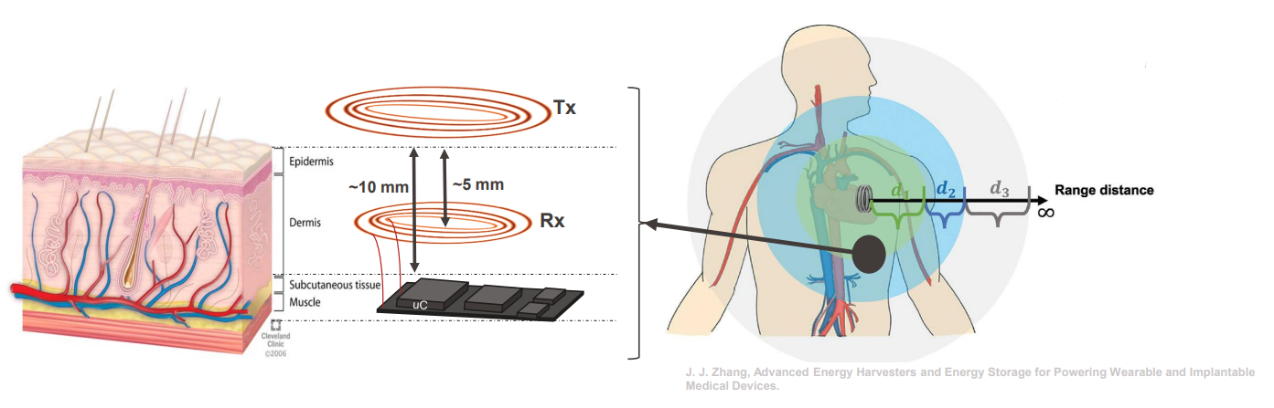
Objectives

Slide 4
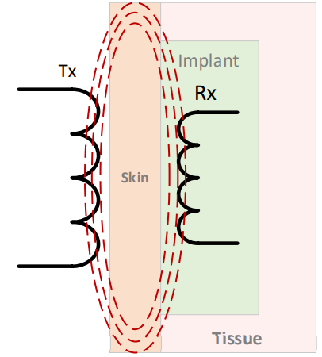
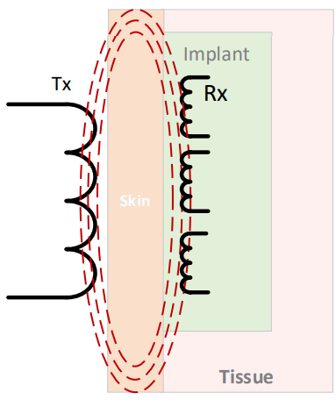
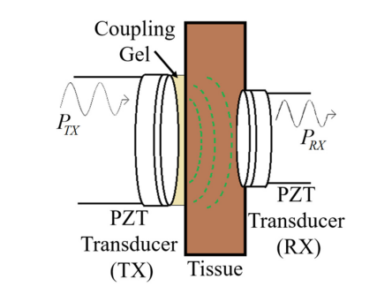
State of the Art
Good candidates for WPT techniques | Pros | Cons
Inductive Coupling | -Power transfert efficiency depends on quality factor, good matching impedance and optimal load impedance -100 kHz – 10 MHz for safety and good PTE | -Sensitive to misalignment -Misalignment can reduce the PTE -3D coils structure can improved the misalignment problem but complexe solution
Multiple Inductive Coupling | -Different type of coil architecture can lead to good PTE -Can have better performance than NRIC | -Higher complexity than NRIC -Effect of misalignment is worse on the PTE compared to NRIC -Higher operating frequency than NRIC leading to potential biosafety problems
Acoustic | -Good PTE -Good frequency range for biosafety | -Under-studied effect on the body -Difficult to design -PTE sensitive to the distance between TX and RX

Slide 5
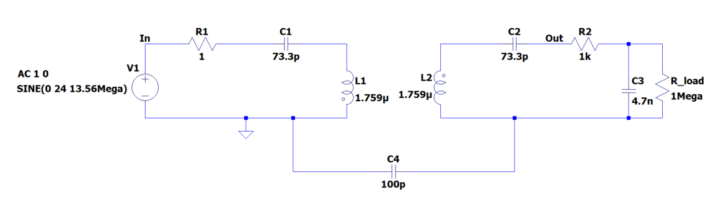

Approach Taken
Inductive coupling firstly
Multiple inductive coupling secondly
Matching Impedance
Load
M₁₂
$C_{parasitic}$ = 5 pF
$R_{parasitic}$= 1 Ω

Slide 6
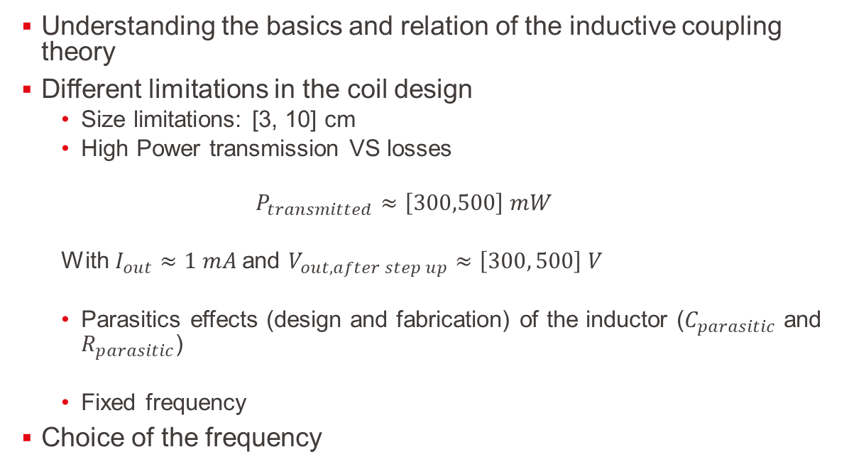
Key Challenges & Constraints
Understanding the basics and relation of the inductive coupling theory
Different limitations in the coil design
  Size limitations: [3, 10] cm
  High Power transmission VS losses
  $$P_{transmitted}≈\left[300,500\right] mW$$
  With $I_{out}≈1 mA$and $V_{out, after step up}≈\left[300, 500\right] V$
  Parasitics effects (design and fabrication) of the inductor ($C_{parasitic}$ and $R_{parasitic}$)
  Fixed frequency
Choice of the frequency

Slide 7
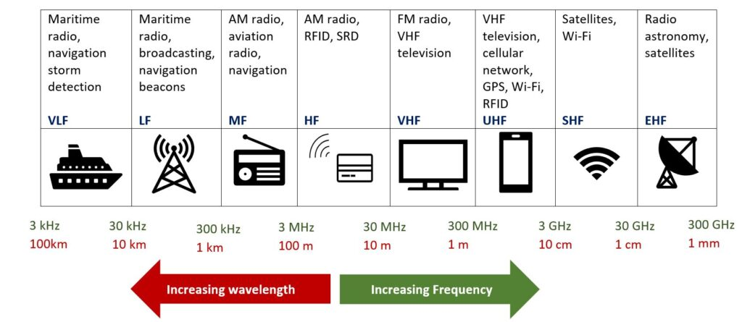

Key Challenges & Constraints: Choice of the frequency
Skin depth
δ$=\frac{1}{\sqrt{πσµf}}$
  $f$ $≈$[10 kHz -15 MHz]
Most used frequency in medical device: $f$ = 13,56 MHz
Quality Factor: Measure of the goodness of a resonant system in term of energy stored versus energy lost
Q $=\frac{2πfL}{R}$
https://soundgirls.org/a-beginners-guide-to-wireless-frequencies/

Slide 8

Key Challenges & Constraints: Choice of the frequency - finding the components
Fixed frequency
Rage of capacitance and inductance values
Resonant frequency:
$f$ $=\frac{1}{2π\sqrt{LC}}$
Quality Factor:
Q $=\frac{2πfL}{R}$
Capacitance | Inductance
~[10 pF; 1 nF] | ~[5, 100] µF

Slide 9
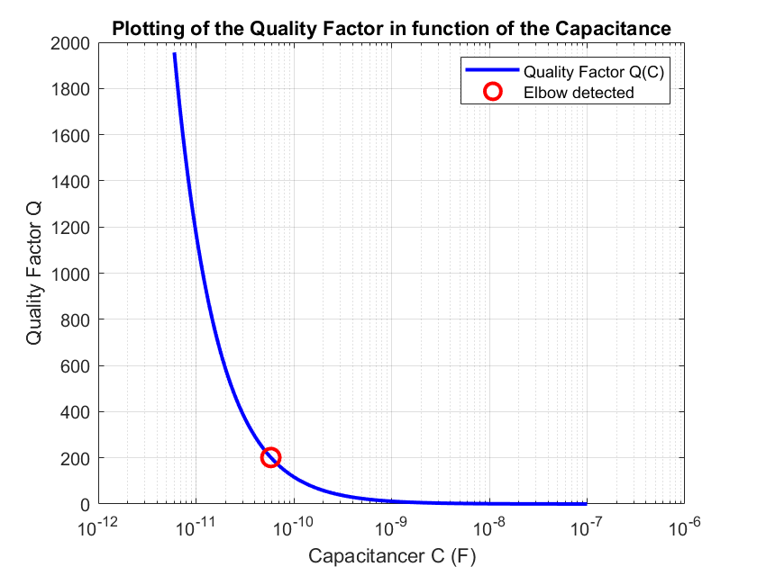


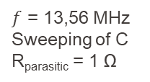
Key Challenges & Constraints: Choice of the frequency - finding the components
Matlab
Quality Factor
+
Resonant frequency
$f$ = 13,56 MHz
Sweeping of C
R_{parasitic} = 1 Ω
Adjusted value of C

Slide 10
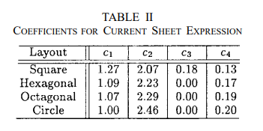
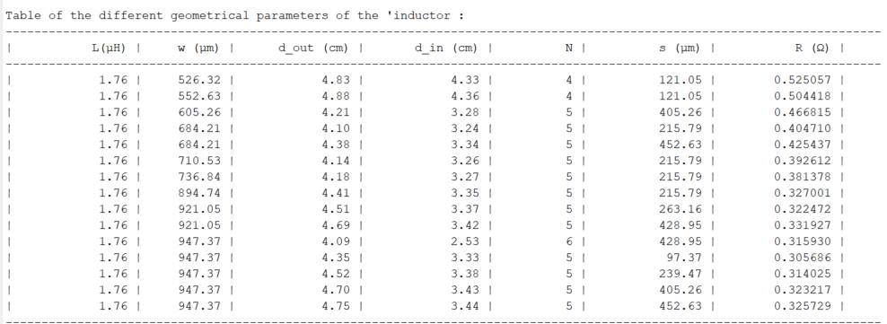

Key Challenges & Constraints:
Choice of the frequency - finding the components – finding the geometric values of L
Based on a approximated formula of a spherical planar coil inductor¹
$L ≈ \frac{μn^{2}d_{avg}c_{1}}{2}(\ln\left(\frac{c_{2}}{ρ}\right)+ c_{3}ρ$ + $c_{4}ρ^{4})$
1. Mohan, S. S., Hershenson, M. del M., Boyd, S. P., & Lee, T. H. (1999). Simple Accurate Expressions for Planar Spiral Inductances. IEEE Journal of Solid-State Circuits, 34(10), 1419-1424.

Slide 11
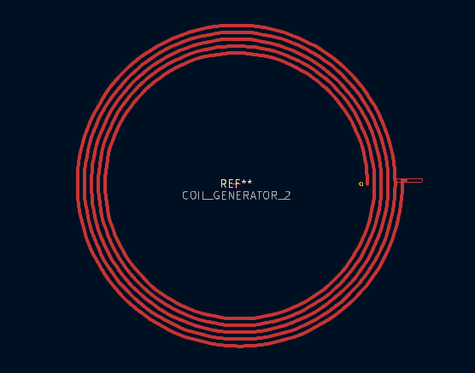
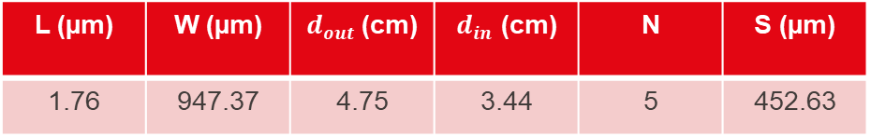
Results: Coil design
Rx
Tx
L (µm) | W (µm) | $d_{out}$(cm) | $d_{in}$ (cm) | N | S (µm)
1.76 | 947.37 | 4.75 | 3.44 | 5 | 452.63

Slide 12
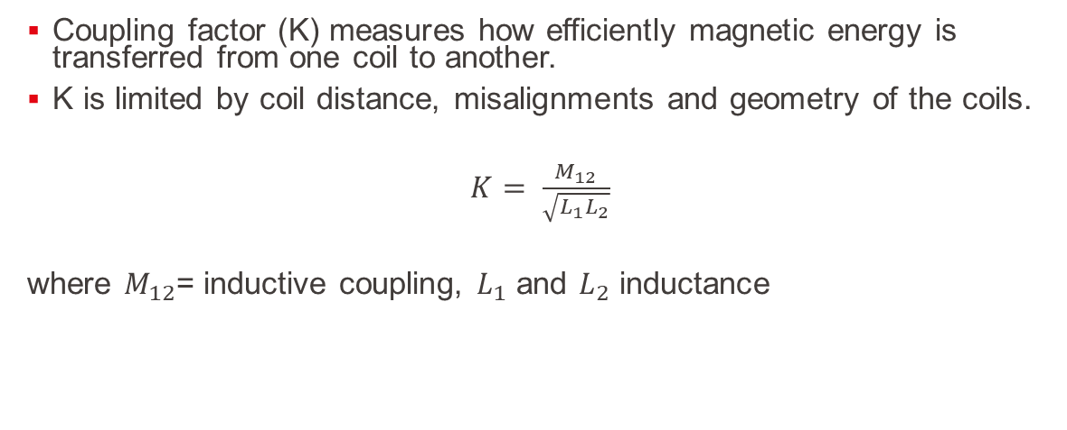
Results:
Coupling factor (K) measures how efficiently magnetic energy is transferred from one coil to another.
K is limited by coil distance, misalignments and geometry of the coils.
$K= \frac{M_{12}}{\sqrt{L_{1}L_{2}}}$
where $M_{12}$= inductive coupling, $L_{1}$ and $L_{2}$ inductance

Slide 13
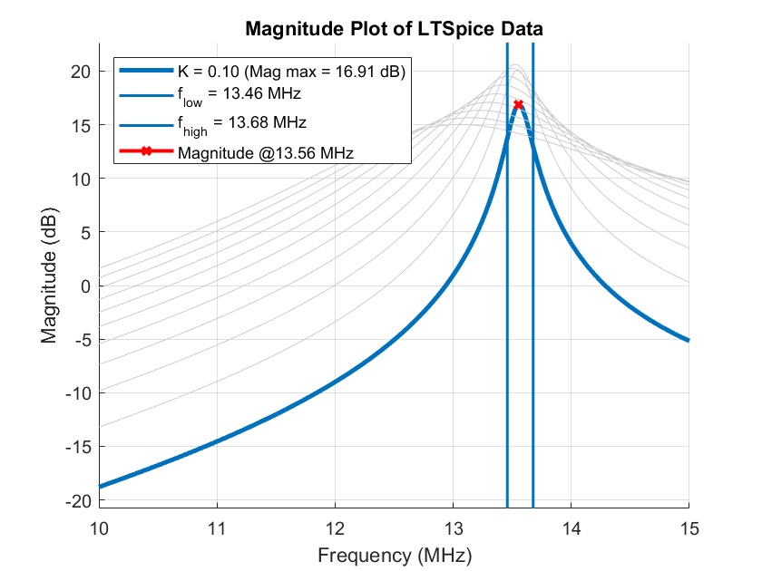
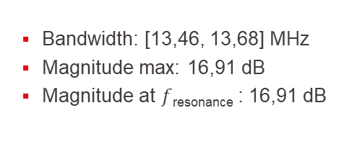
Results:
Simulation of the circuit with different values of K
Bandwidth: [13,46, 13,68] MHz
Magnitude max: 16,91 dB
Magnitude at $f$_{resonance} : 16,91 dB

Slide 14
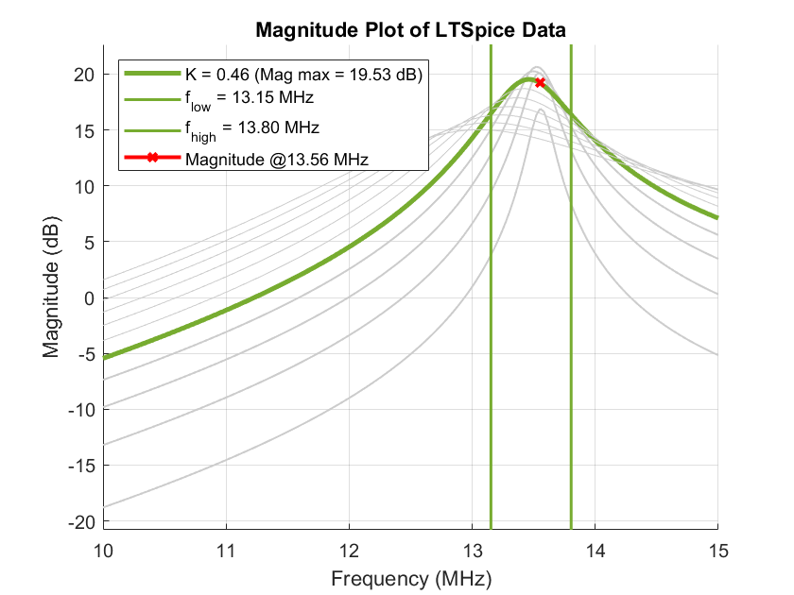
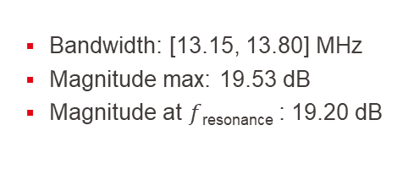
Results:
Simulation of the circuit with different values of K
Bandwidth: [13.15, 13.80] MHz
Magnitude max: 19.53 dB
Magnitude at $f$_{resonance} : 19.20 dB

Slide 15
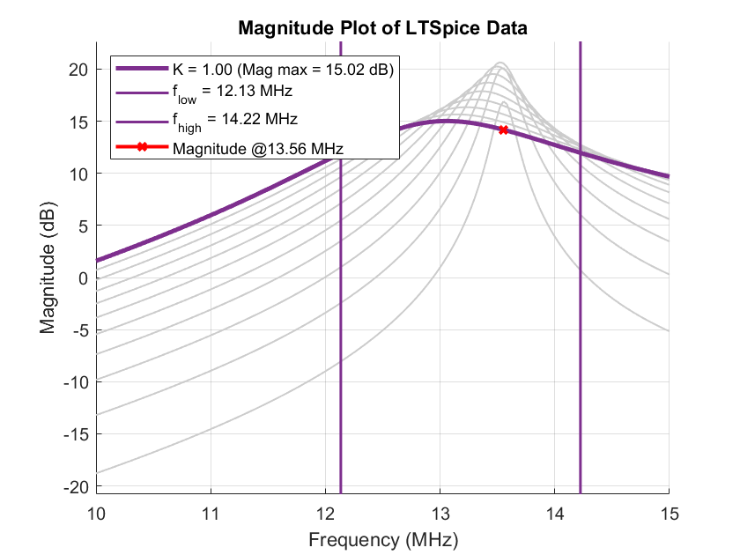
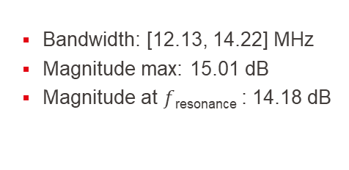
Results:
Simulation of the circuit with different values of K
Bandwidth: [12.13, 14.22] MHz
Magnitude max: 15.01 dB
Magnitude at $f$_{resonance} : 14.18 dB

Slide 16
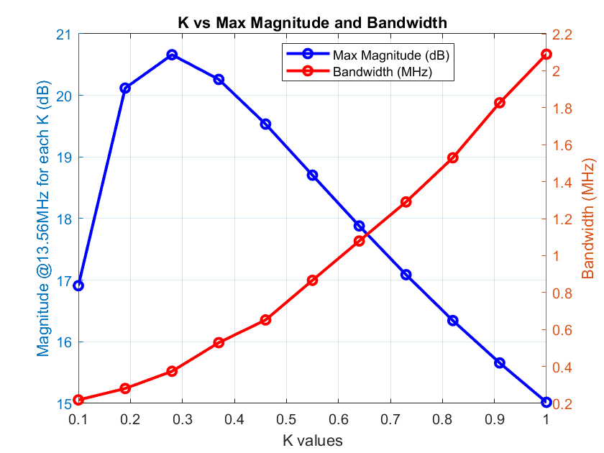
Results:
Simulation of the circuit with different values of K
Trade-off: Bandwidth versus coupling factor (K)
  High K → large bandwidth + small maximal amplitude of the transmitted signal
  Small K →small bandwidth + bigger maximal amplitude of the transmitted signal

Slide 17
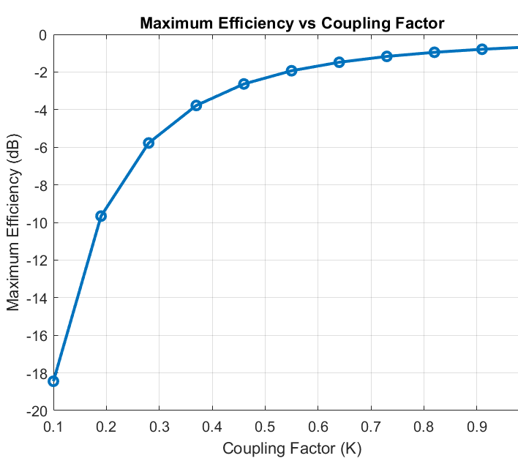
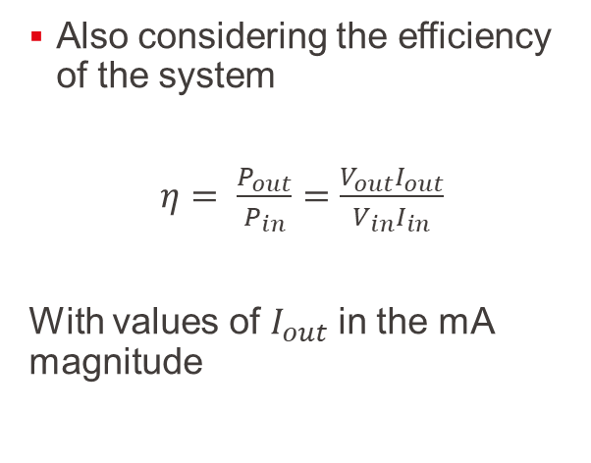
Results:
Simulation of the circuit with different values of K – Efficiency
Also considering the efficiency of the system
$η= \frac{P_{out}}{P_{in}}=$ $\frac{V_{out}I_{out}}{V_{in}I_{in}}$
With values of $I_{out}$in the mA magnitude

Slide 18
What’s Next ?
Rigid PCB - Flexible PCB implementation
Testing and validation of the model
Multiple Inductive Coupling

Slide 19
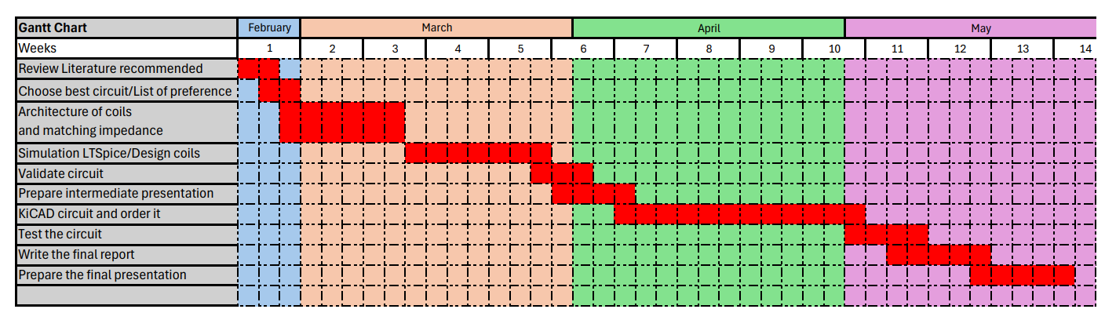
Conclusion
Determined the different values for a coil design
Simulate the circuit to see the effect of the parameters in order to estimate the best trade-off between BW and maximum transmitted power
Here

Slide 21
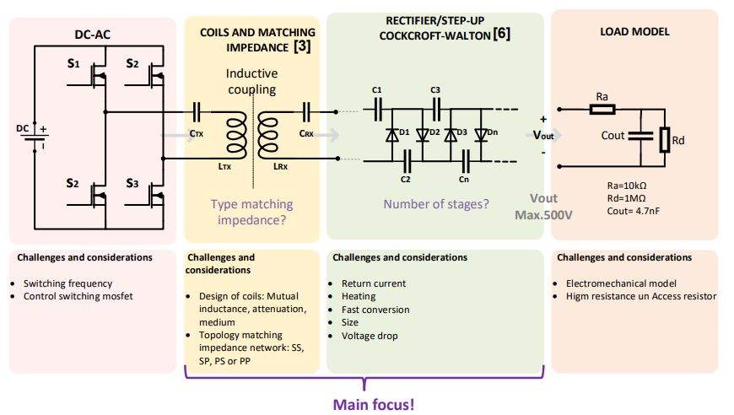

Slide 22
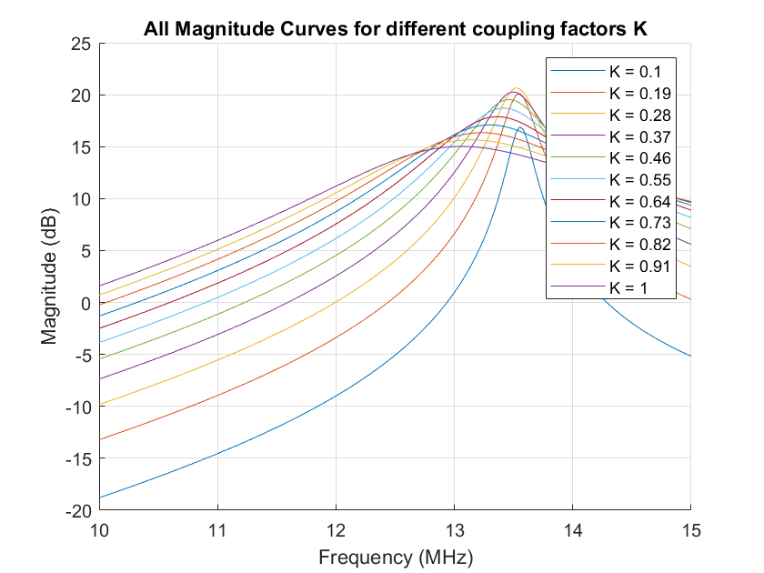

Slide 23
