Slide 1

RobustVLA extension
Alix Papadatos
Florian Tanguy
Mario Fernández Blanco
Tomas Garate Anderegg
VILAB
09.04.2026

Slide 2
Motivation
VLA models are trained and evaluated assuming all sensors are always available. In real-world deployment this assumptions breaks (Hardware failure, power loss etc…)
What happened when a sensor disappears entirely ?
Current work only studies partial degradation (noisy images, corrupted signals).
RobustVLA (ICLR 2026) showed that:
more data alone does not fix robustness
Visual robustness does not transfer to other

Slide 3
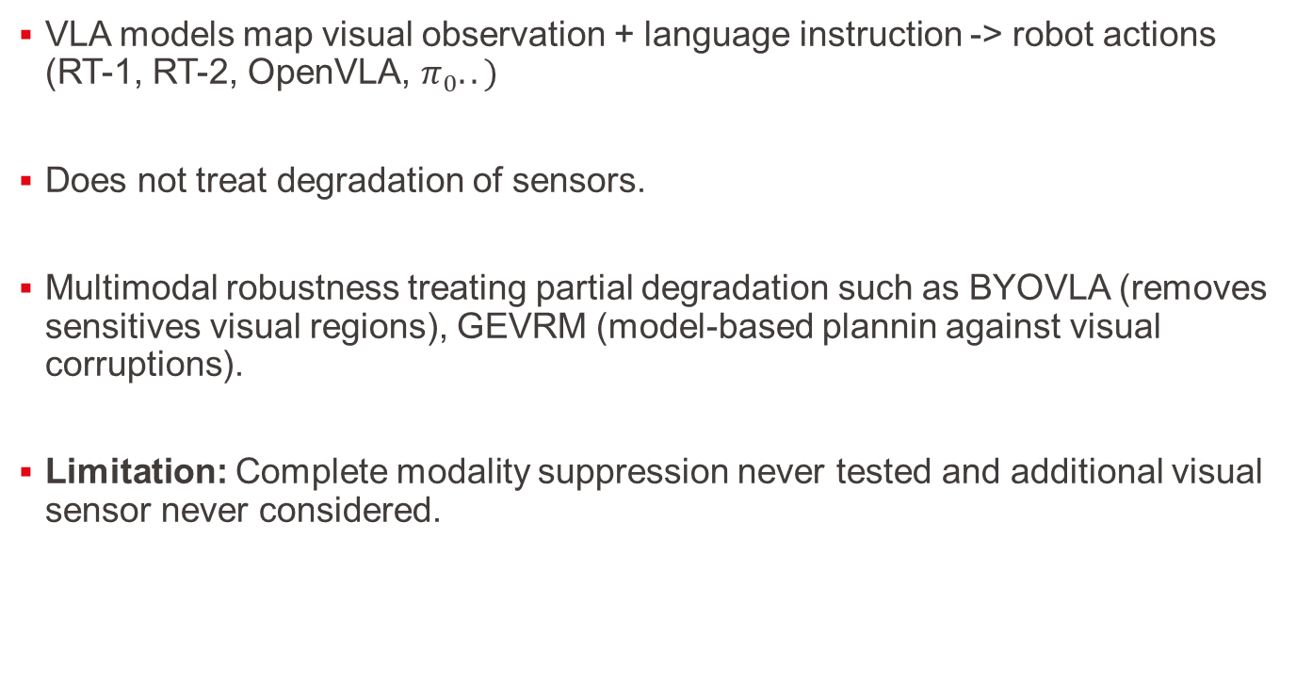
Related Work (1/2)
VLA models map visual observation + language instruction -> robot actions (RT-1, RT-2, OpenVLA, $π_{0}..)$
Does not treat degradation of sensors.
Multimodal robustness treating partial degradation such as BYOVLA (removes sensitives visual regions), GEVRM (model-based plannin against visual corruptions).
Limitation: Complete modality suppression never tested and additional visual sensor never considered.

Slide 4
Related Work (2/2)
Possible solutions: Modality dropout when modalities are absent at test time, use 4M to predicts any modality from any other, Masked Modality Projection uses cross-attn to reconstruct missing modality tokens.
What happens when a modality is completedly absent at inference time in an RGB + Depth VLA setting ? Is passive robustness (e.g.,modality dropout) sufficient or does active cross-modal reconstruction bring additional gains ?

Slide 5
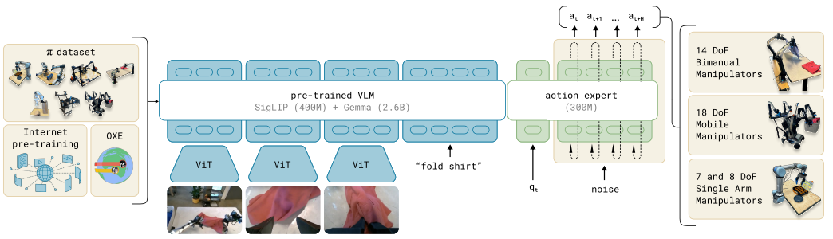


Methodology: RobustVLA = Backbone $π_{0 }$+ training strategies
$$π_{0}$$
c.f.: https://www.pi.website/blog/pi0

Slide 6
Methodology: RobustVLA
$$π_{0}$$
Depth data + Depth encoder
[RGB tokens + Depth tokens]

Slide 7
Methodology: Project strategy
RobustVLA does not support Depth so the plan is to fine-tune with LIBERO dataset.
Strategy 1: Modality Dropout (passive robustness): During training, we randomly zero out one or both modalities.
Limitation: If depth encodes crucial geometric infos, this info is lost when depth is absent !
Strategy 2: Active Reconstruction: When a modality is absent, instead of feeding zeros to the LLM, we add a lightweight cross-attention module that reconstructs the missing modality tokens from the available ones. The LLM always receives a complete token sequence, even when a sensor has failed.

Slide 8
Questions & Feedback?
Alix Papadatos
Florian Tanguy
Tomas Garate Anderegg
IDIAP
07.01.2026

