Slide 1
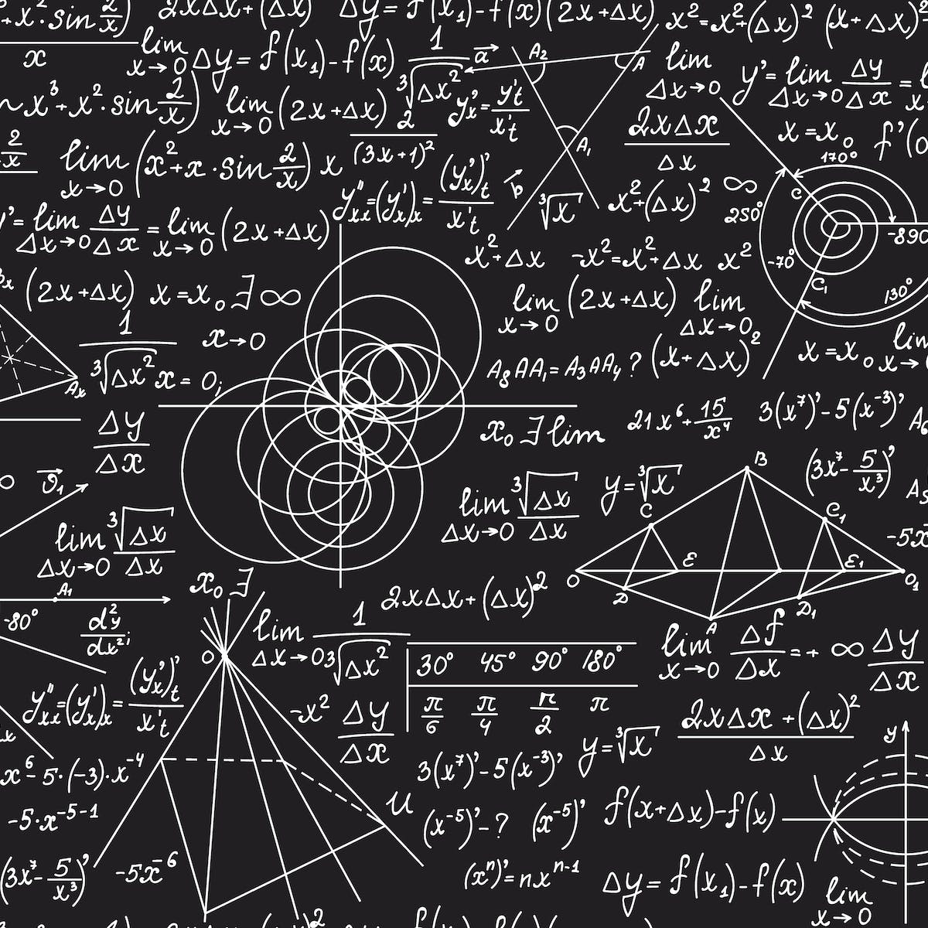

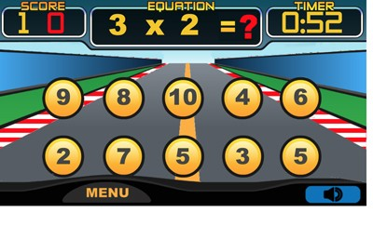
Teaching mathematics through games in primary schools (grades 1-3)
2+2 = 4
Mathematics has not been among the most popular subjects in schools for a long time, many students are afraid of it and try to avoid it. The goal of my article is to look at modern ways of teaching mathematics in schools, which would entertain students and develop their love for this subject from the first years of primary school. There are many programs in the world that try to promote teaching through games already in primary schools with the aim of bringing joy to students from learning new things. Teaching through games has many benefits, but there are also some disadvantages, which I would also like to focus on in my article and evaluate whether such education is really effective.
8
Tomáš Brček
The aim of this article is not only to look at primary school teachers, whose main subject is mathematics and find out how often they use games in their teaching method, but also to come to a conclusion, whether such learning is really beneficial for pupils.

