Slide 1
Location recommendation for a new coffee place in Bratislava
COURSERA – IBM Data Science Professional Certificate
Capstone Project - The Battle of Neighborhoods
Tomas Bvoc
July 2020

Slide 2

Introduction
Data
Solution
Result
Discussion
Conclusion
Tomas Bvoc
July 2020

Slide 3
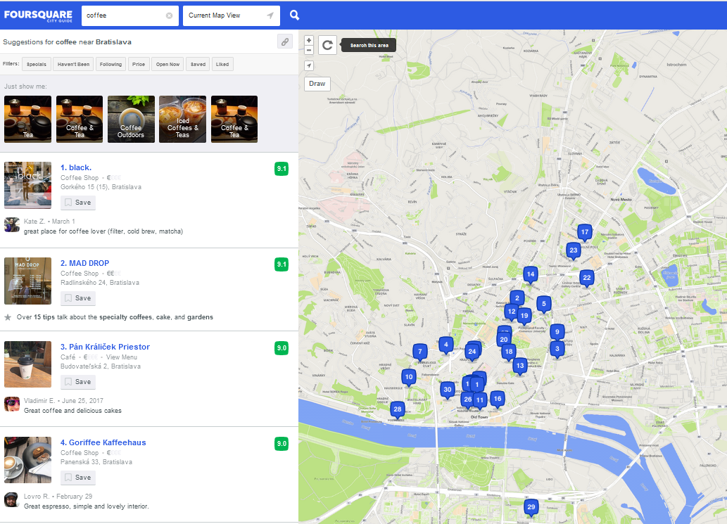
1. Introduction
I can see on my own eyes, that Bratislava, as my hometown, has been developing rapidly in recent years and becoming a cosmopolitan city. There is a special area close to Danube river, so-called Modern downtown, and I live close to it. Well, let’s consider I wish to open a café & coffee shop in this developing borough. Second crucial attribute, as a prerequisite, is to find a place not far away from my own apartment (Mileticova 27). I consider as very important to be able to handle to reach it by walk or bicycle easily - it will help me to spare time and to reduce my cost slightly.
Now, the third attribute needed to find out the correct location where to start a new coffee business. Not too close of existing cafés, not too far from the heart of the freshly growing area.

Slide 4
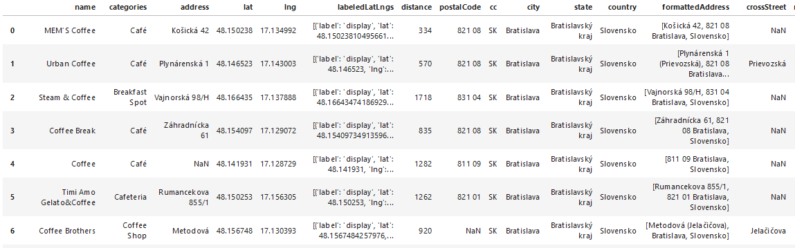
2. DATA
To explore the neighborhoods and coffee places in Bratislava city, I will need a list of Coffee places in Bratislava. I’m about to use Foursquare API https://foursquare.com/. With this data source I’m able to identify existing coffee places around the specified point (my living place).
Data will be inserted into single dataframe with main characteristics : Name of the coffee place; Geographical data – coordinates (Latitude and Longitude) and Address. Some additional data are collected, but let us consider they are not important for the analysis.
Pre-processing of data will be needed – cleaning, setting radius.

Slide 5
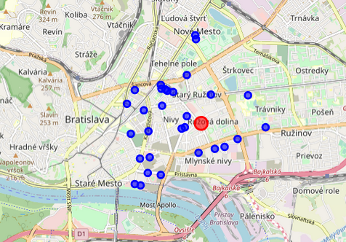
3. Solution
For the data visualization on the street map of Bratislava, Folium has been used.
Map of Bratislava city with existing coffee places (blue circles) and my living place (red circle)

Slide 6
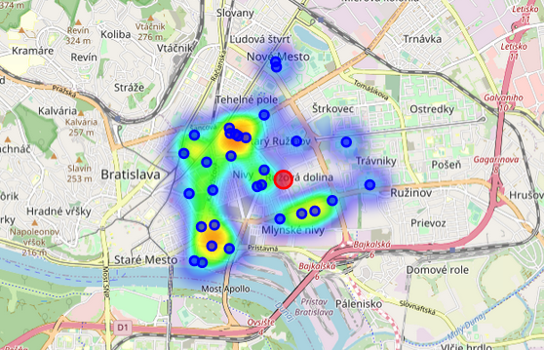
3. Solution
For the data visualization on the street map of Bratislava, Folium has been used.
The ”coffee-places-density map” of Bratislava city with existing coffee places (blue circles) and my living place (red circle) and the

Slide 7
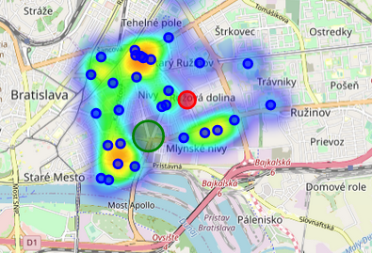
4. Result
One of suitable places for new coffee place appears the be in the surrounding area of the crossroad of streets Košická, Svätoplukova and Mlynské Nivy.
Green circle as suitable area for new coffee place

Slide 8
5. Discussion
In case more detailed and rigorous model is required, more attributes could be considered, for instance it’s possible to exclude abandoned streets or areas with industry background, so called brown spots. On the other hand, in the analysis may be included factors – population density, amount of offices/shops/public transport stops.

Slide 9
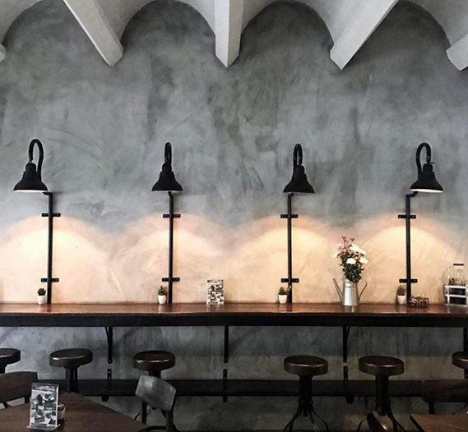
6. Conclusion
Surrounding area of the crossroad of streets Košická, Svätoplukova and Mlynské Nivy has been identified as suitable place for new coffee place in the freshly growing new zone of Bratislava city.

