Slide 1
Data science & machine learning homework Production Alignment Data Prediction
By Tomáš Čajan

Slide 2
Contents of this presentation
1 – Task Description
2 – EDA
3 – Machine Learning models and their performance
4 – Result and Summary

Slide 3
1 – Task description
1. Parse input data and perform explorative analysis (data interpretation, visualization, correlations, etc.)
2. Use adequate statistical and/or machine learning methods to match respective target and query column IDs based solely on alignment values (use only the `train` prefixed files)
3. Test your model on the `test` files and perform appropriate evaluation analysis
4. Present the results

Slide 4
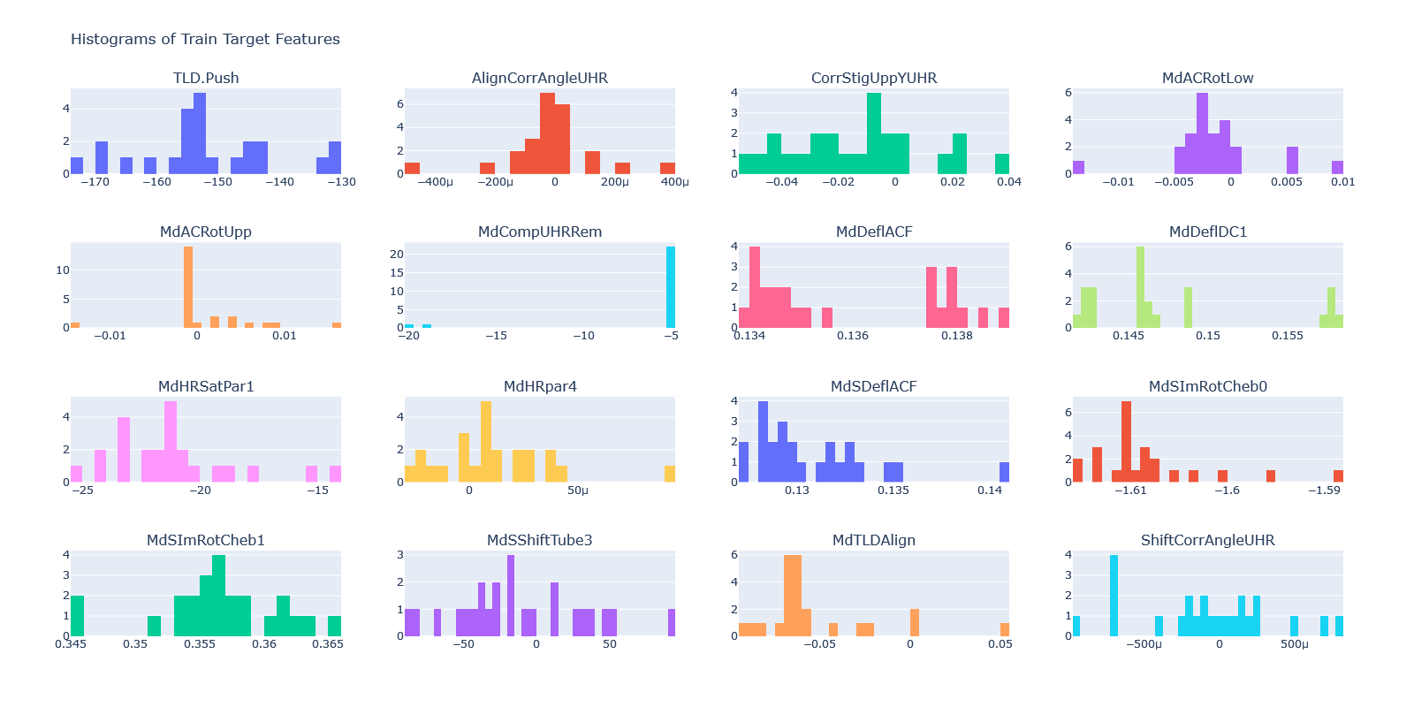
2 EDA – Feature Histograms

Slide 5
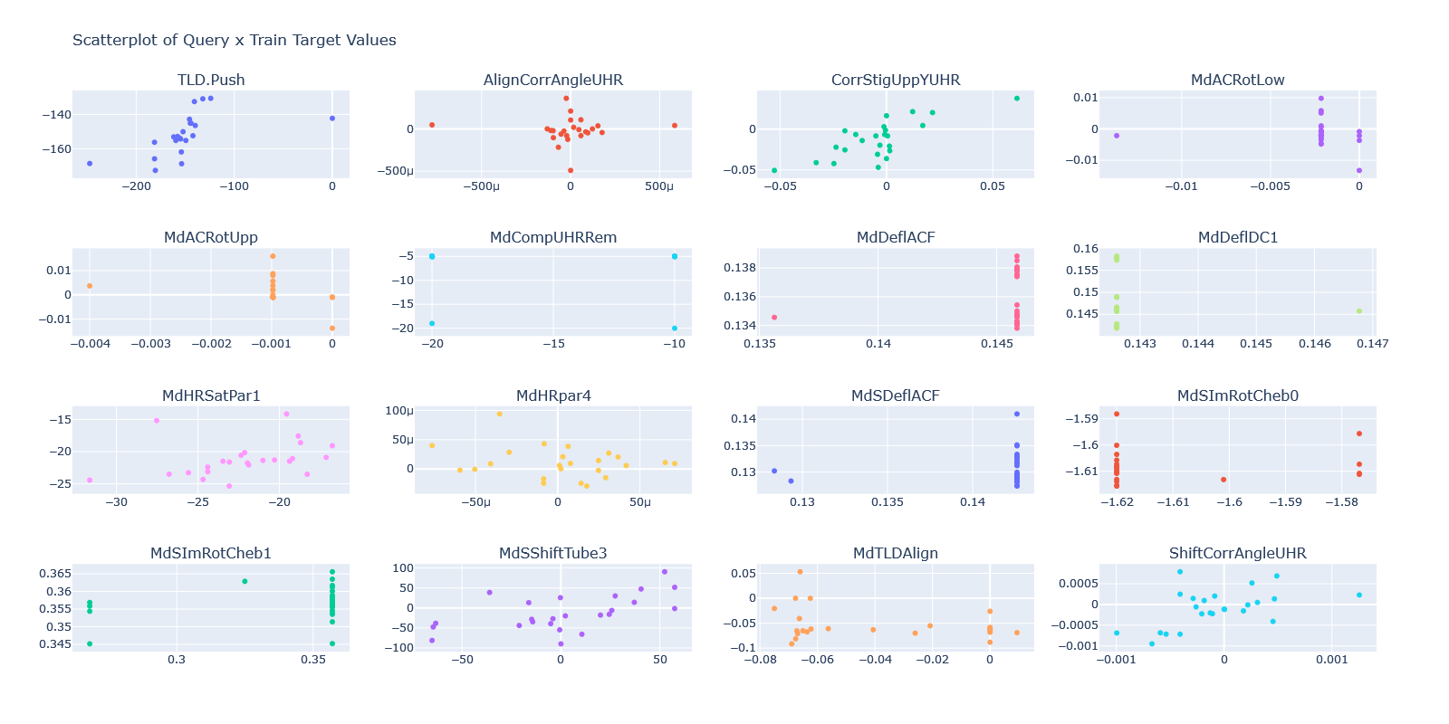
2 EDA – Feature Scatterplots

Slide 6
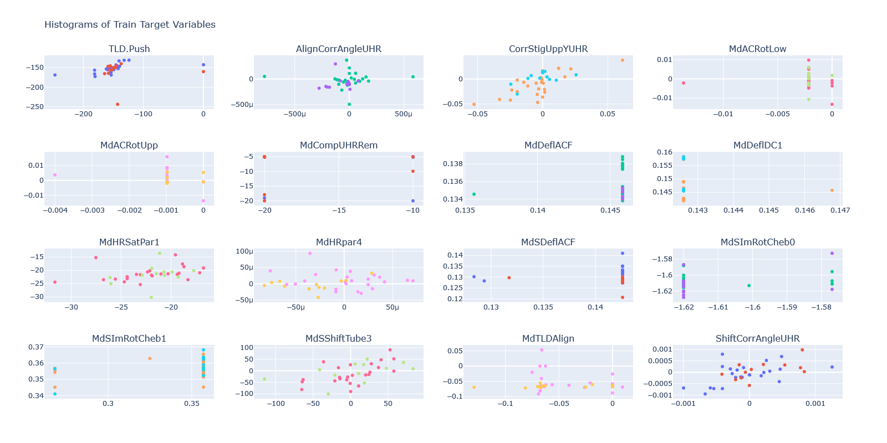
2 EDA – Feature Scatterplots with all data

Slide 7
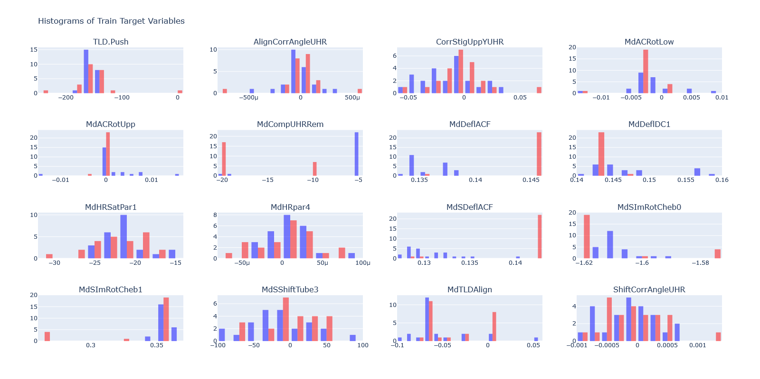
2 EDA – Feature histograms before / after alignment

Slide 8
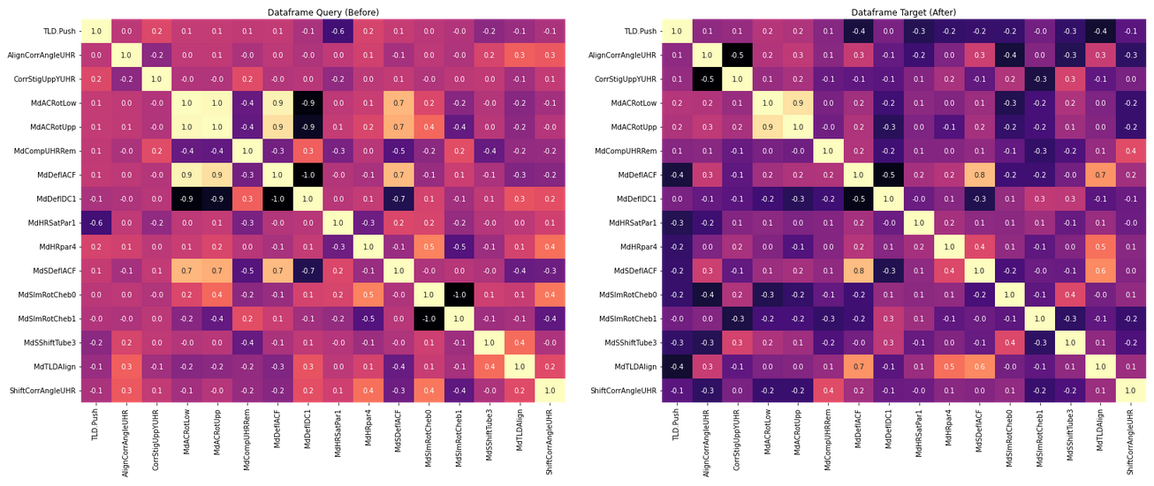
2 EDA – Correlation Heatmaps

Slide 9
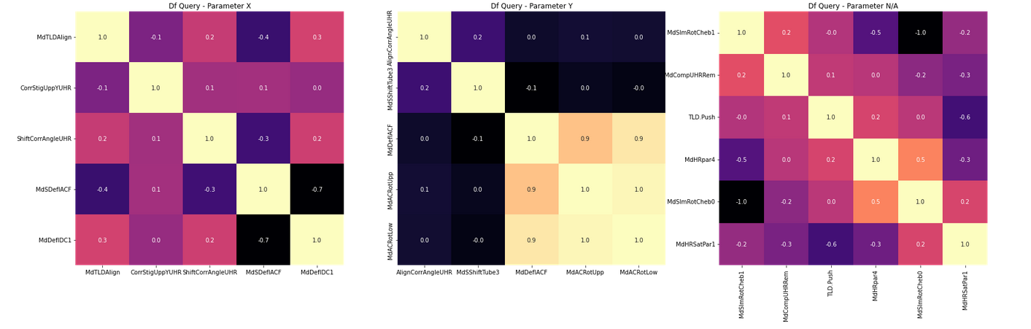
2 EDA – Correlation Heatmaps / Query / Per Parameters

Slide 10
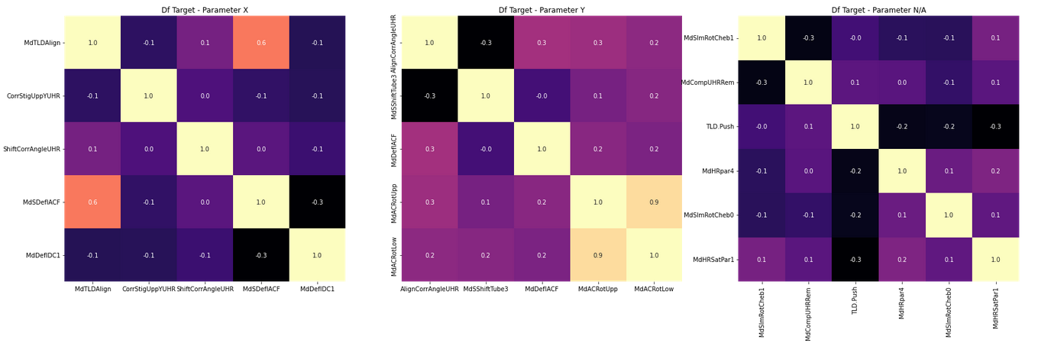
2 EDA – Correlation Heatmaps / Target / Per Parameters

Slide 11
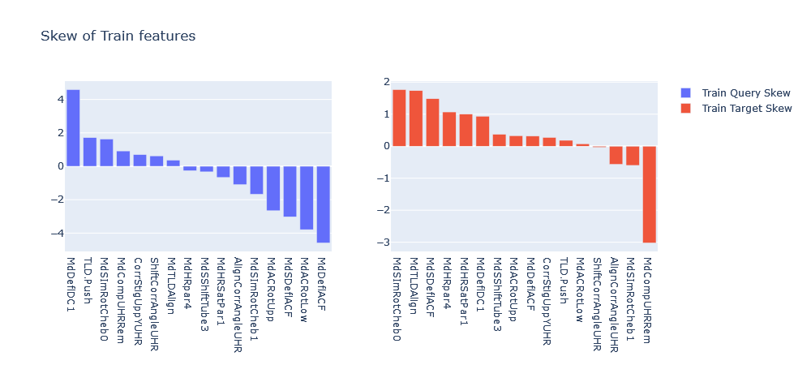
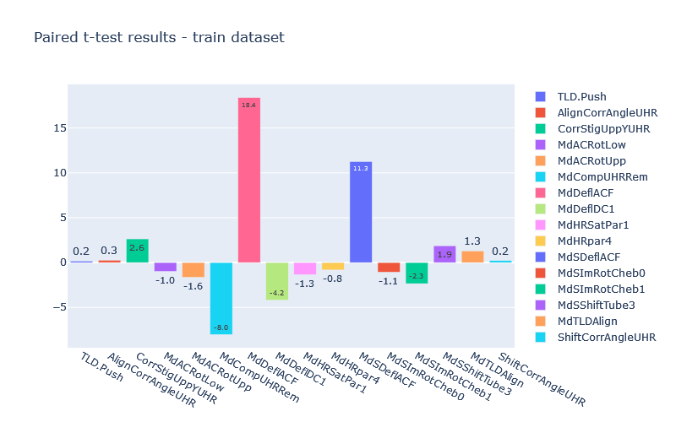
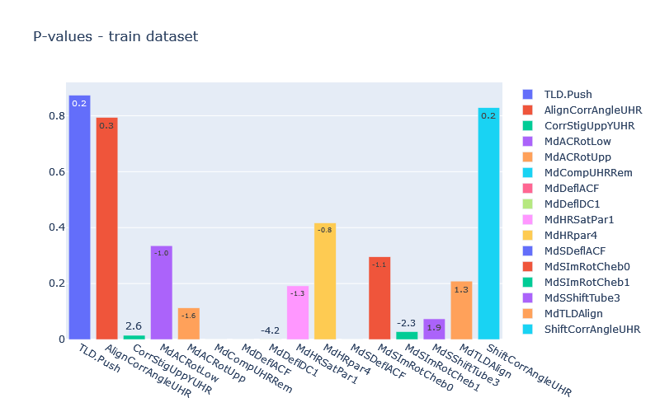
2 EDA – Skew, T-Test, p-values

Slide 12

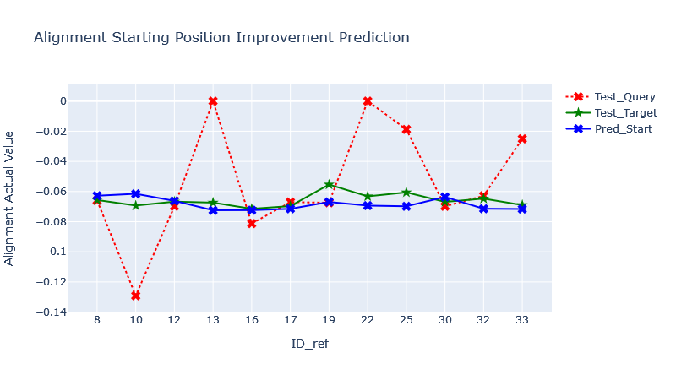
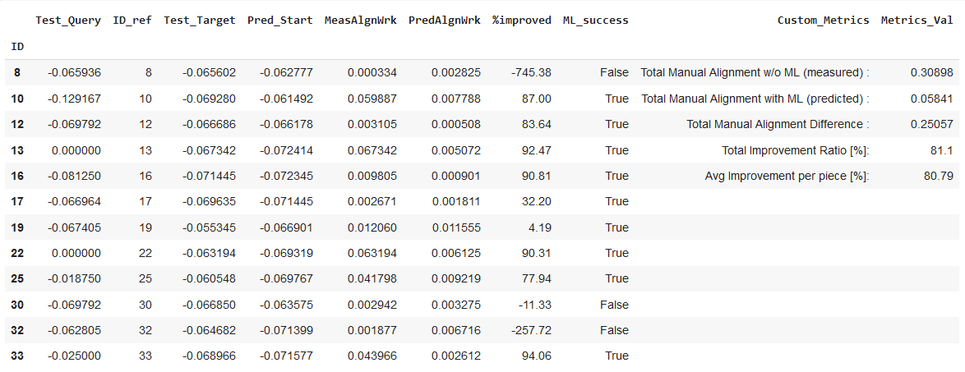
3.1 Parameter MdTLDAlign
ML Model : XGBoost
Feature Selection :

Slide 13

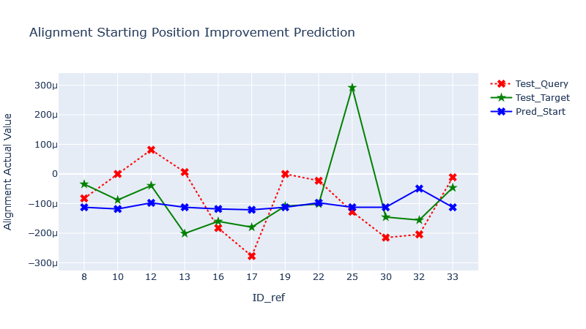
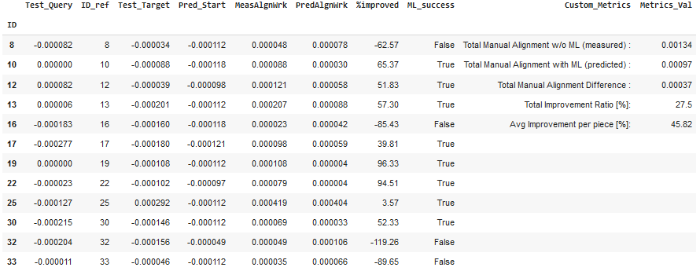
3.2 Parameter AlignCorrAngleUHR
ML Model : RandomForest
Feature Selection :

Slide 14

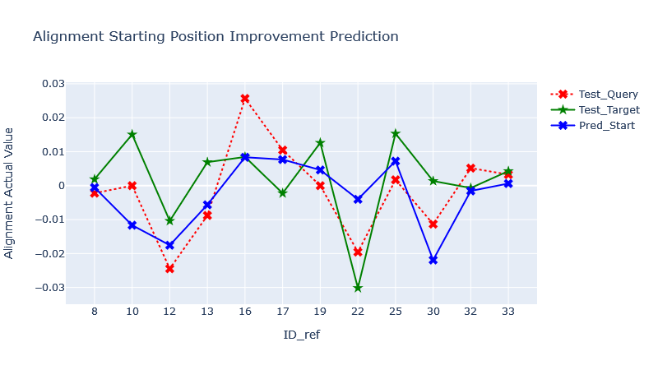
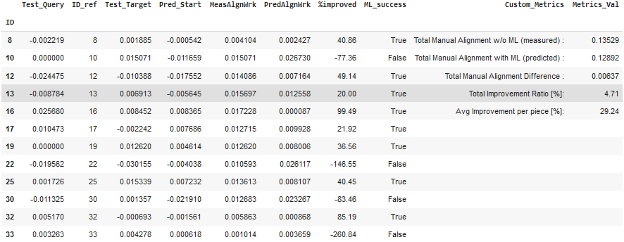
3.3 Parameter CorrStigUppYUHR
ML Model : SupportVectorMachine
Feature Selection :

Slide 15

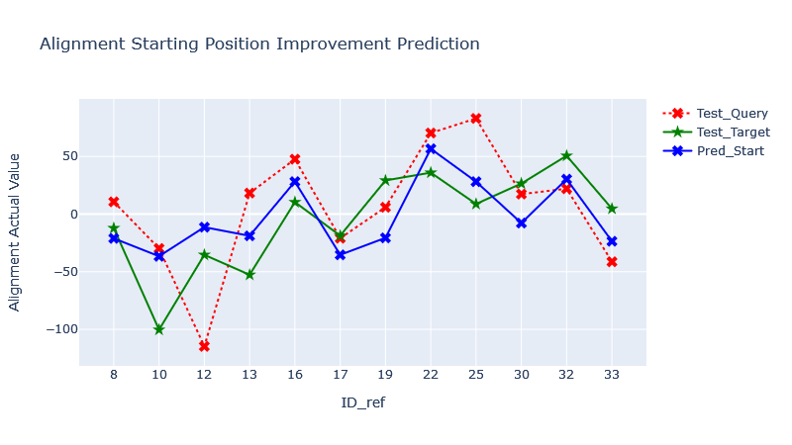
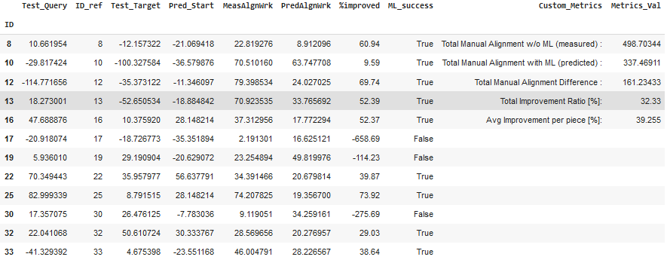
3.4 Parameter MdSShiftTube3
ML Model : XGBoost
Feature Selection :

Slide 16
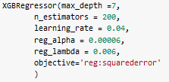
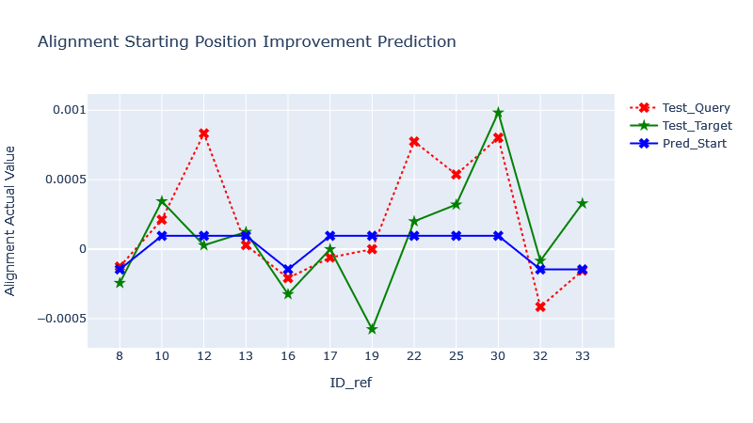
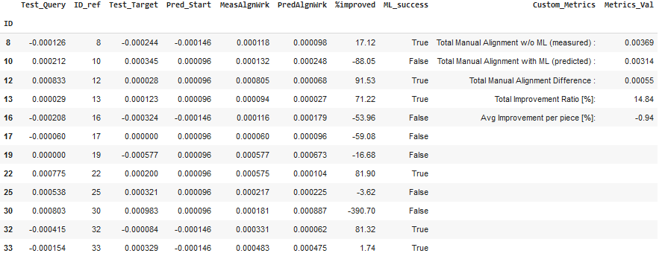
3.5 Parameter ShiftCorrAngleUHR
ML Model : XGBoost
Feature Selection :

Slide 17
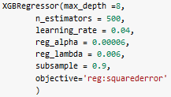
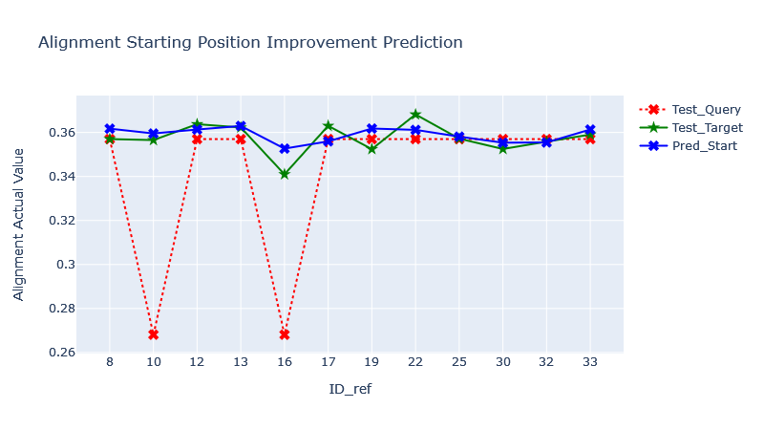
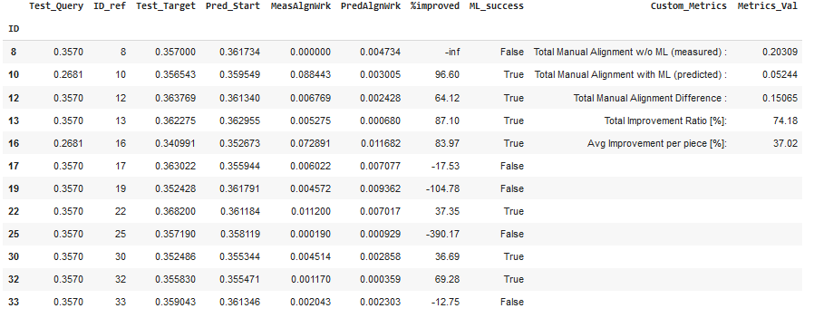
3.6 Parameter MdSImRotCheb1
ML Model : XGBoost
Feature Selection :

Slide 18
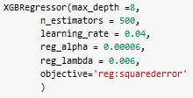
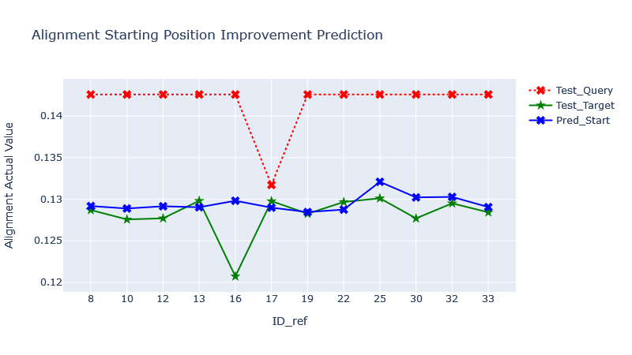
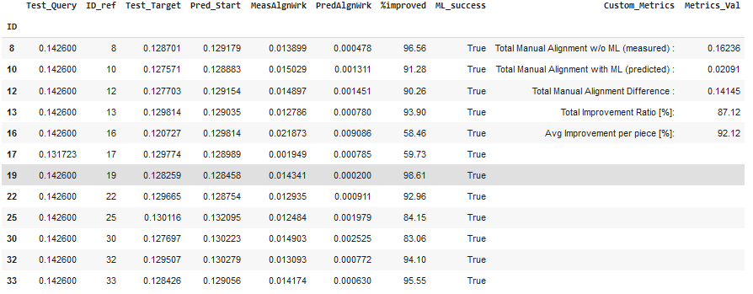
3.7 Parameter MdSDeflACF
ML Model : XGBoost
Feature Selection :

Slide 19

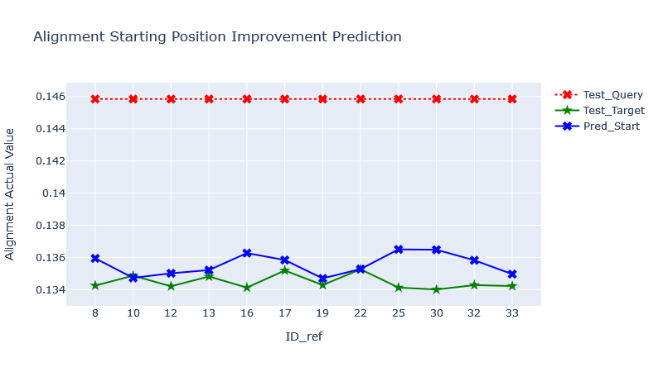
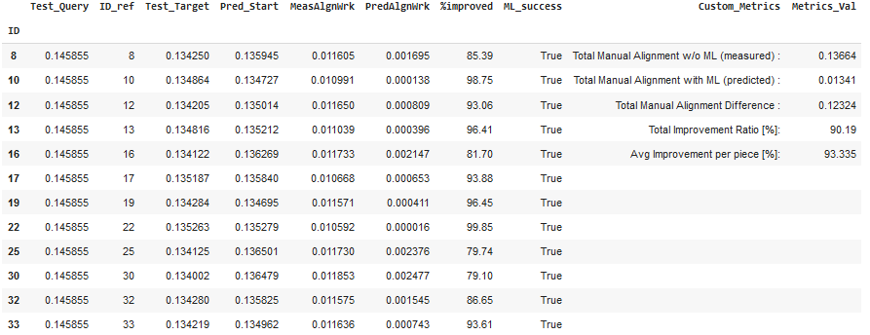
3.8 Parameter MdDeflACF
ML Model : RandomForest
Feature Selection :

Slide 20
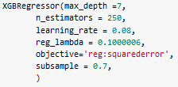
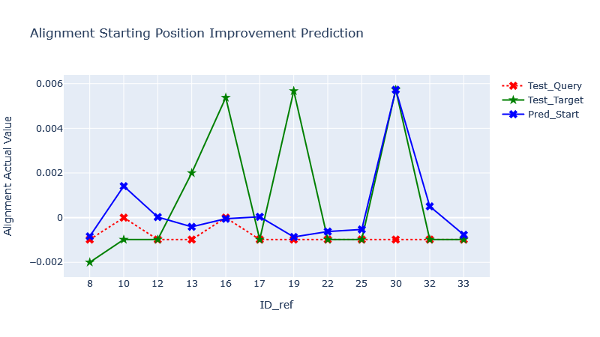
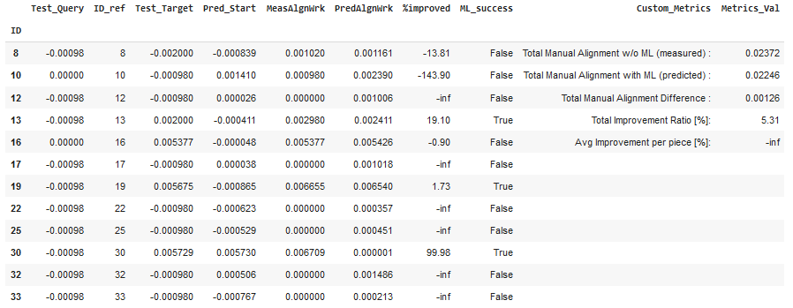
3.9 Parameter MdACRotUpp
ML Model : XGBoost
Feature Selection :

Slide 21
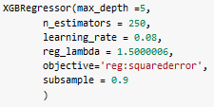
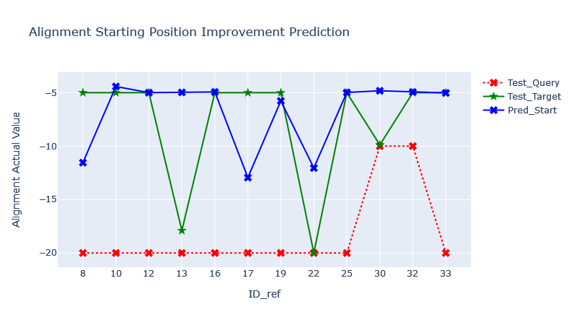
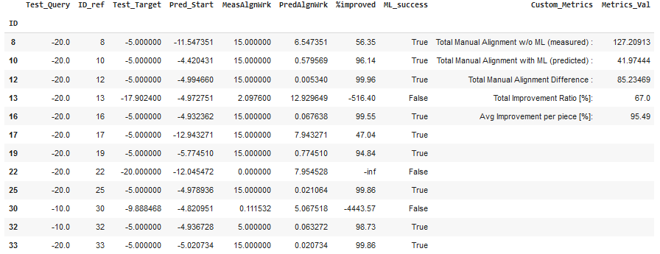
3.10 Parameter MdCompUHRRem
ML Model : XGBoost
Feature Selection :

Slide 22
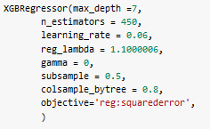
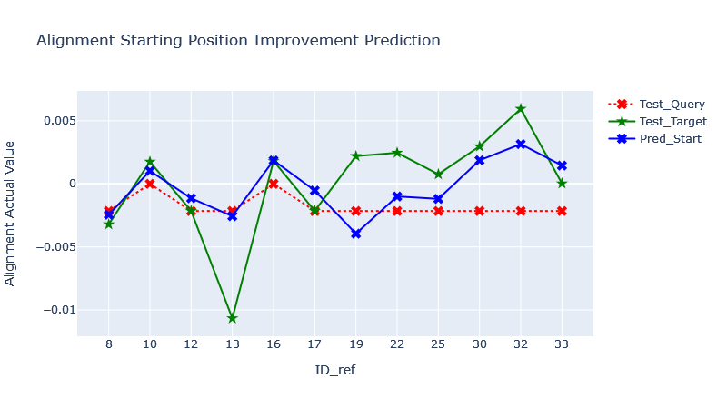
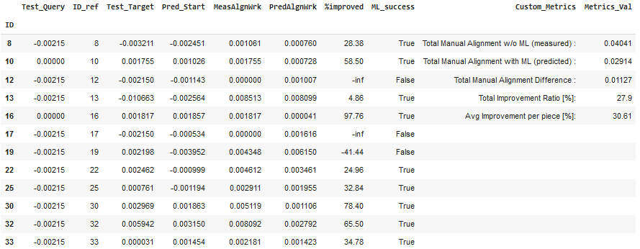
3.11 Parameter MdACRotLow
ML Model : XGBoost
Feature Selection :

Slide 23
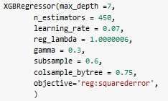
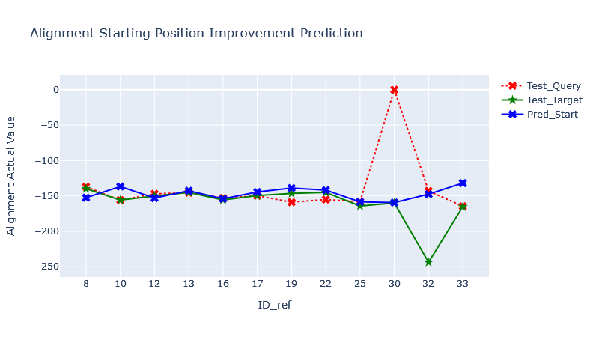
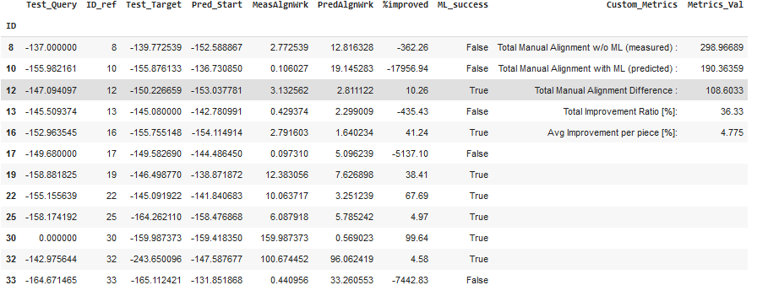
3.12 Parameter TLD.Push
ML Model : XGBoost
Feature Selection :

Slide 24

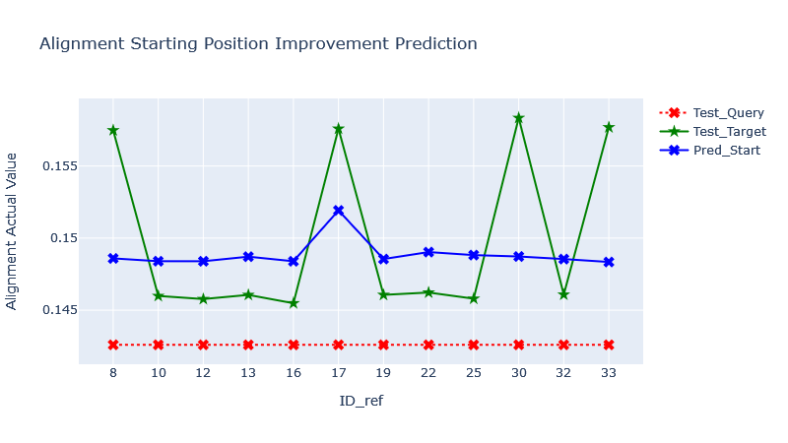
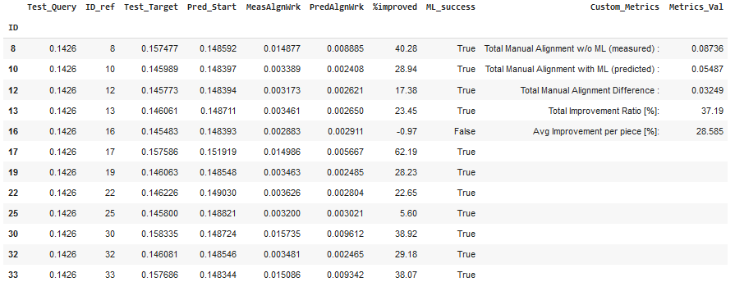
3.13 Parameter MdDeflDC1
ML Model : SVR
Feature Selection :

Slide 25
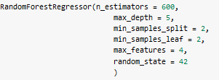
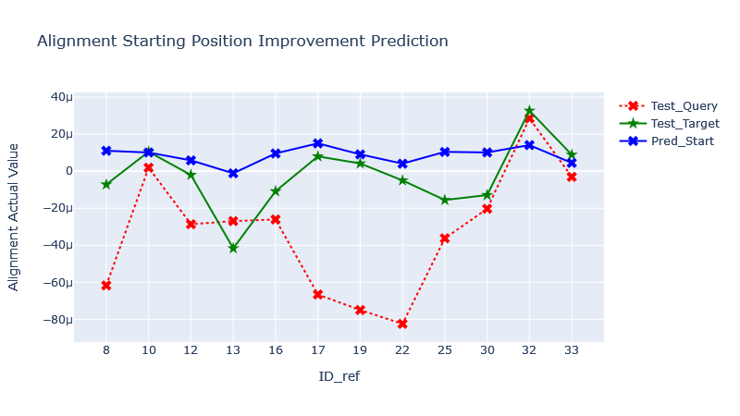
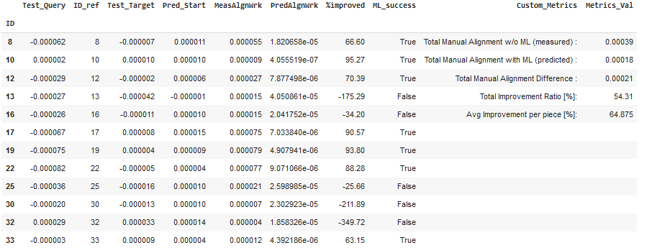
3.14 Parameter MdHRpar4
ML Model : RandomForest
Feature Selection :

Slide 26
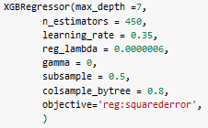
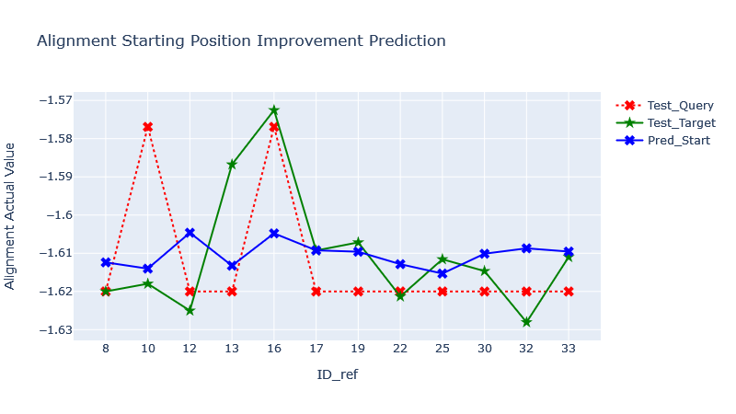

3.15 Parameter MdSImRotCheb0
ML Model : XGBoost
Feature Selection :

Slide 27
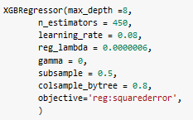
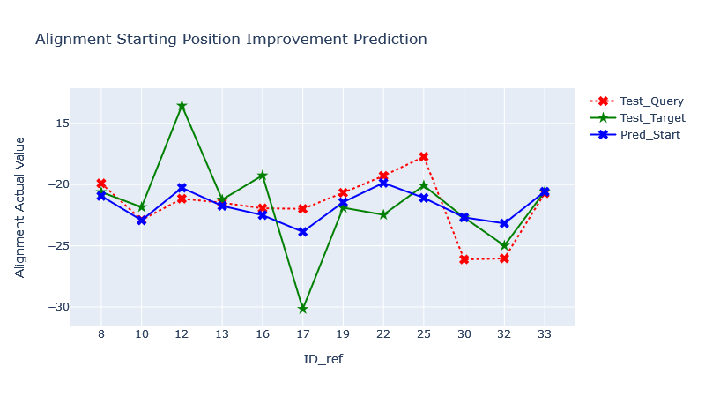

3.16 Parameter MdHRSatPar1
ML Model : XGBoost
Feature Selection :

Slide 28

4 - Final Feature Selection Overview

Slide 29

4 - Alignment Reduction Results

Slide 30
4 - Future improvement points
Gain domain experience for better understanding of Feature Engineering
Get more data from more processes for the ML algorithms
With more data, apply Neural Networks
Explore more Machine learning and Pre-processing methods
Perform more sophisticated hyperparameter tuning with bigger computing power

Slide 31
Thank you for attention

