Slide 1

mixup: BEYOND EMPIRICAL RISK MINIMIZATION
Hongyi Zhang, Moustapha Cisse, Yann N. Dauphin, David Lopez-Paz
Bc. Tomáš Horička, BC. Juraj Budinský

Slide 2
Introduction
Standard training with ERM learns only from the exact training samples.
With large neural networks, this can lead to memorization instead of real generalization.
Models trained this way can also behave unpredictably just outside the training data.
The paper proposes a very simple fix: train on synthetic examples created between real samples.

Slide 3
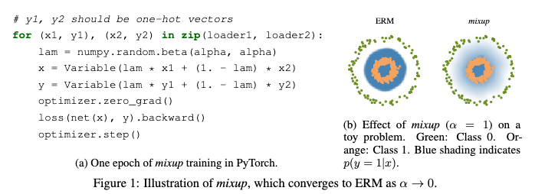
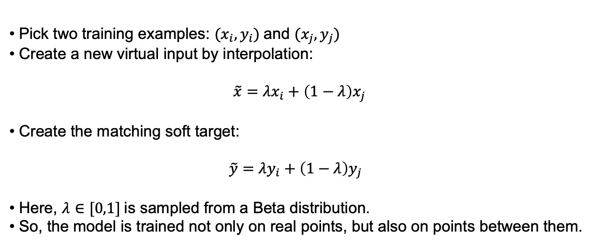
Core idea
Pick two training examples: $(x_{i}​,y_{i}​)$and $(x_{j}​,y_{j}​)$
Create a new virtual input by interpolation:
$\tilde{x}=λx_{i}+\left(1−λ\right)x_{j}$
Create the matching soft target:
$\tilde{y}=λy_{i}+\left(1−λ\right)y_{j}$
Here, $λ∈[0,1]$is sampled from a Beta distribution.
So, the model is trained not only on real points, but also on points between them.

Slide 4
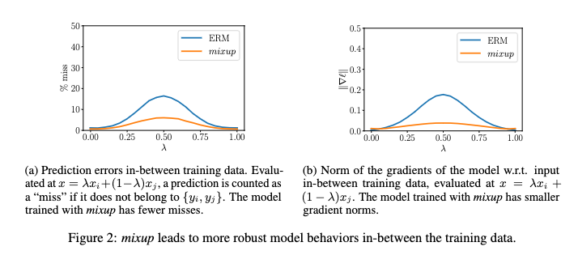
Why it works
mixup encourages the model to behave more linearly between training examples.
This acts as a regularizer and reduces sharp, unstable decision boundaries.
The paper argues that smoother behavior between samples improves generalization.
On the toy example in Figure 1 and the analysis in Figure 2, mixup produces more stable predictions and smaller gradients between samples.

Slide 5
Why is it practical
It is extremely simple to implement.
It adds only minimal computational overhead.
It is data-agnostic: it does not require domain-specific augmentation rules.
In practice, the paper even notes that mixing within a shuffled minibatch works well.

Slide 6
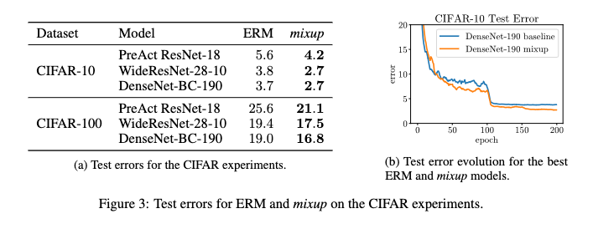
What the paper found
mixup improved image classification results on CIFAR-10, CIFAR-100, and ImageNet.
It also improved performance on speech and tabular data.
It reduced memorization when labels were corrupted.
It increased robustness against adversarial examples.
The paper also reports that it can help stabilize GAN training.

Slide 7
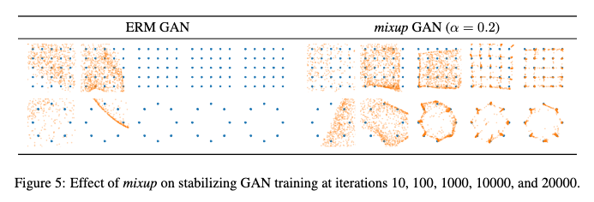
Conclusion
mixup is a simple training principle: learn from interpolations of inputs and labels.
Its purpose is not just augmentation, but enforcing smoother behavior between samples.
This leads to better generalization and more robust models.
The main reason the paper is influential is that such a small change gives benefits across many settings.

