Slide 1
S32K touch sense Solution keyboards and slider
Automotive Microcontrollers & Processors
12th november 2018
Rev 1.0

Slide 2
solution

Slide 3
Solution
Introducing NXP self-capacitance touch sense method supporting:
Touch pads (buttons)
Slider
Based on S32K1xx family members, capable of driving up to 30 electrodes
Satisfy requirements of:
70uA MCU average current consumption
100ms reaction time
Sensitivity tuned for 2mm plastic glass overlay on a top of the electrodes
EMI test with florescent lamp ON

Slide 4
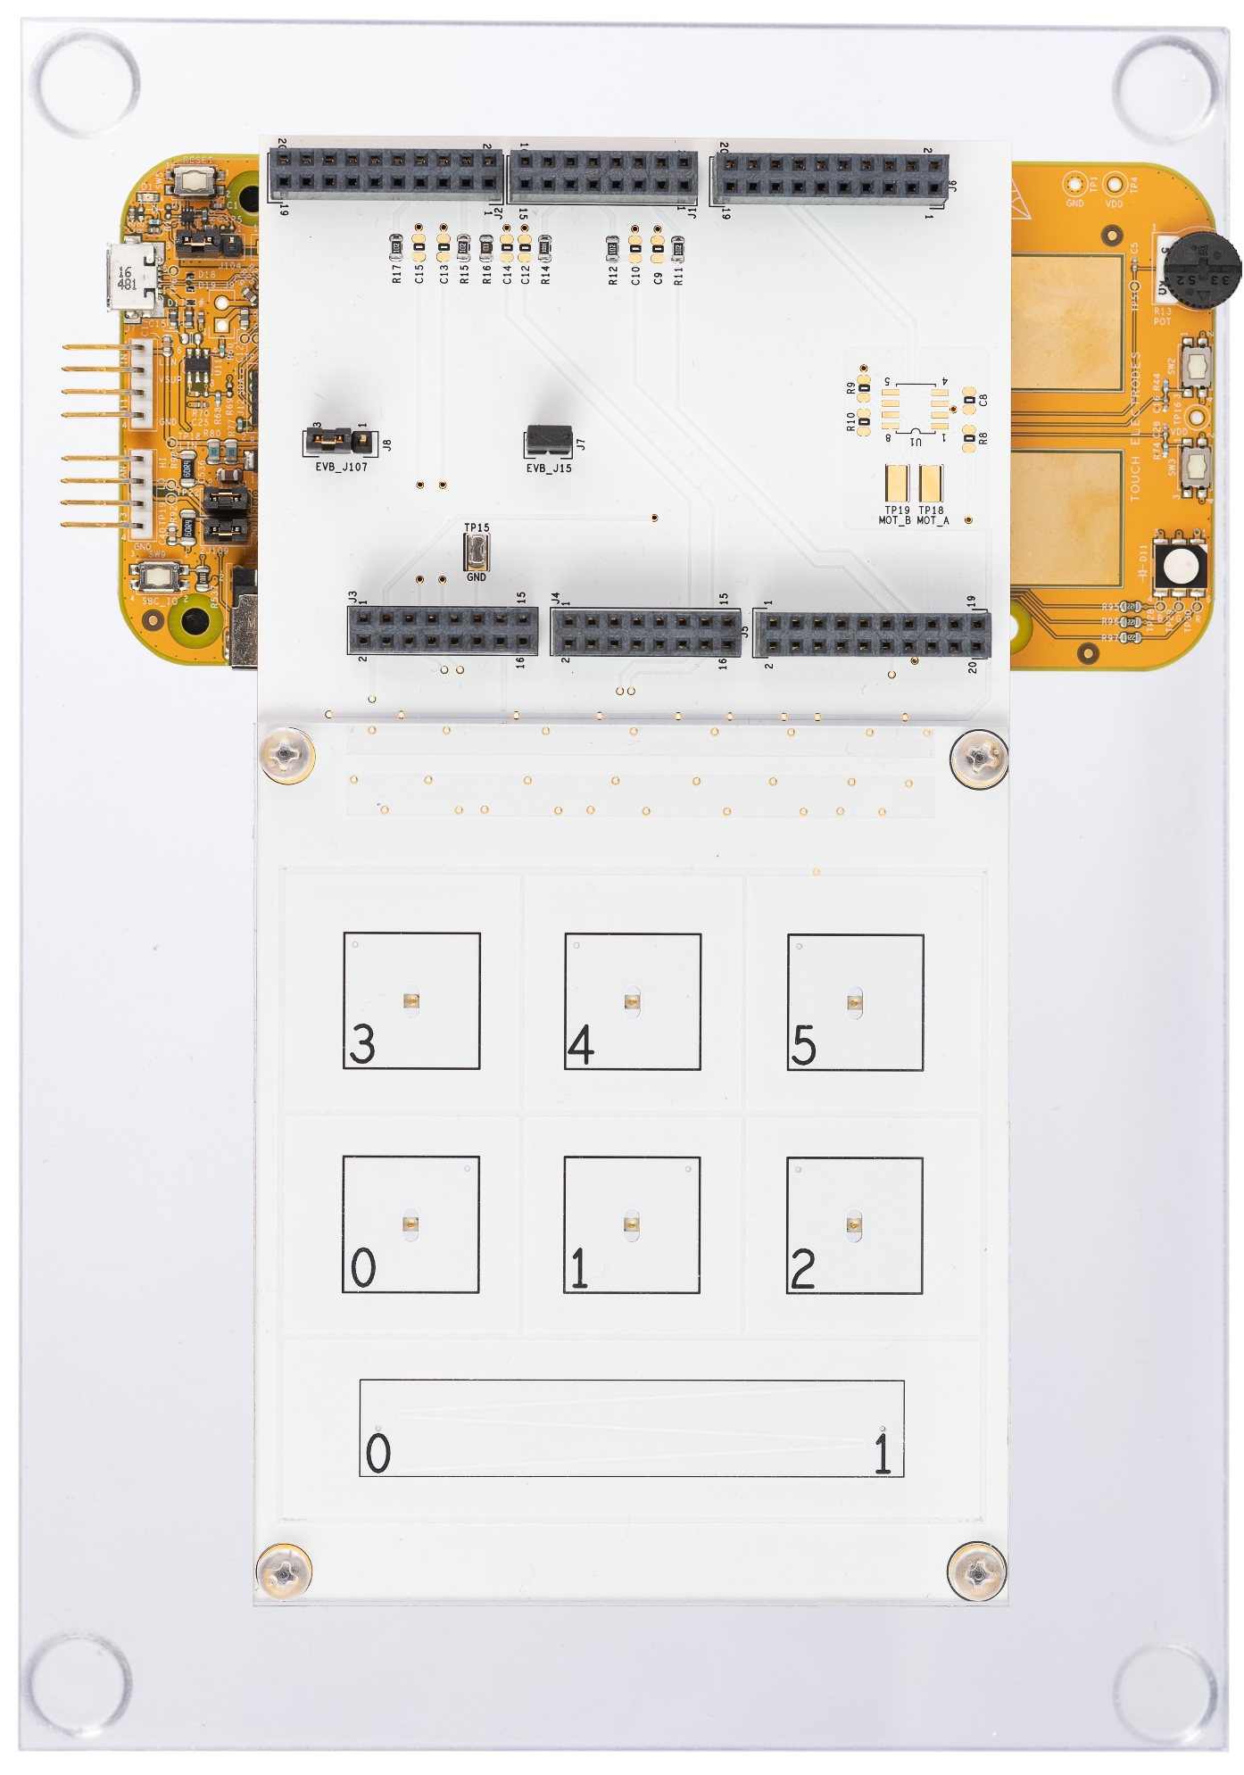
Demo Features
Multiply sampling & signal averaging
Advanced filtering
Thresholds relative to baseline to compensate an environment humidity and temperature change
Optimized solution for small as well as large keypads:
6pads keyboard with 5 position 60mm slider consisting of 2 electrodes
7pads keyboard
S32K144EVB Q100 2pad small keypad enabled

Slide 5
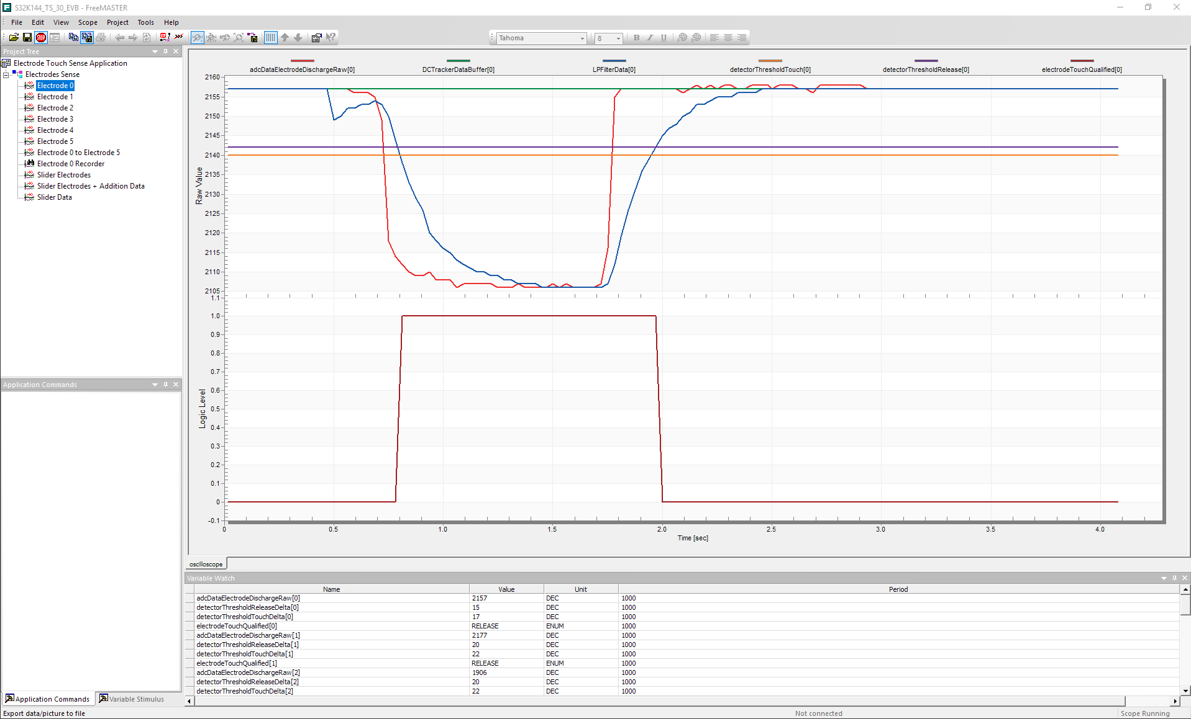
FreeMASTER – Visualization and Parameters Tuning Tool
Touch button electrodes
Variable Display
Variable Watch

Slide 6
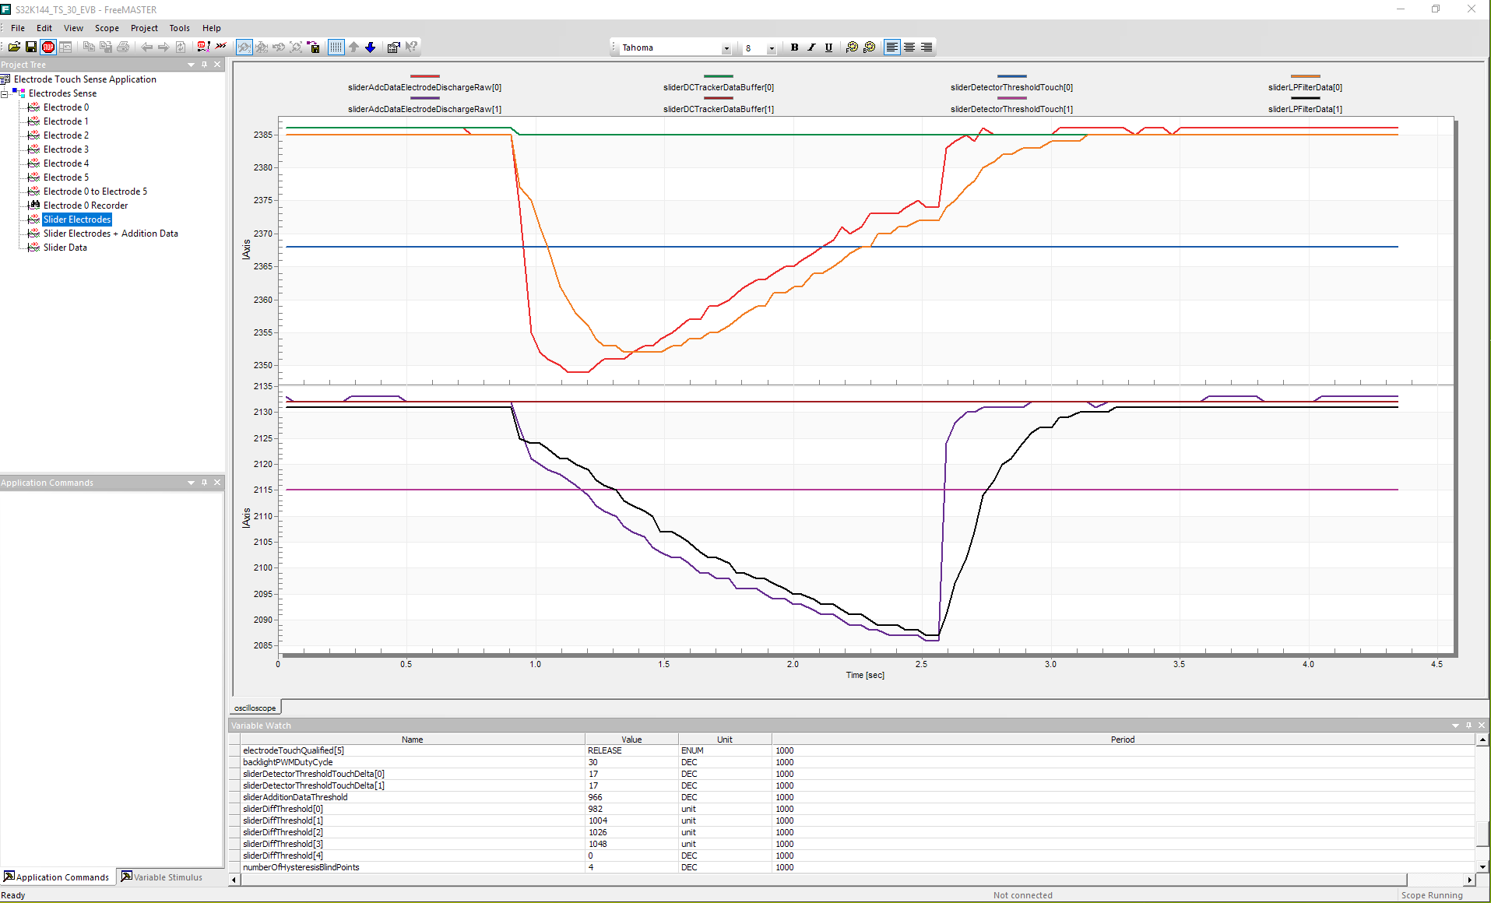
FreeMASTER – Visualization and Parameters Tuning Tool
Slider electrodes
Variable Display
Variable Watch

Slide 7
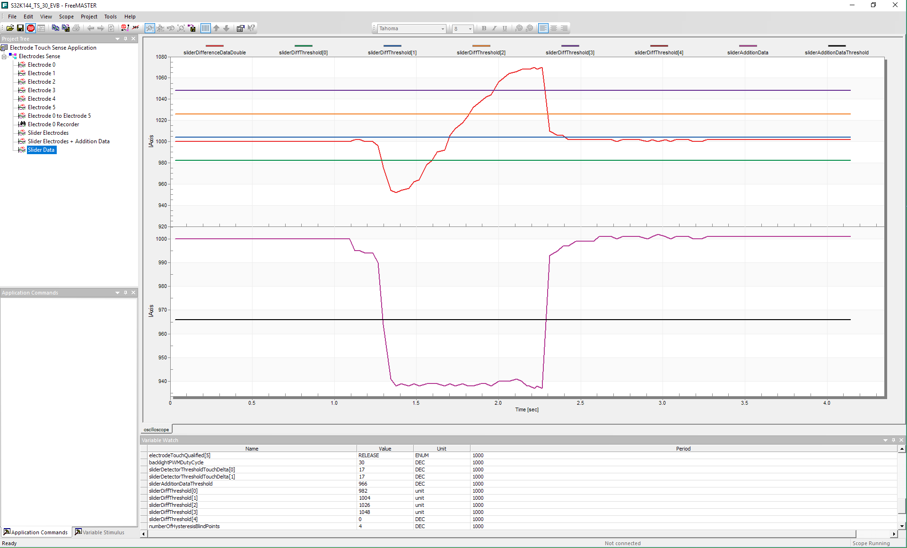
FreeMASTER – Visualization and Parameters Tuning Tool
Slider data
Variable Display
Variable Watch

Slide 8
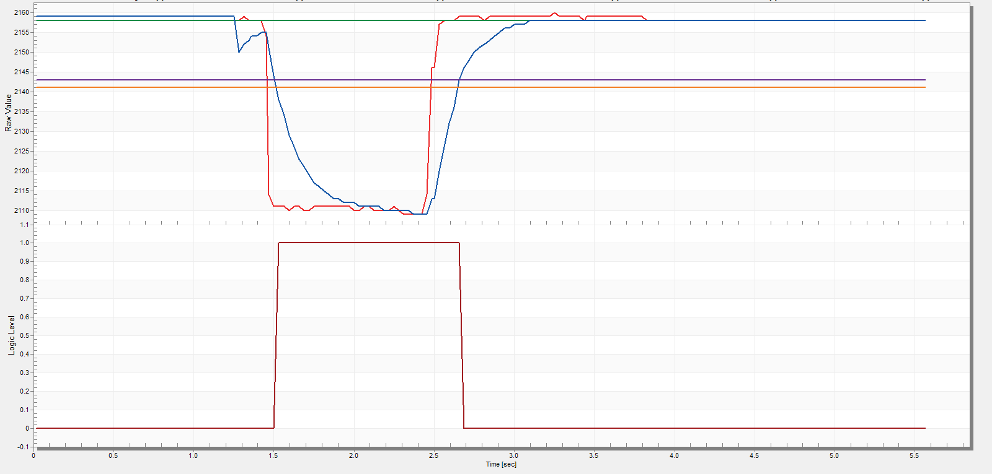
Electrode Data Processing
Electrode Signal
Thresholds
LP Filter
DC Tracker
Touch Report
Electrode
Touched

Slide 9
How to Get demo Running?

Slide 10
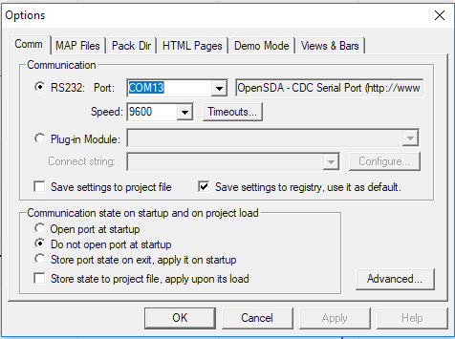
Demo Set-Up
Connect demo board with PC using USB cable
Open project related FreeMASTER page
Establish communication

Slide 11
Demo Operation
Touch keyboard pads or slider
Monitor on-board RGB LED color
Touch pad touch event – single LED color
Slider touch event – LED color is changing along with finger position
Touch pads have bigger priority than slider
Check blue background lighting

Slide 12

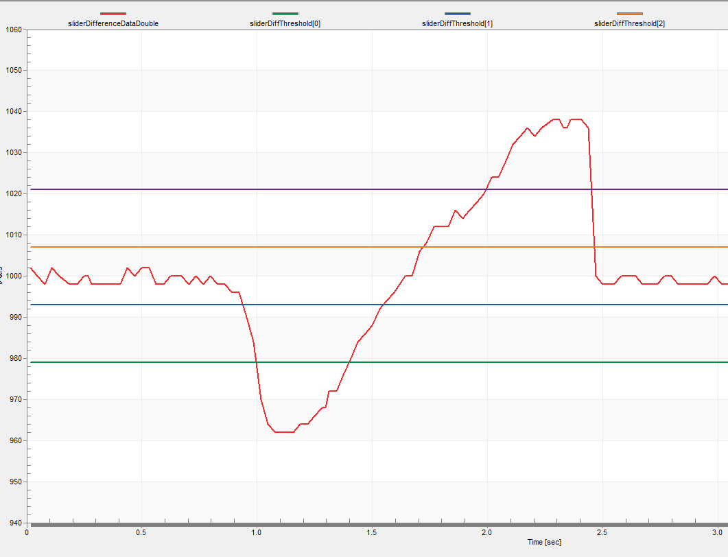

Demo Operation - Position Determination On 5 Segment Slider
Software layer
Hardware layer
Slider difference data
Slider difference data threshold 3
Seg.5
Slider difference data threshold 2
Seg.4
Slider difference data threshold 1
Seg. 3
Electrode 0
Seg. 2
Slider difference data threshold 0
Electrode 1
Software perspective:
Slider difference data change when moving finger across the slider
Seg. 1
User perspective:
Moving finger across the slider from el. 0 to el.1

Slide 13
Demo software

Slide 14
Software
Electrode raw data available for custom operation
Configurable to operate customer hardware design
FreeMASTER – application parameters tuning tool

