Slide 1

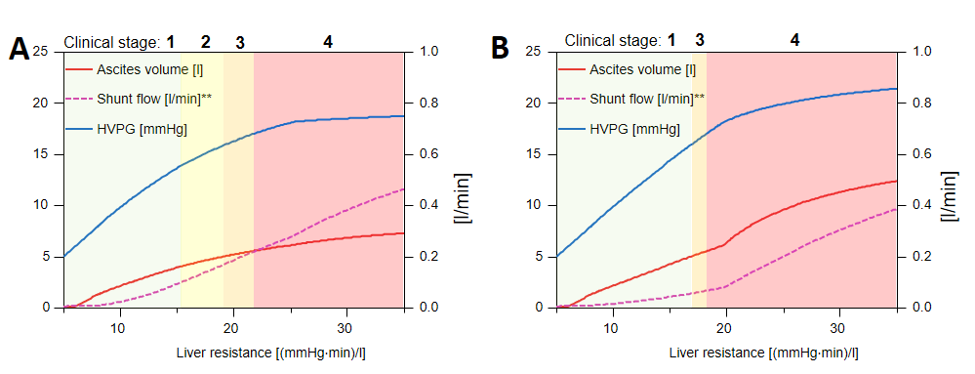
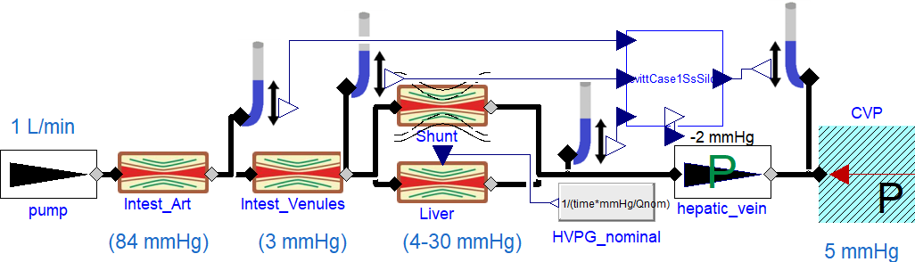
A Computational Model for the Stages of Cirrhosis
Nikhilesh R. Mazumder¹, Filip Jezek², Dan A. Beard²
1 Division of Gastroenterology and Hepatology
2 Department of Molecular and Integrative Physiology
University of Michigan, Ann Arbor, MI, USA; e-mail: fjezek@umich.edu
Introduction
Patients with cirrhosis have portal hypertension, causing collateral shunts from portal vein into the vena cava.
Current clinical model categorizes cirrhosis as stages 1) No varices, no ascites and 2) Non-bleeding varices, no ascites, with ‘decompensated’ cirrhosis stages 3) Ascites +/- varices and 4) variceal bleeding +/- ascites [1].
Patients not always fall into this progression and may initially present with either significant ascites, variceal bleeding or both.
Results
Predicting TIPS and splanchnic flow regulation
The cirrhotic stages phenotypes can be observed by varying shunt compliance (vessel remodeling)
Test dysfunct splanchnic autoregulation using fixed input pressure instead of fixed input flow
With different inflow we reach different HVPG
Effect of Transjugular intrahepatic portosystemic shunt (TIPS)
Shunts are almost closed, HVPG drops, liver receives minimal portal blood flow
HVPG Fixed input pressure
inflow*
HVPG (shunt)
Liver flow (shunt)*
HVPG fixed input flow
inflow*
20
HVPG (TIPS)
Liver flow (TIPS)*
20
1.05
1.2
15
1.00
15
0.8
HVPG [mmHg]
[mmHg]
[l/min]
10
* Splanchnic flow [L/min]
10
0.95
0.4
AIM
explain varying phenotypes of decompensated cirrhosis seen in clinical practice.
Can we simulate the observed phenotypes by varying a single parameter?
5
0.90
5
0
0
1000
2000
3000
0.85
0
10
20
30
0.0
Resistance (dyn.s/cm5)
Liver resistance (mmHg.min/L)
Figure 2. Simulation of cirrhotic clinical stages for compliant (A) and stiff (B) porto-caval shunt. with respect to increased liver resistance Although the transition happens at same HVPG, the underlying dynamics are whole different (cf. the shunt flow and ascites volume). The results are in agreement with progression of clinical stages in [1, while demonstrating two phenotypes of predominant complications, that is the variceal bleeding in case of compliant shunt (fig. 2A) and earlier forming of ascites (fig. 2B) for stiffer shunt.
Figure 3. Simulation of fixed input pressure (transient or chronic dysfunction of splanchnic flow regulation) compared to fixed input flow (normal). With higher liver resistance, we receive lower inflow, resulting in lower HVPG. This can end in insufficient splanchnic perfusion.
Figure 4. Simulation of TIPS effect compared with normal shunted case. Although the TIPS drastically reduces the HVPG, the flow through liver is even more impaired. Flow through shunt is negligible.
Method
0D modeling of the isolated splanchnic hemodynamics (fig 1) with constant inflow of 1 L/min.
Resistive components in series, a model of the peritoneal compartment (from [2]) and a compliant porto-systemic shunt parallel to liver resistance, with diameter proportional to its transmural pressure.
With increasing luminal diameter, a large amount of portal vein flow is shunted, altering the splanchnic hemodynamics.
Progression of cirrhosis simulated by increasing liver resistance
Stages were defined as 1) no ascites present and no varices, 2) varices present > 10 % of the PV flow, 3) ascites volume > 5L and 4) bleeding as Hepatic venous pressure gradient (HVPG) is over 17 mmHg ([4]).
Conclusions
We simulated the observed phenotypes by varying a single parameter – the pressure-diameter responsiveness of the venous shunts.
The model has the ability to describe the different hemodynamic properties associated with cirrhosis on a personalized basis.
Extendable framework (TIPSS, CVS compensations) available at [3]
See for yourself! https://filip-jezek.github.io/Ascites/
References
[1] G. D’Amico, G. Garcia-Tsao, and L. Pagliaro, “Natural history and prognostic indicators of survival in cirrhosis: a systematic review of 118 studies,” J. Hepatol., vol. 44, no. 1, pp. 217–231, Jan. 2006.
[2] D. G. Levitt and M. D. Levitt, “Quantitative modeling of the physiology of ascites in portal hypertension,” BMC Gastroenterol., 2012.
[3] F. Ježek, Ascites: ascites modeling. Github. Accessed: Apr. 04, 2022. [Online]. Available: https://github.com/filip-jezek/Ascites
[4] D M. Al Mahtab et al., “Hepatic Venous Pressure Gradient Measurement in Bangladeshi Cirrhotic Patients: A Correlation with Child’s Status, Variceal Size, and Bleeding,” Euroasian J Hepatogastroenterol, vol. 7, no. 2, pp. 142–145, Jul. 2017.
Figure 1: Model of portal circulation. Left to right: constant flow pump, resistance of intestinal arteries, intestinal veins and liver with parallel shunt, constant pressure drop at hepatic vein and central venous pressure. Peritoneal model from [2] (top right) calculates ascites volume and collapse of the hepatic vein.

