Slide 1
Utilization of GRID technology in processing of medical information
Mgr. Tomáš Kulhánek
Supervisor: Ing. Milan Šárek, CSc.
(CESNET z.s.p.o.)
Consultant: Doc. MUDr. Jiří Kofránek, CSc.
(ÚPF 1.LFUK)

Slide 2
Problem statement
Hypothesis:
The technologies related to grid-computing and cloud-computing may improve processing of medical information to perform demanding tasks which are almost impossible or may need onerous effort to achieve using classical local or institutional resources.
Research questions:
  Is it (grid-computing or cloud-computing) beneficial and how?
  What are the limitations?
  What can be the direction of future biomed. research?

Slide 3
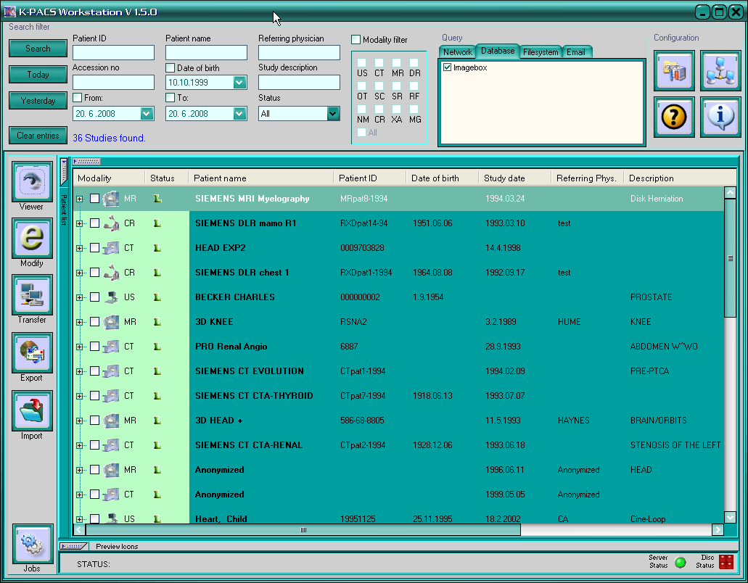
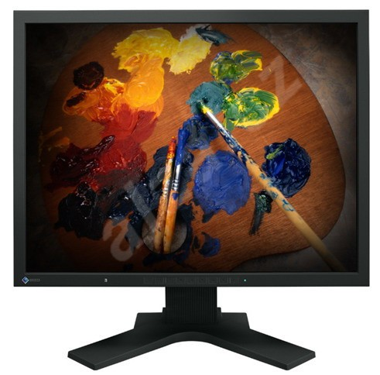
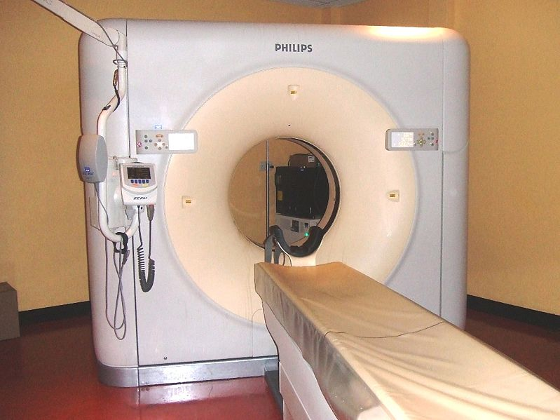
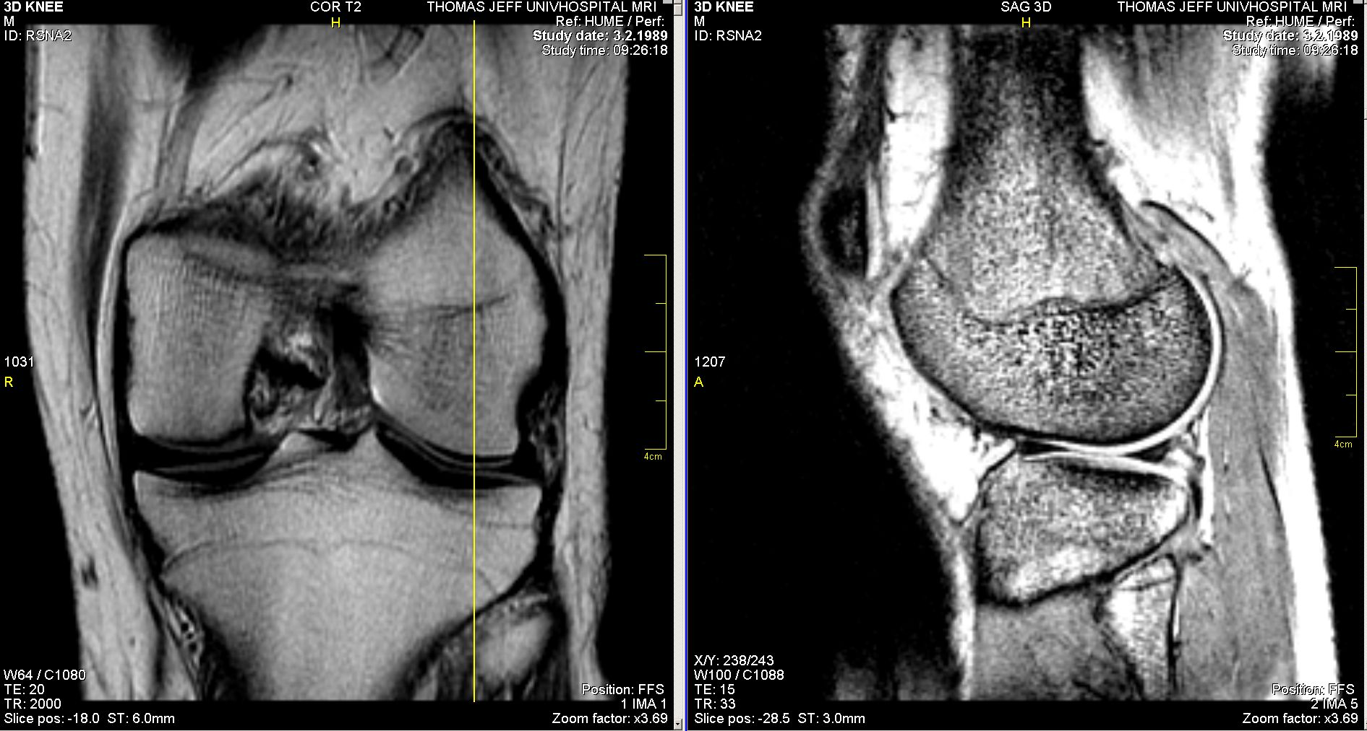
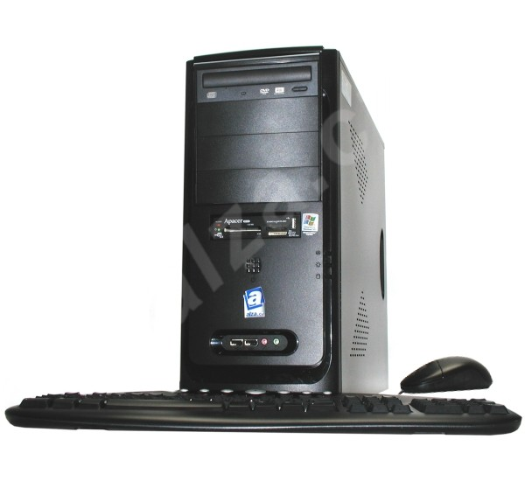
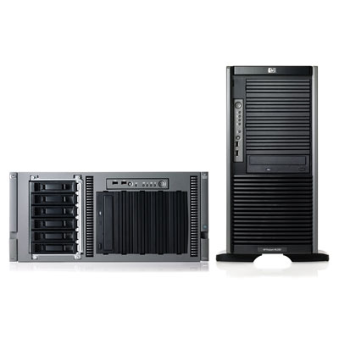
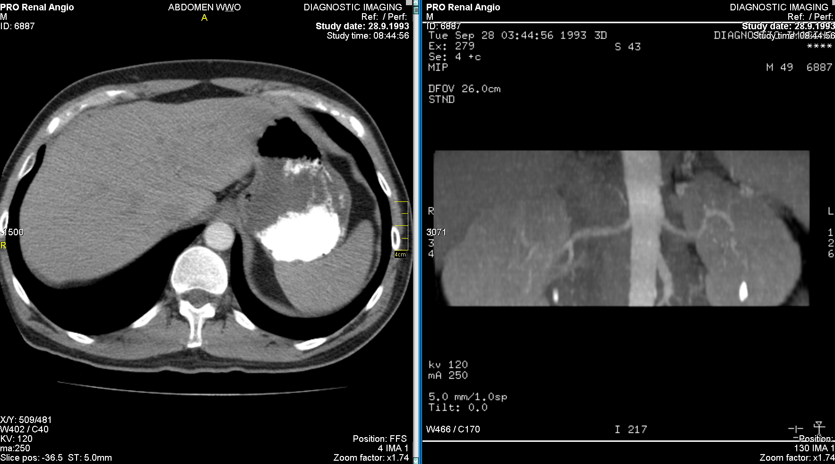
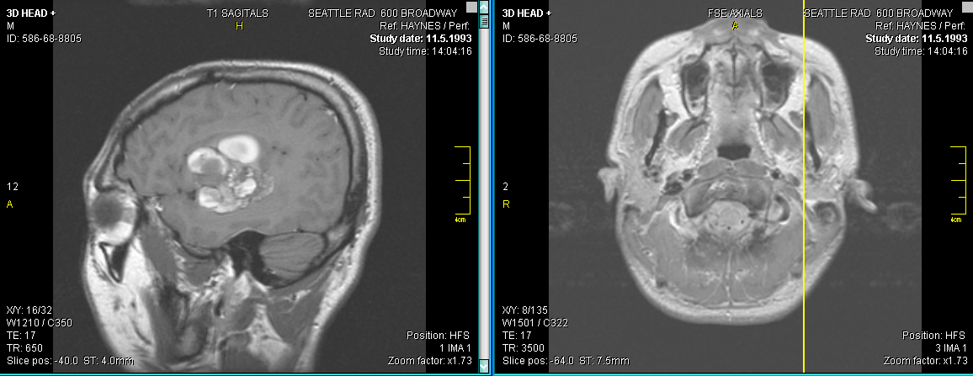
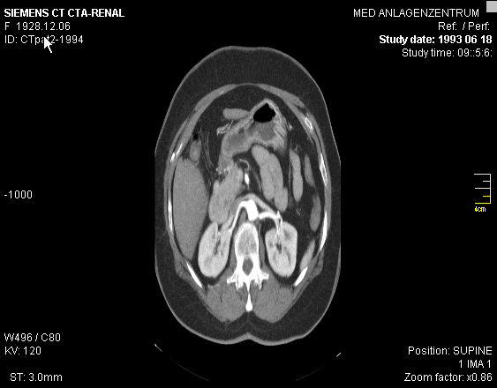
Sharing medical images
Within hospital - PACS(Picture Archiving and Communication Systems) DICOM (Digital Imaging and Communications in Medicine
Among hospitals - MEDIMED – based in Masaryk University
EPACS – based in VFN, provided by ICZ
DICOM

Slide 4
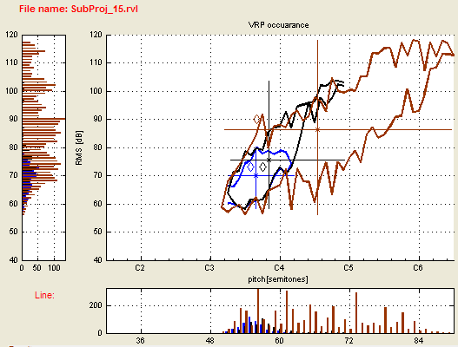

Voice Science
Voice analysis – phoniatric examination, voice professional training

Slide 5

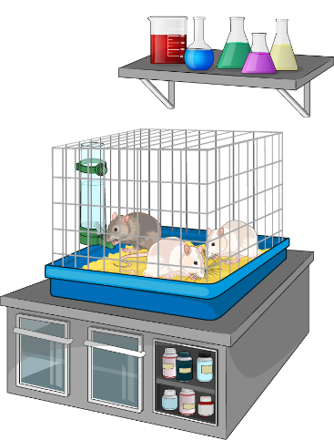
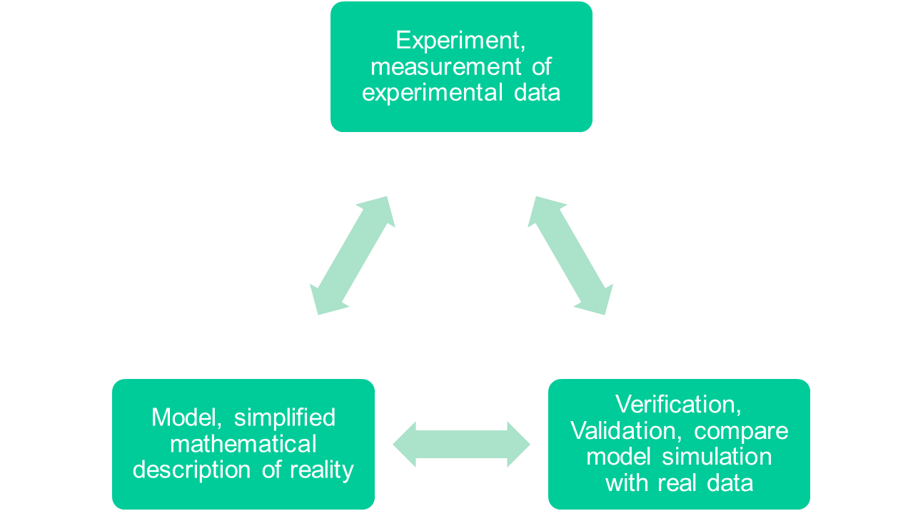
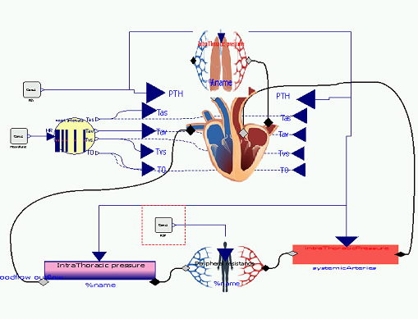


Computational physiology

Slide 6
Methods

Slide 7
Distributed computing
Resources: computers, devices connected via computer network, shared access
Users need sometimes resources.
Manage fair use of resources over network.

Slide 8
Grid computing
Distributed computing,
  shared resources among universities, research institutions, companies
  parallelism, federated access
Service-grid: services by grid-middleware, shared access, CESNET (METACENTRUM), EGI
Desktop-grid, volunteer computing: BOINC framework, SETI@home, Rosetta@home …

Slide 9
Cloud computing
Virtualization
Providers of infrastructure: Amazon EC2, Google Cloud, …,
physical infrastructure – scientific grid
  Ability to execute virtual machines: METACloud, EGIFedCloud
Providers of services: Facebook, Gmail, GoogleDocs, …

Slide 10
Results

Slide 11
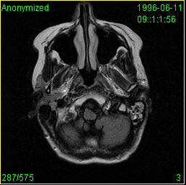
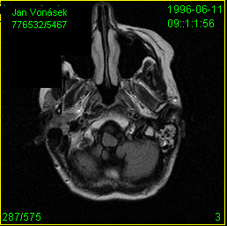




Sharing medical images
Integrated existing system MEDIMED with grid based Globus MEDICUS
DICOM
Grid Gateway
Storage Service Provider
Tomáš Kulhánek and Milan Šárek. Processing of medical images in virtual distributed environment. In Proceedings of the 2009 Euro American Conference on Telematics and Information Systems: New Opportunities to increase Digital Citizenship, page 10. ACM, 2009
Meta Catalog Service

Slide 12
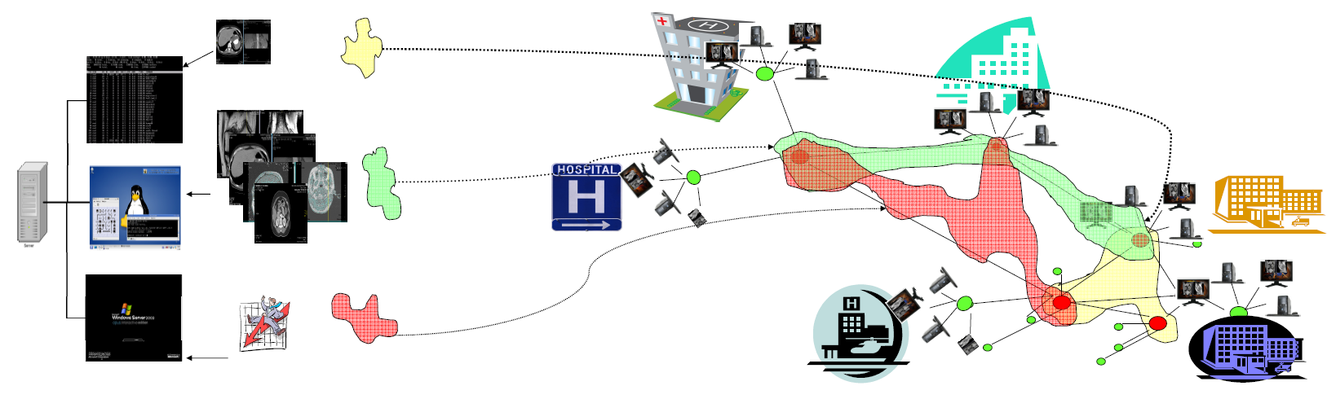
Virtual infrastructure
Virtualization – consolidating computer servers
Connected servers in CESNET, Central Military Hospital and First Faculty of Medicine
Sharing HW for multiple application
Tomáš Kulhánek. Infrastructure for data storage and computation in biomedical
research. European Journal for Biomedical Informatics (EJBI), 6(1):55–58, 2010.

Slide 13
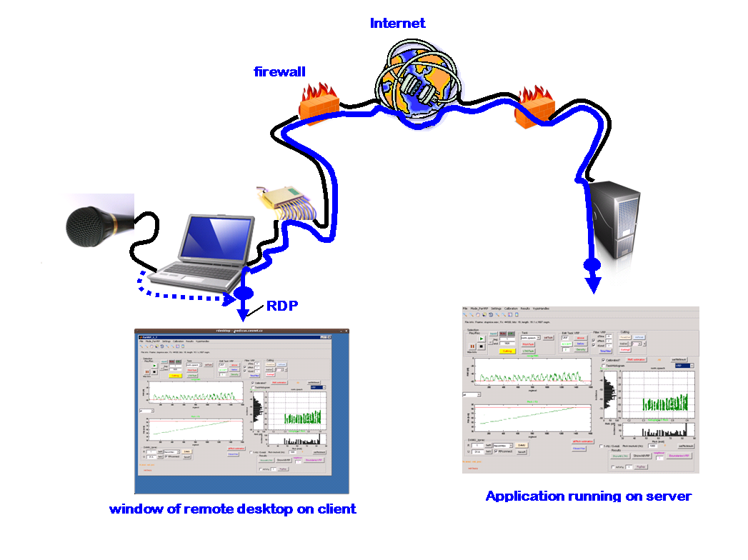
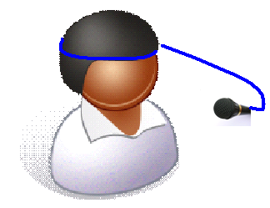

Remote analysis of human voice
Customized RDP protocol with lossless soundrecording redirection, application deployed on virtual server, user connects with remote desktop
Tomáš Kulhánek, Marek Frič, and Milan Šárek. Remote Analysis of Human Voice Lossless Sound Recording Redirection. Analysis of Biomedical Signals and Images. Proceedings of 20th International EURASIP Conference (BIOSIGNAL), pages 394–397, 2010.

Slide 14
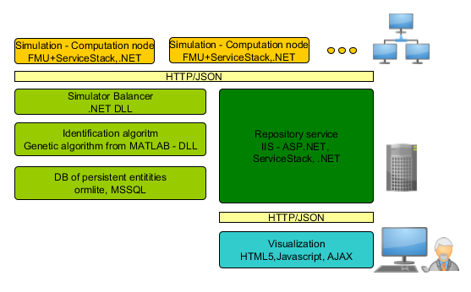
Computational physiology
System for parameter estimation
Modelica model => FMI Executable (commercial Dymola tool)
Web portal and web services => .NET, REST API (ServiceStack,SignalR)
Non-linear mathematical models => Global optimization methods => Genetic algorithm
Each iteration produces independent tasks => we tried Desktop grid (BOINC), local cluster, EGI cloud (CESNET NGI)
Tomáš Kulhánek, Marek Mateják, Jan Šilar, and Jiří Kofránek. Parameter estimation of complex mathematical models of human physiology using remote simulation distributed in scientific cloud. In Biomedical and Health Informatics (BHI), 2014 IEEE-EMBS International Conference on, pages 712–715, 2014. doi:10.1109/BHI.2014.6864463.

Slide 15
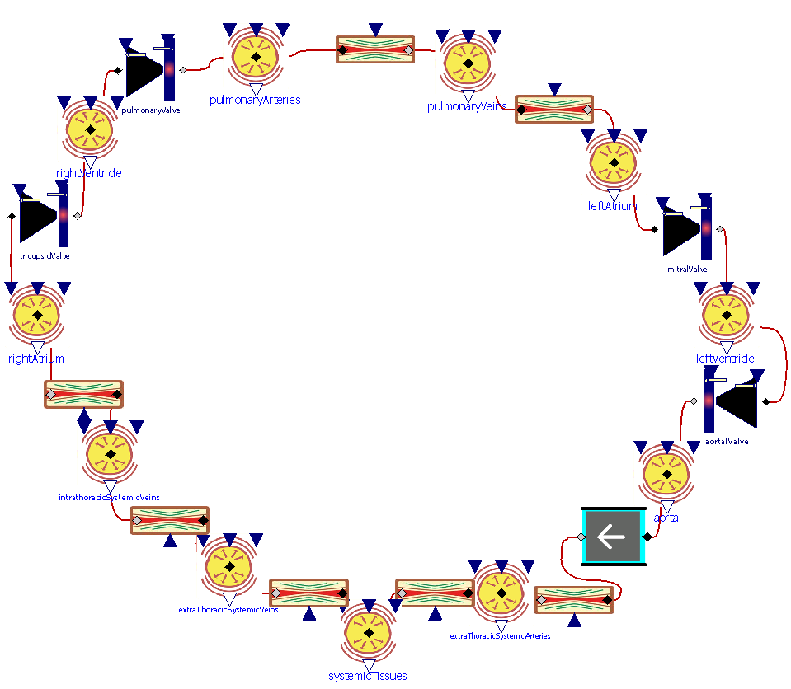


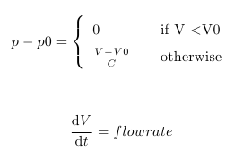





Example – model of cardiovascular system
Elastic baloon
Hydraulic resistor
Pulmonary circulation
Hydraulic valve
Heart
Systemic circulation

Slide 16
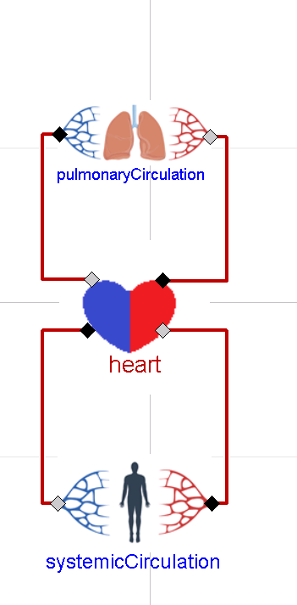
Example – model of cardiovascular system

Slide 17
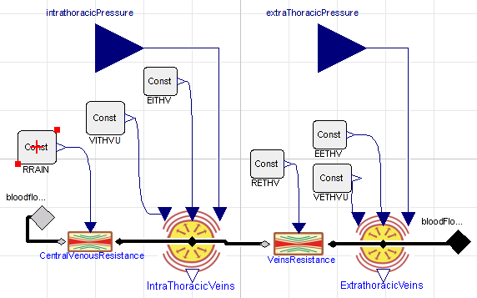
Example – model of cardiovascular system

Slide 18
Example – model of cardiovascular system
RRAIN – resistance of vena cava=0.003 mmHg*s/ml
EITHV – elastance of vena cava = 0.0182 mmHg/ml

Slide 19
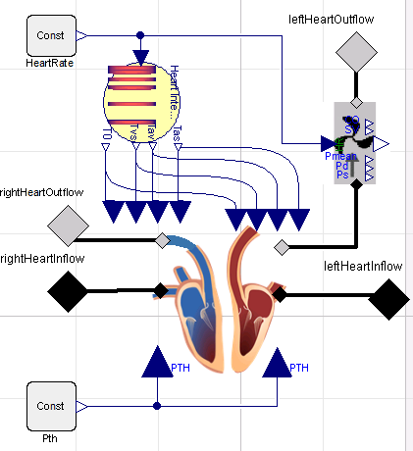
Example – model of cardiovascular system

Slide 20
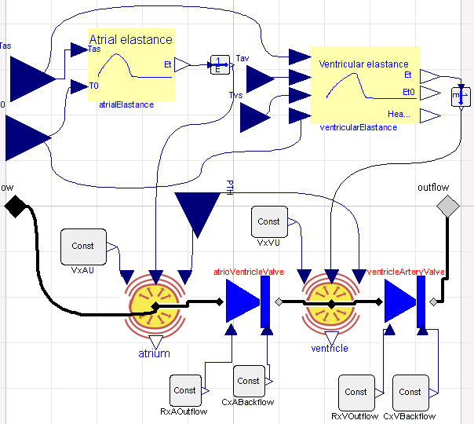
Example – model of cardiovascular system
Ventricula Elastance EMAX = 4 mmHg/ml

Slide 21
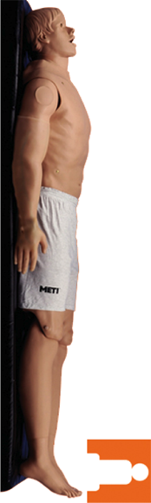
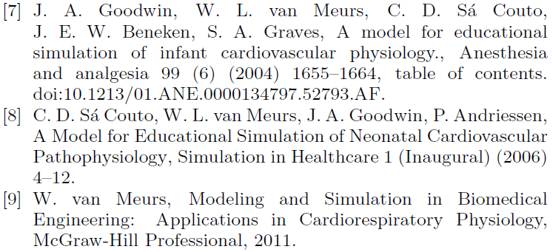
Example – model of cardiovascular system
Ventricula Elastance EMAX = 4 mmHg/ml
RRAIN – resistance of vena cava=0.003 mmHg*s/ml
EITHV – elastance of vena cava = 0.0182 mmHg/ml
…
Parameters of the model

Slide 22
Example – model of cardiovascular system
Ventricula Elastance EMAX = ?
RRAIN – resistance of vena cava=?
EITHV – elastance of vena cava = ?
…
What are the values of the parameters, which fits to concrete human?

Slide 23
Example – model of cardiovascular system
Ventricula Elastance EMAX = ?
RRAIN – resistance of vena cava=?
EITHV – elastance of vena cava = ?
…
What are the values of the parameters, which fits to concrete human?
- Hard(invasive) to measure directly
Measure other model variable
compute parameter, fit simulation with measured data
„parameter identification“
„Model calibration“

Slide 24
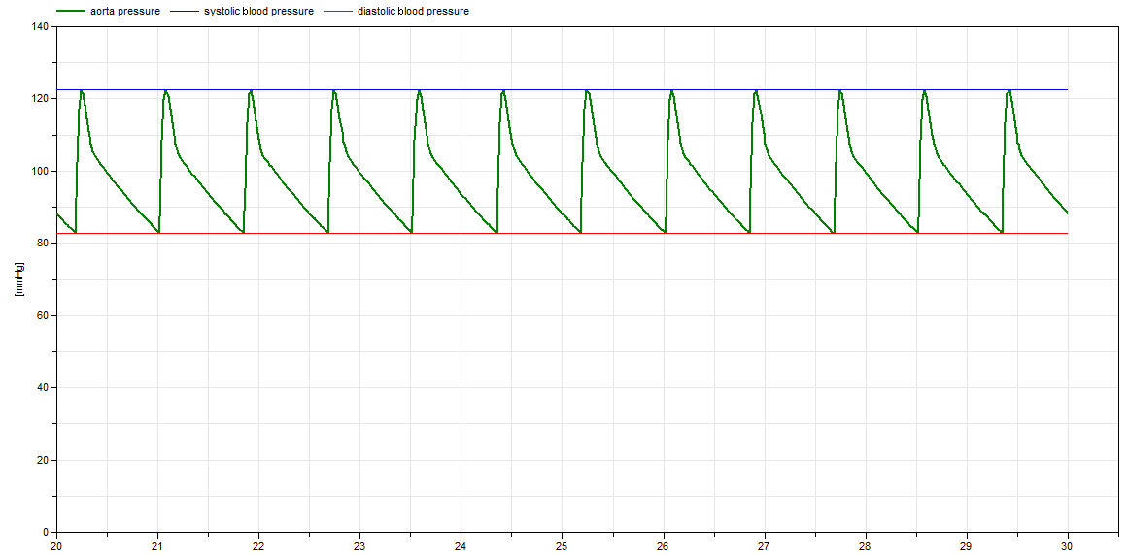
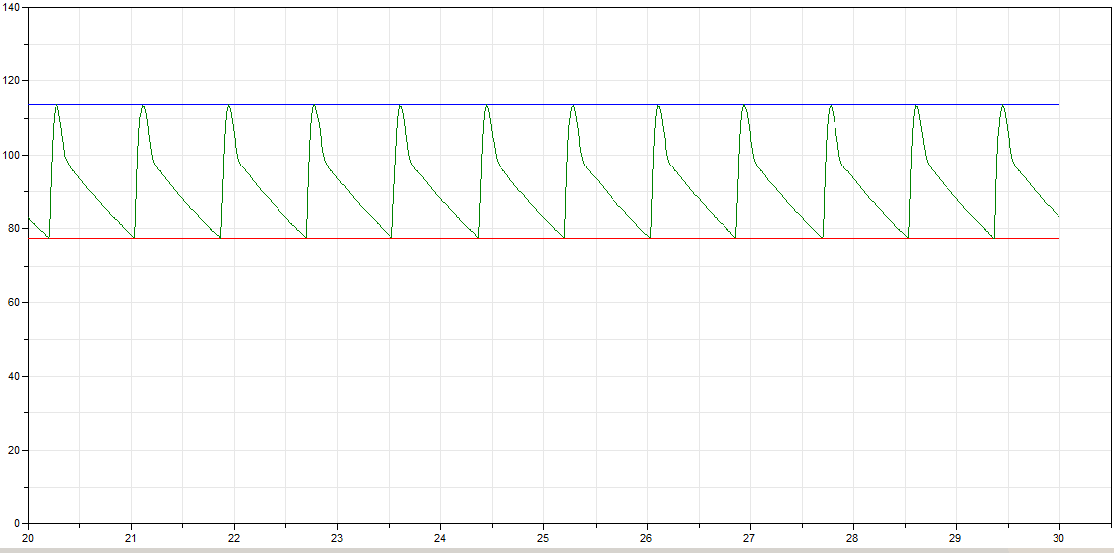
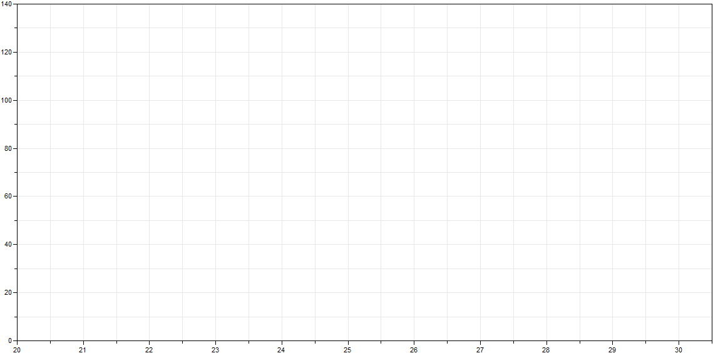
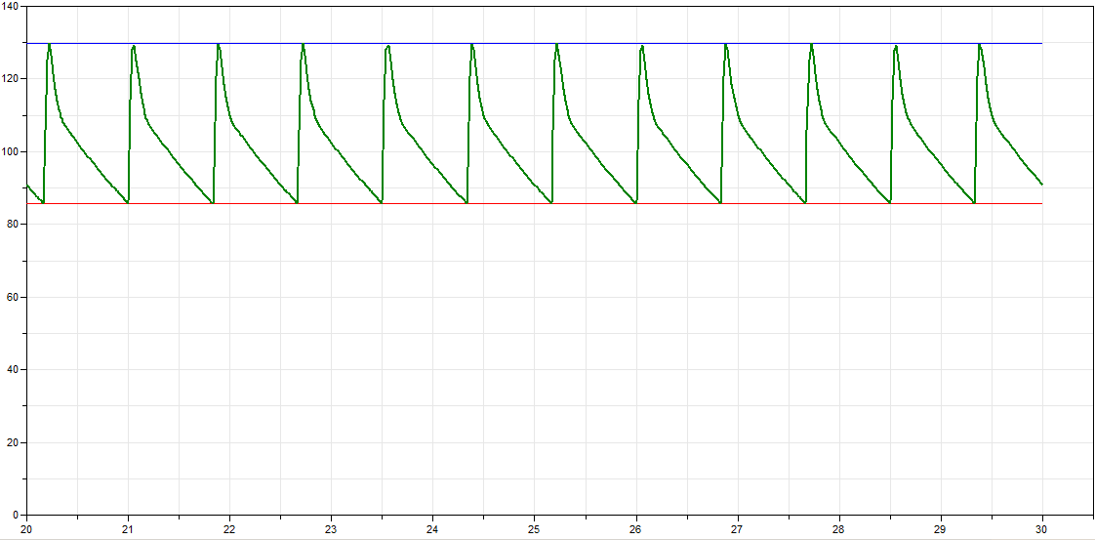

Example – model of cardiovascular system
Measure variable from real patient
Estimate parameters and simulate and compare with the measured data (curve fitting)
Repeat until simulation gives similar result as the measured data

Slide 25
Computational physiology - results
Model of hemodynamics of cardiovascular system
Meurs et al. (2006-2011), Burkhoff et al.(1997-2013) 7), Fernandez de Canete et al. (2013), …
Find factors of vena cava elastance, resistence, ventricular elastance,… to fit pacient data (pressure on different body positions)
5 hours in local cluster
30 minutes in EGI cloud (30 CPU)
heart.heart.leftHeart.ventricularElastance.factor 0.276715208845232
pulmonaryCirculation.EPA.factor 2.42977968242538
pulmonaryCirculation.RPP.factor 0.326200900501185
pulmonaryCirculation.RLAIN.factor 7.03415309534463
heart.heart.leftHeart.RxAOutflow.factor 0.0579461745835701
heart.heart.leftHeart.RxVOutflow.factor 0.115592156812037
heart.heart.rightHeart.ventricularElastance.factor 0.00138825200390164
heart.heart.rightHeart.RxVOutflow.factor 0.0339999571366457
systemicCirculation.systemicVeins.RETHV.factor 21.5099238722829
systemicCirculation.systemicVeins.EITHV.factor 0.183594380817957
systemicCirculation.systemicVeins.VITHVU.factor 0.00115139326808882
systemicCirculation.systemicVeins.RRAIN.factor 29.4603401420539
systemicCirculation.systemicPeripheralVessels.RTA.factor 2.58765141868037
systemicCirculation.systemicPeripheralVessels.RSP.factor 0.744428239928714
systemicCirculation.systemicArteries.EETHA.factor 0.318031878463708
systemicCirculation.systemicArteries.RETHA.factor 0.0792556174368193
systemicCirculation.systemicArteries.EITHA.factor 0.416618612811922

Slide 26
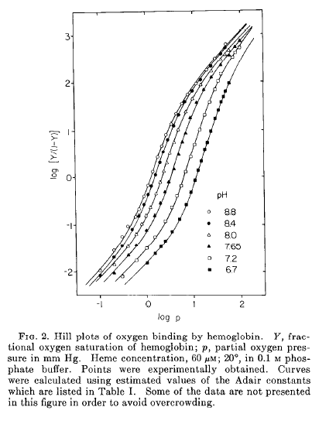
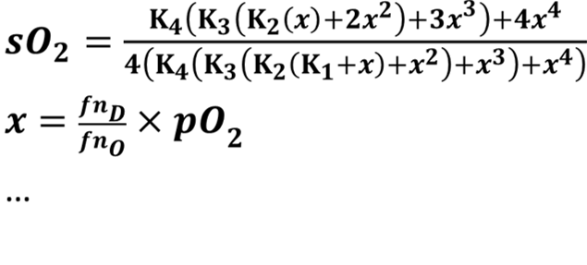
Computational physiology - results
Model of saturation O2 in Hemoglobin
Data Imai (1972), Roughton(1967), …
Theory:
Find K1 … K4 to fit the data
K1=K2 = 0.1301628020369
K3 = 0.744154273954473
K4 = 32.4804162428542
200 000 simulations in local cluster in 20 minutes
Marek Mateják, Tomáš Kulhánek, and Stanislav Matoušek. Adair-Based Hemoglobin Equilibrium with Oxygen, Carbon Dioxide and Hydrogen Ion Activity. Scandinavian journal of clinical and laboratory investigation, 2014. doi:10.3109/00365513.2014.984320. IF(2013):2.009

Slide 27
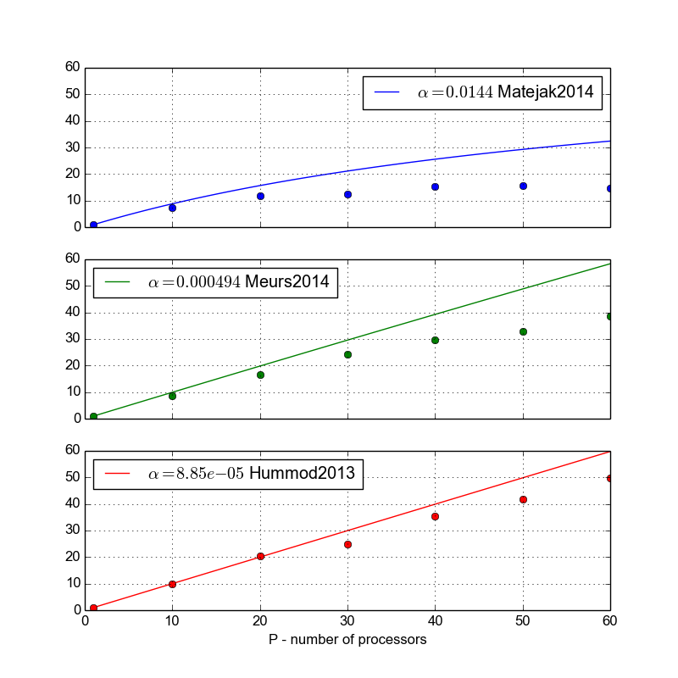
Computational physiology – results on cloud
Theoretical speedup (Amdahl law) vs. Practical speedup on 60 CPU
Complex – Hummod2013 – 49.8x time reduced from 4 days to 2 hours
Medium – Meurs2014 – 38.7x
Simple – Matejak2014 – 14.7x
Medium and complex simulation of models benefits highly from parallel parameter estimation, simple models outperforms on local HPC server

Slide 28
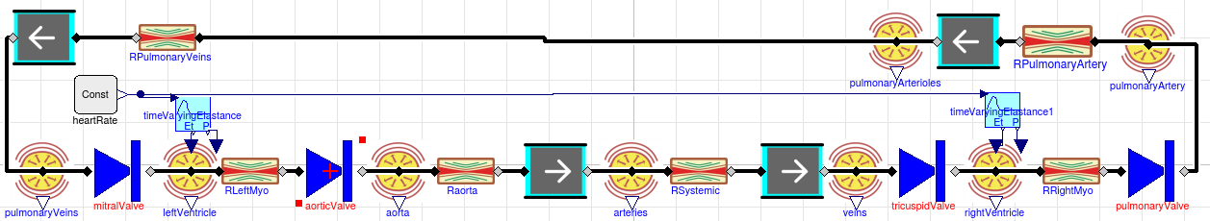
Computational physiology – modeling methodology for pulsatile CVS models
Tomáš Kulhánek, Jiří Kofránek, and Marek Mateják. Modeling of short-term mechanism of arterial pressure control in the cardiovascular system: Object oriented and acausal approach. Computers in Biology and Medicine, 54(1):137–144, 2014. IF(2013):1.475
Tomáš Kulhánek, Martin Tribula, Jiří Kofránek, and Marek Mateják. Simple models of the cardiovascular system for educational and research purposes. MEFANET Journal, 2(2):56–63, 2014.

Slide 29
Problem statement
Research questions:
  Is it (grid-computing or cloud-computing) beneficial and how?
  For sharing medical images – provides robust alternative to current systems of medical image exchange.
  For voice science – ability to connect users from broader geographically dispersed area.
  For computational biology – significant speedup gain in parameter studies – parameter estimation for medium and complex models which are hard to perform locally. For simple models simulation on local server outperforms cloud deployment.

Slide 30
Problem statement
Research questions:
  What are the limitations?
  Cost of porting and integration effort.
    Grid-computing – high → reuse existing application
    Cloud-computing – medium → virtual environment for already familiar application
  Communication overhead.
    For simple models and small sized tasks degrades possible speedup

Slide 31
Problem statement
Research questions:
  What can be the direction of future biomed. Research and grid-computing or cloud-computing research?
  Web services with high added values
    long data preservation, database of physiologically relevant parameters (http://www.physiovalues.org)
    Web application for in-silico simulatio
  In silico trails to improve drug discovery and therapy testing. (Avicena, VPH)
  Deep parameter study with volunteer computing project – Physiome@home
  Lumped parameter models → 3D models

Slide 32
Summary
Studied several grid-computing and clod-computing approaches in several biomedical use-cases
Identified specific field which will benefit from cloud-computing mostly (parameter study of physiological models)
Improved modeling methodology to build complex models of pulsatile CVS.

Slide 33
Thank you for your attention

Slide 35
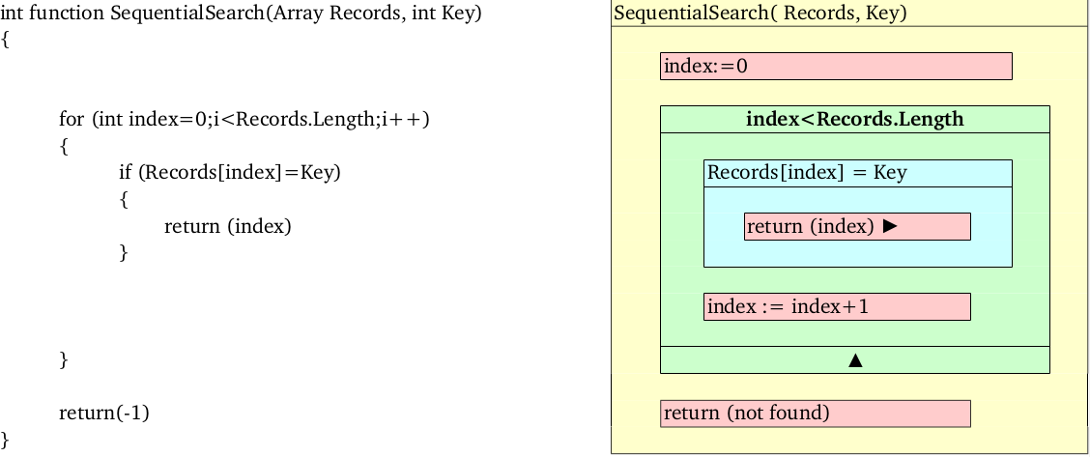
Algorithm
Order of instructions to solve task.
Example: sequential search

Slide 36
Efectivity, time complexity
Sequential search T = O(n)
Depth first search, exponential complexity T= O(k^{n})

Slide 37
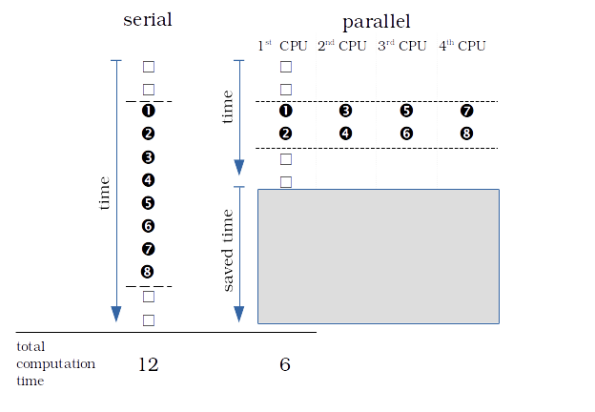
Paralelism

Slide 38
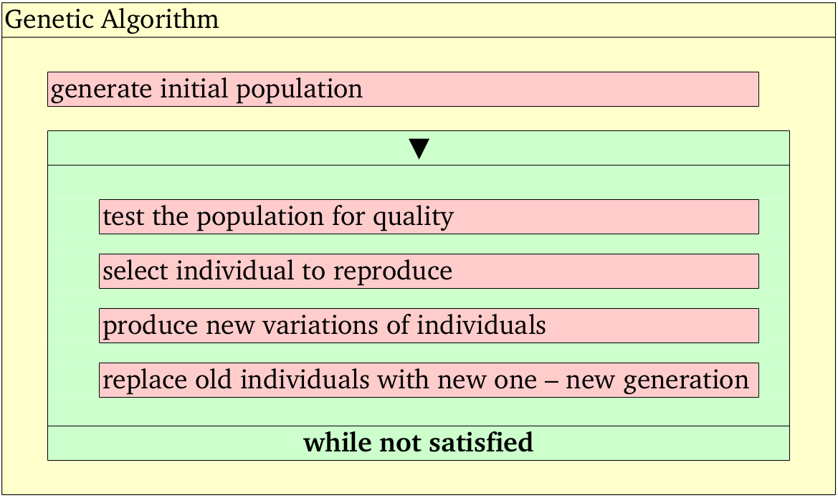
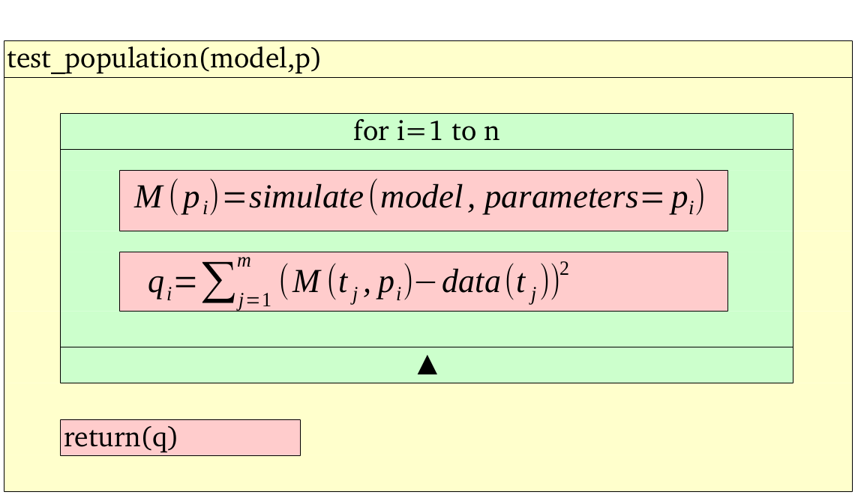
Genetic algorithm

