Slide 1
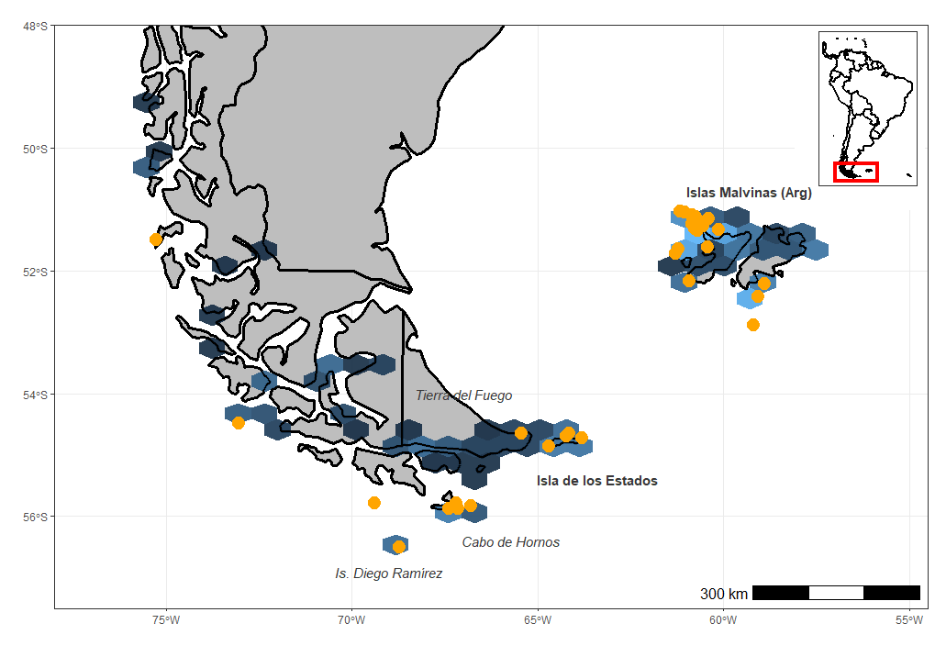
Some data on the species Striated Caracara (Phalcoboenus australis):
Strongly associated with seabird colonies during the breeding season, feeding and breeding on the proximities of penguins colonies.
During the non-breeding season, movement should be induced by the lack of food (penguins leave their colonies to forage in open sea until the next spring).
Distribution restricted to islands in southern South America.
Figure 1. Global distribution (blue) and breeding sites (orange) for the species. “Isla de los Estados” is our study site.

Slide 2
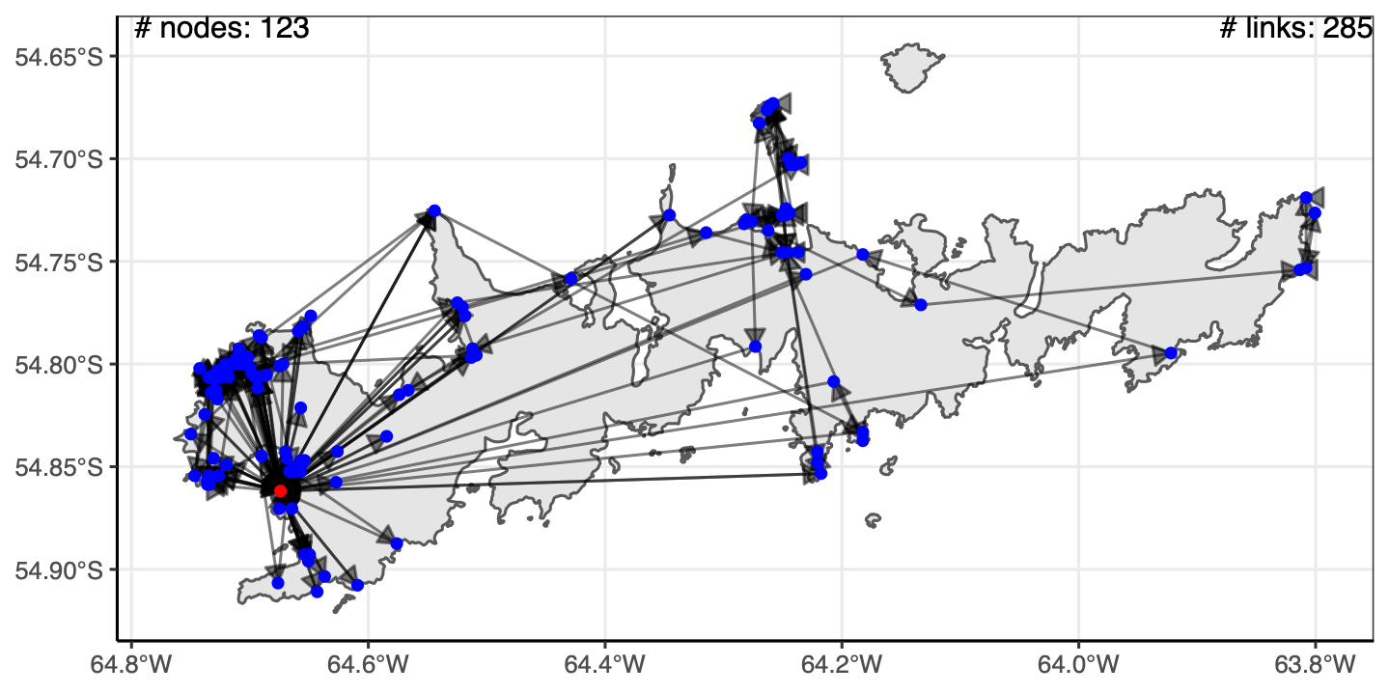
Three criteria to convert GPS data into network format:
1- GPS error: all points closer than 205 m between them were collapsed as the same node.
2- ‘penguin colony node’: all points closer than 300 m to the penguin colony were considered associated to it, therefore forming part of the same ‘colony node’. All nests (and therefore starting points of Striated Caracara studied individuals) are collapsed in the ‘colony node’.
3. ‘sea lion-associated nodes’: all points closer than 1800 m to any sea lion stand. The 1800 m intends to describe the association at the landscape scale, such as any point in a given bay that has sea lions should account as associated to them.
Figure 2. Global network for the 5 individuals of Phalcoboenus australis. In red the ‘colony node’.
5 individuals represent approx. 25 % of that years’ cohort.

Slide 3
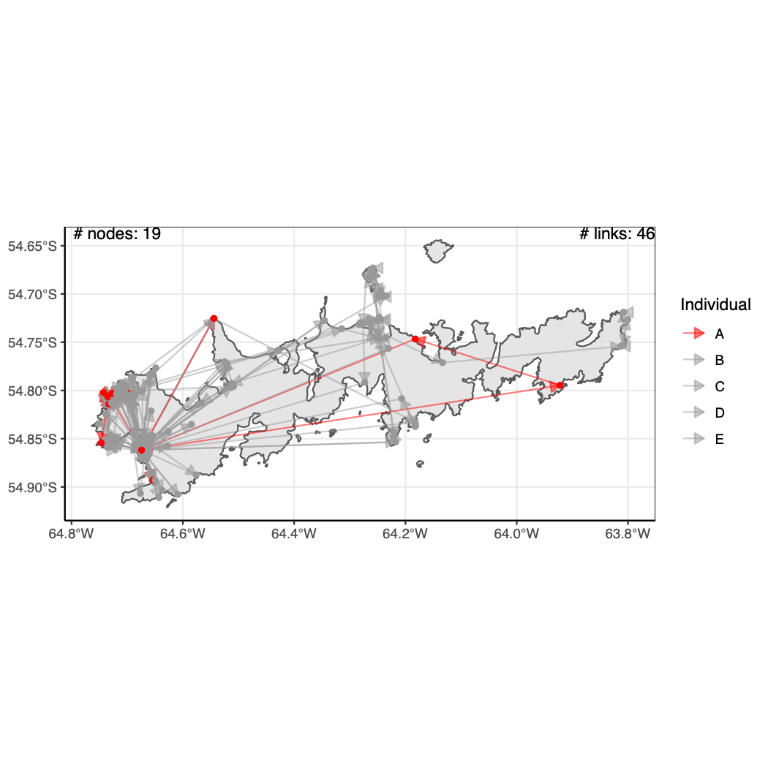
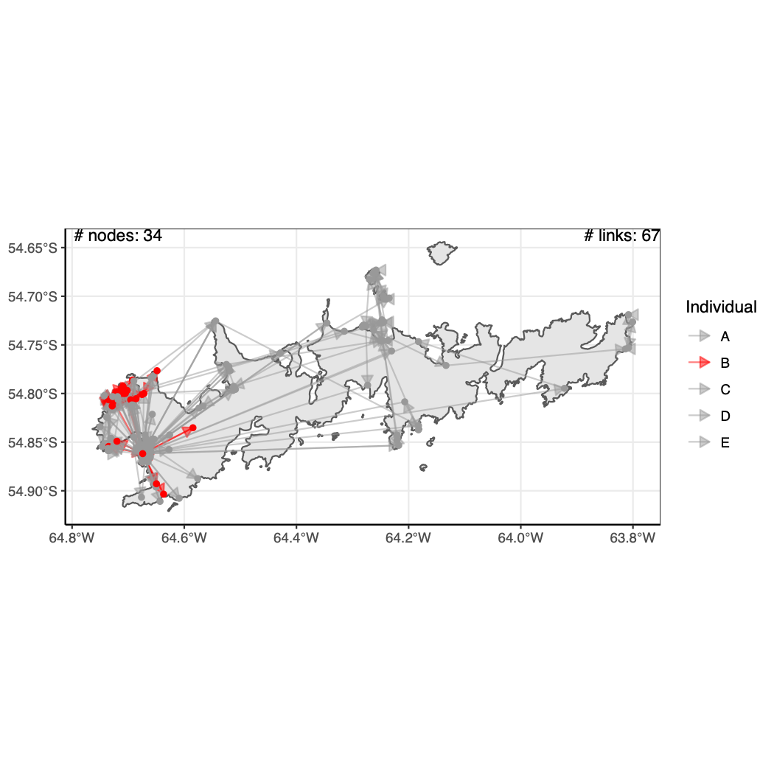
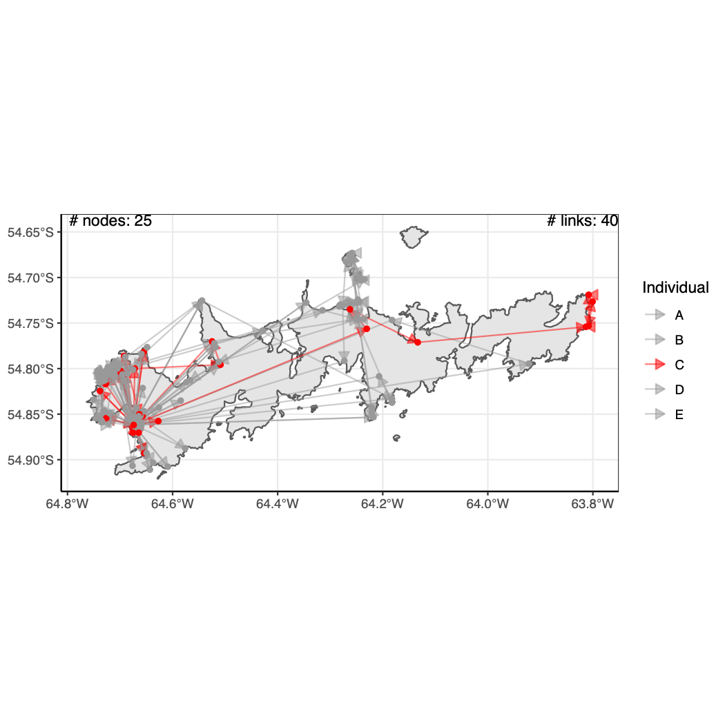
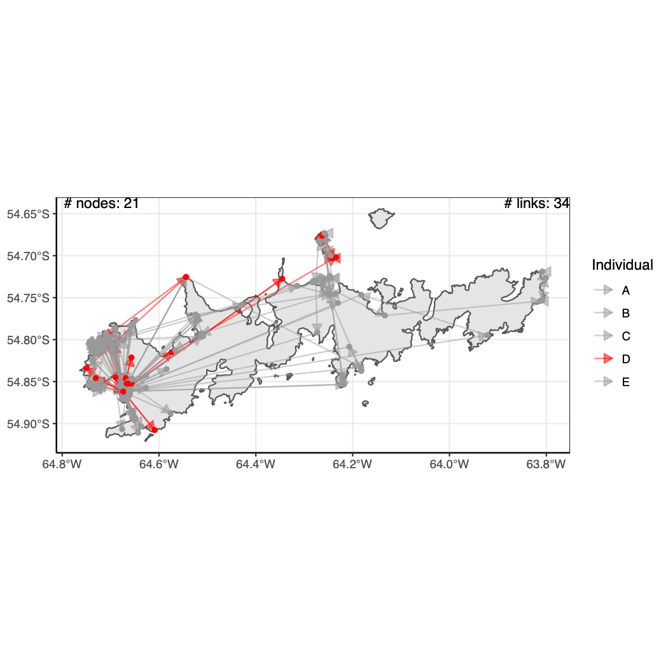
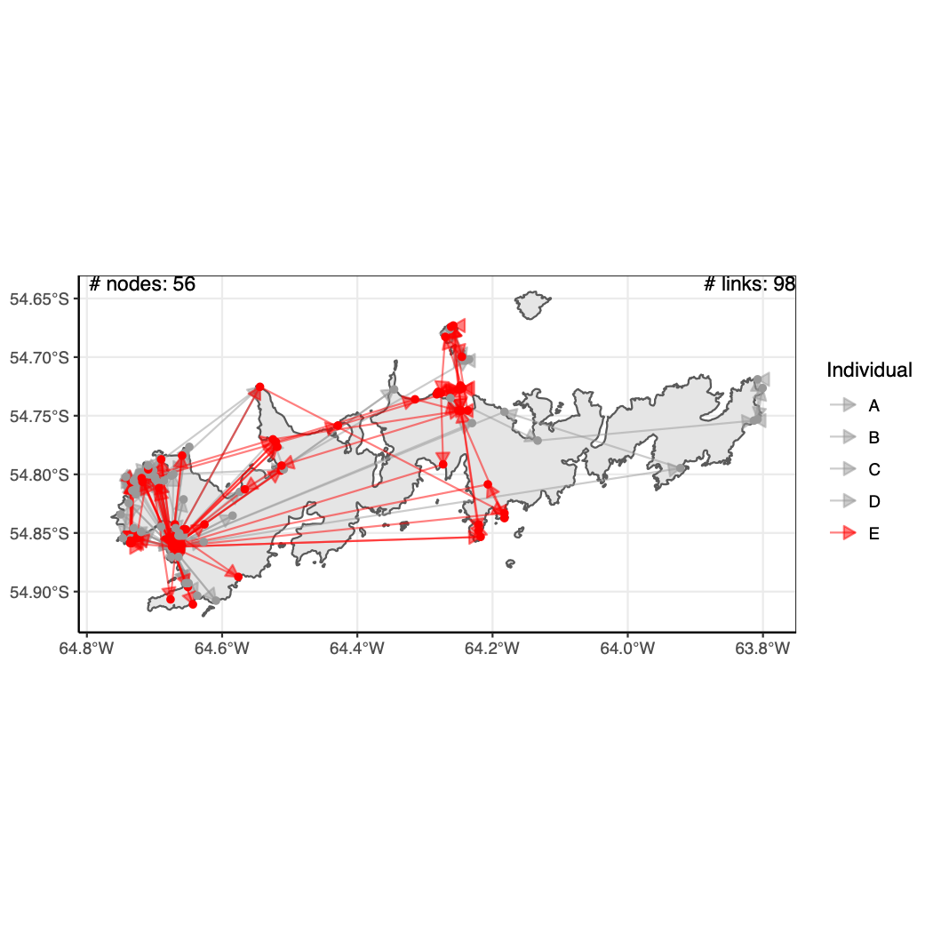
Figure 3. Networks for each of the 5 individuals of Phalcoboenus australis. The individual movements are marked in red for each case. In grey the global network.

Slide 4
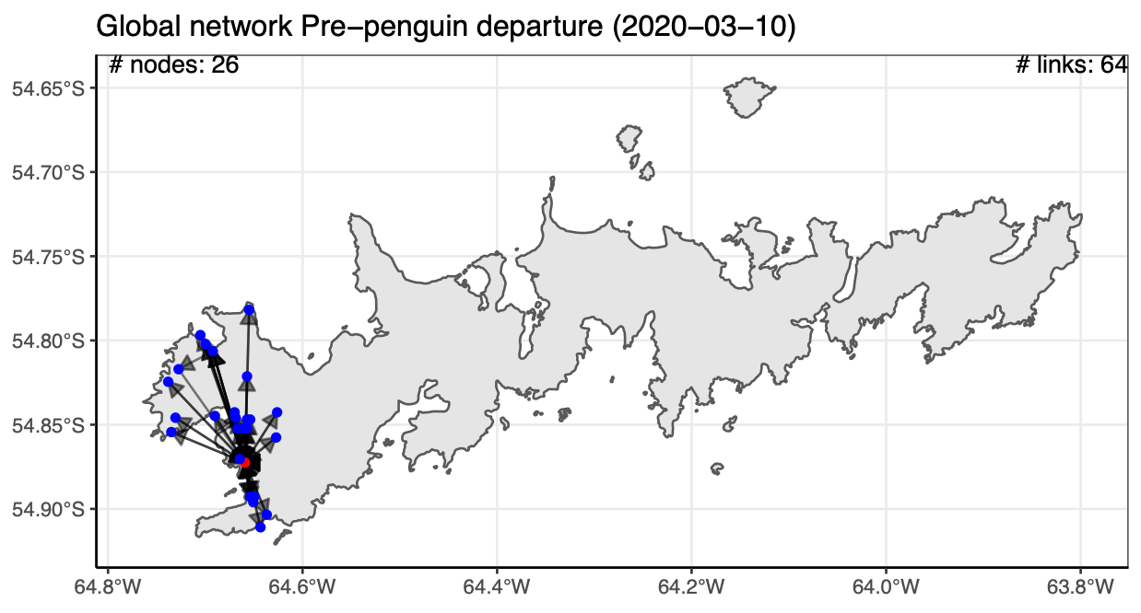
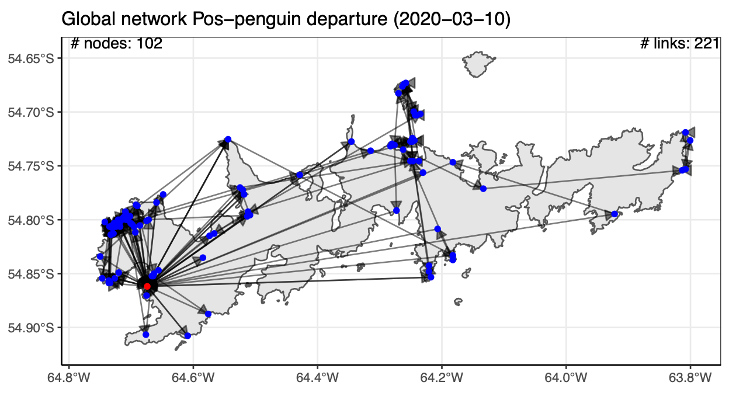
Figure 4. Global networks before and after penguin departure for the 5 individuals of Phalcoboenus australis. In red the ‘colony node’ is marked.

Slide 5
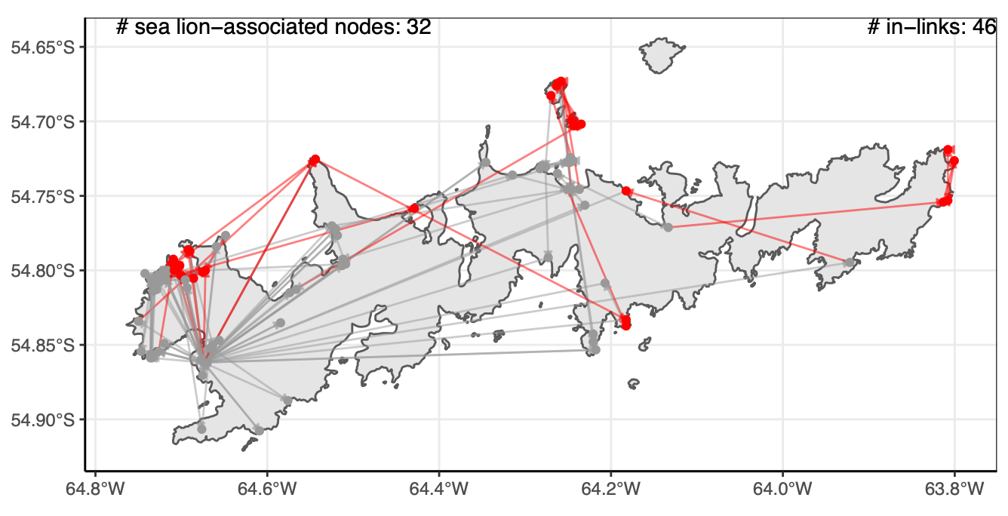
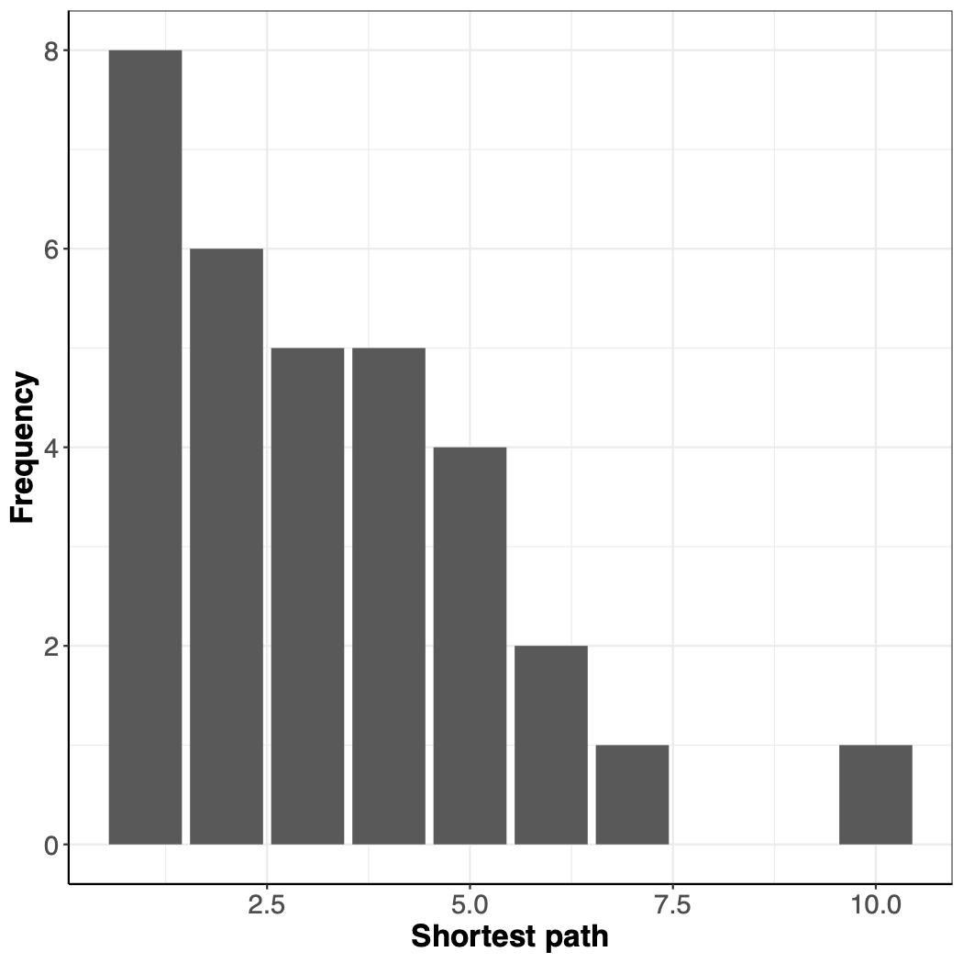
Figure 5. Global network identifying ’sea lion-associated nodes’ and links to them (in-links) after penguin departure. In grey the global network.
Figure 6. Frequency of shortest path between ‘colony node’ and ‘sea lion-associated nodes’.

