Slide 1
MHW3
Prifti Tomas
O46002191
Data: 25/04/2021

Slide 2
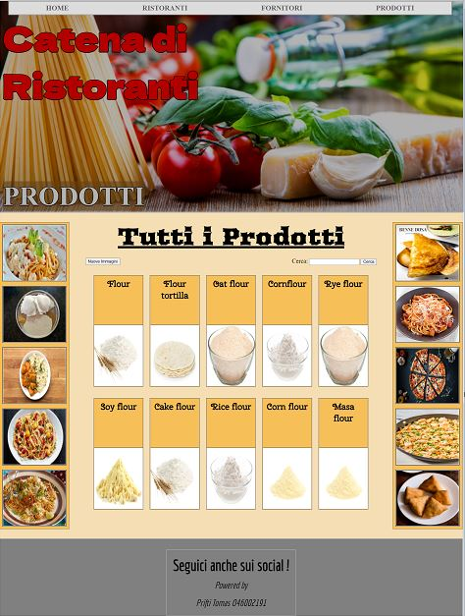
Layout complessivo HTML+CSS

Slide 3
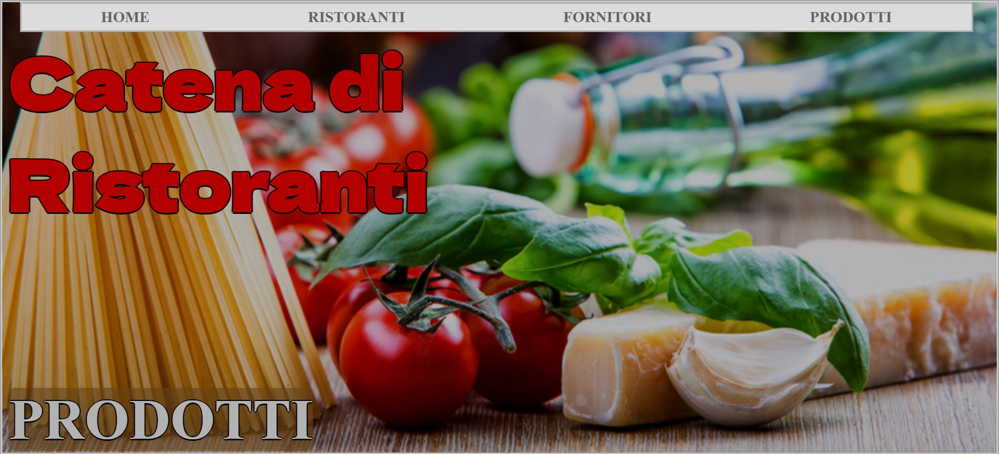
Header
Menù navigazione

Slide 4
Codice HTML
Codice CSS
body {
margin: 0px;
border: 3px solid darkgrey;
}
header {
background-image: url(Immagini/prodotti.jpg);
background-size: cover;
background-position: bottom;
display: flex;
flex-direction: column;
border-bottom: 2px solid darkgrey;
position: relative;
}
#overlay {
background-color: rgba(0, 0, 0, 0.3);
position: absolute;
width: 100%;
height: 100%;
}
<header>
<nav>
<a href=""><strong>HOME</strong></a>
<a href=""><strong>RISTORANTI</strong></a>
<a href=""><strong>FORNITORI</strong></a>
<a href=""><strong>PRODOTTI</strong></a>
</nav>
<div id="menu">
<div></div>
<div></div>
<div></div>
</div>
<div id="overlay"> <!-- Overlay --> </div>
<div id="id_1">
<strong>Catena di</br>Ristoranti</strong>
</div>
<div id="id_2">
<strong>PRODOTTI</strong>
</div>
</header>

Slide 5
Continuo Codice CSS
nav {
background-color: rgb(220, 220, 220);
display: flex;
justify-content: space-around;
align-items: center;
height: 40px;
width: 95%;
left: 2%;
right: 2%;
border: 3px solid darkgrey;
position: fixed;
z-index: 100;
} nav a {
color: rgb(100, 100, 100);
font-size: calc(8px + 1vw);
text-decoration: none;
} nav a:hover {
color: black;
text-decoration: underline;
}
nav a:active {
color: white;
} #menu {
display: none;
position: absolute;
top: 0px;
right: 0px;
height: 50px;
width: 50px;
justify-content: center;
align-items: center;
flex-direction: column;
background-color: rgb(220, 220, 220, 0.2);
} #menu div {
height: 3px;
width: 30px;
margin: 3px 0px;
background-color: white;
}
#id_1 {
margin-top: 40px;
margin-left: 10px;
}
#id_1 strong {
font-size: calc(30px + 5vw);
font-family: 'Dela Gothic One', cursive;
color: red;
}
#id_2 {
margin-top: calc(160px + 5vw);
margin-left: 10px;
}
#id_2 strong {
font-size: calc(10px + 5vw);
border-radius: 10px;
background-color: rgba(149, 95, 32, 0.6);
color: white;
}
#id_1 strong, #id_2 strong {
text-shadow: -2px 0 black, 0 2px black, 2px 0 black, 0 -2px black;
}
CSS Menù navigazione

Slide 6
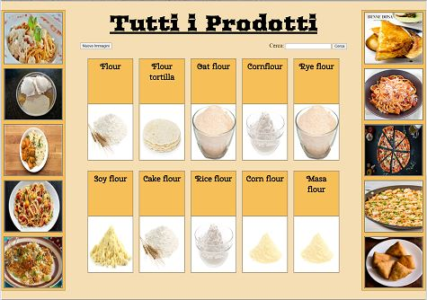
Sezione contenuti

Slide 7
Codice HTML
<section>
<div class="lateral_block">
<!-- <img src=""> -->
</div>
<div id="main_block">
<h1 id="title_blocks">
Tutti i Prodotti
</h1>
<div id="input_block">
<input id="input_images" , type="button" , value="Nuove Immagini">
<form>
<span>Cerca:</span>
<input id="input_content" , type="text">
<input id="input_button" , type="submit" , value="Cerca">
</form>
</div>
<div id="all_blocks">
<!--
<div class="block">
<h1 class="name">
</h1>
<img class="image" src="">
</div>
-->
</div>
</div>
<div class="lateral_block">
<!-- <img src=""> -->
</div>
<div id="modal" , class="hidden">
<div id="modal_block">
<img id="modal_image" src="">
<div id="modal_content">
<h1 id="modal_name"></h1>
<div id="modal_text"></div>
</div>
</div>
</div>
</section>

Slide 8
Codice CSS
section {
background-color: wheat;
display: flex;
padding: 2% 0%;
height: 1000px;
}
.lateral_block {
width: 15%;
display: flex;
flex-direction: column;
justify-content: space-around;
align-items: center;
border: 1px groove darkgrey;
background-color: rgb(247, 191, 88);
}
.lateral_image {
width: 90%;
height: 18%;
border: 3px groove darkgrey;
background-color: white;
}
#main_block {
width: 70%;
}
#title_blocks {
margin: 0% 3%;
font-size: calc(30px + 3vw);
text-align: center;
text-decoration: underline;
font-family: 'Arbutus', cursive;
}
#input_block {
display: flex;
justify-content: space-between;
align-items: center;
margin: 2% 5%;
}
form {
margin: 0px;
}
form span {
font-size: 20px;
}
#input_button:hover, #input_images:hover {
cursor: pointer;
}
#all_blocks {
display: flex;
flex-wrap: wrap;
justify-content: center;
height: 80%;
}
#noElement {
font-size: calc(20px + 2vw);
color: red;
margin: 5% 5%;
text-align: center;
}
.block {
display: flex;
flex-direction: column;
justify-content: space-between;
align-items: center;
border: 2px groove darkgrey;
height: 45%;
width: 15%;
margin: 1% 1%;
background-color: rgb(247, 191, 88);
word-wrap: break-word;
}

Slide 9
Continuo Codice CSS
#modal_content {
width: 45%;
background-color: rgb(247, 191, 88);
border-left: 2px groove darkgrey;
padding: 2%;
overflow-y: scroll;
}
#modal_name {
font-family: 'Cherry Swash', cursive;
margin-top: 0px;
}
#modal_text {
font-family: 'Space Mono', monospace;
}
.no_scroll {
overflow: hidden;
}
.hidden {
display: none;
}
.flex {
display: flex;
}
#modal {
position: fixed;
width: 100%;
height: 100%;
top: 0px;
left: 0px;
background-color: rgba(0, 0, 0, 0.9);
z-index: 100;
justify-content: center;
align-items: center;
}
#modal_block {
width: 55%;
height: 60%;
display: flex;
border: 2px groove darkgrey;
}
#modal_image {
height: 100%;
width: 55%;
background-color: white;
}
.name {
margin: 0px;
margin-top: 5%;
width: 90%;
font-size: calc(13px + 1vw);
font-family: 'Cherry Swash', cursive;
text-align: center;
}
.image {
border-top: 2px groove darkgrey;
width: 100%;
height: 55%;
background-color: white;
}
.image:hover {
cursor: pointer;
}

Slide 10

Footer
Codice HTML
Codice CSS
footer {
background-color: grey;
display: flex;
justify-content: center;
align-items: flex-end;
height: 250px;
border-top: 3px solid darkgrey;
}
footer div {
text-align: center;
padding: 20px 20px;
border: 2px solid darkgrey;
font-family: 'Economica', sans-serif;
font-weight: bold;
font-size: 50px;
}
<footer>
<div>
Seguici anche sui social !</br>
<em>Powered by</br>
Prifti Tomas O46002191
</em>
</div>
</footer>
footer div em {
font-size: 30px;
font-weight: normal;
}

Slide 11
Javascript
/* Foodish */
/* https://foodish-api.herokuapp.com/images/somefoodish/ */
/* Spoonacular */
/* https://spoonacular.com/food-api/ */
const api_key = "47acbd1bd0424de6b34f73a2162b0bd5";
const URLingredient = "https://spoonacular.com/cdn/ingredients_500x500/"
const MAX_LATERAL_BLOCK = 5;
let NUM_IMAGE = 0;
const data = ["pasta", "ice", "flour", "sugar", "oil", "salt", "orange"];
const word = data[Math.round(Math.random() * (data.length - 1))];
const section = document.querySelector("section");
const form = document.querySelector("form");
createLateralBlocks();
form.addEventListener("submit", searchBlock);
document.querySelector("#modal").addEventListener("click", closeModal);
document.querySelector("#modal_block").addEventListener("click", doNothing);
document.querySelector("#input_images").addEventListener("click", newImages);
const lateralImageList = document.querySelectorAll(".lateral_image");
newImages();
searchOnWeb1(word);
Sezione principale

Slide 12
Continuo Codice JS
Funzioni REST API per comunicare con i due siti web e gestire le informazioni ricevute.
function searchOnWeb1(str) {
fetch("https://api.spoonacular.com/food/ingredients/search?apiKey=" + api_key + "&query=" + str).then(onResponse, onError).then(onJson1);
}
function searchOnWeb2() {
fetch("https://foodish-api.herokuapp.com/api/").then(onResponse, onError).then(onJson2);
}
function onResponse(response) {
return response.json();
}
function onError(error) {
console.log("Errore: " + error);
}
function onJson1(json) {
document.querySelector("#all_blocks").innerHTML = "";
createBlocks(json);
}
function onJson2(json) {
lateralImageList[NUM_IMAGE++].src = json.image;
/* Soluzione all'errore */
/* if (NUM_IMAGE == MAX_LATERAL_BLOCK * 2) {
NUM_IMAGE = 0;
} */
}

Slide 13
Continuo Codice JS
function searchBlock(event) {
event.preventDefault();
const str = event.currentTarget.querySelector("#input_content").value.toLowerCase();
searchOnWeb1(str);
}
function openModal(event) {
const id = event.currentTarget.parentNode.dataset.id;
fetch("https://api.spoonacular.com/food/ingredients/" + id + "/information?amount=1&apiKey=" + api_key).then(onResponse, onError).then(onJsonModal);
}
function onJsonModal(json) {
document.querySelector("#modal_image").src = URLingredient + json.image;
document.querySelector("#modal_name").textContent = json.name[0].toUpperCase() + json.name.substring(1).toLowerCase();
document.querySelector("#modal_text").innerHTML = jsonDescription(json);
const modal = document.querySelector("#modal");
modal.classList.remove("hidden");
modal.classList.add("flex");
document.body.classList.add("no_scroll");
}
function jsonDescription(json) {
const array = json.nutrition.nutrients;
let str;
str = "COST: " + json.estimatedCost.value + " " + json.estimatedCost.unit + "<br>NUTRIENTS:<br>";
for (const obj of array) {
str += " - " + obj.name.toUpperCase() + ": " + obj.amount + " " + obj.unit + ";<br>";
}
return str;
}
Funzione per gestire la ricerca dopo il submit.
Funzioni per gestire i contenuti della modale relativi all’elemento selezionato.

Slide 14
Continuo Codice JS
Funzioni per chiudere la modale e per gestire le immagini laterali che verranno visualizzate.
function closeModal(event) {
document.body.classList.remove("no_scroll");
document.querySelector("#modal").classList.remove("flex");
document.querySelector("#modal").classList.add("hidden");
}
function doNothing(event) {
event.stopPropagation();
}
function newImages() {
NUM_IMAGE = 0;
for (let i = 0; i < MAX_LATERAL_BLOCK * 2; i++) {
searchOnWeb2();
}
}

Slide 15
Continuo Codice JS
function createBlocks(json) {
/* Il JSON contiene un array di elementi chiamato 'results' dove ogni elemento ha il proprio 'id', 'name', 'image' */
const array = json.results;
const all_blocks = document.querySelector("#all_blocks");
if (array.length == 0) {
const noElement = document.createElement("h1");
noElement.id = "noElement";
noElement.textContent = "Nessun Prodotto Disponibile !";
all_blocks.appendChild(noElement);
return;
}
/* Creation all main blocks */
let block, name, img, imageURL;
for (let i = 0; i < array.length; i++) {
/* Creation Block */
block = document.createElement("div");
block.classList.add("block");
block.dataset.id = array[i].id;
all_blocks.appendChild(block);
Funzione principale !
Creazione di tutti i blocchi all’interno della sezione principale. Inoltre, aggiunge le classi, il testo, le immagini e i listener ai blocchi corrispondenti.
/* Creation Name */
name = document.createElement("h1");
name.classList.add("name");
name.textContent = array[i].name[0].toUpperCase() + array[i].name.substring(1).toLowerCase();
block.appendChild(name);
/* Creation Image */
imageURL = URLingredient + array[i].image;
img = document.createElement("img");
img.classList.add("image");
img.src = imageURL;
block.appendChild(img);
}
const imageList = document.querySelectorAll(".image");
for (const image of imageList) {
image.addEventListener("click", openModal);
}
}

Slide 16
Continuo Codice JS
Funzione per riempire i blocchi laterali con immagini ricevute dalle API precedenti.
function createLateralBlocks() {
const lateral_blockList = document.querySelectorAll(".lateral_block");
let image;
for (const lateral_block of lateral_blockList) {
for (let i = 0; i < MAX_LATERAL_BLOCK; i++) {
image = document.createElement("img");
image.classList.add("lateral_image");
lateral_block.appendChild(image);
}
}
}

