Slide 1

angular
part 4
kamil mijacz
Notes:
https://pl.wikipedia.org/wiki/Angular_(framework)#/media/File:Angular_full_color_logo.svg

Slide 2
plan
model binding
html5 forms
template forms
reactive forms
validation

Slide 3
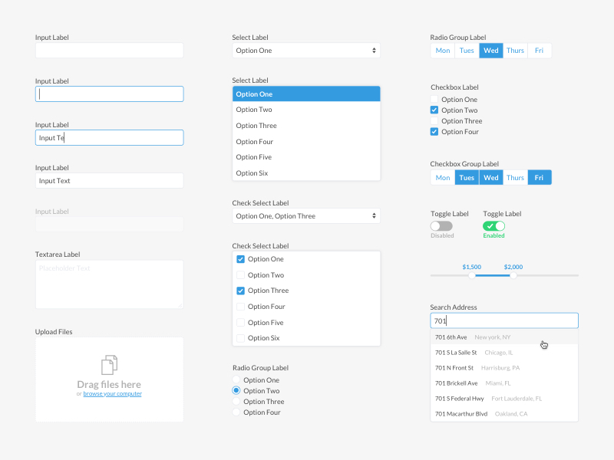
Notes:
https://hahoangv.wordpress.com/2016/05/30/display-data-in-angular-2/

Slide 4
model (data) binding
<input type="text" name="title" [(ngModel)]="title" />
Notes:
https://blog.thoughtram.io/angular/2016/10/13/two-way-data-binding-in-angular-2.html

Slide 5
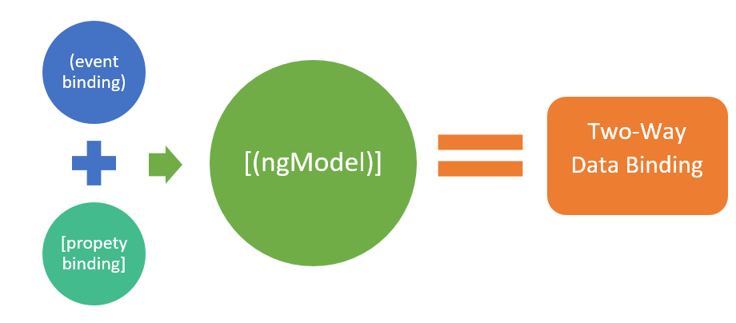
model (data) binding
Notes:
https://hahoangv.wordpress.com/2016/05/30/display-data-in-angular-2/

Slide 6
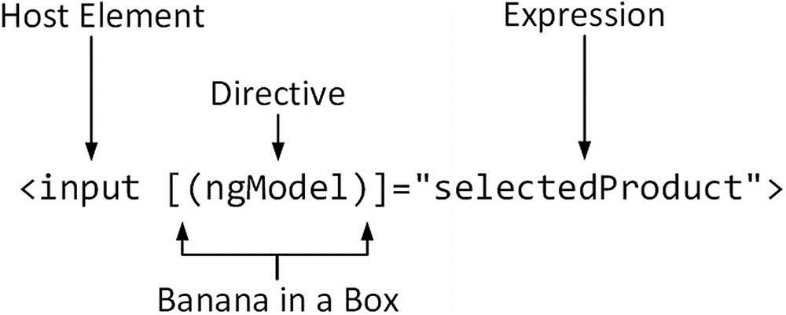
model (data) binding
Notes:
https://hahoangv.wordpress.com/2016/05/30/display-data-in-angular-2/

Slide 7
model (data) binding
NgModel connects a model property to an input control
NgModel is distributed via the @angular/forms package
must be registered with the application module to be used
Notes:
https://hahoangv.wordpress.com/2016/05/30/display-data-in-angular-2/

Slide 8
model (data) binding
import { FormsModule } from '@angular/forms’;
@NgModule({
declarations: […],
imports: [BrowserModule,FormsModule,…],
exports: […],
providers: […],
bootstrap: [AppComponent]
})
export class AppModule { }
Notes:
https://hahoangv.wordpress.com/2016/05/30/display-data-in-angular-2/

Slide 9
model binding
<input type="text" name="title„
[ngModel]="title"
(ngModelChange)="title = $event" />
Notes:
https://hahoangv.wordpress.com/2016/05/30/display-data-in-angular-2/

Slide 10
model (data) binding
Component Code
Component Model
Component Code
Component Model
[ngModel]
(ngModelChange)
[(ngModel)]
Input Control
Input Control
One-Way Data Binding
Two-Way Data Binding
Notes:
The key difference is the location of the component code and the bi-directional arrows.
Both, approaches can update the model, the key is managing the updates through component code versus automatic bindings.
Two-way results in more than one source of truth for the component model.

Slide 11
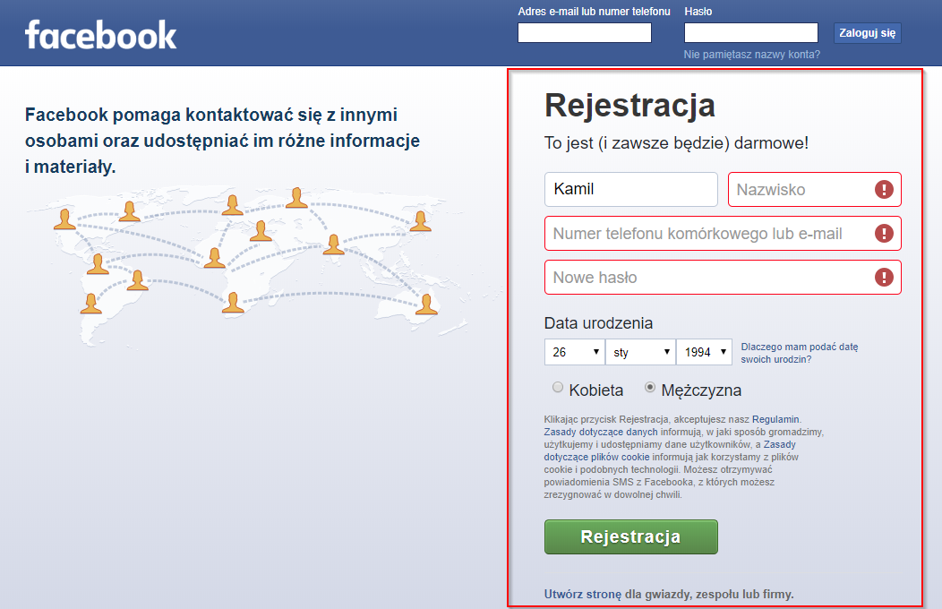

Slide 12
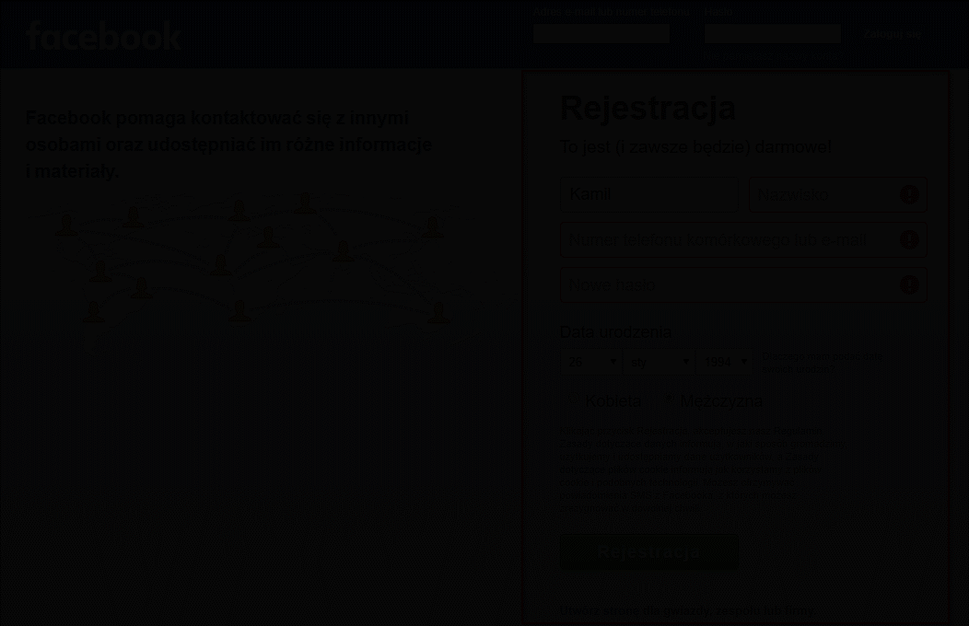

Slide 13
html5 forms
<form>
send request with body (POST)
submit event
value verification = validation

Slide 14
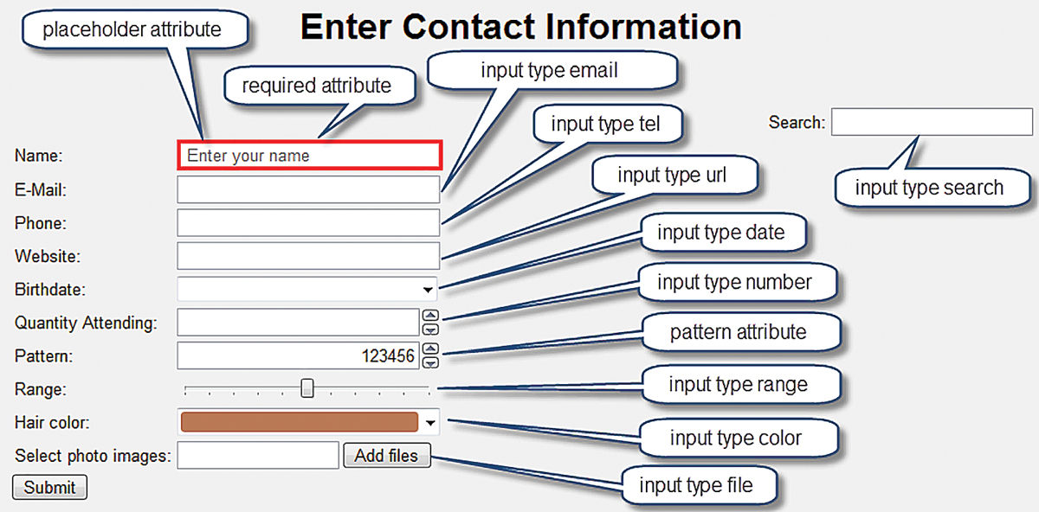

Slide 15
html5 forms
https://htmlreference.io/forms/

Slide 16
template forms
Angular Froms
Template Forms
Reactive Forms

Slide 17
template forms
NgForm
NgModelGroup
NgModel

Slide 18
template forms
NgForm, NgModelGroup, NgModel
the tree of form control objects
the component model
contain information about the form and it's controls such as validation state
contains the information entered via the form
connect HTML5 forms to a tree of form control objects and the component model

Slide 19
template forms
<form novalidate #f="ngForm" (ngSubmit)="onSubmit(f)">
<label>
<span>Full name</span>
<input type="text"
placeholder="Your full name" name="name" ngModel>
</label>
…
<div ngModelGroup="account">
<label><span>Email address</span>
<input type="email" placeholder="Your email address" name="email" ngModel>
</label>
</div>
<button type="submit">Sign up</button>
</form>
Notes:
https://hahoangv.wordpress.com/2016/05/30/display-data-in-angular-2/

Slide 20
template forms
…
<div ngModelGroup="account">
<label>
<span>Email address</span>
<input type="email" placeholder= "…" name="email" ngModel>
</label>
</div>
<button type="submit">Sign up</button>
</form>
Notes:
https://hahoangv.wordpress.com/2016/05/30/display-data-in-angular-2/

Slide 21
reactive forms
import ReactiveFormsModule from @angular/forms
manages the data flows
between form controls and the data model
FormBuilder enables forms to be more easily created
data collected does not automatically update the data model
code must be written to transfer that data to the data model

Slide 22
reactive forms
FormGroup
FormControl
FormArray
FormBuilder

Slide 23
reactive forms
public newColorControl: FormControl
= new FormControl("", Validators.required);
<input type="text" [formControl]="newColorControl">
Notes:
To connect the FormControl instance to an actual control on the form, the formControl attribute directive is used

Slide 24
reactive forms
public colorForm: FormGroup = new FormGroup({
newColorControl: new FormControl("", Validators.required),
});
<form [formGroup]="colorForm" novalidate>
<div>
<label for="new-color-input">New Color:</label>
<input type="text" id="new-color-input" formControlName="newColorControl">
</div>
</form>

Slide 25
reactive forms
Traditional Approach
Traditional approach with object hierarchy and parameters
Form Builder for larger forms
Form Builder uses a simple object literal
this.profileForm = new FormGroup({
firstNameControl: new FormControl(""),
lastNameControl: new FormControl(""),
});
Form Builder Approach
this.profileForm = this.fb.group({
firstNameControl: [ "" ],
lastNameControl: [ "" ],
});

Slide 26
template vs reactive forms
template forms:
use a declarative approach to configuring Angular forms
provide a directive, NgModel, to connect the component model to the form control
not available until the second change detection cycle
more familiar to AngularJS developers transitioning to Angular
reactive forms:
use an imperative approach to configuring Angular forms and require a little more work to configure
do not directly connect form controls to the component model
additional code is needed to extract the form data
more familiar to jQuery and React developers
become more popular

Slide 27
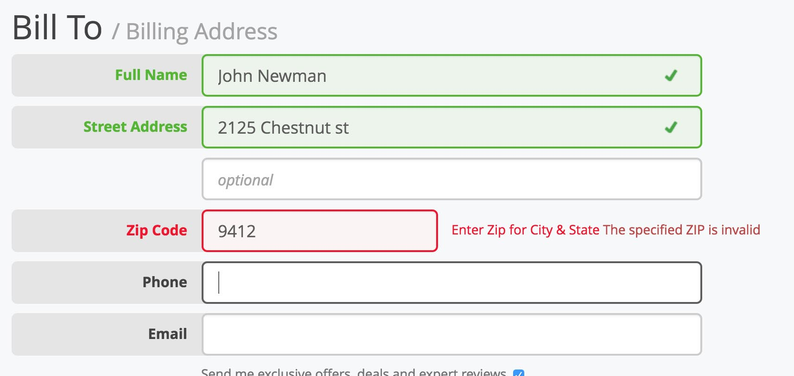
validation
Notes:
https://baymard.com/blog/inline-form-validation

Slide 28
validation attribute
required | value that must be provided
minlength | minimum number of characters
maxlength | maximum number of characters (cannot be applied directly to form elements because it conflicts with the HTML5 attribute)
pattern | regular expression that the value provided by the user must match.

Slide 29
validation
<input class="form-control"
name="name"
[(ngModel)]="title"
required
minlength="5"
pattern="^[A-Za-z ]+$" />
Notes:
https://hahoangv.wordpress.com/2016/05/30/display-data-in-angular-2/

Slide 30
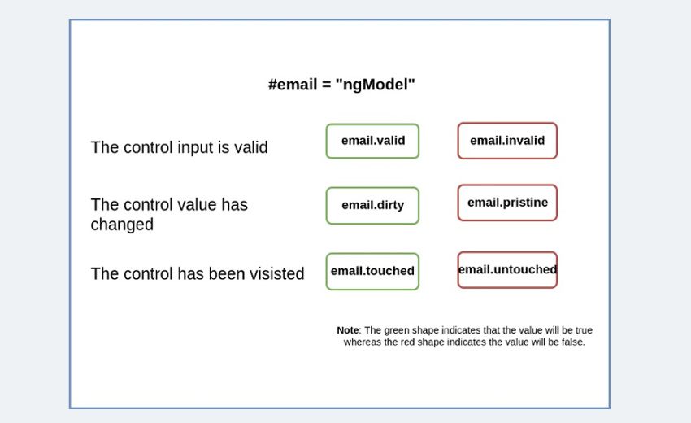
validation (control state)

Slide 31
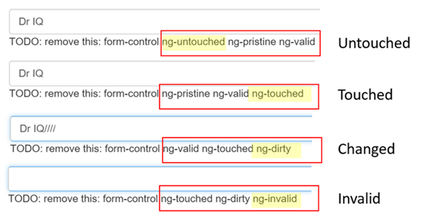
validation (control state)

Slide 32

https://github.com/Banndzior
#slack
kamil.mijacz@gmail.com
kamil.mijacz@softwarehut.com
Notes:
https://www.flickr.com/photos/jeffdjevdet/18027482924

