Slide 1

angular
part 3
kamil mijacz
Notes:
https://pl.wikipedia.org/wiki/Angular_(framework)#/media/File:Angular_full_color_logo.svg

Slide 2
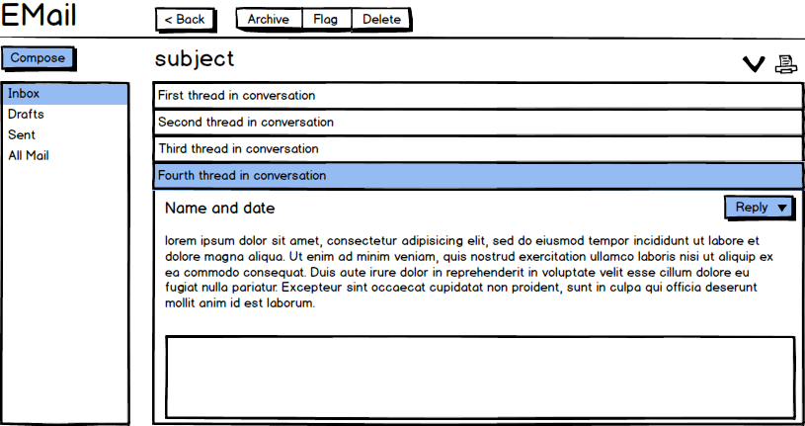
Notes:
https://www.google.pl/search?biw=1920&bih=938&tbm=isch&sa=1&ei=kTYUXJnwIfDRrgSG9aygBA&q=email+client+wireframe&oq=email+client+wireframe&gs_l=img.3...0.0..201287...0.0..0.0.0.......0......gws-wiz-img.oZ63m4hgDnc
https://www.visual-paradigm.com/learning/handbooks/agile-handbook/desktop-application-wireframe.jsp

Slide 3
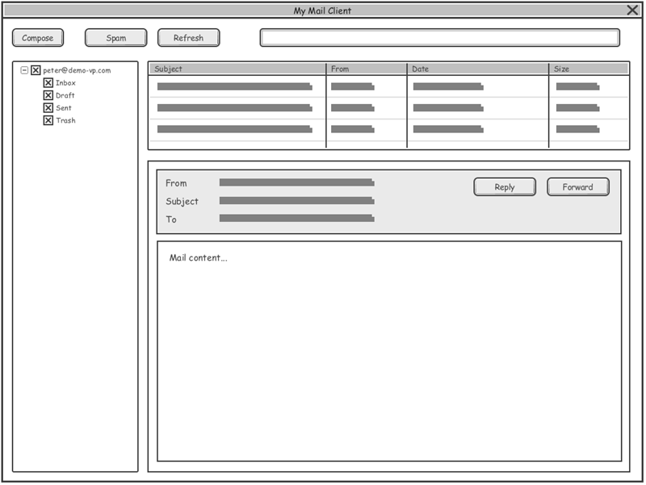
Notes:
https://www.google.pl/search?biw=1920&bih=938&tbm=isch&sa=1&ei=kTYUXJnwIfDRrgSG9aygBA&q=email+client+wireframe&oq=email+client+wireframe&gs_l=img.3...0.0..201287...0.0..0.0.0.......0......gws-wiz-img.oZ63m4hgDnc
https://www.visual-paradigm.com/learning/handbooks/agile-handbook/desktop-application-wireframe.jsp

Slide 4
plan
logic flow (component communication)
service logic
review
typescript basics

Slide 5

Notes:
http://www.thebluediamondgallery.com/wooden-tile/images/review.jpg

Slide 6
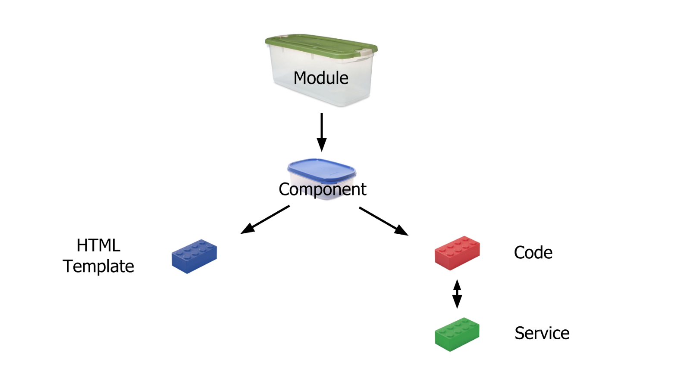
architecture

Slide 7
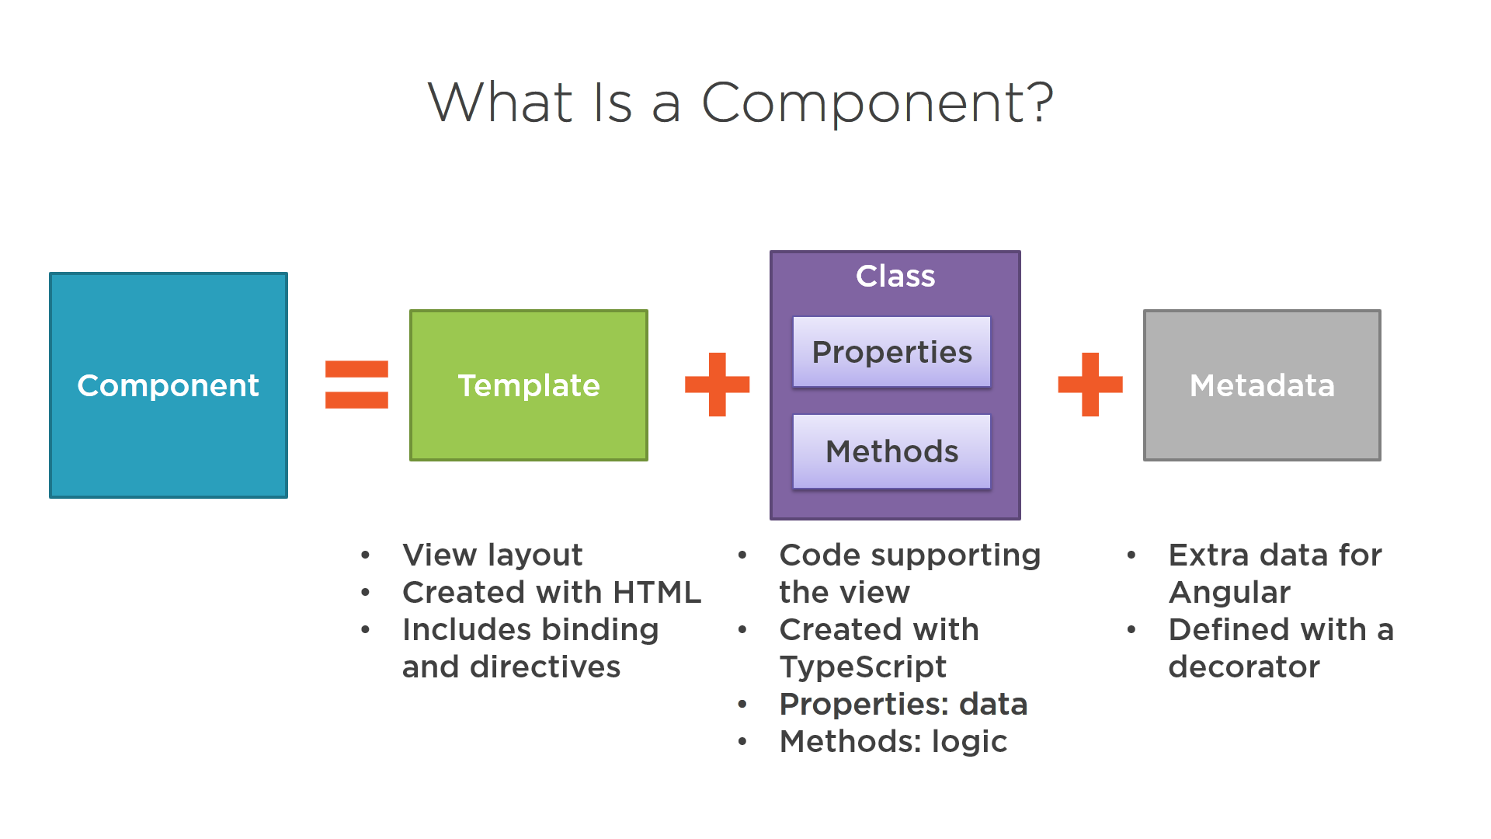

Slide 8
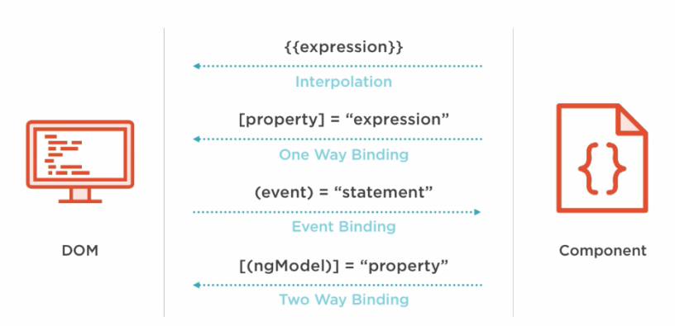
component data flows
Notes:
https://hahoangv.wordpress.com/2016/05/30/display-data-in-angular-2/

Slide 9
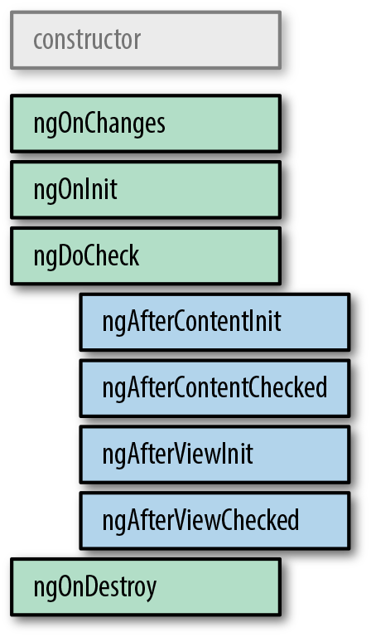
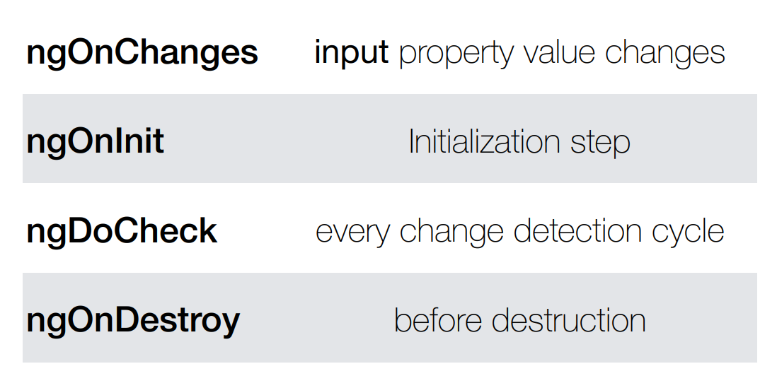
component lifecycle
Notes:
https://angular.io/guide/lifecycle-hooks

Slide 10
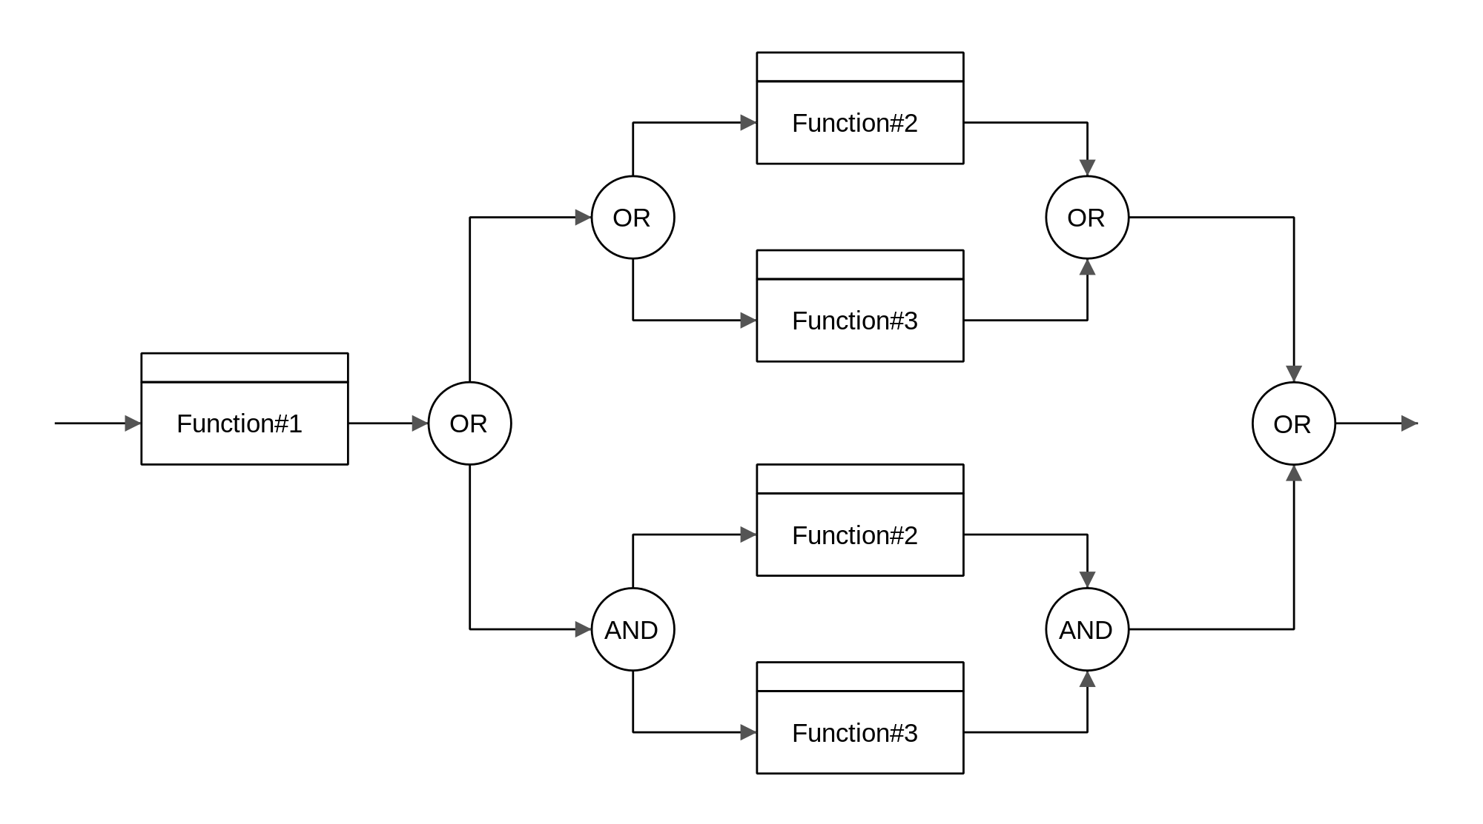
flow
(component
vommunication)
Notes:
https://commons.wikimedia.org/wiki/File:Msi_wind_netbook_U90x_internals.jpg

Slide 11
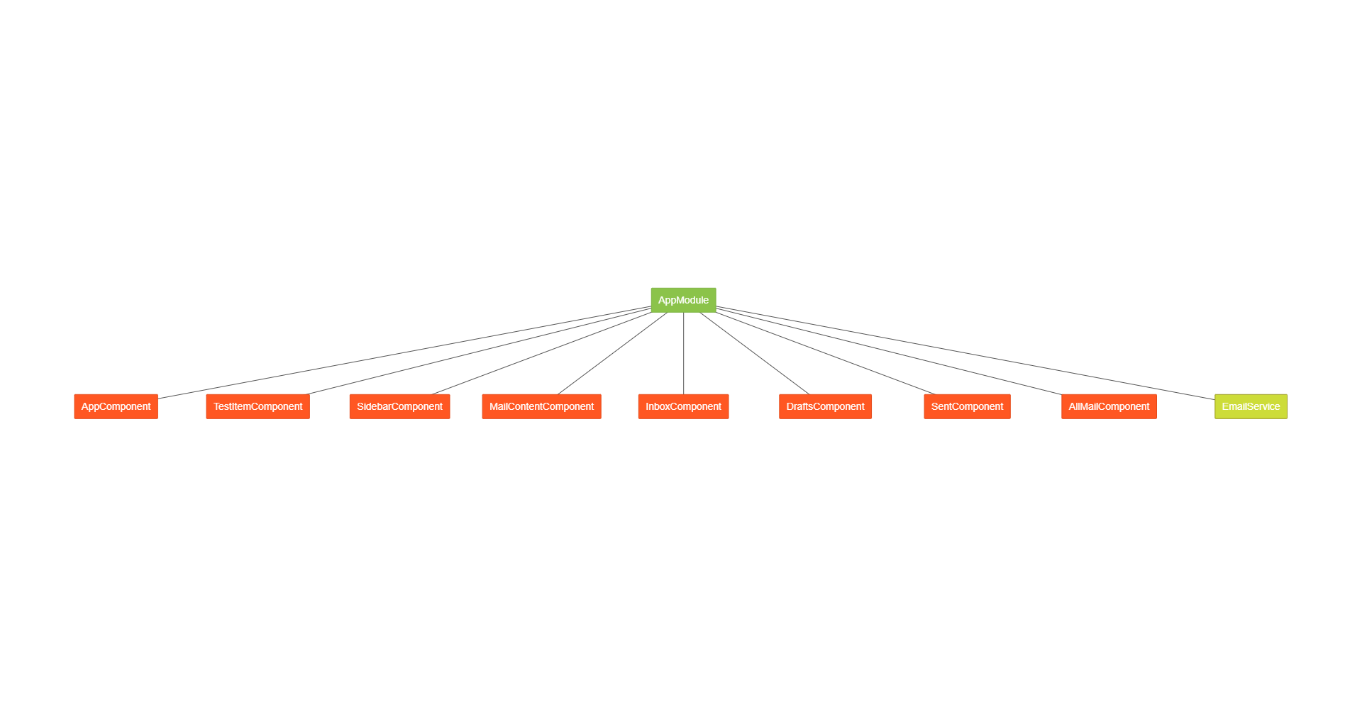
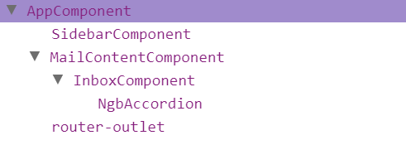
hierarchy of components

Slide 12
component communication
parent component
passing data via properties
emmiting custom events
(events)
[properties]
child component
Notes:
1-way data flow

Slide 13
component communication
parent component
referencing with a local variable
querying child components
@ViewChildren(…)
@ContentChildren(…)
#variable
variable
.action()
child component
Notes:
1-way data flow

Slide 14
component communication
parent component
dependency cycle with forwardRef
forwardRef()
child component
Notes:
1-way data flow

Slide 15
component communication
Component A
via service
Shared Service Instance
Component B
Component C
Notes:
1-way data flow

Slide 16
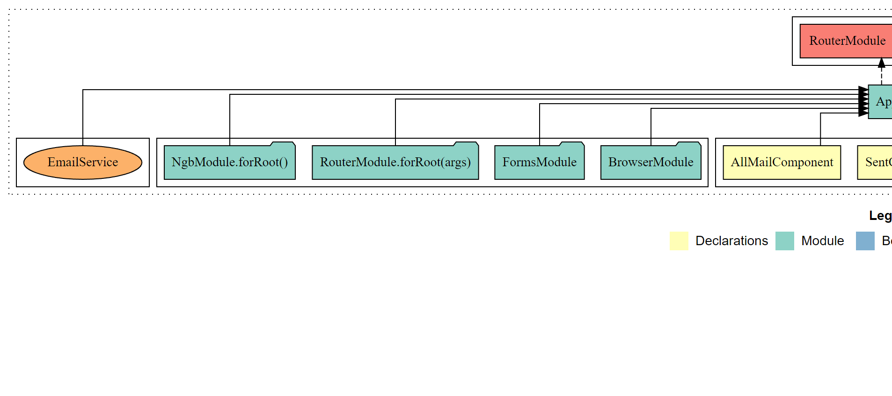
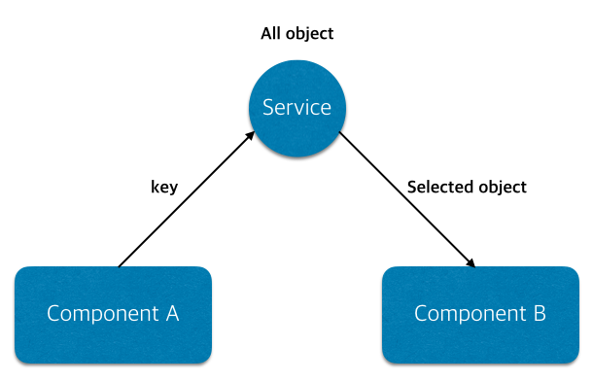
services
Notes:
http://www.thebluediamondgallery.com/wooden-tile/images/review.jpg

Slide 17
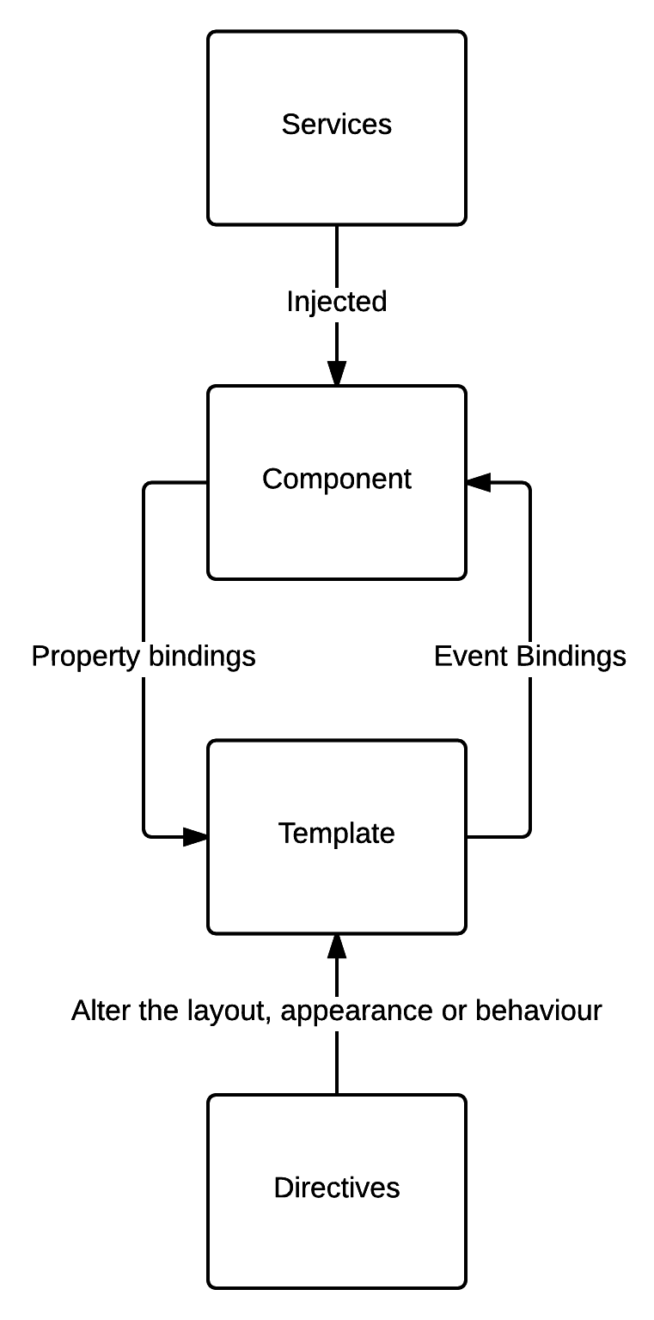
services
…are objects
simplify the structure of applications
with @Injectable decorator
classes declare dependencies on services
using constructor parameters

Slide 18
services
ng g service data
Notes:
https://hahoangv.wordpress.com/2016/05/30/display-data-in-angular-2/

Slide 19
services
import { Injectable } from '@angular/core';
@Injectable()
export class DataService {
constructor() { }
}
Notes:
https://hahoangv.wordpress.com/2016/05/30/display-data-in-angular-2/

Slide 20
services
…
export class DataService {
private counter: number;
constructor() {
this.counter = 0;
}
action() {
this.counter++;
}
}
Notes:
https://hahoangv.wordpress.com/2016/05/30/display-data-in-angular-2/

Slide 21
services
…
import { DataService } from './data.service';
@NgModule({
...
providers: [ DataService ],
...
)
Notes:
https://hahoangv.wordpress.com/2016/05/30/display-data-in-angular-2/

Slide 22
services
…
import { DataService } from '../data.service';
@Component(…)
export class TestComponent implements OnInit {
constructor(private dataService : DataService,
private testService: TestService) { }
…
}
Notes:
https://hahoangv.wordpress.com/2016/05/30/display-data-in-angular-2/

Slide 23
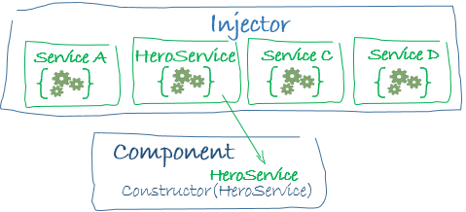
service injection
Notes:
https://hahoangv.wordpress.com/2016/05/30/display-data-in-angular-2/

Slide 24

https://github.com/Banndzior
#slack
kamil.mijacz@gmail.com
kamil.mijacz@softwarehut.com
Notes:
https://www.flickr.com/photos/jeffdjevdet/18027482924

